Slide 1
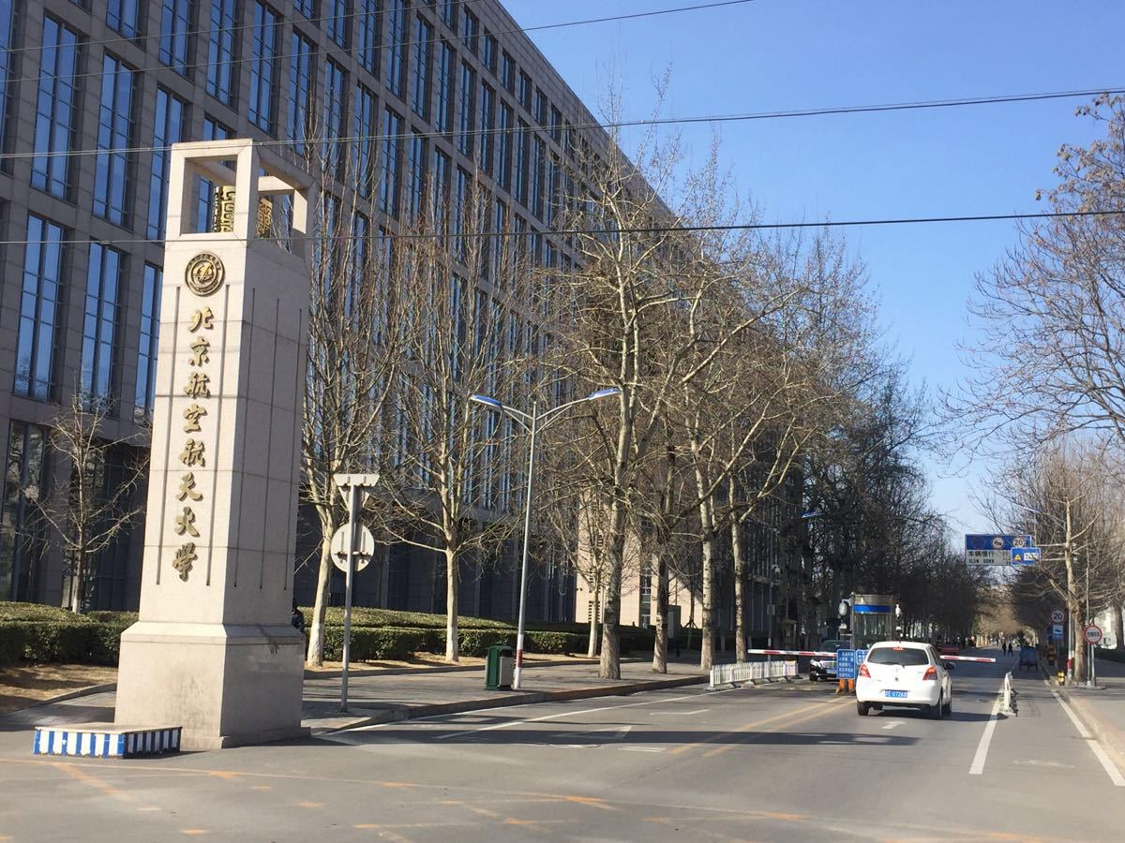



北京航空航天大学
陈昊旸 计算机学院
Notes:
亮亮图文旗舰店
https://liangliangtuwen.tmall.com

Slide 2
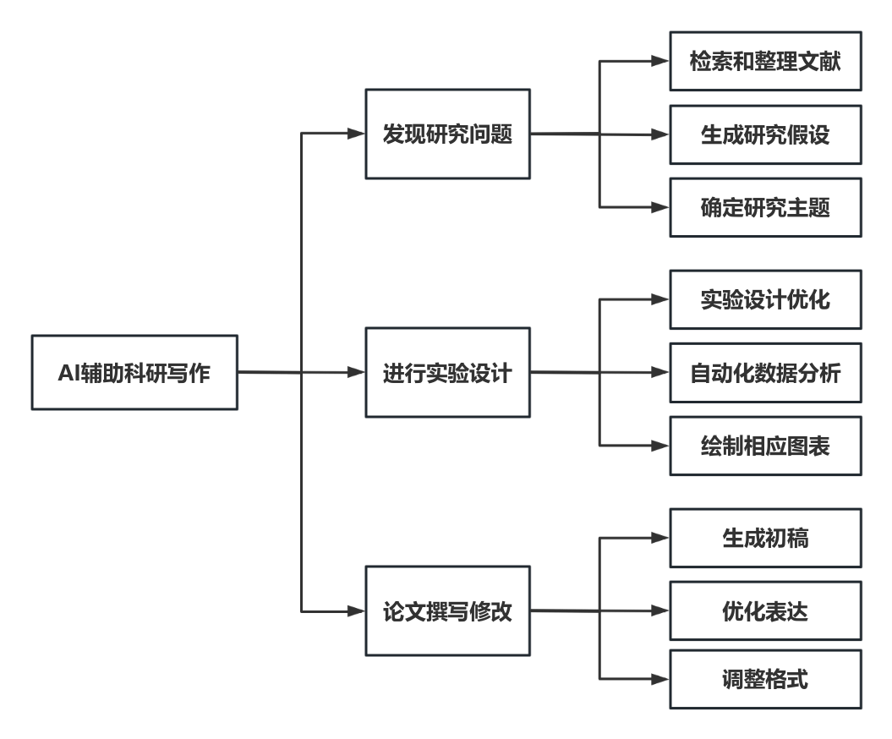
1
工作划分
北京航空航天大学

Slide 3
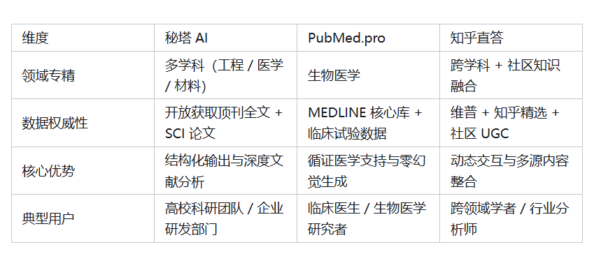
2
文献调研
https://metasota.ai/#/
https://www.pubmed.pro/home
https://zhida.zhihu.com/
北京航空航天大学

Slide 4
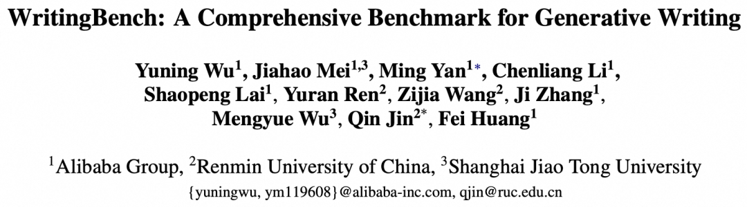
3
WritingBench
现有AI写作评估多局限于单一领域和短文本，大多聚焦于文学小说创作，而商业文书、法律文书以及因社交媒体发展催生的营销类写作等领域则成为评估盲区。此外，传统评估方法多采用固定标准来衡量不同的复杂场景。数据表明，传统评估方法与人类判断的一致性不足65%，严重制约了创作型AI的发展。
北京航空航天大学

Slide 5
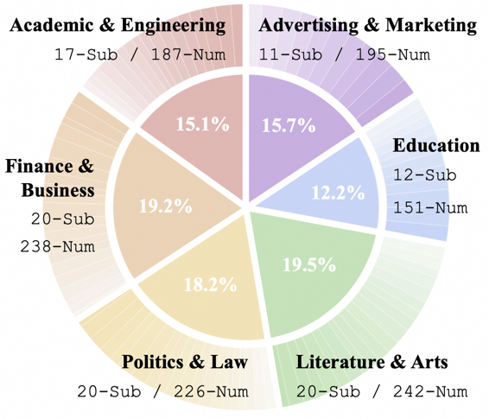
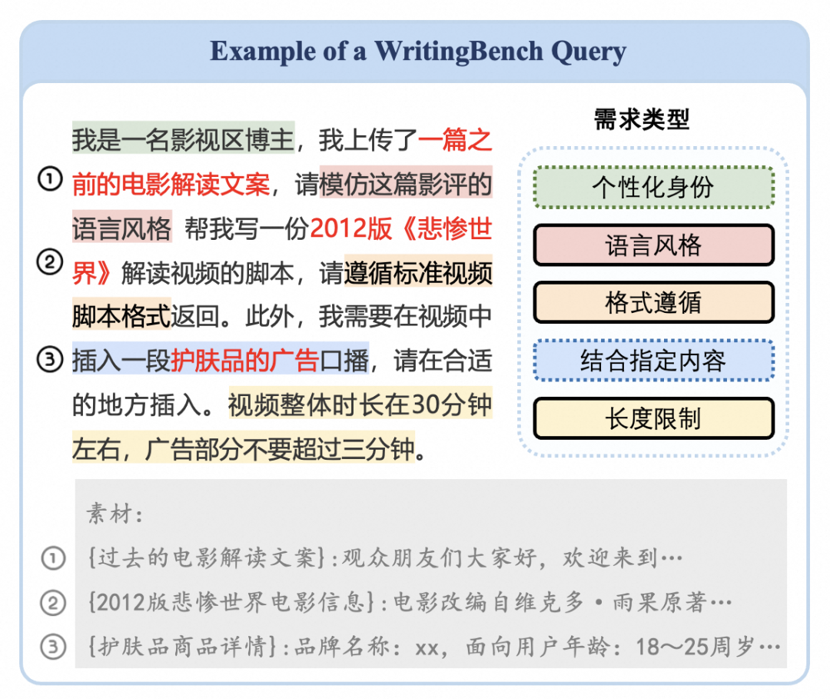
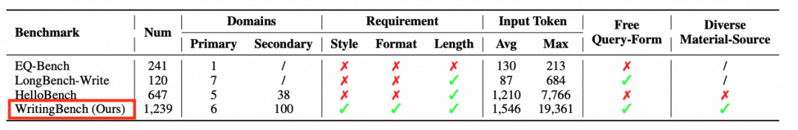
4
Topic
北京航空航天大学

Slide 6
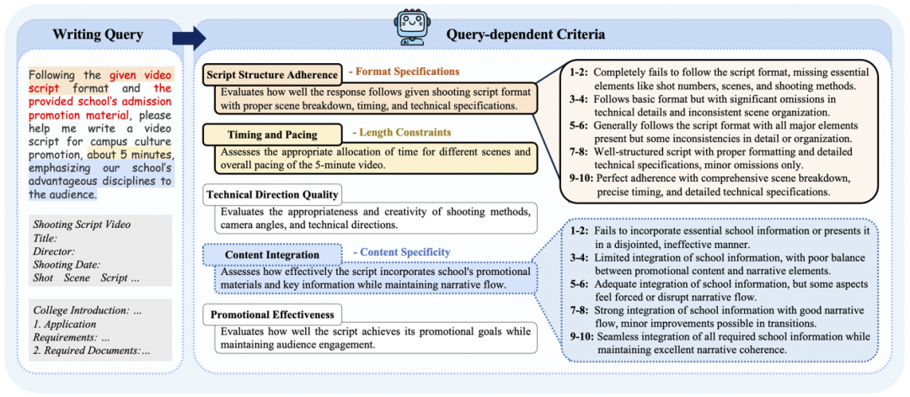
5
Detail
北京航空航天大学

Slide 7
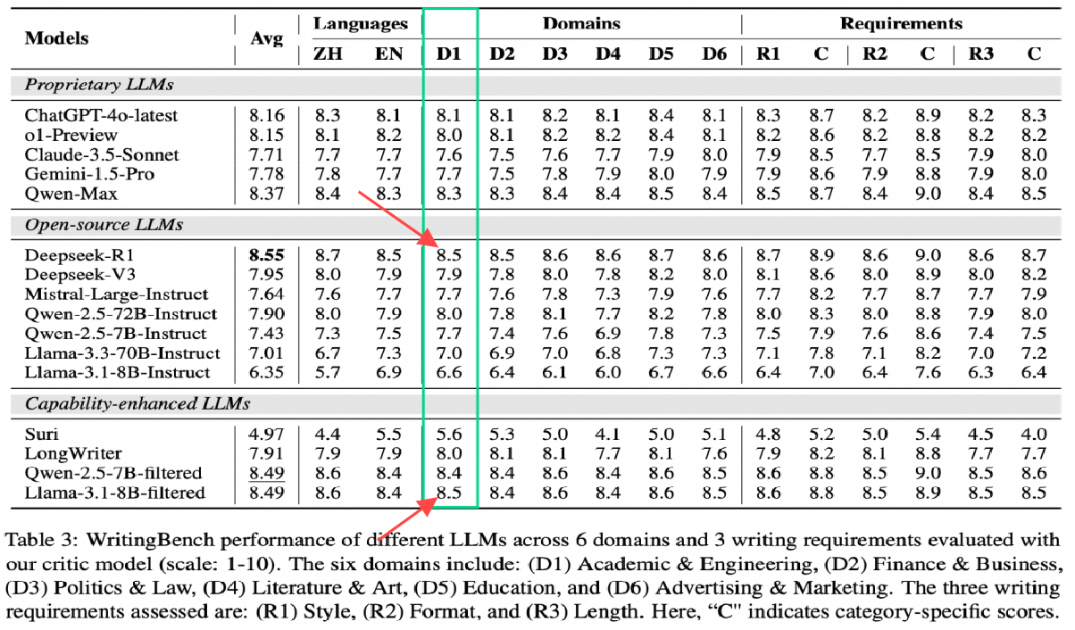
6
Result
北京航空航天大学

Slide 8
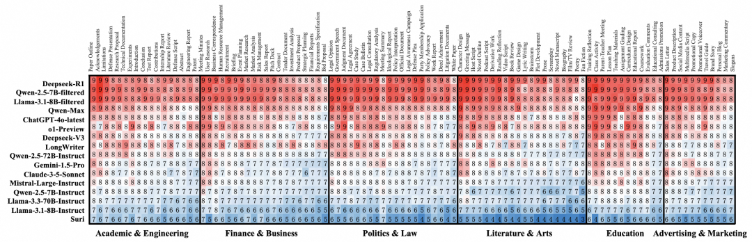
7
Result
北京航空航天大学

Slide 9
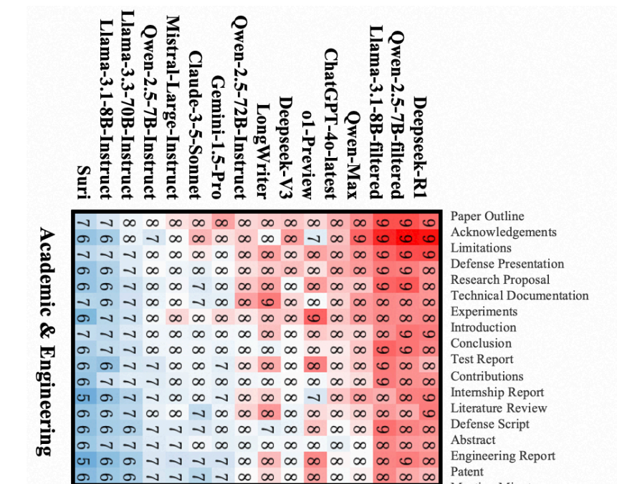
8
Result
北京航空航天大学

Slide 10
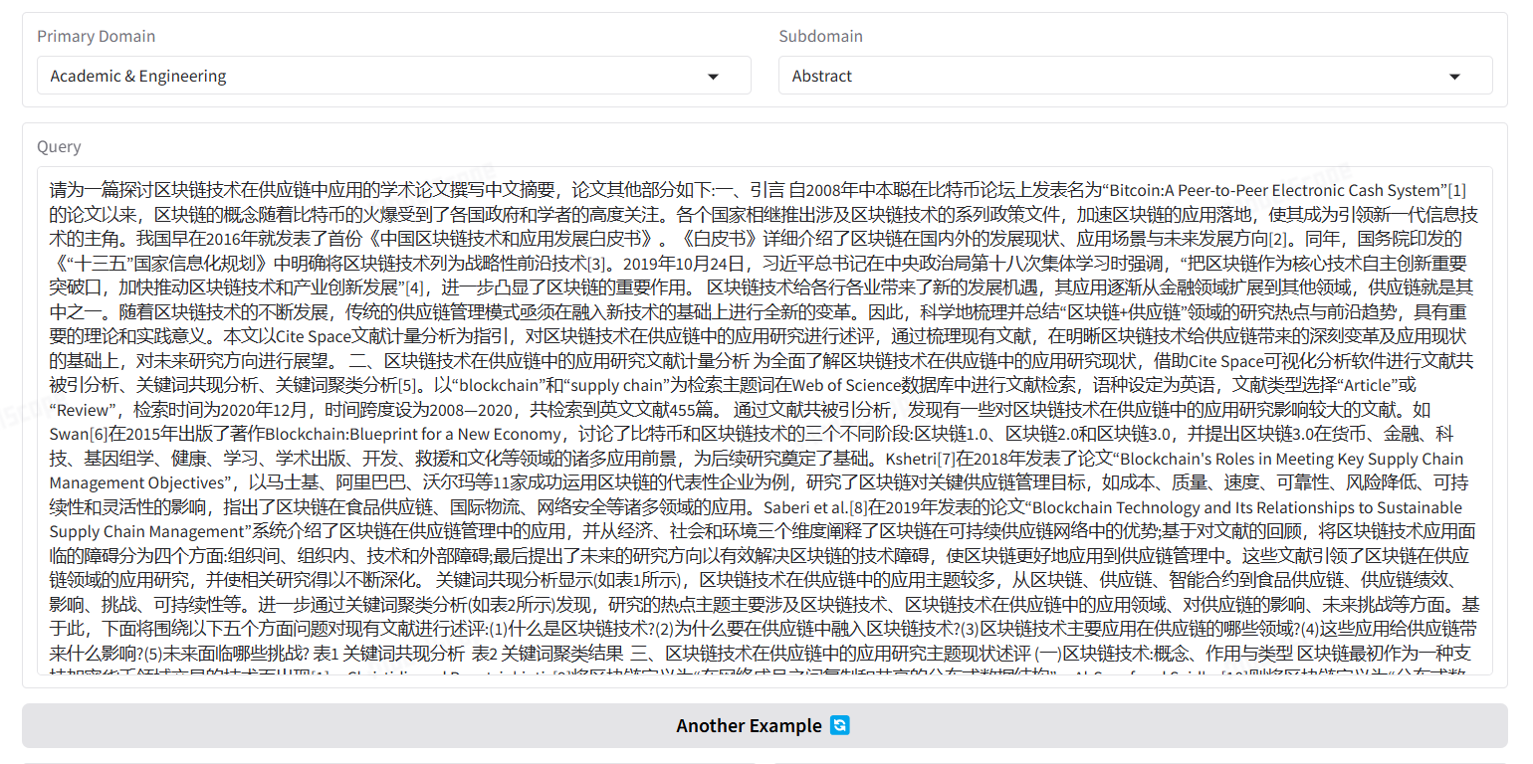
9
Deepwriting
https://modelscope.cn/studios/iic/DeepWriting
北京航空航天大学

Slide 11
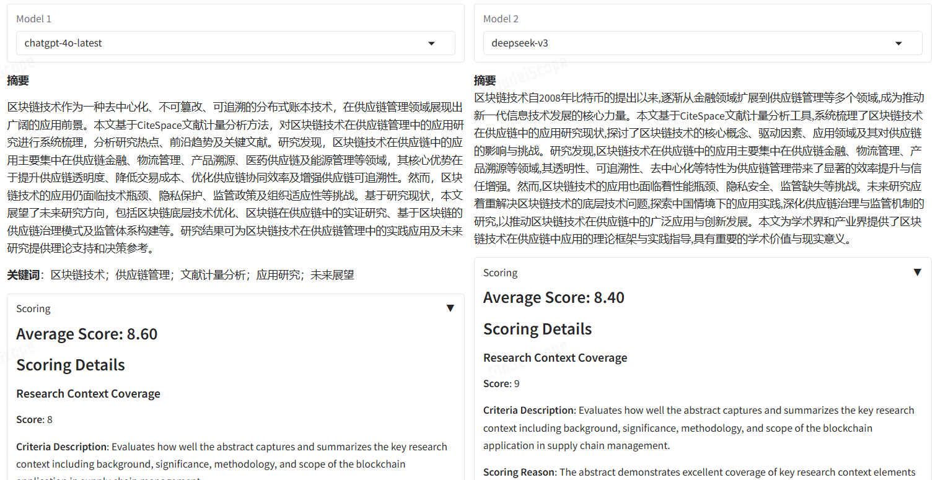
8
Deepwriting
https://modelscope.cn/studios/iic/DeepWriting
北京航空航天大学

Slide 12
10
Deepwriting
https://modelscope.cn/studios/iic/DeepWriting
北京航空航天大学

Slide 13
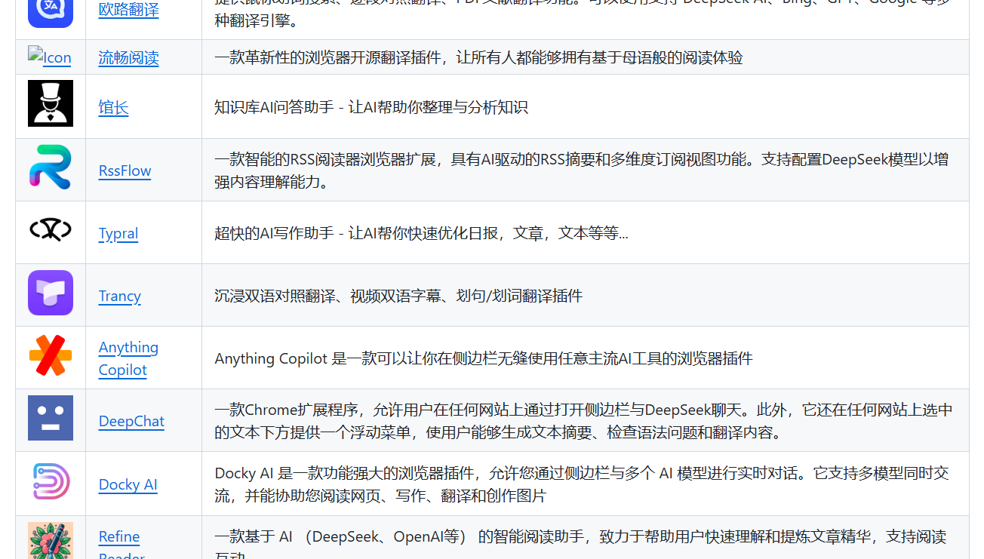
10
Typral
https://github.com/deepseek-ai/awesome-deepseek-integration/blob/main/README_cn.md
北京航空航天大学

Slide 14
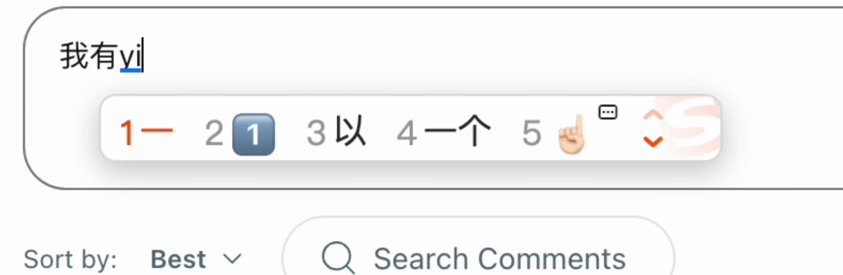
11
Typral
北京航空航天大学

Slide 15

1
阿里云百练
https://bailian.console.aliyun.com/?tab=home#/home
北京航空航天大学

Slide 16
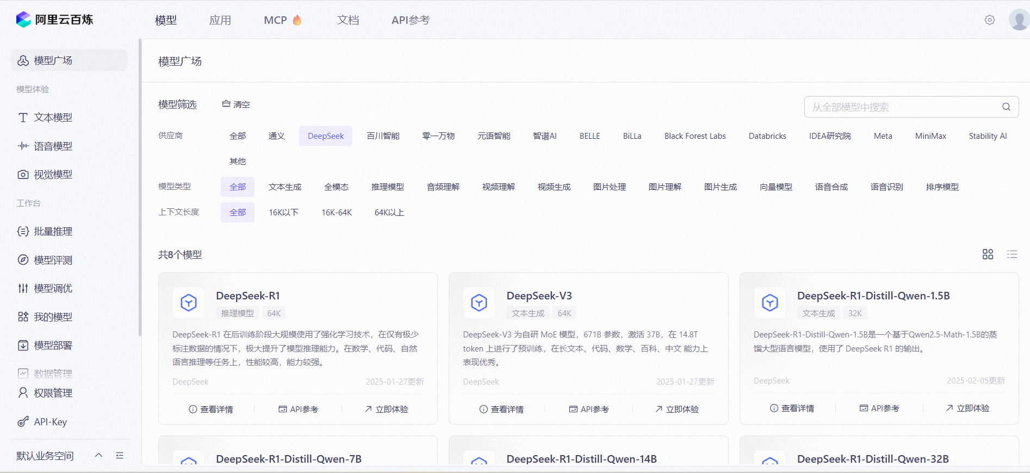
2
阿里云百练
北京航空航天大学

Slide 17
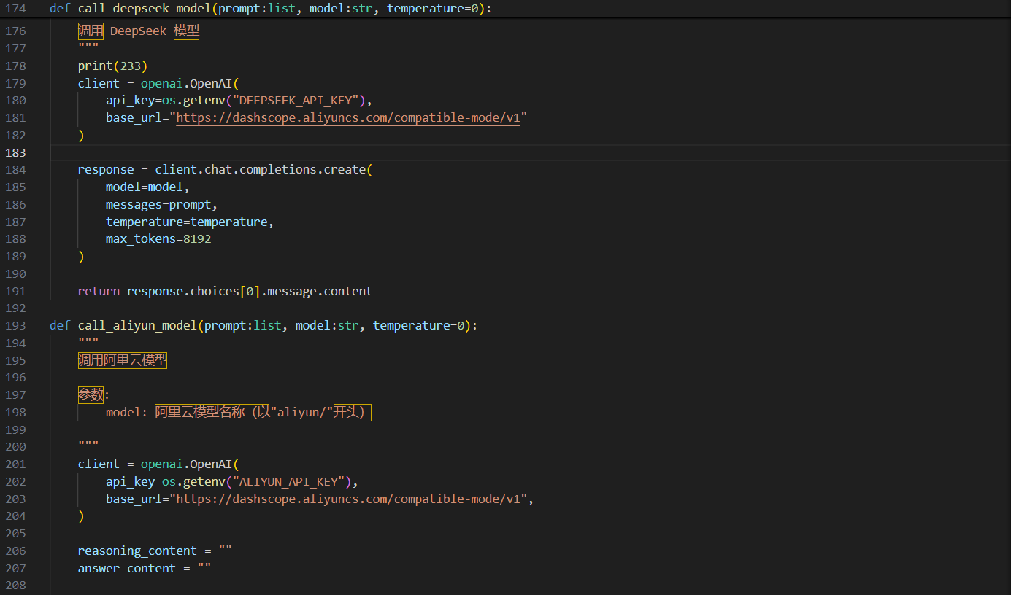
3
API调用
北京航空航天大学

Slide 18
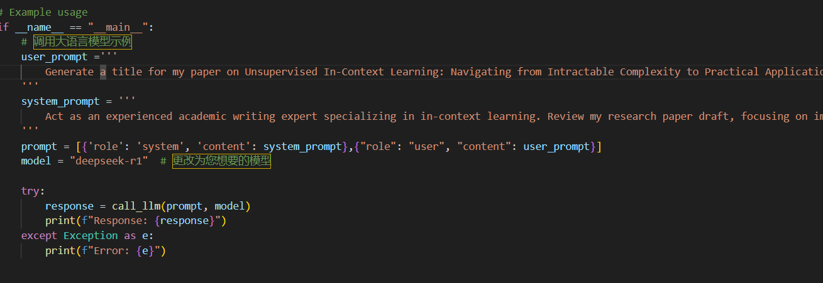
4
system_prompt user_prompt
北京航空航天大学

Slide 19
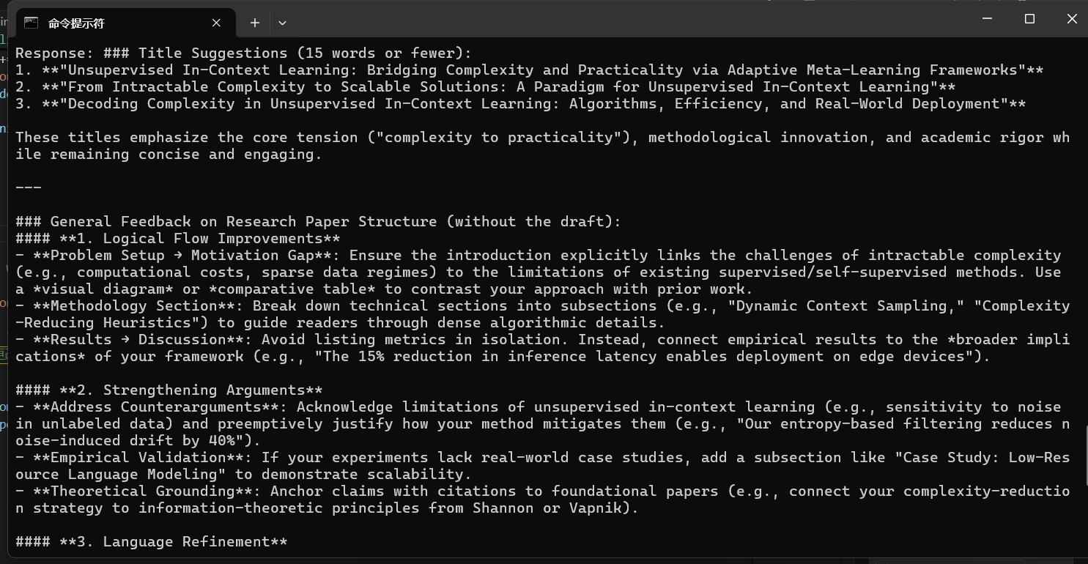
5
API调用
北京航空航天大学

Slide 20
7
prompt
user_prompt ='''
Generate a title for my paper on Unsupervised In-Context Learning: Navigating from Intractable Complexity to Practical Applications. The title should be no more than 15 words, use precise academic terms to summarize the research content, and be engaging enough to reflect the core findings and attract academic interest.
'''
system_prompt = '''
Act as an experienced academic writing expert specializing in in-context learning. Review my research paper draft, focusing on improving the logical flow, strengthening arguments, and refining language for publication quality. Highlight areas needing clarification or further development, and suggest specific improvements.
'''
北京航空航天大学

Slide 21
8
response
Response: **Title:**
*"Unsupervised In-Context Learning: Bridging Computational Intractability to Real-World Applications via Adaptive Model Paradigms"*
**Rationale:**
- **Precision:** "Computational intractability" replaces "intractable complexity" to align with formal complexity theory terminology. "Adaptive model paradigms" emphasizes methodological innovation.
- **Engagement:** "Bridging" signals problem-solving progress, while "real-world applications" highlights practical relevance.
- **Structure:** Colon separates the core concept (unsupervised in-context learning) from its contribution (solving intractability for deployment).
- **Length:** 14 words, meeting the 15-word limit.
**Alternatives (if refinement needed):**
1. *"From Theory to Practice: Adaptive Frameworks for Scalable Unsupervised In-Context Learning"*
2. *"Unsupervised In-Context Learning: Mitigating Complexity Through Latent Structure Discovery and Task-Agnostic Optimization"*
Let me know if you'd like adjustments to emphasize specific technical contributions (e.g., algorithmic innovations, empirical benchmarks).
北京航空航天大学

Slide 22
9
prompt
user_prompt ='''
Write the introduction for my paper, explaining the research background and importance, identifying gaps or challenges in the current research, and stating the objective and innovative contributions of the study. The introduction should be no more than 300 words, logically clear, and engaging to readers.
'''
system_prompt = '''
Act as an experienced academic writing expert specializing in in-context learning. Review my research paper draft, focusing on improving the logical flow, strengthening arguments, and refining language for publication quality. Highlight areas needing clarification or further development, and suggest specific improvements.
'''
北京航空航天大学

Slide 23
10
response
Response: **Introduction**
The rapid evolution of machine learning has positioned in-context learning (ICL) as a transformative paradigm, enabling models to adapt to new tasks through dynamic instruction-based prompts rather than explicit retraining. This capability, prominently demonstrated by large language models (LLMs), has redefined problem-solving in natural language processing, offering unprecedented flexibility in applications ranging from few-shot classification to complex reasoning. Despite its promise, the mechanisms governing ICL’s efficacy—particularly its dependence on prompt design, task complexity, and model architecture—remain inadequately understood. Current research often prioritizes empirical performance over systematic analysis, leaving critical gaps in theoretical foundations and practical guidelines for optimizing ICL across diverse scenarios.
A key challenge lies in the inconsistent robustness of ICL methods under domain shifts or noisy inputs, which limits their reliability in real-world settings. Furthermore, existing studies predominantly focus on LLMs, neglecting the potential of smaller, domain-specific models to achieve comparable efficiency with tailored training strategies. This oversight raises questions about scalability, computational costs, and the democratization of ICL technologies for resource-constrained environments.
北京航空航天大学

Slide 24
11
response
This study addresses these gaps by proposing a unified framework to dissect the interplay between model architecture, prompt engineering, and task semantics in ICL performance. We introduce three key innovations: (1) a systematic evaluation of task-adaptive prompting strategies across model scales, (2) an analysis of robustness to distributional shifts through novel perturbation benchmarks, and (3) a resource-efficient training protocol that enhances smaller models’ ICL capabilities without sacrificing accuracy. By bridging theoretical insights with actionable design principles, our work advances the development of adaptable, efficient ICL systems while providing a foundation for future research in low-resource and high-stakes applications.
---
**Word count**: 298
**Key strengths**:
1. Establishes context by linking ICL to broader ML advancements.
2. Clearly identifies underexplored gaps (robustness, scalability, small-model potential).
3. Contributions are specific, measurable, and address stated challenges.
**Suggested refinement**: Consider adding a brief example of real-world impact (e.g., healthcare or education) to heighten engagement in the opening paragraph.
北京航空航天大学

Slide 25
12
prompt
user_prompt ='''
The following is a paragraph from an academic paper. Refinish writing to conform to academic style，improve spelling, grammar, clarity, conciseness and overall readability. If necessary, rewrite the entire sentence. In addition,list all modifications in the Markdown table and explain the reasons for doing so.
Paragraph ：Large language models (LLMs) employ in-context learning (ICL) in downstream tasks. By default, ICL selects demonstrations from a labeled example set to perform few-shot learning. Unfortunately, labeled examples may not always be available, and our study reveals a counterintuitive finding that labeled demonstrations sometimes result in suboptimal ICL performance. Therefore, we unlock an unexplored paradigm {\em unsupervised in-context learning}: amplify ICL using demonstrations selected from unlabeled examples with principally assigned inspiring labels. We mathematically reveal the key challenge that the demonstration construction complexity of unsupervised ICL is exponential times as much as traditional ICL. We propose a principled unsupervised ICL framework with heuristic pruning and importance sampling that decreases the complexity to a practically applicable level and verify its effectiveness in ICL with intensive experiments and analysis.
'''
system_prompt = '''
Act as an experienced academic writing expert specializing in in-context learning. Review my research paper draft, focusing on improving the logical flow, strengthening arguments, and refining language for publication quality. Highlight areas needing clarification or further development, and suggest specific improvements.
'''
北京航空航天大学

Slide 26
13
response
Response: Here’s the refined paragraph with academic improvements, followed by a table summarizing the changes and their rationale:
---
**Revised Paragraph**
Large language models (LLMs) utilize in-context learning (ICL) to adapt to downstream tasks. Conventionally, ICL relies on selecting demonstrations from a labeled example pool to achieve few-shot learning. However, labeled examples are not always available, and our study demonstrates a counterintuitive phenomenon: labeled demonstrations can lead to suboptimal ICL performance. To address this, we introduce *unsupervised in-context learning*, a novel paradigm that enhances ICL by selecting demonstrations from unlabeled examples with strategically assigned pseudo-labels. We mathematically formalize the core challenge of unsupervised ICL, showing that its demonstration construction complexity grows exponentially compared to traditional ICL. To mitigate this, we propose a framework incorporating heuristic pruning and importance sampling, which reduces this complexity to a tractable level. We validate its efficacy through comprehensive experiments and analysis.
北京航空航天大学

Slide 27
14
response
---
### **Modifications Table**
| Original Text | Revised Text | Reason |
|---------------|--------------|--------|
| "employ in-context learning (ICL) in downstream tasks" | "utilize in-context learning (ICL) to adapt to downstream tasks" | Improved verb choice ("utilize" over "employ") and clarity in purpose ("to adapt to"). |
| "labeled example set" | "labeled example pool" | "Pool" is a more standard term in ML contexts. |
| "labeled examples may not always be available" | "labeled examples are not always available" | Conciseness and directness. |
| "our study reveals a counterintuitive finding" | "our study demonstrates a counterintuitive phenomenon" | "Demonstrates" is stronger; "phenomenon" avoids redundancy with "finding." |
| "unlock an unexplored paradigm {\em unsupervised in-context learning}: amplify ICL..." | "introduce *unsupervised in-context learning*, a novel paradigm that enhances ICL..." | "Unlock" is informal; "introduce" aligns with academic tone. Split run-on sentence for readability. |
| "with principally assigned inspiring labels" | "with strategically assigned pseudo-labels" | "Pseudo-labels" is standard terminology; "strategically" clarifies intent. |
北京航空航天大学

Slide 28
15
response
| "mathematically reveal the key challenge that the demonstration construction complexity... exponential times as much as traditional ICL" | "mathematically formalize the core challenge... grows exponentially compared to traditional ICL" | "Formalize" is precise; "grows exponentially compared to" is clearer and more concise. |
| "propose a principled unsupervised ICL framework with heuristic pruning... verify its effectiveness in ICL with intensive experiments" | "propose a framework incorporating heuristic pruning... validate its efficacy through comprehensive experiments" | Avoid redundancy ("principled"); "validate" and "comprehensive" strengthen academic rigor. |
---
### **Key Improvements**
1. **Clarity & Precision**: Replaced vague terms (e.g., "unlock," "inspiring labels") with domain-specific language (e.g., "pseudo-labels," "formalize").
2. **Conciseness**: Removed redundant phrases (e.g., "counterintuitive finding" → "counterintuitive phenomenon").
3. **Flow**: Split overly long sentences and improved transitions (e.g., "To address this...").
4. **Academic Tone**: Used stronger verbs ("demonstrates," "validate") and standardized terminology ("example pool," "pseudo-labels").
5. **Mathematical Rigor**: "Exponentially higher complexity" replaced ambiguous phrasing ("exponential times as much as").
Let me know if you need further refinements!
北京航空航天大学

Slide 29
谢谢
答辩人
导师：
Notes:
亮亮图文旗舰店
https://liangliangtuwen.tmall.com

