Slide 1
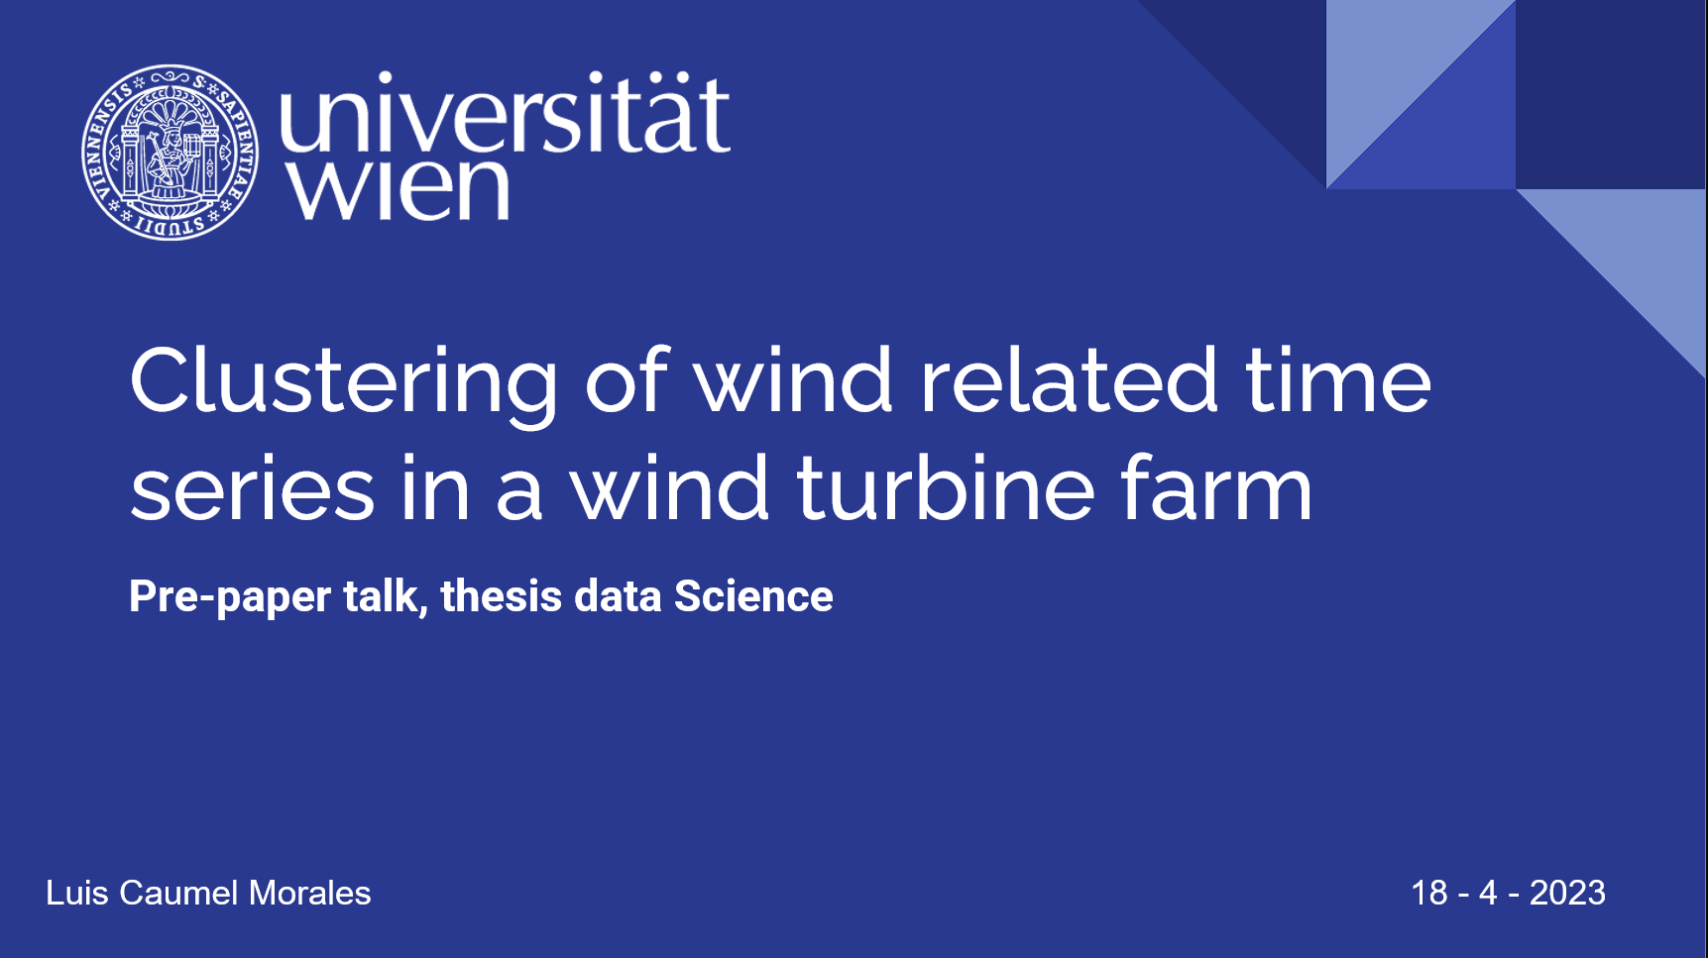


Slide 2
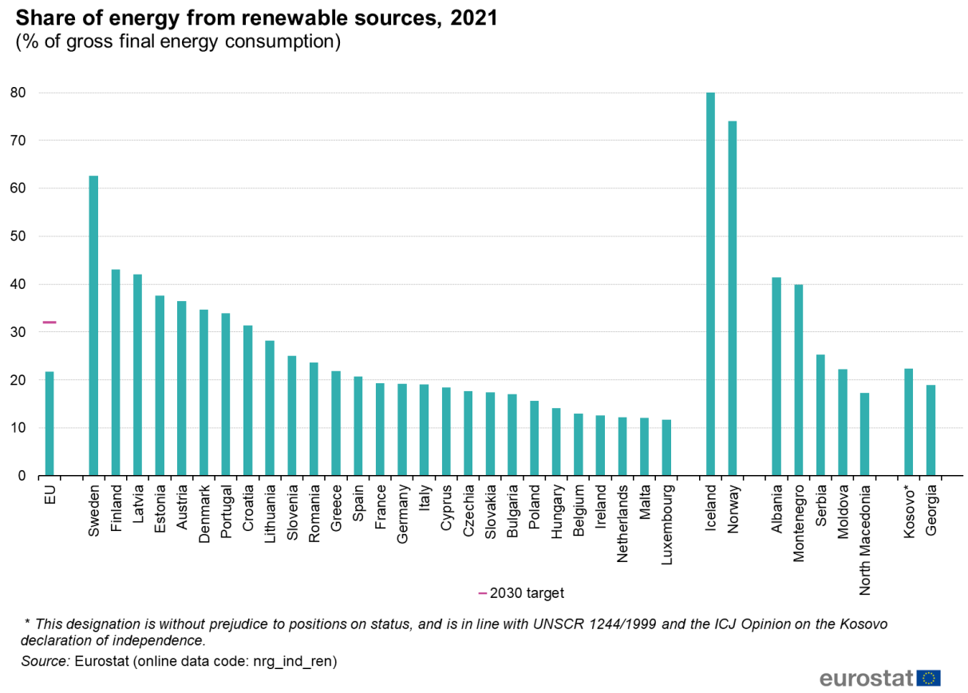
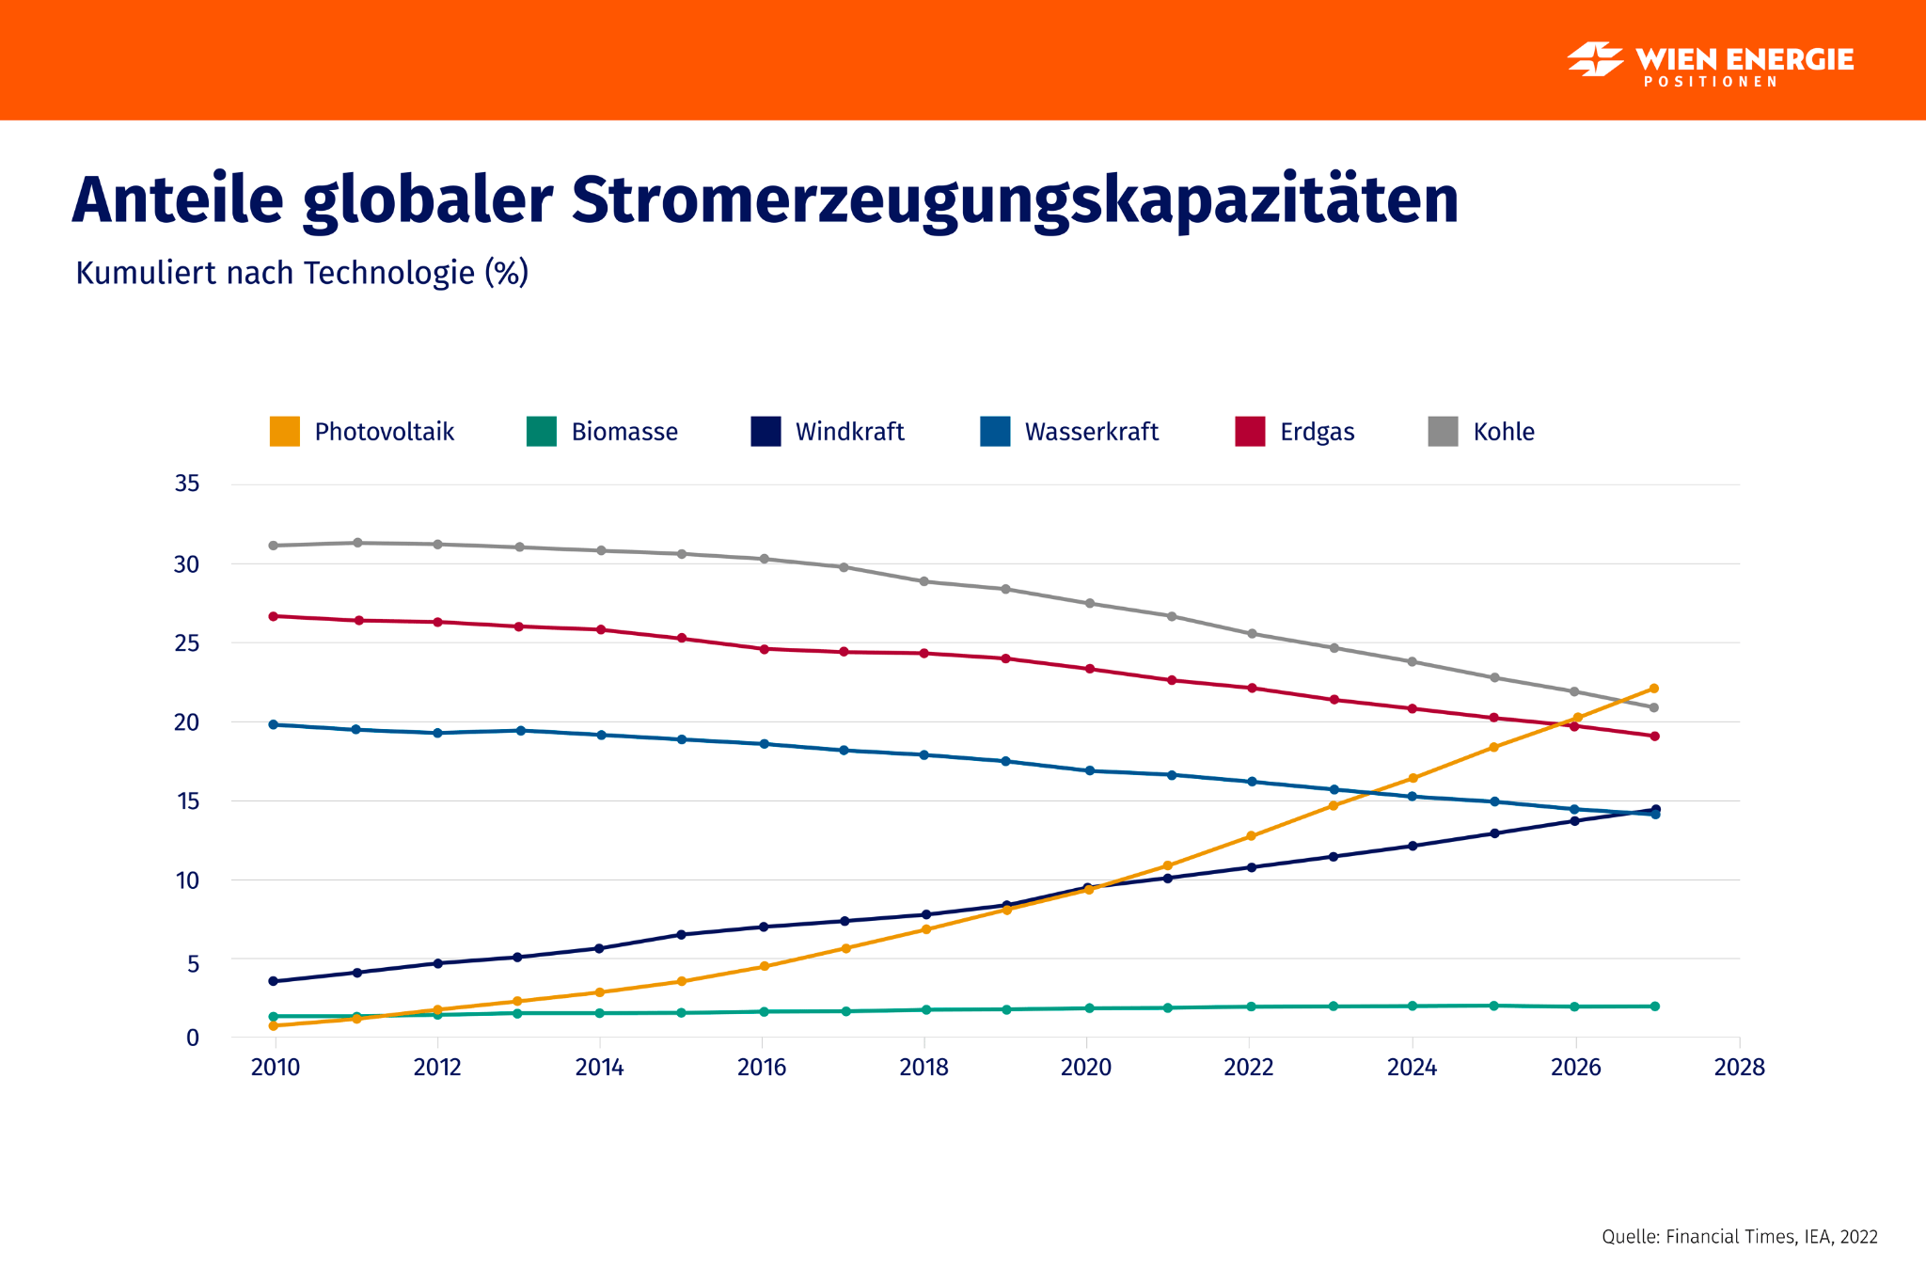
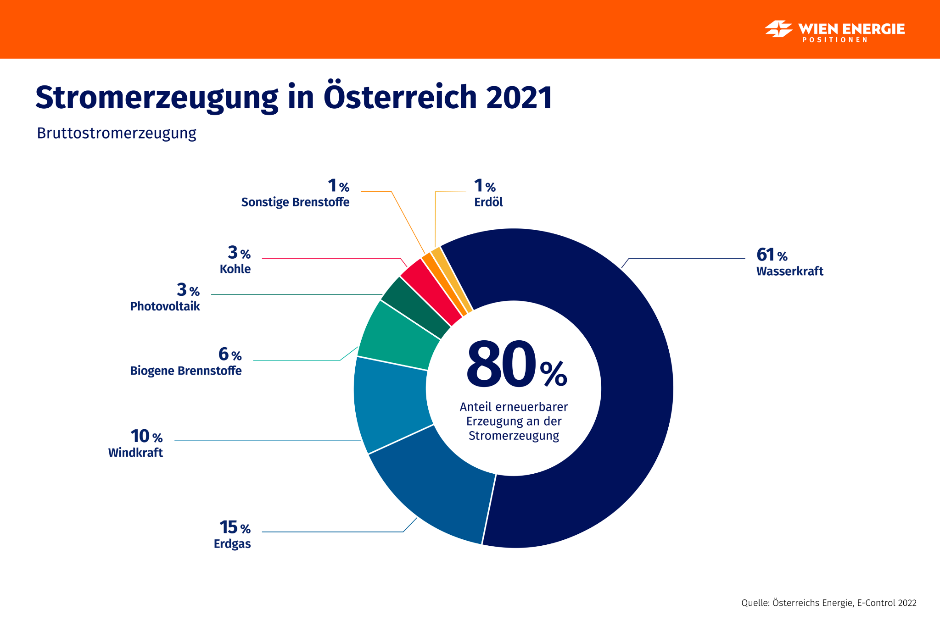
Introduction
Renewable energies have experienced rapid growth in recent years due to technological advancements, cost reductions, and increasing awareness of climate change.
Global share of renewable energy in electricity generation reached 32% in 2021 and is projected to increase further. We refer to renewables: solar, wind, hydro, geothermal, and bioenergy
For this reason, it is necessary to study possible problems we may encounter, as in this case extreme events.
Notes:
https://ec.europa.eu/eurostat/statistics-explained/index.php?title=File:Share_of_energy_from_renewable_sources,_2021_(%25_of_gross_final_energy_consumption).png
https://positionen.wienenergie.at/grafiken/stromerzeugung-in-osterreich/
https://positionen.wienenergie.at/grafiken/anteile-globaler-stromerzeugungskapazitaeten/

Slide 3

Explain the problem
As renewable energy becomes more prevalent, it's crucial to understand possible challenges and risks associated with it like:
Enhance the resilience of renewable energy systems to
extreme events and climate-related risks.
Extreme events have many faces, scales and effect and
can be a challenge to the operation and maintenance
of renewable energy infrastructure.
Identifying and understanding extreme events,
their causes and the main variables can help
develop strategies to minimize potential impacts
on renewable energy systems.
Notes:
https://www.flaticon.com/free-icon/wind-turbine_5223040

Slide 4
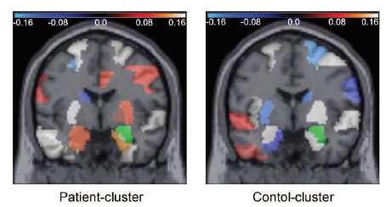
Motivation
The aim is to study how different variables can help us to study extreme events using
a general method for clustering of temporal data which was applied in psychiatry.
As a reference we have the paper, “Mining Interaction Patterns among Brain Regions by Clustering”, which seeks to identify brain areas with a similar intrinsic interaction pattern by clustering to study psychiatric disorders.
Through this approach, we can see a similarity:
Areas of the brain - Variables
Type pair of patient (Healthy person) to the
pair high extreme wind and moderate wind
scenario.
C. Plant, A. Zherdin, C. Sorg, A. Meyer-Baese and A. M. Wohlschläger, "Mining Interaction Patterns among Brain Regions by Clustering," in IEEE Transactions on Knowledge and Data Engineering, vol. 26, no. 9, pp. 2237-2249, Sept. 2014, doi: 10.1109/TKDE.2013.61.

Slide 5



Data
Dataset consists of hourly data for 20 years from a wind farm with 38 wind turbines. In it we have data such as:
Relative humidity, boundary layer height, geopotential.
Dew point temp and relative humidity at 2m.
Temperature, Wind speed at 100m, 135m.
Cloud coverage, Ozone and potential vorticity.
And we seek to study different extreme events and make different division:
high wind speed scenario with ≥ 15 m/s, maximum value of wind speed before the wind turbines must be turned off
Low wind speed scenario with ≤ 2 m/s as minimum value of wind speed.
Moderate wind speed scenario wind we consider wind with speed: 6 m/s ≤ ws ≤ 8 m/s .

Slide 6
Research questions
In this section, we explain the research questions posed so far:
Identifying the extreme events and calm periods of wind for the last 20 years in the wind farm
What other variables and with which values of coefficients contribute to the extreme wind?
Find the similar intrinsic interaction pattern between the different variables.
Which variables interact with each other in these scenarios, and what are the differences among the variables in these scenarios?
What range of time series should we split to improve the results of our model ? Starting with 4 days (96 rows/hours).

Slide 7

Method: Interaction K-means (IKM)
Clustering algorithm that extends K-means by taking into account interaction between variables.
This algorithm considers the relationships between different variables, such as wind speed, wind direction, temperature, pressure… which can collectively influence the performance of extreme events.
By considering interactions between variables, IKM
algorithm can help identify patterns and relationships
with extreme events.
C. Plant, A. Zherdin, C. Sorg, A. Meyer-Baese and A. M. Wohlschläger, "Mining Interaction Patterns among Brain Regions by Clustering," in IEEE Transactions on Knowledge and Data Engineering, vol. 26, no. 9, pp. 2237-2249, Sept. 2014, doi: 10.1109/TKDE.2013.61.

Slide 8

Method: Interaction K-means
For this reason, and because of the results observed in the paper “Mining Interaction Patterns among Brain Regions by Clustering”, it was decided to apply the interactive k-mean algorithm to the data. In which we can highlight:
It assumes that variables are independent and does not account for interactions between them.
Is Addresses this limitation by incorporating pairwise interaction terms between variables in the objective function.
In addition to the proposed model, other models are being
considered for comparison, such as
Linear K-means
Nonlinear K-means
SF (structure-based statistical features clustering)
ICACLUS (independent component analysis)

Slide 9


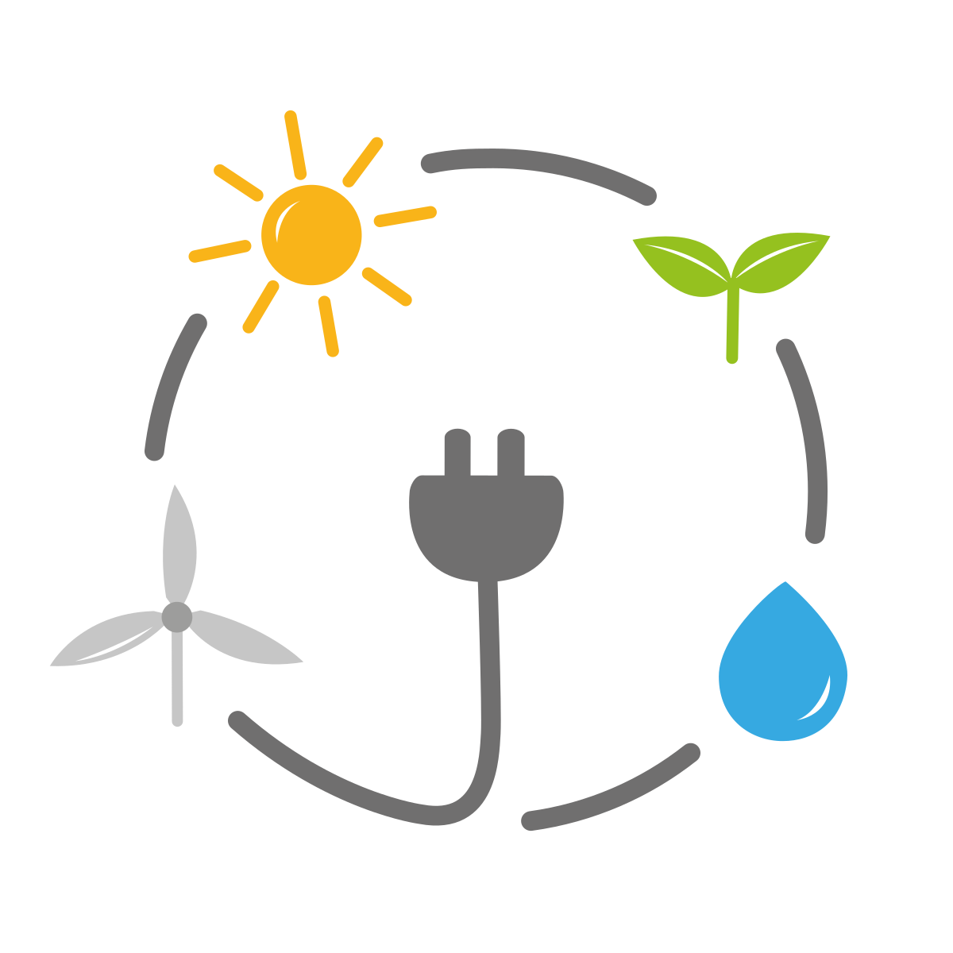



Major (Potential) contributions
1. Enhanced understanding patterns
Understanding intricate relationships between variables
Can aid in predicting and mitigating the impact of extreme events.
5. Policy and regulatory improvements
01
The insights gained from Interaction K-means analysis can:
Inform policymakers, regulators in developing guidelines and standards for wind farm design, operation, and maintenance.
02
2. Optimized wind farm layout
05
Minimizing the impact of extreme events of the wind farm in:
Performance,
Efficiency
Longevity
03
4. Better energy production forecasting
3. Improved predictive maintenance
For develop more accurate forecasting models for energy production
Better grid management, reduced reliance on backup power sources.
04
Recognizing patterns for anticipate potential issues like turned off and perform maintenance on turbines before they fail

Slide 10


Questions and Comments

Slide 11
Major (Potencial) contributions
Enhanced understanding of extreme event patterns: understanding the intricate relationships between different variables that contribute to extreme events in a wind farm. Can aid in predicting and mitigating the impact of extreme events.
Optimized wind farm layout: Minimizing the impact of extreme events on the overall performance, efficiency, and longevity of the wind farm.
Improved predictive maintenance: Recognizing patterns in extreme events can help anticipate potential issues, turned off and perform maintenance on turbines before they fail
Better energy production forecasting: Can develop more accurate forecasting models for energy production. Better grid management, reduced reliance on backup power sources.
Policy and regulatory improvements: The insights gained from Interaction K-means analysis can inform policymakers and regulators in developing guidelines and standards for wind farm design, operation, and maintenance. This can lead to more resilient and efficient wind energy infrastructure.

