Slide 1
Domain Generalization in a Causal Perspective: Deconfounding the Domain Biases
Shiyang Yan, Michele Sebag
Inria, Saclay --Île-de-France

Slide 2
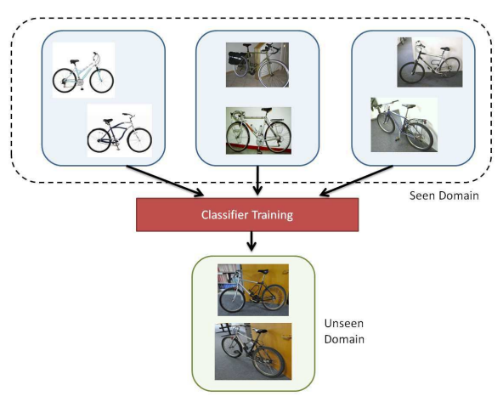
Task to Tackle: Domain Generalization (DG)
Domain Generalization (DG) is a challenging transfer learning task, which aims to train a recognition model in several known domains, and test it in an unknown target domain.
In this presentation, we analyze the DG problem from a viewpoint of casual inference.

Slide 3
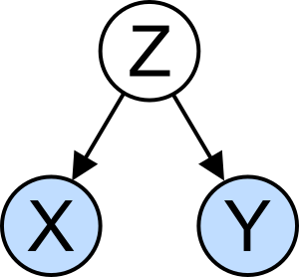
Causal Modeling why cause inference?
Ladder of Causation: Causality provides two distinct layers on top of traditional statistics.
(Pearl et al.) characterizes this relationship as the Ladder of Causality.
The Ladder has three levels: Seeing (statistics, the current prediction model), Doing (intervention, what we targets at in this presentation), and Imagining (counterfactuals).
Confounder is an existing problem in current prediction model that could be solved by intervention: is a variable that influences both the cause and effect, causing a spurious association.
Z is a confounder.

Slide 4
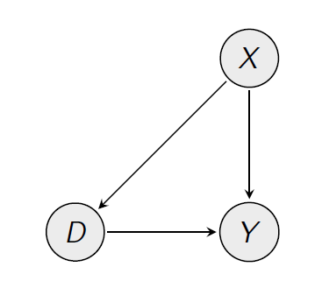
Causal Modeling Causal Theory Basics (1)
Intervention: Back-door adjustment and Front-door adjustment.
Back-door adjustment: Determine confounder X (age, gender) drive both D (a drug, the cause) and Y (health, the effect).
Find units with the same values for X (same age, same gender), but different values for D, and compute the difference in Y. If there is a difference in Y between these units, it should be due to D, and not due to X.
Here X, the confounder is measurable.
This is a kind of intervention
since we control the value of
the confounder to find the true cause.

Slide 5
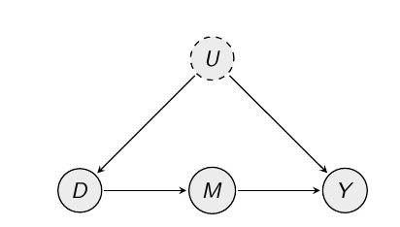
Causal Modeling Causal Theory Basics (2)
Front-door Adjustment: to understand precisely the mechanism by which D (let's now say it's smoking) affects Y (lung cancer).
The problem is that U is unobservable.
Let's say it all flows through variable M (tar in lungs): D (smoking) affects M (tar), and M (tar) affects Y; there is no direct effect. Then, to find the effect of D on Y, compute the effect of smoking on tar, and then the effect of tar on lung cancer.

Slide 6
Causal Modeling problem definition
In DG, we denote the inputs as causes X.
We denote the actual output of the category classifier as A, the effects.
A is also termed as the potential outcome, and the remaining challenge is how to only use the training data to estimate it effectively.
Usually, we would use Monte Carlo estimation to approximate A as E[A|X=x], for example, usual deep net training with stochastic gradient descent (SGD) is an example of Monte Carlo estimation.
The unobserved confounder C, which affects the input images x and the potential outcome A.
The style of the images affects both the inputs and the outputs, making the style as the confounder C.

Slide 7
Causal Modeling backdoor adjustment in the existence of confounders
We can say that the Monte Carlo estimation of a recognition model is biased, which is expressed as E[A|X=x] != A.
In causal theory, the backdoor adjustment, which requires observing and measuring all the confounders C and associate them with each data sample, expressed as:
E[Y|X=x, C=c] =Y.
The confounder C is required to be measurable in a data sample level, and be processed together with the input data x.

Slide 8
Causal Modeling
However, measuring the confounders in a data sample level is extremely hard.
One reason is the confounders are unobservable. Another reason is that the confounders varies in difference scenarios.
Think as the background is hard to measure and varies among different images.
Luckily, the deconfounder theory (Wang and Blei, 2019) formulates a substitute confounder to perform causal inference.
The defonfounder theory approximate the proxy confounder via factorization of multiple causes, more formally:
P(x¹,...,x^{N}|Z=z) =∏_{n}P(x^{n}|Z=z),
which means that the z is a good substitute confounder if the generative learning can factorize and represent the distribution effectively.

Slide 9
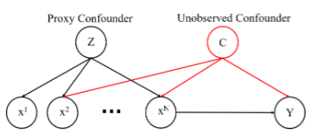
Deconfounder theory Proof: Through contradiction
The proof of the deconfounder theory via contradiction:
If there exists another unobserved confounder C, according to the Graph Theory, the conditional independence between x¹, x²,...,x^{N} cannot be hold.
In other words, the conditional independence between these inputs x¹,x²,...,x^{N}, will eliminate any other unobserved confounder, serving as a unique proxy.

Slide 10
Problem still exist due to lack of uniqueness, etc.
D’Amour et al. show that the lack of uniqueness of the factorization process and the factorized model would make the deconfouder theory impossible.
One Counter example:
First let’s see the Assumption in Deconfounder:
There exists an unobserved variable U such that:
U blocks all backdoor paths from A to Y and
U factorizes the distribution of A.
Hence, U is the substitute confounder.
consider all variables are linearly related, and all independent errors are Gaussian. Letting
w∼ N(0,σ²_{w}) for each w ∈ {A,Y,U}, the structural equations for this setting are:
U := w _{U ,} (The confounder)
A:= αU + w _{A} (The causes)
Y :=βA+γU+ w _{Y} (The effects)
Where w* is independent noise.
This data-generating process satisfies the Assumption.

Slide 11
Problem still exist due to lack of uniqueness, etc.
We will focus specifically on estimating the conditional E[Y | do(A = a)], which is fully parameterized by β.
The marginal covariance matrix of the observable variables (A,Y) is a 2×2 matrix. Its entries are defined by:
ΣAA =αασ²_{U} +diag(σ²_{A})
ΣAY =Σ_{AA}β+γσ²_{U}α
ΣYY =(βα+γ)²σ²_{U} +βdiag(σ²_{A})β +σ²_{Y}
In these equations, the quantity on the LHS is observable while the parameters on the RHS are unobservable.
The scale of U (σ_{U}) is not identified given A.
This is a well-known non-identification result in confirmatory factor analysis.

Slide 12
Problem still exist due to lack of uniqueness, etc.
The Assumption in Deconfounder:
There exists an unobserved variable U such that:
U blocks all backdoor paths from A to Y and
U factorizes the distribution of A.
Hence, U is the substitute confounder.
consider all variables are linearly related, and all independent errors are Gaussian. Letting
w∼ N(0,σ²_{w}) for each w ∈ {A,Y,U}, the structural equations for this setting are:
U := w _{U ,} (The confounder) (the amplitude of the noise matter)
A:= αU + w _{A} (The causes)
Y :=βA+γU+ w _{Y} (The effects)
Where w* is independent noise.
This data-generating process satisfies the Assumption.

Slide 13
Problem still exist due to lack of uniqueness, etc.
Nevertheless, (D’amour et al.) provides several practical insights for this problem.
Practical Insights:
Flexible, nonparametric models are likely to behave unpredictably when they are used to estimate causal effects in this setting.
One may be able to obtain numerically stable estimates of causal effects with parametric assumptions in this setting, still suggest caution, unless one has strong prior knowledge that the parametric specification is correct.
Parametric assumptions can induce identification in this setting.

Slide 14
Another perspective: identifiability condition of factor models
(Hyvarinen et al. 2019) states that the essential difference to most methods for unsupervised representation learning is that the approach starts by defining a generative model in which the original latent variables can be recovered, i.e. the model is identifiable by design.
If the observed data x are obtained as i.i.d. samples, i.e. there is no temporal or similar structure in the data, the model is seriously unidentifiable (Hyvarinen and Pajunen, 1999).
(Hyvarinen et al. 2019) propose that the independent components are dependent on some additional auxiliary variable, while being conditionally mutually independent given the auxiliary variable.
This statement motivate us to design the proposed neural model.

Slide 15
Recap the Flow
DG problem →Unobserved Confounders
→ Seek solution from Deconfounder Theory.
→ Deconfounder Theory not well established due to non-identifiability of Factor Model.
→ Generalized Contrastive Learning (Hyvarinen et al. 2019) meets identifiability condition, also following the practical insights of (D’amour et al.) at the same time.
→ Our specific solutions follows.

Slide 16
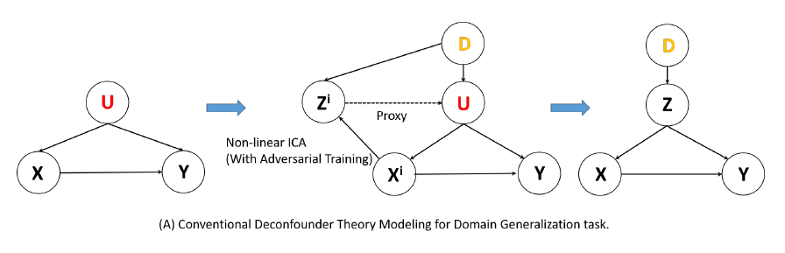
The Corresponding Problem to Un-uniqueness in the Domain Generalization Task
As we observe, modeling the DG process with original deconfounder theory will bring a neglected variable D, which is the domain, in the final causal diagram, making the computation incorrect.

Slide 17
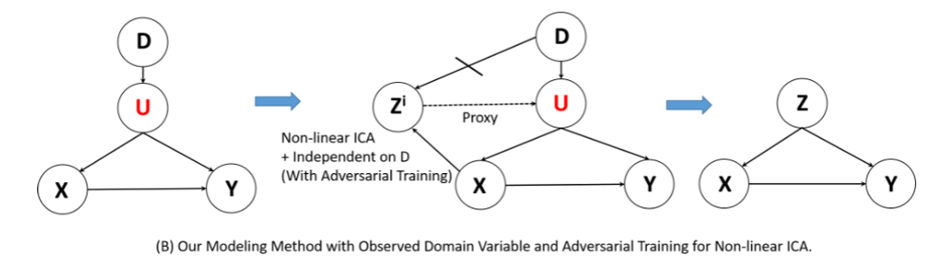
A Solution proposed
Factorization in our case, only makes the {Z^{i}, i = 1,...,N} mutually independent to each other, cannot eliminate the dependence link between Z and D.
We would like a restricted factorized model to make the deconfounder theory condition well satisfied, with a new restriction that the derived factors are invariant to D.

Slide 18
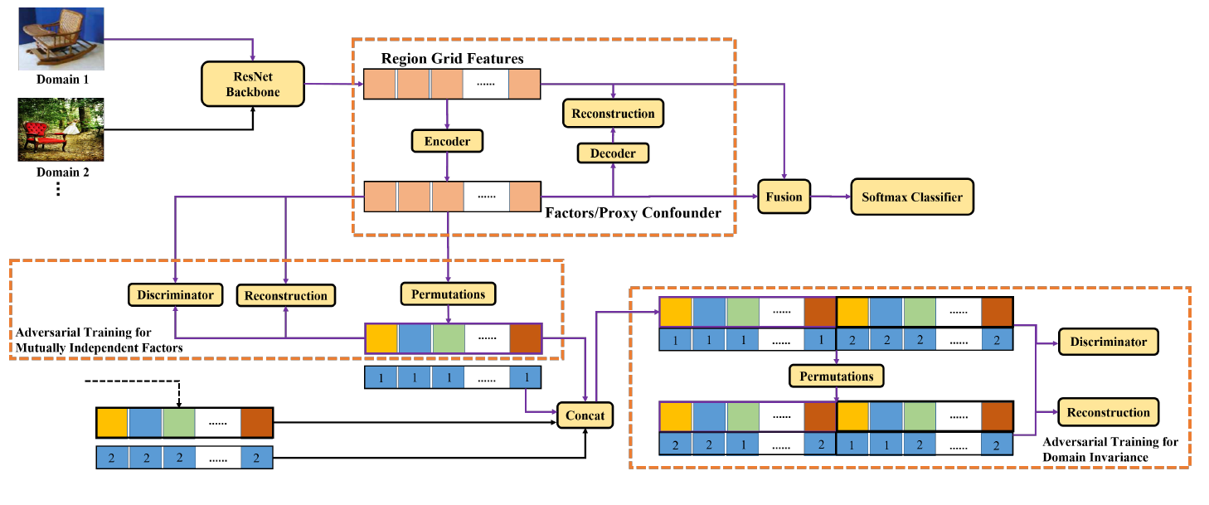
The neural model’s schematic diagram

Slide 19
Methods we applied (Step 1)
We go to the initial step, apply Non-linear ICA via adversarial Learning (Brakel and Bengio, et al. 2017) to make mutually independent factors, which, corresponds to the practical implementation of the original deconfounder theory.
The non-linear ICA via adversarial learning makes use of the permutation invariant property of the independent factorized distributions, i.e., the order of the factors in multiplication does not matter if these factors are mutually independent, and vice versa.
Adversarial learning is to match the distribution between the joint and the marginal distribution, realizing the order-invariant factors.

Slide 20
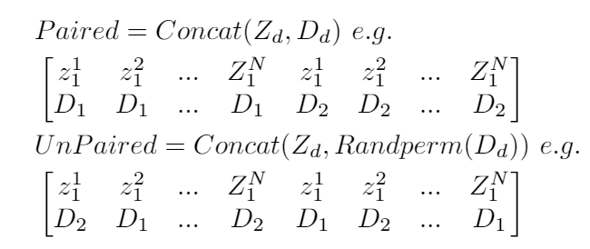
Methods we applied (Step 2)
Second, we apply a new restriction to realize a domain-invariant factors.
We propose an adversarial contrastive learning pipeline. Similar to the generalized contrastive learning for non-learn ICA, we define a paired features and unpaired features, corresponding to concatenation of the factors with domain labels, and factors with permuted domain labels, formally:

Slide 21
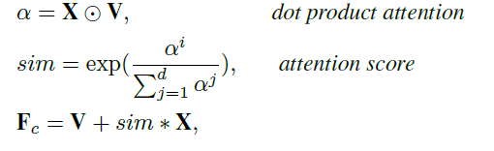
Methods we applied (Step 3)
Last, with the mutually independent and domain-independent factors obtained, we fuse these proxy confounders with the original region features to perform object recognition. The feature fusion process is formally described as following process:
Where α is the dot product of the region features and the proxy confounders, which is subsequently processed via a Softmax, and elementally multiplied with the image features to form F_{c}, i.e., the feature of confounders.

Slide 22

Methods we applied (Step 4)
At last, we residual connect the F_{c} with the original features X, which is the final features before the Softmax classifier
The final loss functions can be expressed as:

Slide 23
An explanation of the neural model.
From D’Amour et al. ‘s perspective, we alleviate the un-uniqueness issue of the deconfounder theory by using a parametric model and a new restrictions (prior knowledge of the domains) on the factors.
From the Hyvarinen et al.’s perspective, we improve the identifiability condition of the factor models by realizing an adversarial contrastive learning with auxiliary domain labels.

Slide 24
Experiments datasets
The VLCS dataset (Torralba & Efros, 2011), with 5 classes, involves four datasets respectively shared by the PASCAL VOC 2007, LabelMe, Caltech and Sun.
The Office-Home dataset (Saenko et al., 2010), with 65 classes, includes 15,500 images of everyday objects in the office and home scenarios, divided in four domains: Artistic images (Ar), Clip Art (Cl), Product images (Pr) and Real-World images (Rw).
The PACS dataset (Li et al., 2017), with 7 classes, includes 9,991 images divided in four domains: Photo (P), Art Painting (A), Cartoon (C), and Sketch (S). On each benchmark, the ADVICA classifier is trained on all domains but one and tested on the remaining one.

Slide 25
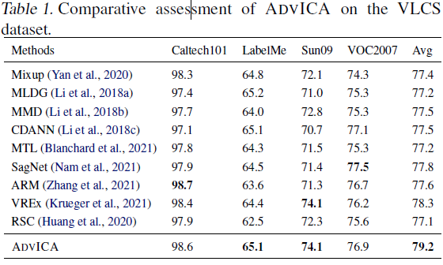
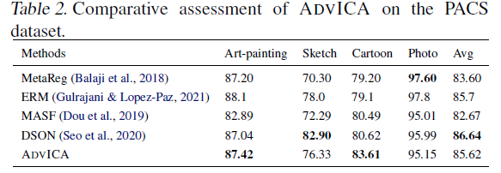
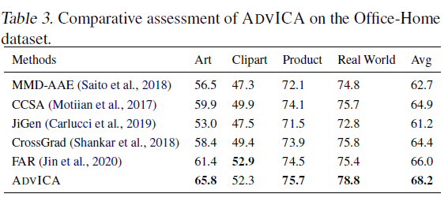
Experiments Results

Slide 26
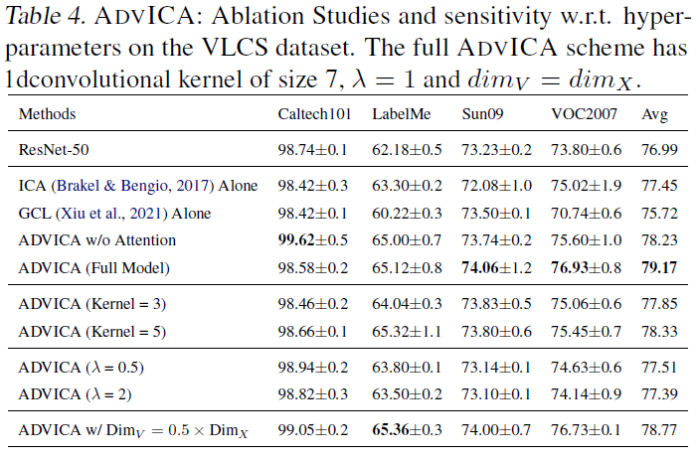
Experiments Ablation Studies and Analysis
The non-linear ICA standalone (Brakel & Bengio, 2017) and the generalized constrastive loss (GCL) standalone (Xiu et al., 2021) are respectively displayed on the second and third lines.
The higher performance of the ICA standalone compared to GCL is tentatively explained from the fact that the SHCs are more constrained, with a lower risk of unidentifiability.
Eventually, the merits of combining both the ICA and the GCL in ADVICA, yielding the best average accuracy are tentatively explained as the combination of the losses mitigates the un-identifiability risk and enforces a higher robustness through domain invariance.
The ablation studies on the training efficiency are shown in Table 5. The ADVICA has a moderately longer training time than the ResNet-50 baseline.

Slide 27
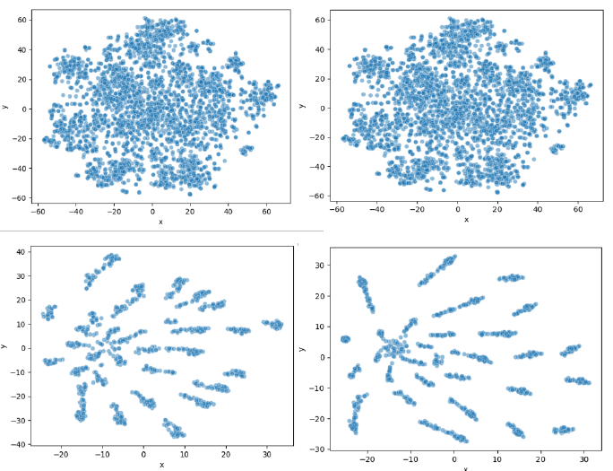
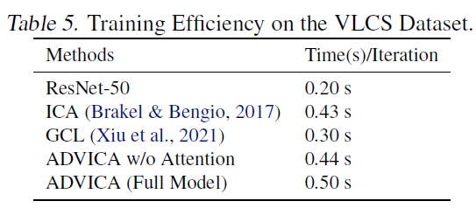
Experiments Ablation Studies and Analysis
The training efficiency are shown in Table 5.
The ADVICA has a moderately longer training time than the ResNet-50 baseline
We last investigate the representation learned by ADVICA, compared to the baseline representation learned by ResNet-50.
Considering the VOC2007 (Left) and LabelMe (Right) domains of the VLCS benchmark, we apply t-SNE (Van der Maaten & Hinton, 2008) on the X representation of the data, available in both ResNet-50 and ADVICA. The ADVICA scheme induces well separated clusters of points (Fig. 3, bottom), as opposed to ResNet-50 standalone (Fig. 3, top).

Slide 28
Conclusions
The proposed ADVICA scheme extracts substitute hidden confounders that are mutually independent along the nonlinear ICA scheme (Brakel & Bengio, 2017), and it further enforces their independence w.r.t. the domains through an adversarial training scheme inspired from (Hyvarinen et al., 2019; Xiu et al., 2021).
ADVICA is empirically validated comparatively to the state of the art on three DG benchmarks, behaving on par or better than the prominent approaches. The visual inspection of the data representation derived from ADVICA (Fig. 3) suggests that the overall scheme enables to forge consistent views of the classes.
An appealing perspective opened by the present work is to inspect and interpret the Substitute Hidden Confounder (SHCs) per se, and try to relate them to the specifics of the data distributions in each domain. Ultimately, the challenge is to identify when a model is no longer applicable to out-of-distribution data, and to devise indicators characterizing when it is the case.

Slide 29
Key References
Y. Wang and D. M. Blei, “The blessings of multiple causes,” Journal of the American Statistical Association, vol. 114, no. 528, pp. 1574–1596, 2019.
A. D’Amour, “On multi-cause causal inference with unobserved confounding: Counter examples, impossibility, and alternatives,”arXiv preprint arXiv:1902.10286, 2019.
P. Brakel and Y. Bengio, “Learning independent features with adversarial nets for non-linear ica,” arXiv preprint arXiv:1710.05050, 2018.
Xiu, Zidi, et al. "Supercharging Imbalanced Data Learning With Energy-based Contrastive Representation Transfer." arXiv e-prints (2020): arXiv-2011.
Khemakhem, Ilyes, Diederik Kingma, Ricardo Monti, and Aapo Hyvarinen. "Variational autoencoders and nonlinear ica: A unifying framework." In International Conference on Artificial Intelligence and Statistics, pp. 2207-2217. PMLR, 2020.
Hyvarinen, Aapo, Hiroaki Sasaki, and Richard Turner. "Nonlinear ICA using auxiliary variables and generalized contrastive learning." The 22nd International Conference on Artificial Intelligence and Statistics. PMLR, 2019.

Slide 30
Thank you!

