Slide 1
Linear Regression
Marcell O MarcellDaniel.Orban[at]edfenergy[dot]com

Slide 2

Simple Linear Regression (SLR)
$g\left(x\right)=y$
Linear case – linear in arguments
$g\left(x\right)= β_{0}+β_{1}x$
Intercept
Slope

Slide 3
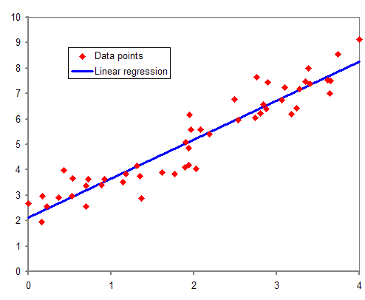
Linear Regression on a graph
Notes:
Robot analogy: Try to draw a line that is closest to ALL data points

Slide 4

Multiple linear regression (MLR)
$g\left(x_{1},x_{2},…,x_{n}\right)=y$
Linear case – linear in arguments
$g\left(x_{1},x_{2},…,x_{n}\right)= β_{0}+β_{1}x_{1}+…+β_{n}x_{n}$

Slide 5
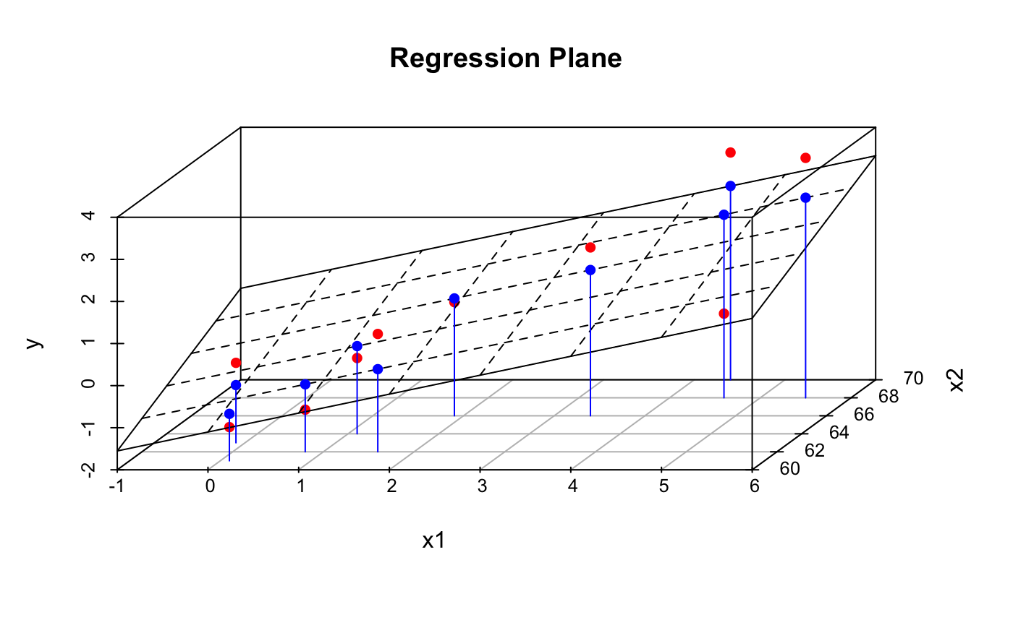
Multiple Linear Regression in 3D
Notes:
All adding variables does is to increase the number of dimensions that the plot has. NOTE: Can only plot 2 (MAX 3) of the x variables simultaneously

Slide 6
Common pitfalls to avoid 1
Ice cream sales (£) = 854 + 12 000 * shark attacks
How can shark attacks cause ice cream sales?
Correlation is NOT causation (but causation implies correlation)
Notes:
Hidden variable: Hot weather which increases ice cream sales but also shark attacks due to more people visiting the beach

Slide 7
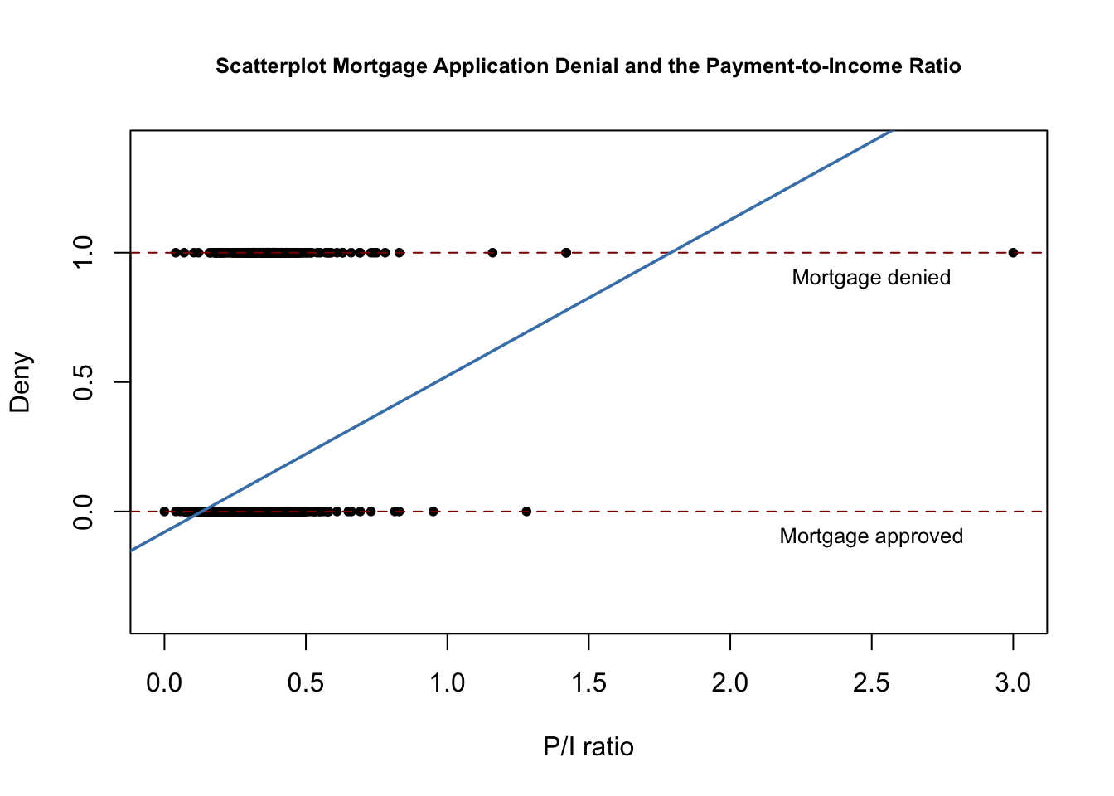
Common pitfalls to avoid 2.1
Prob > 1
Prob < 0
Notes:
Beware of the limits of a linear model – MLR is pretty BAD for probabilities not only because of this

Slide 8
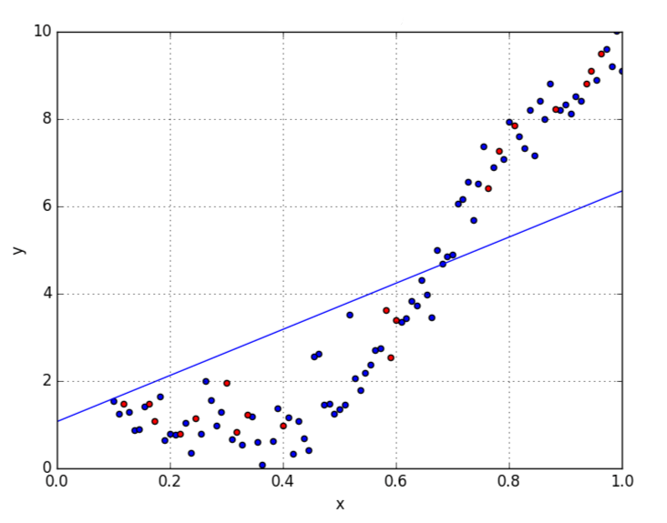
Common pitfalls to avoid 2.2
Notes:
Linear Regression does NOT suit non-linear relationships, always check your data first!

Slide 9
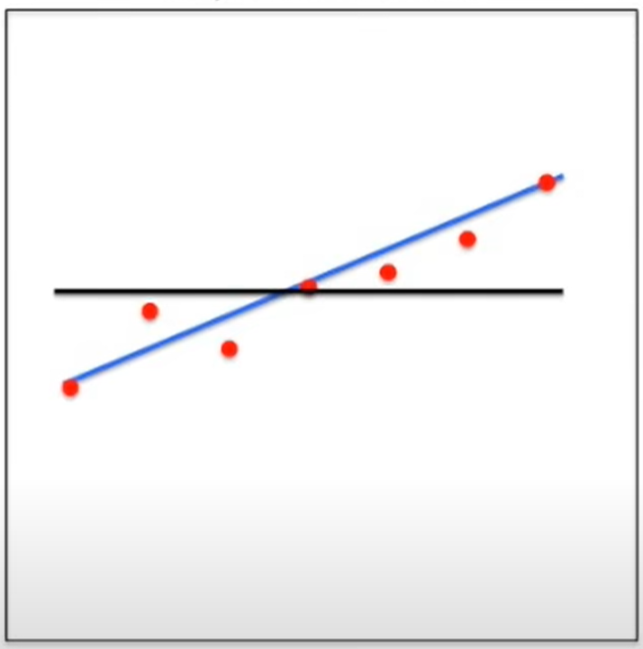

Common pitfalls to avoid 3
R-squared: Measure of how
much variation in data is
explained by model
$$R^{2}=\frac{Black−Blue}{Black}$$
Notes:
R-squared formula refers to the length of the black and blue lines, respectively

Slide 10
Model training & testing
I have past data to train my model
I want to predict the future
Overfitting: Excellent training predictions, poor predictions for unseen data
K-fold cross-validation
Split data into k groups
Train data on k-1 groups, test on last group (group k)
Choose the best model among those trained

Slide 11
Too many slides
Let’s get coding!

Slide 12
Thank you for your attention!
If you have any questions, contact me at:
MarcellDaniel.Orban[at]edfenergy[dot]com

Slide 13
Sources of pictures
Slide 3: https://en.wikipedia.org/wiki/Regression_analysis
Slide 5: https://rpubs.com/ericroh/334817
Slide 7: https://www.econometrics-with-r.org/11-1-binary-dependent-variables-and-the-linear-probability-model.html
Slide 8: https://towardsdatascience.com/5-types-of-regression-and-their-properties-c5e1fa12d55e
Slide 9: https://www.youtube.com/watch?v=2AQKmw14mHM (5:31)

