Slide 1

Lecture – 8/27/2025
CS 341 – Advanced Data Structures

Slide 2
Course Information
Lecture:
  Monday/Wednesday
    2:15 PM – 3:30 PM (JH 174)
Instructor:
  Dr. Ryan Rybarczyk
    rrybarcz@butler.edu
Office:
  JH 298
Office Hours:
  Monday/Wednesday
    11:00 AM – 12:00 PM, 1:00 PM – 2:00 PM
  By Appointment

Slide 3
Syllabus
Canvas

Slide 4

Additional Resources
Study Tables
  Monday – Thursday
  7:00 PM – 9:00 PM
  September 2nd – December 11th
    No Study Tables Fall Break or Thanksgiving Break
Course TA:
  Brady Werling
    bwerling@butler.edu
    Office Hours: TBA

Slide 5
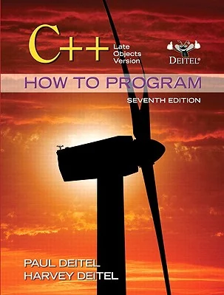
Textbook
C++: How To Program – Late Objects Version
  7th Edition
  Paul Deitel
  Harvey Deitel
Periodic Assigned Readings
  Links
  Articles
  PDF’s

Slide 6
What are we going to learn?
Explore Object-Oriented Concepts in C++
  How to create a “proper” class in C++
  How to create a Makefile to link these “pieces” together
  Be able to check and ensure no memory leaks are present in our code – dynamic memory management
    Utilize pointers to manage our dynamically created objects

Slide 7
What are we going to learn?
Explore various Abstract Data Types (ADT)
  Be able to implement a Linked List in C++
  Be able to implement a Hash Table in C++
  Be able to implement a Binary Search Tree in C++
  Be able to implement an Red Black Tree in C++
    Understand how to perform a tree traversal in C++
  Be able to implement a Trie in C++
Perform an analysis of an ADT’s performance

Slide 8
Quiz #1

Slide 9
What is Data Abstraction?

Slide 10
Why is Data Abstraction Important?

Slide 11
Object-Oriented Concepts
What is the OO Concept?
  It really boils down to the idea that we can model things in software using terminology that we use to describe the same “objects” in the domain world.
Pillars of OO Programming Paradigm:
  Inheritance
  Polymorphism
  Data Abstraction
  Encapsulation

Slide 12
Object-Oriented Concepts
Encapsulation
  Objects combine data and operations.
Inheritance
  Classes inherit properties from other classes.
Polymorphism
  Objects determine appropriate operations at execution time.
Abstraction
  ?

Slide 13
What is Abstraction???
Separate purpose of a module from its implementation
Specifications do not indicate how to implement
Able to use without knowing implementation

Slide 14
C++ Review
In-Class Exercise

Slide 15
C++ Review
class Rectangle
{
int width,height;
public:
Rectangle(int,int);
int area()
{
return width*height;
}
};

Slide 16
C++ Review
Let’s look at another example:
class Rectangle
{
int width,height;
public:
Rectangle(int x,int y);
int area();
};

Slide 17
Object-Oriented Programming
Ok – so when we first learned how to write a C++ program we put all of our code into a file with an extension of .cpp.
But before when we created the file we did not create something with the name class or wrap it in {}
  No less the crazy semi-colon there at the end of the file…

Slide 18
C++ Review
#include <iostream>
class Rectangle
{
int width,height;
public:
Rectangle();
Rectangle(int w,int h)
{
width = w;
height = h;
}
void printArea()
{
std::cout << width*height;
}
};

Slide 19
;

