Slide 1

Lecture – 10/6/2025
CS 341 – Advanced Data Structures

Slide 2
Assignment #2
Feedback

Slide 3
Assignment #3
Questions?

Slide 4
Bitwise Operations

Slide 5
Bitwise Operations
Motivation:
  Integer types such as the familiar (int) are machine dependent.
  One machine may give a size of an int to be four (4) bytes while another machine may give it a size of two (2) bytes.
    Most machines can handle this but what if you had limited storage available and space was a premium?

Slide 6
Bitwise Operations
We can use logical operators – think of the first time you saw truth tables…
We can model this relationship based upon logical operators.
  AND
  OR
  XOR
  …

Slide 7
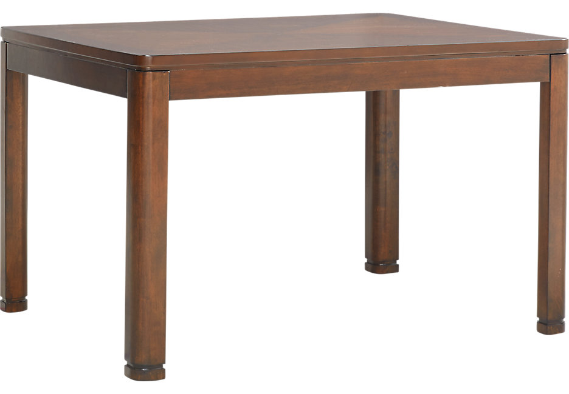
Bitwise Operations
I am truthful: 1 == 0001
Source: https://images2.roomstogo.com/is/image/roomstogo/dr_tbl_42116891_sutterplace_brown_cherry~Sutter-Place-Brown-Cherry-Dining-Table.jpeg?$PDP_Primary_936x650$

Slide 8
Bitwise Operations
Bit Manipulation:
  Bitwise AND (&)
  Bitwise Inclusive OR (|)
  Bitwise Exclusive OR (^)
  One’s Complement (~)
The first three are binary operators - the one’s complement is a unary operator.

Slide 9
Bitwise Operations
Let’s start with AND…
  Better yet go read my clock in my office. ☺
Let’s assume we have two unsigned integers:
unsigned int x = 87;
unsigned int y = 15;

Slide 10
Bitwise Operations
What are the binary representation of these two numbers:
15
  0000 0000 0000 1111
87
  0000 0000 0101 0111

Slide 11
Bitwise Operations
Now if we perform the following bitwise operation:
x & y
0 | 0 | 0 | 0 | 1 | 1 | 1 | 1
0 | 1 | 0 | 1 | 0 | 1 | 1 | 1
0 | 0 | 0 | 0 | 0 | 1 | 1 | 1

Slide 12
Bitwise Operations
#include <iostream>
int main()
{
unsigned int x = 15;
unsigned int y = 87;
int z(0);
z = x & y;
std::cout << "Bitwise AND: " << z << std::endl ;
return 0;
}

Slide 13
Bitwise Operations
Now if we perform the following bitwise operation:
x | y
0 | 0 | 0 | 0 | 1 | 1 | 1 | 1
0 | 1 | 0 | 1 | 0 | 1 | 1 | 1
0 | 1 | 0 | 1 | 1 | 1 | 1 | 1

Slide 14
Bitwise Operations
#include <iostream>
int main()
{
unsigned int x = 15;
unsigned int y = 87;
int z(0);
z = x | y;
std::cout << "Bitwise OR: " << z << std::endl ;
return 0;
}

Slide 15
Bitwise Operations
Now if we perform the following bitwise operation:
x ^ y
0 | 0 | 0 | 0 | 1 | 1 | 1 | 1
0 | 1 | 0 | 1 | 0 | 1 | 1 | 1
0 | 1 | 0 | 1 | 1 | 0 | 0 | 0

Slide 16
Bitwise Operations
#include <iostream>
int main()
{
unsigned int x = 15;
unsigned int y = 87;
int z(0);
z = x ^ y;
std::cout << "Bitwise XOR: " << z << std::endl ;
return 0;
}

Slide 17
Bitwise Operations
Now if we perform the following bitwise operation:
~x
0 | 0 | 0 | 0 | 1 | 1 | 1 | 1
1 | 1 | 1 | 1 | 0 | 0 | 0 | 0

Slide 18
Bitwise Operations
#include <iostream>
int main()
{
unsigned int x = 15;
unsigned int y = 87;
int z(0);
z = ~x;
std::cout << "Bitwise 1’s Compliment: " << z << std::endl;
return 0;
}

Slide 19
Bitwise Operations
Left Shift Operator (<<)
  Shifts the bits to the left by the number of positions specified by expression.
Right Shift Operator (>>)
  Shifts the bits to the right by the number of positions specified by expression.

Slide 20
Bitwise Operations
#include <iostream>
int main()
{
unsigned int x = 1;
int z(0);
z = x << 2;
std::cout << "Bitwise Left Shift: " << z << std::endl;
return 0;
}

Slide 21
Bitwise Operations
#include <iostream>
int main()
{
unsigned int x = 8;
int z(0);
z = x >> 2;
std::cout << "Bitwise Right Shift: " << z << std::endl;
return 0;
}

Slide 22
Bitwise Operations
Bit Set:
  #include <bitset>
#include <iostream>
int main()
{
char x = 8;
char z;
z = x >> 2;
std::cout << "Bitwise Right Shift: " << std::bitset<8>(z) << std::endl;
return 0;
}

Slide 23
Bitwise Operations
In-Class Example

Slide 24
;

