Slide 1

Lecture – 11/5/2025
CS 341 – Advanced Data Structures

Slide 2
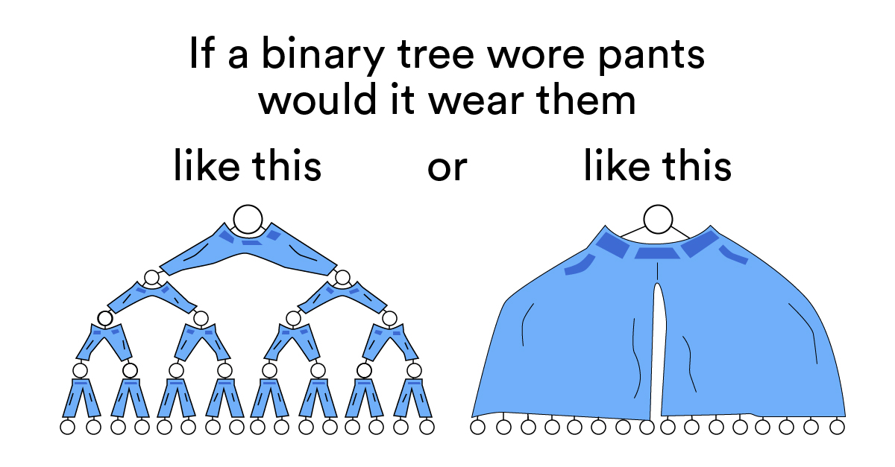

Slide 3
Assignment #4
Q/A

Slide 4
Assignment #5
Canvas

Slide 5
Assignment #5
Red-Black Tree
  Binary Search Tree
  Node Coloring
  Left/Right Shifts
  Insertions Only!
Due:
  11/21/2025
    11:59:59 PM

Slide 6
Binary Search Tree
In-Class Example

Slide 7
Red-Black Trees
Chapter 19

Slide 8
Red-Black Trees
A type of balanced Binary Search Tree (BST).
  We have been using this idea of balance previously when introducing BST.
  All the same properties of BST hold here.
Each Node has a color – either RED or BLACK – which helps to maintain balance within the tree hierarchy.
This balance ensures efficient tree operations.

Slide 9
Red-Black Trees
Most Binary Search Tree operations take O(h) time – where h is the height of the tree.
This can quickly become O(n) if the tree is unbalanced.
  We would obviously desire a much better upper bound for our tree operations.

Slide 10
Red-Black Trees
Balance is important as it allows for “optimal” search/insertion/deletion times within the tree.
  Unbalanced Trees can have time worse than log N for basic tree operations.
If we desire the optimal time for our tree is there a way we can ensure that the tree is always kept in a balanced state?

Slide 11
Red-Black Trees
Rules:
  A Red-Black Tree must be a type of Binary Search Tree.
  The root Node is Black
  Every Node when inserted begins as a Red Node.
  If a Node is Red then its Children must be Black.
  Every path from a Node to a nullptr must contain the same number of Black Nodes.
    This ensures that the tree will remain balanced.
  Every leaf (nullptr) must be Black.

Slide 12
Red-Black Trees
We will need to create a new Class – TreeNode – that will inherit from our Node Class and add the following attributes:
  Left Child
  Right Child
  Parent
For the Red-Black Tree we also need to add an attribute to store the color of the Node.

Slide 13
Red-Black Trees
Let’s begin by inserting a TreeNode into our Red-Black Tree.
  The RB Tree is initially empty and thus our root is pointing at the nullptr.
When we insert ANY TreeNode into our RB Tree we need to set it initial color to RED.
  Property #3

Slide 14
Red-Black Trees
If the RB is empty – as it should be on the initial input – we need to set the root pointer to the new TreeNode and change its color from RED to BLACK.
  Property #2
Now that we have a RB Tree started we can start inserting additional TreeNodes.

Slide 15
Red-Black Trees
Now when we insert a second TreeNode we will begin by inserting it as a leaf Node within the Tree.
  It’s color will still be RED – it does not violate Property #6 because the children of this new Node are Black.
We need to examine whether it belongs in the left or right subtree.
  If it is greater than the root it belongs in the right subtree.
  If it is less than the root it belongs in the left subtree.

Slide 16
Red-Black Trees
Let’s assume that our root is the integer 7 and we are trying to insert the data value 15 into our tree.
  We know that by the rules of a Binary Search Tree that the value 15 belongs in the right subtree.
At this we can insert our third value 4.
  4 is less than 7 (our root) so we can insert it into our left subtree of 7.
    Are all our properties still holding?

Slide 17
Red-Black Trees
7
4
15

Slide 18
Red-Black Trees
Let’s try to throw a wrench into things and add the number 10.
  Now 10 is greater than 7 so we know it is going to be in the right subtree of 7 but it is less than 15, meaning that it will be in 15’s left subtree.
Remember that when we insert this node we need to start with its color Red – which we know is going to create a further headache…

Slide 19
Red-Black Trees
When we insert 10 into our tree – everything goes well until we realize that 10 is colored Red and 15 is colored Red.
  This violates a couple of our properties as we not only have two consecutive Red nodes in the tree but we also two adjacent nodes that are Red within our Tree.
We are going to need to do some recoloring to take care of this problem.

Slide 20
Red-Black Trees
7
4
15
10

Slide 21
Red-Black Trees
Now we can’t just recolor the 15 because then that violates our Property #5
  Because the left subtree of 7 would have fewer Black nodes than the right subtree.
We actually need to recolor both the 4 and the 15 in order to maintain not only balance but also proper coloring.
  Black Nodes: 4, 7, 15
  Red Nodes: 10

Slide 22
Red-Black Trees
7
4
15
10

Slide 23
Red-Black Trees
Now let’s throw in some total chaos just to make things interesting.
  We will insert 13.
Now we know that 13 will go in the right subtree of 7 and the left subtree of 15 but the right subtree of 10.
  By rules of insertion though we now have two consecutive RED nodes which is a violation.

Slide 24
Red-Black Trees
7
4
15
10
13

Slide 25
Red-Black Trees
We need to perform a Left Rotation to attempt to resolve this situation.
We need rotate the 13 into a position where it goes from the child of 10 to the parent of 10…and also is now linked to the 15 as its child.
  When we do this we are still in violation because we STILL have two consecutive RED nodes.

Slide 26
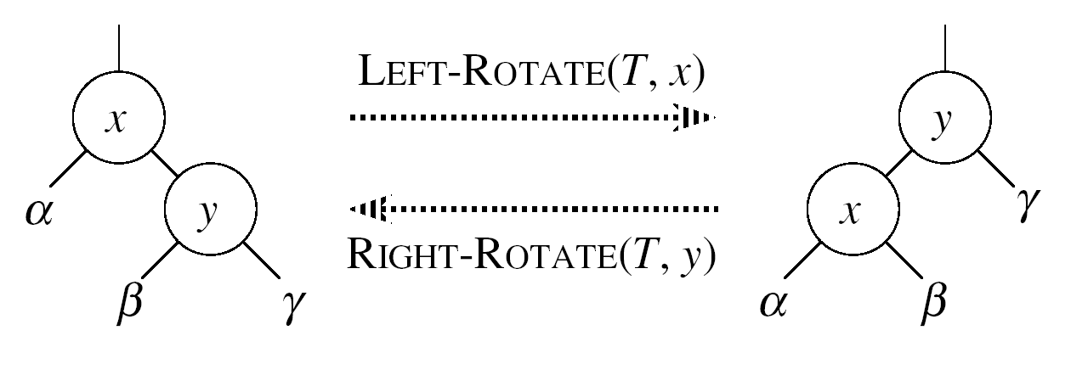
Red-Black Trees
Left Rotation:
  Repositions the Node y as the root of the subtree.
  Assumes the right child of Node x is not the nullptr.

Slide 27
Red-Black Trees
7
4
15
13
10

Slide 28
Red-Black Trees
We need to perform a further rotation – this time executing a Right Rotation in order to not only balance our Tree but also perform a recoloring to ensure that we adhere to all the properties of RB Trees.
Note:
  We had to go through the Left Rotation first in order to put ourselves in position to adhere to the rules of Binary Search Trees.

Slide 29
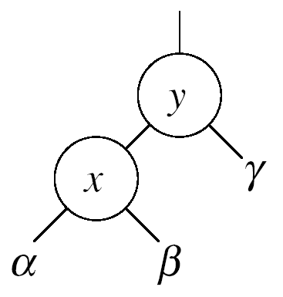
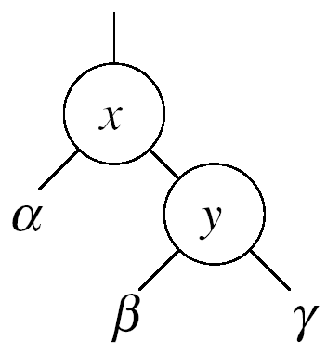


Red-Black Trees
Right Rotation:
  Repositions the Node x as the root of the subtree.
  Assumes that the left child of Node y is not the nullptr

Slide 30
Red-Black Trees
In order to perform a Right Rotation of our Tree we need to rotate our 13 to be the new parent node of BOTH our 15 and our 10.
The 13 is now the right child of the 7 which is our root node.
We need to recolor our nodes such that our 13 is colored BLACK and our 15 is now colored RED.

Slide 31
Red-Black Trees
7
4
13
10
15

Slide 32
Red-Black Trees
We have now completed our insertions and we can note that not only have we maintained all of the properties of a Red-Black Tree in terms of coloring but we have also inserted and adjusted such that the tree is balanced.
We can now traverse the tree and find in an efficient manner and find/discover the color of each respective TreeNode.

Slide 33
;

