Slide 1

Lecture – 11/10/2025
CS 341 – Advanced Data Structures

Slide 2
Assignment #5
Q/A

Slide 3
Red-Black Trees
Chapter 19

Slide 4
Red-Black Trees
A type of balanced Binary Search Tree (BST).
  We have been using this idea of balance previously when introducing BST.
  All the same properties of BST hold here.
Each Node has a color – either RED or BLACK – which helps to maintain balance within the tree hierarchy.
This balance ensures efficient tree operations.

Slide 5
Red-Black Trees
Most Binary Search Tree operations take O(h) time – where h is the height of the tree.
This can quickly become O(n) if the tree is unbalanced.
  We would obviously desire a much better upper bound for our tree operations.

Slide 6
Red-Black Trees
Balance is important as it allows for “optimal” search/insertion/deletion times within the tree.
  Unbalanced Trees can have time worse than log N for basic tree operations.
If we desire the optimal time for our tree is there a way we can ensure that the tree is always kept in a balanced state?

Slide 7
Red-Black Trees
Rules:
  A Red-Black Tree must be a type of Binary Search Tree.
  The root of the entire tree is Black
  Every Node when inserted begins as a Red Node.
  If a Node is Red then its Children must be Black.
  Every path from a Node to a nullptr must contain the same number of Black Nodes.
    This ensures that the tree will remain balanced.
  Every leaf (nullptr) must be Black.

Slide 8
Red-Black Trees
Let’s begin by inserting a TreeNode into our Red-Black Tree.
  The RB Tree is initially empty and thus our root is pointing at the nullptr.
When we insert ANY TreeNode into our RB Tree we need to set it initial color to RED.
  Property #3

Slide 9
Red-Black Trees
If the RB is empty – as it should be on the initial input – we need to set the root pointer to the new TreeNode and change its color from RED to BLACK.
  Property #2
Now that we have a RB Tree started we can start inserting additional TreeNodes.

Slide 10
Red-Black Trees
Now when we insert a second TreeNode we will begin by inserting it as a leaf Node within the Tree.
  It’s color will still be RED – it does not violate Property #6 because the children of this new Node are Black.
We need to examine whether it belongs in the left or right subtree.
  If it is greater than the root it belongs in the right subtree.
  If it is less than the root it belongs in the left subtree.

Slide 11
Red-Black Trees
Let’s assume that our root is the integer 7 and we are trying to insert the data value 15 into our tree.
  We know that by the rules of a Binary Search Tree that the value 15 belongs in the right subtree.
At this we can insert our third value 4.
  4 is less than 7 (our root) so we can insert it into our left subtree of 7.
    Are all our properties still holding?

Slide 12
Red-Black Trees
7
4
15

Slide 13
Red-Black Trees
Let’s try to throw a wrench into things and add the number 10.
  Now 10 is greater than 7 so we know it is going to be in the right subtree of 7 but it is less than 15, meaning that it will be in 15’s left subtree.
Remember that when we insert this node we need to start with its color Red – which we know is going to create a further headache…

Slide 14
Red-Black Trees
When we insert 10 into our tree – everything goes well until we realize that 10 is colored Red and 15 is colored Red.
  This violates a couple of our properties as we not only have two consecutive Red nodes in the tree but we also two adjacent nodes that are Red within our Tree.
We are going to need to do some recoloring to take care of this problem.

Slide 15
Red-Black Trees
7
4
15
10

Slide 16
Red-Black Trees
Now we can’t just recolor the 15 because then that violates our Property #5
  Because the left subtree of 7 would have fewer Black nodes than the right subtree.
We actually need to recolor both the 4 and the 15 in order to maintain not only balance but also proper coloring.
  Black Nodes: 4, 7, 15
  Red Nodes: 10

Slide 17
Red-Black Trees
7
4
15
10

Slide 18
Red-Black Trees
Now let’s throw in some total chaos just to make things interesting.
  We will insert 13.
Now we know that 13 will go in the right subtree of 7 and the left subtree of 15 but the right subtree of 10.
  By rules of insertion though we now have two consecutive RED nodes which is a violation.

Slide 19
Red-Black Trees
7
4
15
10
13

Slide 20
Red-Black Trees
We need to perform a Left Rotation to attempt to resolve this situation.
We need rotate the 13 into a position where it goes from the child of 10 to the parent of 10…and also is now linked to the 15 as its child.
  When we do this we are still in violation because we STILL have two consecutive RED nodes.

Slide 21
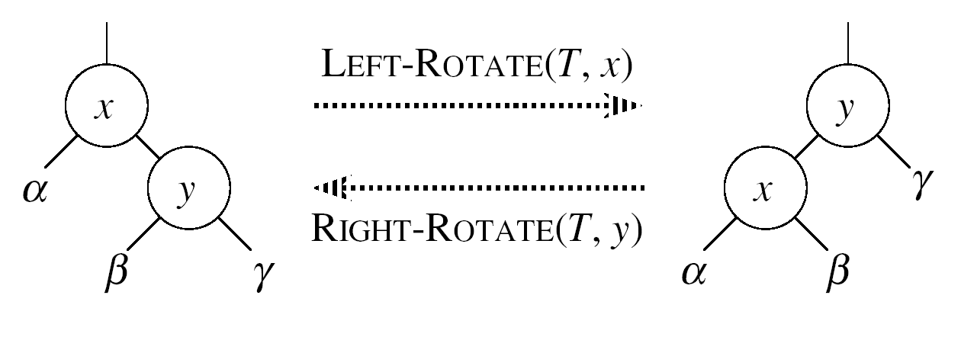
Red-Black Trees
Left Rotation:
  Repositions the Node y as the root of the subtree.
  Assumes the right child of Node x is not the nullptr.

Slide 22
Red-Black Trees
7
4
15
13
10

Slide 23
Red-Black Trees
We need to perform a further rotation – this time executing a Right Rotation in order to not only balance our Tree but also perform a recoloring to ensure that we adhere to all the properties of RB Trees.
Note:
  We had to go through the Left Rotation first in order to put ourselves in position to adhere to the rules of Binary Search Trees.

Slide 24
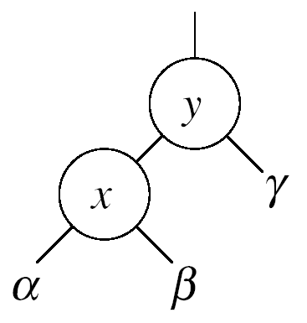
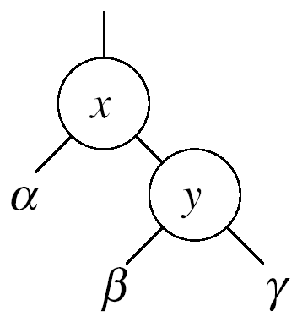


Red-Black Trees
Right Rotation:
  Repositions the Node x as the root of the subtree.
  Assumes that the left child of Node y is not the nullptr

Slide 25
Red-Black Trees
In order to perform a Right Rotation of our Tree we need to rotate our 13 to be the new parent node of BOTH our 15 and our 10.
The 13 is now the right child of the 7 which is our root node.
We need to recolor our nodes such that our 13 is colored BLACK and our 15 is now colored RED.

Slide 26
Red-Black Trees
7
4
13
10
15

Slide 27
Red-Black Trees
We have now completed our insertions and we can note that not only have we maintained all of the properties of a Red-Black Tree in terms of coloring but we have also inserted and adjusted such that the tree is balanced.
We can now traverse the tree and find in an efficient manner and find/discover the color of each respective TreeNode.

Slide 28
Red-Black Trees
What does the Tree look like after inserting 17?
What does the Tree look like after inserting 17, 14, 16?

Slide 29
Red-Black Trees
7
4
13
10
15
17

Slide 30
Red-Black Trees
7
4
13
10
15
14
17

Slide 31
Red-Black Trees
13
7
15
4
10
14
17
16

Slide 32
Red-Black Trees
An interesting factoid about Red-Black Trees:
A Red-Black Tree with n internal nodes has a height of at-most 2log(n+1)

Slide 33
Red-Black Trees
Helpful Hints:
  When you invoke the insertNode method of our Red-Black Tree Class we will need to insert a new RED colored Node into our Tree according to the properties of a Binary Search Tree.
  From within that method we will need to invoke a second method balanceColor to ensure that all of the properties of a Red-Black Tree are upheld.

Slide 34
Red-Black Trees
When we insert a node into a Red-Black Tree, we initially set the color of the new node to RED.
Why don’t we choose to set the color to BLACK?

Slide 35
Red-Black Trees
Inserting a RED node is less likely to violate the rules of a Red-Black Tree than if we chose to insert a BLACK colored node.
Reason:
  If the new RED node is attached/linked to a BLACK node – no Red-Black Tree rule is violated. The same cannot be said for the reverse situation.

Slide 36
Red-Black Trees
Rules:
  A Red-Black Tree must be a type of Binary Search Tree.
  The root of the entire tree is Black
  Every Node when inserted begins as a Red Node.
  If a Node is Red then its Children must be Black.
  Every path from a Node to a nullptr must contain the same number of Black Nodes.
    This ensures that the tree will remain balanced.
  Every leaf (nullptr) must be Black.

Slide 37
Binary Search Trees
Deletions

Slide 38
Removing A Node
Removing a Node from a Tree can be just as challenging as Inserting a Node.
  In fact it is often times much more difficult!
Three Conditions:
  The Node to be deleted is a leaf node.
  The Node to be deleted has one child.
  The Node to be deleted has two children.

Slide 39
Removing A Node
Leaf Node Deletion:
  We just need to change the appropriate child attribute (our pointer) in the Node’s Parent to point to nullptr.
  We need to delete said Node from the Heap – to avoid memory leaks.
    Each Node should have a Destructor that allows for this removal of the Node from the Tree.

Slide 40
Removing A Node
One Child Deletion:
  Here we have to manage two connections:
    One to the Parent.
    One to the Child.
  We need to reassign our pointers to move the Child up to the existing Parent Node and link those two together.
    Don’t forget to clean up the mess the deleted Node left behind – otherwise, a memory leak!

Slide 41
Removing A Node
Two Children Deletion:
  Replace the Node with its Inorder successor.
    The Node with the next-highest key (to the deleted node) in the subtree is called its Inorder successor.
  To find the successor:
    Remove the Node’s Right Child.
    Follow the path of Left Children.
      The last Left Child in this path is the successor of the original Node.

Slide 42
Binary Search Trees
Tree Traversals

Slide 43
Binary Search Trees
Traversals
  Inorder
  Preorder
  Postorder
We will reach the same endpoint – a leaf Node…but how we get there is very different and this can alter how we “view” the tree.

Slide 44
Inorder Traversal
An Inorder Traversal will cause all the nodes to be visited in ascending order.
Inorder Traversal (Recursion):
  Traverse Left Subtree
  Visit the Node
  Traverse Right Subtree

Slide 45
Inorder Traversal
inOrder(node root)
{
if (root != null)
{
      inOrder(root.getLeftChild());
      std::cout << root.getData() << “ “;
      inOrder(root.getRightChild());
}
}

Slide 46
Preorder Traversal
A Preorder Traversal:
  Visit the node
  Traverse the Left Subtree
  Traverse the Right Subtree

Slide 47
Preorder Traversal
preOrder(node root)
{
if (root != null)
{
std::cout << root.getData() << “ “;
      preOrder(root.getLeftChild());
      preOrder(root.getRightChild());
}
}

Slide 48
Postorder Traversal
A Postorder Traversal:
  Traverse the Left Subtree
  Traverse the Right Subtree
  Visit the node

Slide 49
Postorder Traversal
postOrder(node root)
{
if (root != null)
{
      postOrder(root.getLeftChild());
      postOrder(root.getRightChild());
      std::cout << root.getData() << “ “;
}
}

Slide 50
Tree Traversals
In order to find a specific node within the Tree we need to:
  Start from the Root.
    If the key value is same as the Node, then Node is found.
    If key is greater than Node, search the Right Subtree, else search the Left Subtree. (Depending on Traversal Approach)
  Continue till the Node is found or the entire Tree is traversed.
Time required (Big-O) to find a node depends on how many levels need to be traversed.
  What is the worst case?

Slide 51
;

