Slide 1

Lecture – 11/19/2025
CS 341 – Advanced Data Structures

Slide 2


Slide 3
Assignment #5
Q/A

Slide 4
Hash Tables
Chapter 18

Slide 5
Hashing
Many different ways we can map a key to a specific “bucket.”
One of the most common and the simplest is to use modulus.
Our hashing function will be calculated as follows:
key % size_of_hash_table

Slide 6
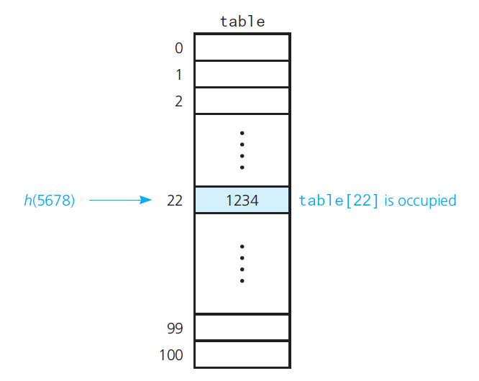
Hashing

Slide 7
Hashing
Let’s take a look at an example…
What is the simplest Hash Table?
  An Array of records.
We have a key and we can get the value – in theory the index of the element is the key.
  Integers make great keys – but anything can be a key.

Slide 8
Hashing
When we want to insert a new element into a Hash Table we need to convert our key into the index of the Array.
This conversion process is known as hashing and the index of the Array is known as the hash value of the key.

Slide 9
Hashing
Now the key is how do we select a hash function that will allow us to place our element into our “hash table?”
We could use the modulus of the key to find the appropriate “bucket” or Array indices.
  This is a good approach in the given approach as it will allow us to manage our Array.

Slide 10
Hashing
The Hash Function in the ideal situation is called a perfect hash function.
  This function maps each search key into a unique location of the hash table.
A perfect hash function is only possible if you know all of the search keys.
  What is the likelihood of this occurring?

Slide 11
Hashing
Ok…let’s assume we are using our Array as a Hash Table and we have the following two key entries we need to insert 102 and 152.
Now, let’s assume that our hashing function is the KEY % 50.
  Both entries yield a result of 2.
    So, after we insert the key 102 into the 2nd indexed position in the Array we have no space for the key 152….

Slide 12
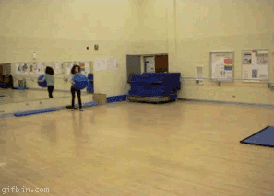
Hashing

Slide 13
Collisions
How do we resolve a collision when one happens?
The easiest solution would to just move forward until we find an open position within our Array.
  Now what do we do in the above scenario where our key of 152 is not located in Bucket #2?

Slide 14
Collisions
Selecting Digits:
  You select specific digits in your search key to pick the index that the item should be inserted into.
Problem:
  Does not distribute the entries evenly in the Hash Table.

Slide 15
Collisions
Folding:
  Here we could add up all of the digits of our search key and then place the entry in the summation index.
Problem:
  We still have the potential for future collisions and you may have to “fold” a number of times before resolving the collision.

Slide 16
Collisions
Modulo
  Computing the modulus of the table size and placing the entry into that position.
    This eliminates one of the problems with respect to folding.
Problem:
  See the same explanation that we saw with folding in terms of multiple collisions – this approach tends to be a popular solution.

Slide 17
Collisions
Approach 1: Open Addressing
  Linear Probing
  Quadratic Probing
  Double Hashing
  Increase size of Hash Table

Slide 18
Linear Probing
You search the Hash Table sequentially, starting from the original hash location until we find an open, unoccupied, spot/bucket to place the entry into.
  If necessary you can “wrap around” to find an open spot.
Removals present a challenge however…

Slide 19
Linear Probing
Insert(x)
  Keep probing until an empty slot is found. Once an empty slot is found, insert key.
Search(x)
  Keep probing until slot’s key doesn’t become equal to x or an empty slot is reached.
Delete(k)
  Keep probing until the keys slot is found and remove the key.
    More on this later, as it is quite complex…

Slide 20
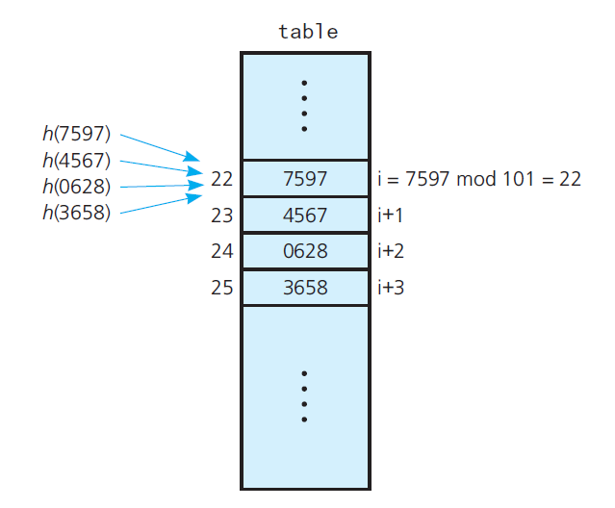
Linear Probing

Slide 21
Linear Probing
Linear Probing:
  Collision Scheme
hash(x) = x % size + n

Slide 22
Linear Probing
When you remove an entry we can’t just leave the space “open” because we could place an entry that doesn’t belong in the spot due to Linear Probing.
Why???

Slide 23
Linear Probing
Let’s say you wanted to two values – x and y (both of which had the same hash value.
  Using Linear Probing when we find that the first spot is taken we move to the next open spot to insert y.
Now let’s say that we remove the first entry, x, and mark that bucket as open. When we attempt to search for y we will compute the hash and look in the bucket previously occupied by x but we won’t find y.
  This is a problem!

Slide 24
Linear Probing
Solution:
  Occupied
  Empty
  Removed
Removed:
  This status tells us to keep looking as when we originally inserted the value it had to use a different hash to find an open position.

Slide 25
Linear Probing
Occupied:
  This indexed position is currently held by an entry in the Hash Table.
Empty:
  This indexed position has never been used by an entry.
Removed:
  This indexed position previously held an entry (Occupied) but is now available.

Slide 26
Linear Probing
Question:
  If we insert a bunch of entries and then delete them does that render the table useless as all of the positions would essentially be marked as REMOVED?
Answer:
  No, because we can still insert something into either an Empty or Removed bucket since that will ensure that any search will still force the proper probing to be completed.

Slide 27
Linear Probing
Linear Probing Problems:
  The entries tend to cluster together.
Primary Clustering
  Clusters tend to get closer and closer together and ultimately end up in larger clusters.
    Population control
  Long Probe Searches!
    Decrease overall efficiency of hashing.

Slide 28
;

