Slide 1

Lecture – 12/1/2025
CS 341 – Advanced Data Structures

Slide 2
Assignment #6
Canvas

Slide 3

Assignment #6
The Last Can Of Who-Hash
  Hash Tables
    Linear Probing
    Quadratic Probing
    Separate Chaining
    Cuckoo Hashing
Due:
  12/12/2025 11:59:59 PM

Slide 4
Hash Tables
Chapter 18

Slide 5
Hashing
Many different ways we can map a key to a specific “bucket.”
One of the most common and the simplest is to use modulus.
Our hashing function will be calculated as follows:
key % size_of_hash_table

Slide 6
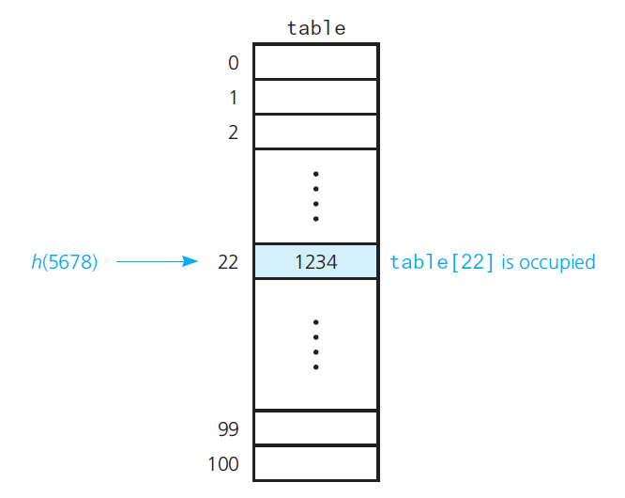
Hashing

Slide 7
Hashing
Let’s take a look at an example…
What is the simplest Hash Table?
  An Array of records.
We have a key and we can get the value – in theory the index of the element is the key.
  Integers make great keys – but anything can be a key.

Slide 8
Hashing
When we want to insert a new element into a Hash Table we need to convert our key into the index of the Array.
This conversion process is known as hashing and the index of the Array is known as the hash value of the key.

Slide 9
Hashing
Now the key is how do we select a hash function that will allow us to place our element into our “hash table?”
We could use the modulus of the key to find the appropriate “bucket” or Array indices.
  This is a good approach in the given approach as it will allow us to manage our Array.

Slide 10
Hashing
The Hash Function in the ideal situation is called a perfect hash function.
  This function maps each search key into a unique location of the hash table.
A perfect hash function is only possible if you know all of the search keys.
  What is the likelihood of this occurring?

Slide 11
Hashing
Ok…let’s assume we are using our Array as a Hash Table and we have the following two key entries we need to insert 102 and 152.
Now, let’s assume that our hashing function is the KEY % 50.
  Both entries yield a result of 2.
    So, after we insert the key 102 into the 2nd indexed position in the Array we have no space for the key 152….

Slide 12
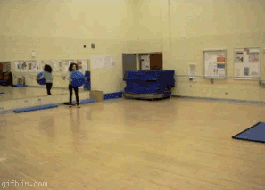
Hashing

Slide 13
Collisions
How do we resolve a collision when one happens?
The easiest solution would to just move forward until we find an open position within our Array.
  Now what do we do in the above scenario where our key of 152 is not located in Bucket #2?

Slide 14
Collisions
Selecting Digits:
  You select specific digits in your search key to pick the index that the item should be inserted into.
Problem:
  Does not distribute the entries evenly in the Hash Table.

Slide 15
Collisions
Folding:
  Here we could add up all of the digits of our search key and then place the entry in the summation index.
Problem:
  We still have the potential for future collisions and you may have to “fold” a number of times before resolving the collision.

Slide 16
Collisions
Modulo
  Computing the modulus of the table size and placing the entry into that position.
    This eliminates one of the problems with respect to folding.
Problem:
  See the same explanation that we saw with folding in terms of multiple collisions – this approach tends to be a popular solution.

Slide 17
Collisions
Approach 1: Open Addressing
  Linear Probing
  Quadratic Probing
  Double Hashing
  Increase size of Hash Table

Slide 18
Linear Probing
You search the Hash Table sequentially, starting from the original hash location until we find an open, unoccupied, spot/bucket to place the entry into.
  If necessary you can “wrap around” to find an open spot.
Removals present a challenge however…

Slide 19
Linear Probing
Insert(x)
  Keep probing until an empty slot is found. Once an empty slot is found, insert key.
Search(x)
  Keep probing until slot’s key doesn’t become equal to x or an empty slot is reached.
Delete(k)
  Keep probing until the keys slot is found and remove the key.
    More on this later, as it is quite complex…

Slide 20
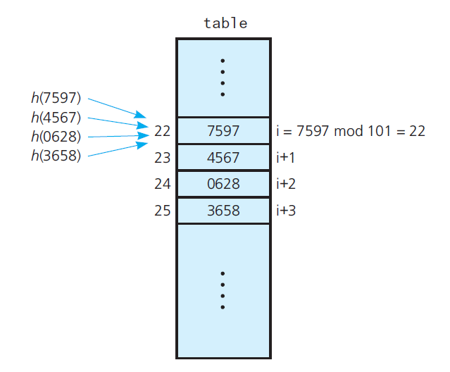
Linear Probing

Slide 21
Linear Probing
Linear Probing:
  Collision Scheme
hash(x) = hash(x) % size + n

Slide 22
Linear Probing
When you remove an entry we can’t just leave the space “open” because we could place an entry that doesn’t belong in the spot due to Linear Probing.
Why???

Slide 23
Linear Probing
Let’s say you wanted to two values – x and y (both of which had the same hash value.
  Using Linear Probing when we find that the first spot is taken we move to the next open spot to insert y.
Now let’s say that we remove the first entry, x, and mark that bucket as open. When we attempt to search for y we will compute the hash and look in the bucket previously occupied by x but we won’t find y.
  This is a problem!

Slide 24
Linear Probing
Solution:
  Occupied
  Empty
  Removed
Removed:
  This status tells us to keep looking as when we originally inserted the value it had to use a different hash to find an open position.

Slide 25
Linear Probing
Occupied:
  This indexed position is currently held by an entry in the Hash Table.
Empty:
  This indexed position has never been used by an entry.
Removed:
  This indexed position previously held an entry (Occupied) but is now available.

Slide 26
Linear Probing
Question:
  If we insert a bunch of entries and then delete them does that render the table useless as all of the positions would essentially be marked as REMOVED?
Answer:
  No, because we can still insert something into either an Empty or Removed bucket since that will ensure that any search will still force the proper probing to be completed.

Slide 27
Linear Probing
Linear Probing Problems:
  The entries tend to cluster together.
Primary Clustering
  Clusters tend to get closer and closer together and ultimately end up in larger clusters.
    Population control
  Long Probe Searches!
    Decrease overall efficiency of hashing.

Slide 28
Quadratic Probing
We can avoid the problems with clustering in Linear Probing by moving towards a quadratic approach.
The same approach that we saw in Linear Probing is found here, except we search quadratic for an open position.

Slide 29
Quadratic Probing
Let hash(x) be the slot index computed using the hash function – remember we are using key % size.
  If the bucket hash(x) is OCCUPIED, then we try (hash(x) + 1^2).
  If (hash(x) + 1^2) is also OCCUPIED, then we try (hash(x) + 2^2).
  If (hash(x) + 2^2) is also OCCUPIED, then we try (hash(x) + 3^2).
  This process is repeated for all the values of i until an empty slot is found.

Slide 30
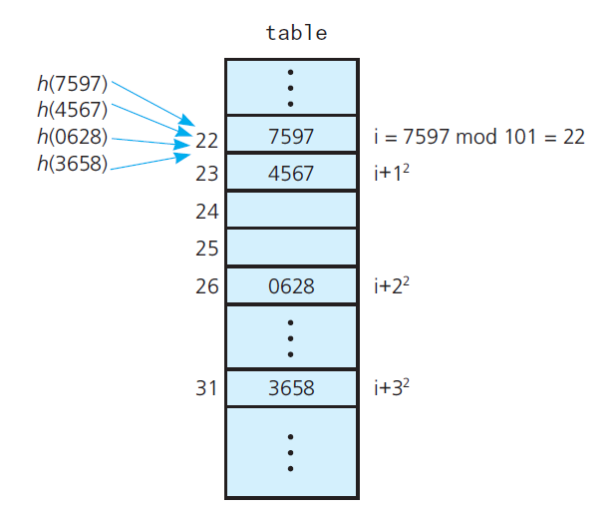
Quadratic Probing

Slide 31
Quadratic Probing
Quadratic Probing:
  Collision Scheme
hash(x) = x % size + n²
Where n starts at zero (0) and increases by one (1) for each collision.

Slide 32
Quadratic Probing
The same challenges when it comes to removal that we discussed with Linear Probing are found here.
We must mark any space that was previously occupied during deletion as REMOVED otherwise we will have a problem when attempting to search the Hash Table.

Slide 33
Quadratic Probing
Secondary Clustering:
  When two search keys hash into the same location.
  Quadratic probing uses the same probe sequence for each one.
We still run into the problems that Linear Probing posed but the clustering is less likely.

Slide 34
Double Hashing
A third approach is that of Double Hashing.
Double Hashing:
  Applies a second hash function to key when a collision occurs.
Double Hashing:
hash2(x) = (size/2) – (x % (size/2))

Slide 35
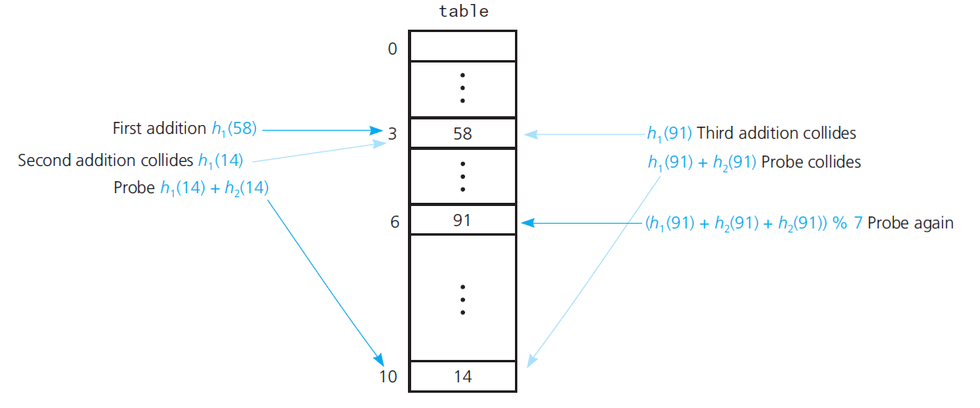
Double Hashing

Slide 36
Collisions
Approach 2: Closed Addressing
  Resolving collisions by restructuring the Hash Table.
Methods:
  Buckets
  Separate Chaining
    Singularly Linked List
    Doubly Linked List

Slide 37
Separate Chaining
Separate Chaining avoids collisions all together by chaining entries together within a given “bucket.”
We apply our hash function and locate the bucket.
  Even if the bucket is OCCUPIED we simply “append” the new entry onto any existing entries in the list.

Slide 38
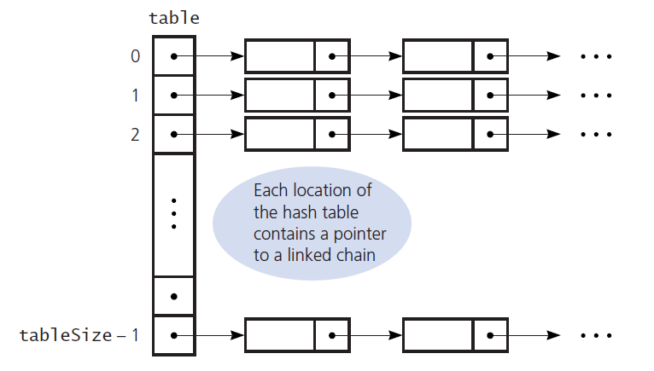
Separate Chaining

Slide 39
Separate Chaining
HEY!
  That looks oddly familiar…
SINGULARLY LINKED LIST!

Slide 40
Separate Chaining
We can do even better than Singularly Linked Lists however…we saw that Doubly Linked List were an improvement because we could move forwards as well as backwards in the List.
How would this benefit us here when it comes to Hash Tables and Collision handling?

Slide 41
Separate Chaining
With Doubly Linked Lists once we find an entry we don’t need to iterate back through the List to find either where it should be inserted/removed and the impacted Nodes.
We have that information already so this saves us time when it comes to both insertions and deletions from the Hash Table.

Slide 42
Separate Chaining
If we have a Singularly Linked List that is as follows:
1->2->3
If we attempted to remove the ‘2’ from the List we would have to link the ‘1’ to the ‘3’ but we have no connection with the ‘1’ so we would have to iterate back through the list to “get” it.
  This creates a time complexity of O(n)

Slide 43
Separate Chaining
If we instead use a Doubly Linked List, say in the form of:
1<->2<->3
We already have the link back to the ‘1’ so we can simply reassign the pointers to the two Linked Nodes and all is good!
  Here we have a time complexity of O(1)

Slide 44
Cuckoo Hashing
Cuckoo Cuckoo

Slide 45
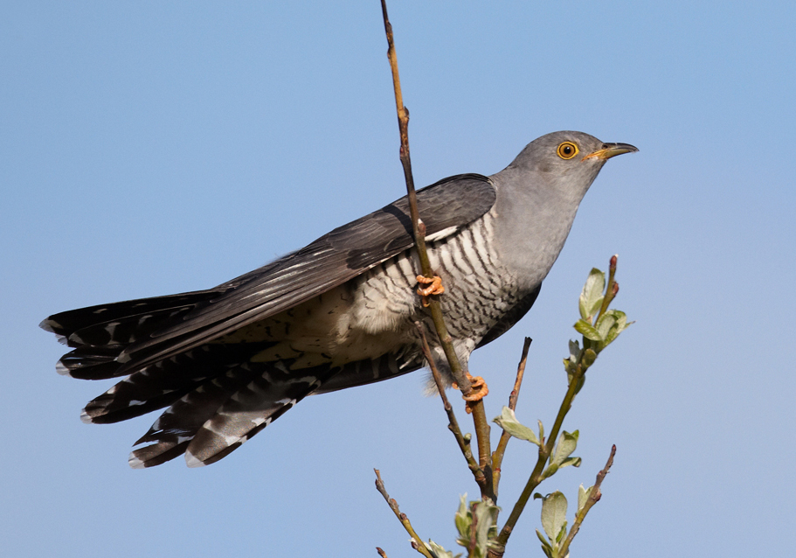
Cuckoo Hashing
Collision Handling Technique
  Named after the Cuckoo bird.
Why?
  The Cuckoo bird will “take over” other birds nests’ and remove any eggs/babies to make room for their own.
    That is not very nice!

Slide 46
Cuckoo Hashing
Cuckoo hashing applies the idea of multiple choice and relocation together.
  Guarantees O(1) worst case lookup time!
Multiple Choice:
  We provide two different hashing functions and let “it” choose.
Relocation:
  If the “bucket” is occupied – we simply “push” the existing value out and insert our value.
    We don’t lose the value though…

Slide 47
Cuckoo Hashing
If the alternate position (Hash Function #2) of former key is vacant – simply insert.
Otherwise, the former key displaces the key.
  This process will continue until the procedure finds a vacant position, or enters a cycle.
    What is a cycle???

Slide 48
Cuckoo Hashing
What is a cycle?
  This term can hold multiple definitions within the realm of hashing – the easiest to understand is the occurrence that no open “buckets” exist for all of the hashing functions.
What should we do?
  We need to rehash the entire data structure.
    UGH!

Slide 49
Cuckoo Hashing
Insertion:
  O(1)
    As long as the number of keys is kept below half of the capacity of the hash table (e.g., no chance of cycles)
Deletion:
  O(1)
    Just requires inspection of just two locations in the hash table.

Slide 50
Cuckoo Hashing
How do we determine the Hash Functions:
  h1(key) = key % SIZE_OF_HASH_TABLE
  h2(key) = (key / SIZE_OF_HASH_TABLE) % SIZE_OF_HASH_TABLE

Slide 51
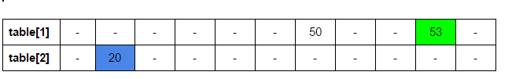
Cuckoo Hashing
Hash Table Size
  11 (x2)
Hash Function:
  h1(key) = key%11 h2(key) = (key/11)%11
Inserts:
  20, 50, 53

Slide 52
Hashing Efficiency

Slide 53

Hashing Efficiency
Load Factor measures how full a Hash Table is:
Unsuccessful searches often require much time than successful searches.
  WHY?

Slide 54
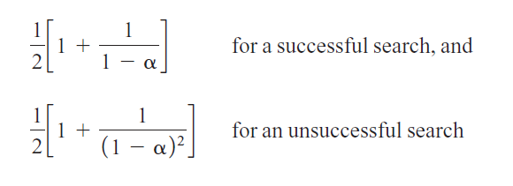
Linear Probing: Efficiency
*Avg. # of Comparisons

Slide 55
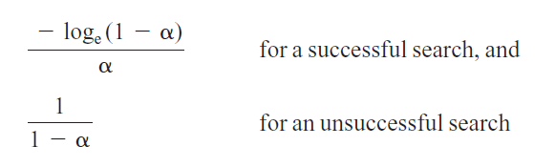
Quadratic Probing: Efficiency
*Avg. # of Comparisons

Slide 56
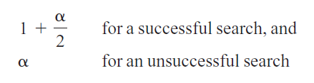
Separate Chaining: Efficiency
*Avg. # of Comparisons

Slide 57
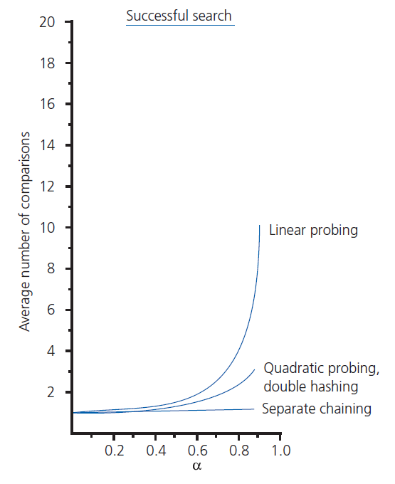
Hash Table: Efficiency

Slide 58
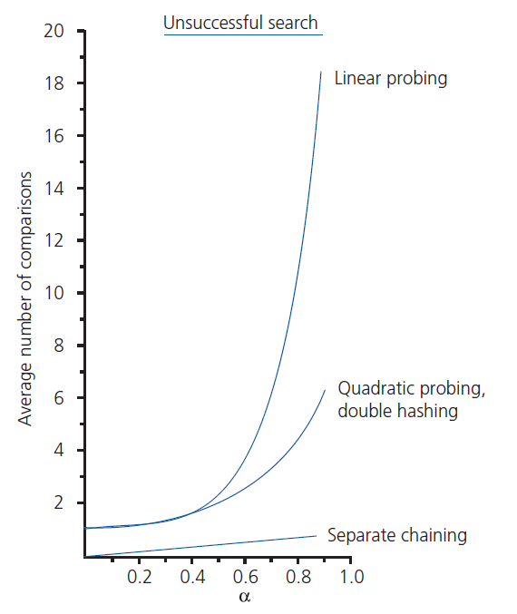
Hash Table: Efficiency

Slide 59
;

