Slide 1

Lecture – 12/3/2025
CS 341 – Advanced Data Structures

Slide 2
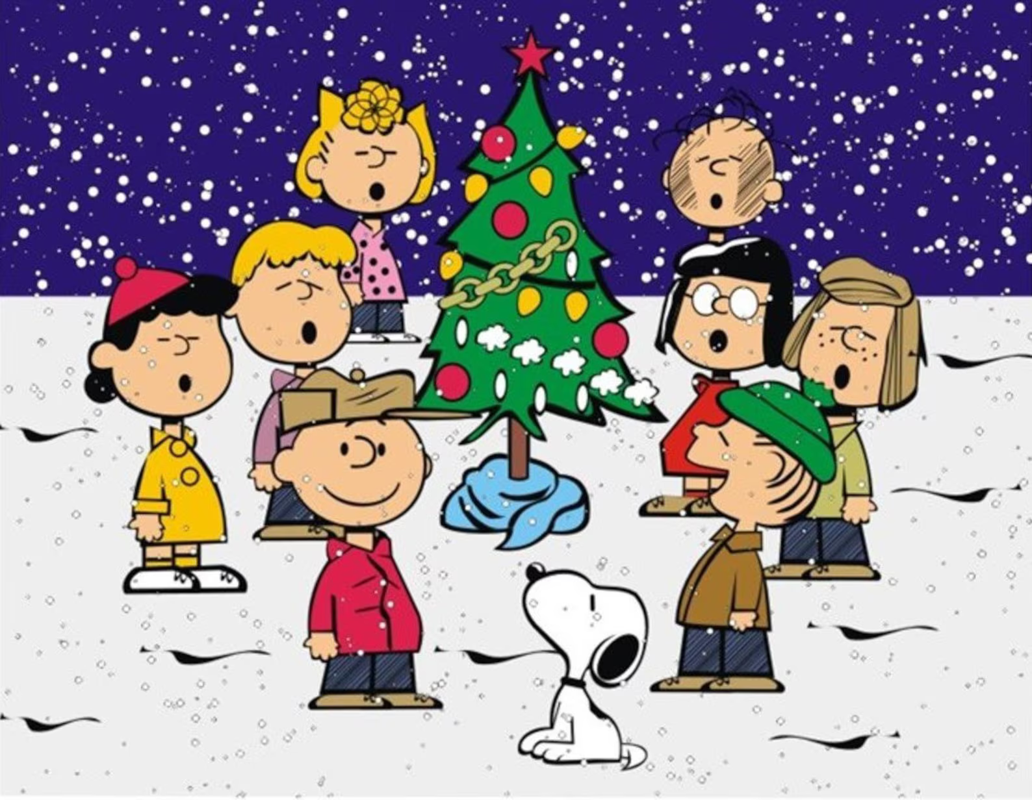

Slide 3

CSSE Code Jam
Please join us Friday December 12th from 7:00 PM - ???? in JH 174 as we celebrate the end of the Fall semester with a Code Jam. Now you may be asking yourself what is a Code Jam? The simple answer is AWESOME fun…the longer answer is an evening spent with peers/friends writing code, getting help on end of semester assignments and projects, and socializing. Dr. R. along with other faculty/staff will be present during the fun evening. Now the good stuff - I will be providing free pizza (I only buy the good stuff, Bazbeauxs) at the event -- (shameless plug that the ACM Student chapter is selling pop in the fridge)…AND will be offering free helpful assistance on any and all work (although pizza sounds better) for the duration of the event. Come stay for a little or the whole evening – all our welcome!
**using namespace std; was NOT used in the making of this flier**

Slide 4
Course Evaluations
Class Climate

Slide 5
Assignment #6
Questions?

Slide 6
Hashing
In-Class Examples

