Slide 1

VITeats
Software Engineering
Project Review 2
Hrishikesh D. Nayak 24BDS1007
Hardik Lalla 24BDS1010
8 October 2026
github.com/Caust2c/VITeats
01
Notes:
Source: C:/Users/hardi/Downloads/Project-Review1-1.pdf. Review 1 is the historical project baseline. Its proposed features are not evidence of completed implementation. Team names and IDs from page 1. Review 2 builds on the Review 1 project rather than claiming a new project.

Slide 2
Problem statement
Review 1 identified four student needs
Meal-time clarity
Make the current meal and available menu easier to identify.
Reliable collection
Keep order QR information accessible when campus Wi-Fi is weak.
Frequent ordering
Reduce repeated browsing with search, favourites and quick orders.
Spending control
Help students track expenditure against a personal monthly budget.
02
Notes:
Source: C:/Users/hardi/Downloads/Project-Review1-1.pdf. Review 1 is the historical project baseline. Its proposed features are not evidence of completed implementation. Pages 1-3 describe the team’s observations of Foodpark usability, meal labelling, connectivity and lack of budget/quick-order tools. These observations are project motivation, not a measured campus-wide survey or verified current competitor capability assessment.

Slide 3
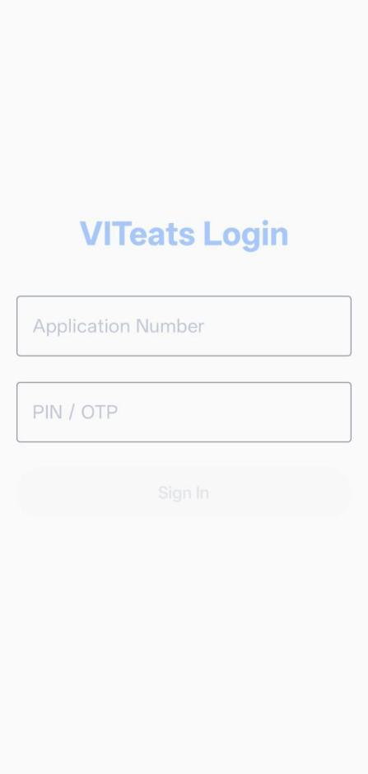
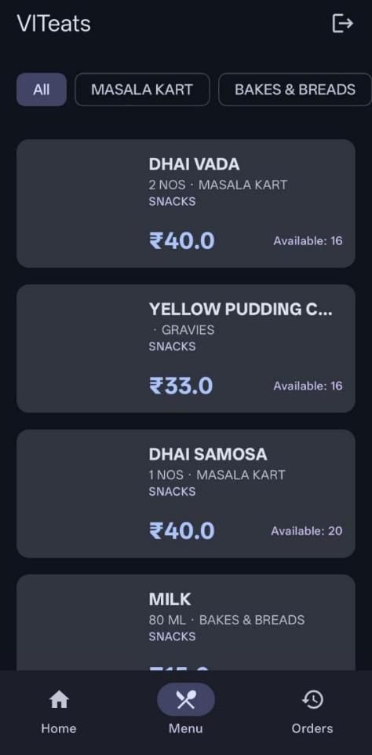
Review 1 baseline
Foundation already established
Login and session handling
Home and student information
Live menu and order-data integration
Compose UI and repository structure
Original screenshots from Review 1
Login
Menu
03
Notes:
Source: C:/Users/hardi/Downloads/Project-Review1-1.pdf. Review 1 is the historical project baseline. Its proposed features are not evidence of completed implementation. Pages 5-6 document authentication, home/student information, menus, order data and networking. The two images are original Review 1 screenshots from page 6 and do not represent the current Review 2 UI.

Slide 4
Literature survey: Review 1 solutions
Solution reviewed | Review 1 context | Design lesson for VITeats
Proodle / Foodpark | Existing institutional backend | Reuse account, menu and order services
Rassence | Outlet-specific campus application | Explore a common campus interface
Swiggy | General food-ordering marketplace | Borrow familiar search and order-history patterns
Zomato | General food-discovery marketplace | Focus the workflow on campus collection
Review 2 retains the Proodle backend and focuses on the student Android client.
04
Notes:
Source: C:/Users/hardi/Downloads/Project-Review1-1.pdf. Review 1 is the historical project baseline. Its proposed features are not evidence of completed implementation. Pages 2-3 compare Proodle, Rassence, Swiggy and Zomato. This slide preserves that historical comparison at a general level. It does not assert current pricing, service availability or measured shortcomings. Integration across all VIT outlets remains an aspiration rather than a completed capability.

Slide 5
Literature survey: research extension
Study | Method / focus | Application to Review 2
Noordin and Mohd Zain 2023 [1] | Campus ordering app 36 usability responses | Test student tasks and ease of use
Kambli et al. 2020 [2] | Dining capacity and queue simulation | Measure counter waiting as well as ordering
Yu et al., FoodWise 2023 [3] | Campus feedback and behaviour engagement | Evaluate whether spending feedback helps users
The survey supports a local evaluation plan rather than assumed efficiency gains.
05
Notes:
[1] N. Noordin and N. Mohd Zain (2023). Mobile application for ordering food from UiTM Arau Campus cafeteria. REMACS 5.0, pp. 225-226. https://ir.uitm.edu.my/id/eprint/100569/
[2] A. Kambli, A. A. Sinha and S. Srinivas (2020). Improving campus dining operations using capacity and queue management: A simulation-based case study. Journal of Hospitality and Tourism Management, 43, 62-70. https://doi.org/10.1016/j.jhtm.2020.02.008
[3] Y. Yu et al. (2023). FoodWise: Food Waste Reduction and Behavior Change on Campus with Data Visualization and Gamification. COMPASS 2023. https://arxiv.org/abs/2307.12882; https://doi.org/10.1145/3588001.3609364
Review 2 extends the Review 1 product comparison with academic work. Noordin/Mohd Zain use functional testing and 36 usability responses. Kambli et al. study capacity and queue management using simulation. FoodWise combines campus feedback and engagement with a dashboard and mobile app. These outcomes do not establish VITeats performance.

Slide 6
Research gap
Campus fit
A student workflow must reflect VIT meal sessions and collection rules.
Combined experience
Ordering, favourites and budget feedback need a coherent interface.
Connectivity
Review 1’s offline QR objective still needs persistent local storage.
Local evidence
Usability and payment/collection reliability need testing with Foodpark users.
06
Notes:
Source: C:/Users/hardi/Downloads/Project-Review1-1.pdf. Review 1 is the historical project baseline. Its proposed features are not evidence of completed implementation. Pages 2-3 establish a campus-specific usability gap. The three studies provide examples rather than exhaustive coverage. Current source code confirms Proodle-only integration, online QR retrieval and advisory budget calculations. The research gap is scoped to this project and local evaluation.

Slide 7
Objectives
Improve daily use
Offer meal-time information, menu search and favourite dishes.
Complete ordering
Provide cart review, PIN authorization, history and order QR display.
Support spending plans
Show monthly spending, remaining budget and daily allowance guidance.
Improve resilience
Complete offline QR access and validate the app with campus users.
07
Notes:
Source: C:/Users/hardi/Downloads/Project-Review1-1.pdf. Review 1 is the historical project baseline. Its proposed features are not evidence of completed implementation. Objectives preserve the original direction, while status is shown later. Offline QR caching, safe current-menu reordering and wider institutional adoption are targets rather than completed outcomes.

Slide 8
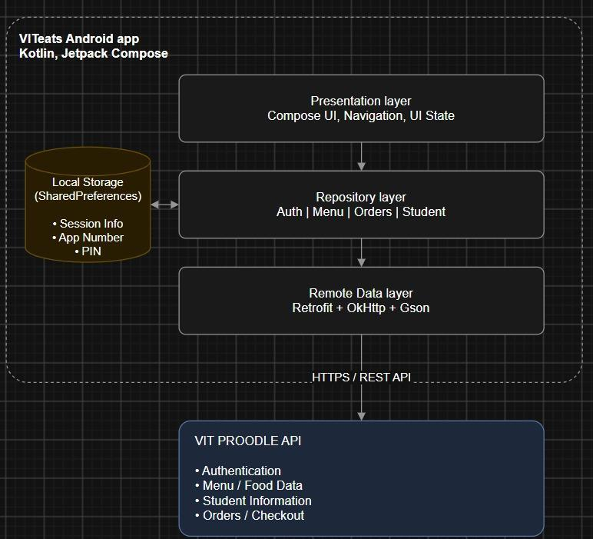
Methodology: architecture
Review 1 architecture retained
Compose screens and ViewModels
Repositories separate UI and data
Retrofit, OkHttp and Gson connect
to the existing Proodle API
Review 2 adds encrypted session values
and local budget / favourite preferences.
08
Notes:
Source: C:/Users/hardi/Downloads/Project-Review1-1.pdf. Review 1 is the historical project baseline. Its proposed features are not evidence of completed implementation. Page 4 supplies the original architecture image, reproduced without changes. Current implementation extends local preferences to budget/favourites and uses Android Keystore for encrypted session values. No dedicated local database or durable offline QR cache is present. Sources: SessionManager.kt, security/CryptoManager.kt, BudgetManager.kt and FavouritesManager.kt.

Slide 9
Methodology: order workflow
01
02
03
04
Select
Review
Submit
Collect
Search the menu
and choose quantities
Check the total
and confirm the PIN
Create the order
and request payment
Retrieve the order QR
for counter verification
After an uncertain payment, check order history and wallet before retrying.
09
Notes:
Source: C:/Users/hardi/Downloads/Project-Review1-1.pdf. Review 1 is the historical project baseline. Its proposed features are not evidence of completed implementation. The Review 1 cart/checkout plan on pages 7-8 now maps to CartRepository, CartViewModel, CartScreen and OrderRepository. Source checkout obtains an order number, inserts items and processes wallet payment. It expects a 1|reference response. Backend payment and QR semantics require live acceptance testing.

Slide 10
Results: progress since Review 1
Review 1 deliverable | Review 2 implementation
Secure PIN storage | Android Keystore encryption for saved session values
Menu search and favourites | Dish/outlet search and locally saved favourite IDs
Cart and checkout | Quantity controls, total review and PIN payment flow
Budget management | Monthly allocation, spending summary and daily allowance
Settings and personalization | Settings screen with persistent dark-mode preference
Implementation evidence now extends beyond the Review 1 foundation.
10
Notes:
Source: C:/Users/hardi/Downloads/Project-Review1-1.pdf. Review 1 is the historical project baseline. Its proposed features are not evidence of completed implementation. Pages 7-8 listed these items as pending deliverables. Current code contains the listed capabilities. Implemented means present in the repository, not production accepted. Sources: CryptoManager.kt, AuthScreen.kt, MenuScreen.kt, FavouritesManager.kt, CartRepository.kt, CartScreen.kt, OrderRepository.kt, BudgetManager.kt, StudentViewModel.kt, SettingsScreen.kt and ThemeManager.kt.

Slide 11
Results: partially completed objectives
Order QR
Retrieval and rendering exist. Persistent offline caching remains pending.
Quick reorder
Shortcut exists. Current-menu matching needs correction and validation.
Budget limits
Spending feedback exists. Checkout does not enforce a spending limit.
Campus coverage
The client integrates Proodle. Support for other systems remains future scope.
11
Notes:
Source: C:/Users/hardi/Downloads/Project-Review1-1.pdf. Review 1 is the historical project baseline. Its proposed features are not evidence of completed implementation. Pages 1-2 promise offline QR caching and budget enforcement. Current OrdersViewModel fetches QR from the API and stores temporary state only. OrderDetailsScreen renders it. Reorder code can create a fallback product when matching fails. BudgetSummary calculates guidance but checkout has no budget gate. Wider integration beyond Proodle is not implemented.

Slide 12
Results: recorded unit tests
23 / 23
Test suite | Passed
Student ViewModel | 10
Budget summary | 4
Cart and meal helpers | 4
Theme preferences | 3
Menu item model | 1
Template arithmetic | 1
tests passed in the
recorded run
0 failures or errors
8 October 2026
Local logic has test evidence. System testing and UAT remain the next milestones.
12
Notes:
Sources: app/build/test-results/testDebugUnitTest/TEST-*.xml, recorded 8 October 2026 at 14:58:33Z. 23 tests passed, including 22 application-focused tests and 1 template arithmetic test, with zero failures/errors/skips. These reports are existing evidence and were not freshly rerun for this presentation. They do not verify live backend integration, offline QR, capacity or UAT.

Slide 13
Results: remaining work and hostel rollout
Complete commitments
Add offline QR caching, safe reordering and remaining history/receipt tools.
Validate transactions
Test session recovery, meal/outlet mapping and payment/collection exceptions.
Evaluate with users
Run Foodpark UAT and a supervised hostel pilot with agreed metrics.
Prepare wider adoption
Approve a signed release, support ownership and vendor capacity before expansion.
13
Notes:
Source: C:/Users/hardi/Downloads/Project-Review1-1.pdf. Review 1 is the historical project baseline. Its proposed features are not evidence of completed implementation. Pages 7-8 identify integration testing, UAT, documentation and release APK as remaining milestones. Source review also shows missing persistent QR caching, reorder fallback issues, fixed meal-session/outlet mappings and no date/meal filtering or dedicated receipt workflow. Existing usage DOCX and presentations are support documentation, not a final approved academic report or release sign-off.

Slide 14
References
Project baseline
VITeats Software Engineering Project: Review-1 Report
Hrishikesh D. Nayak and Hardik Lalla. Project-Review1-1.pdf
Academic extension
[1] Noordin and Mohd Zain (2023). Campus cafeteria ordering app
REMACS 5.0, pp. 225-226. ir.uitm.edu.my/id/eprint/100569/
[2] Kambli, Sinha and Srinivas (2020). Campus dining capacity and queues
Journal of Hospitality and Tourism Management. DOI: 10.1016/j.jhtm.2020.02.008
[3] Yu et al. (2023). FoodWise. COMPASS 2023
DOI: 10.1145/3588001.3609364. arxiv.org/abs/2307.12882
14
Notes:
Source: C:/Users/hardi/Downloads/Project-Review1-1.pdf. Review 1 is the historical project baseline. Its proposed features are not evidence of completed implementation.
[1] N. Noordin and N. Mohd Zain (2023). Mobile application for ordering food from UiTM Arau Campus cafeteria. REMACS 5.0, pp. 225-226. https://ir.uitm.edu.my/id/eprint/100569/
[2] A. Kambli, A. A. Sinha and S. Srinivas (2020). Improving campus dining operations using capacity and queue management: A simulation-based case study. Journal of Hospitality and Tourism Management, 43, 62-70. https://doi.org/10.1016/j.jhtm.2020.02.008
[3] Y. Yu et al. (2023). FoodWise: Food Waste Reduction and Behavior Change on Campus with Data Visualization and Gamification. COMPASS 2023. https://arxiv.org/abs/2307.12882; https://doi.org/10.1145/3588001.3609364
Implementation evidence: current VITeats source and existing unit-test XML reports. Review 1 screenshots and architecture image are reproduced as historical baseline material.

