Slide 1

VITeats
Software Engineering
Project Review 2
Hrishikesh D. Nayak 24BDS1007
Hardik Lalla 24BDS1010
8 October 2026
github.com/Caust2c/VITeats
01
Notes:
Source: C:/Users/hardi/Downloads/Project-Review1-1.pdf. Review 1 is the historical project baseline. Its proposed features are not evidence of completed implementation. Team names and IDs from page 1. Review 2 builds on the Review 1 project rather than claiming a new project.

Slide 2
Problem statement
Review 1 identified four student needs
Meal-time clarity
Make the current meal and available menu easier to identify.
Reliable collection
Keep order QR information accessible when campus Wi-Fi is weak.
Frequent ordering
Reduce repeated browsing with search, favourites and quick orders.
Spending control
Help students track expenditure against a personal monthly budget.
02
Notes:
Source: C:/Users/hardi/Downloads/Project-Review1-1.pdf. Review 1 is the historical project baseline. Its proposed features are not evidence of completed implementation. Pages 1-3 describe the team’s observations of Foodpark usability, meal labelling, connectivity and lack of budget/quick-order tools. These observations are project motivation, not a measured campus-wide survey or verified current competitor capability assessment.

Slide 3
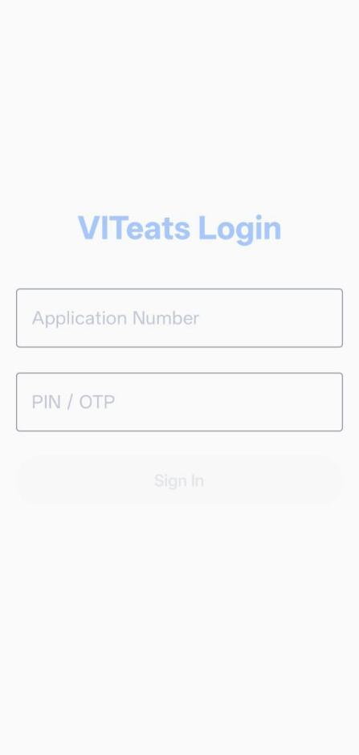
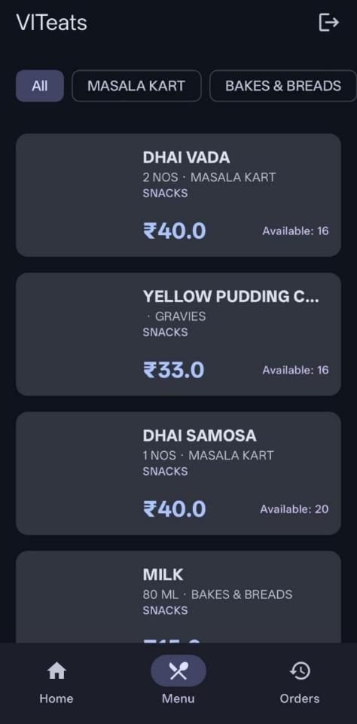
Review 1: Home and Menu
Login
Menu
03
Notes:
Source: user-supplied updated app screenshot, C:/Users/hardi/Downloads/3987a60c-aea3-4c0e-83ba-042d70baecac.jpg
Source: user-supplied updated app screenshot, C:/Users/hardi/Downloads/a64a1aa2-cb5a-4d05-81d3-a57194665703.jpg
Screenshots show the current interface. Sample account amounts are not campus-wide results.

Slide 4
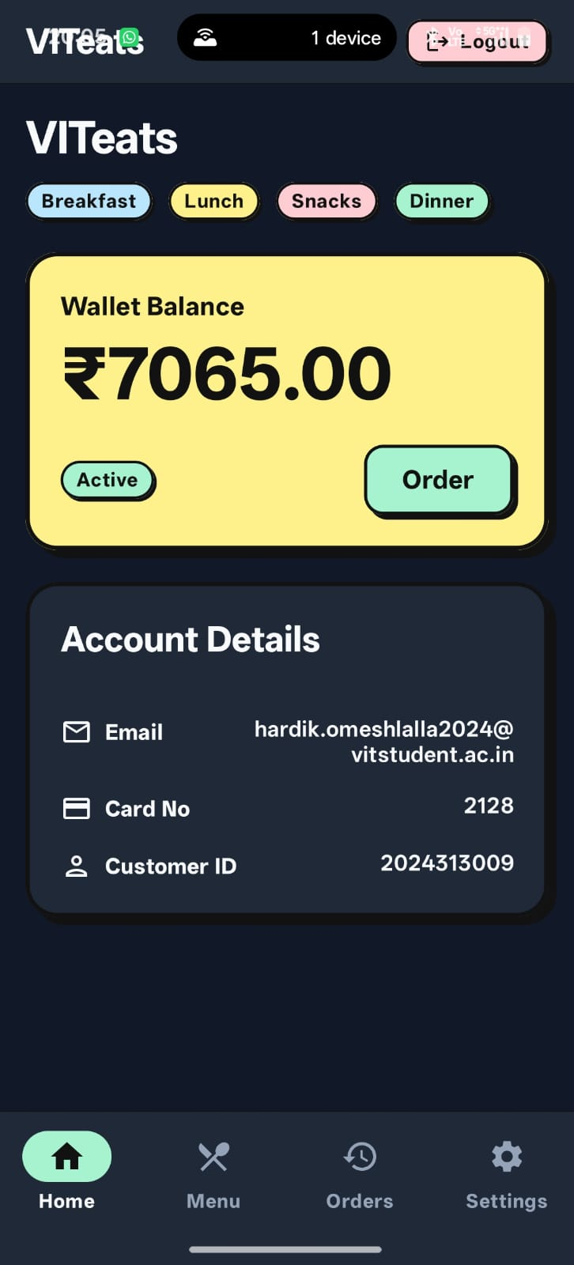
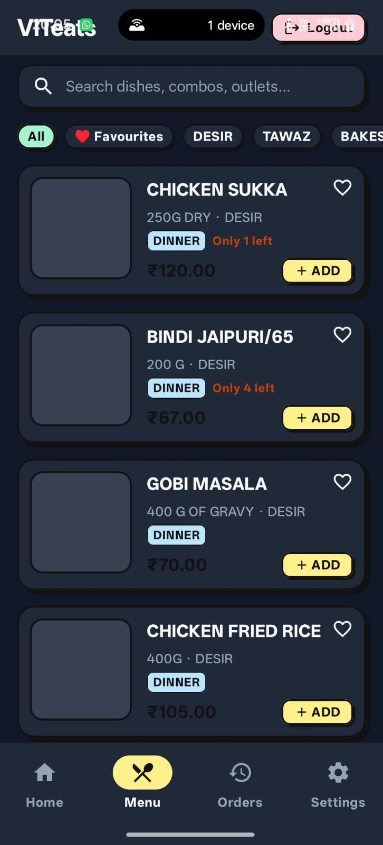
Review 2: Home and Menu
Home and wallet
Menu and favourites
Meal shortcuts and wallet balance
Search, outlet filters and stock labels
03
Notes:
Source: user-supplied updated app screenshot, C:/Users/hardi/Downloads/3987a60c-aea3-4c0e-83ba-042d70baecac.jpg
Source: user-supplied updated app screenshot, C:/Users/hardi/Downloads/a64a1aa2-cb5a-4d05-81d3-a57194665703.jpg
Screenshots show the current interface. Sample account amounts are not campus-wide results.

Slide 5
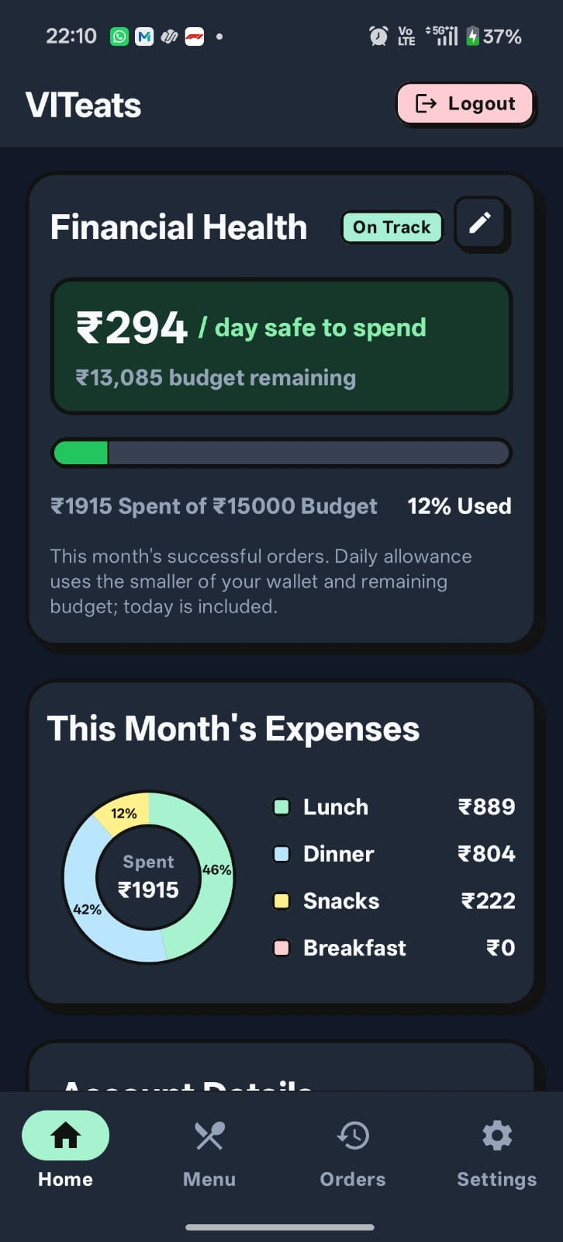
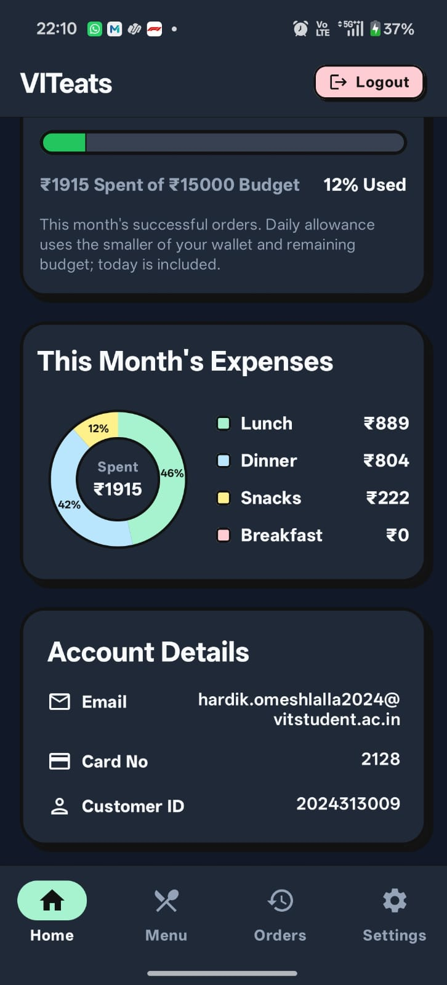
Review 2: Spending Dashboard
Financial health
Expenses and account
Budget remaining and daily allowance
Meal spending breakdown and account details
04
Notes:
Source: user-supplied updated app screenshot, C:/Users/hardi/Downloads/3f5af889-2fd2-411e-bb0a-6fa8d3bb741e.jpg
Source: user-supplied updated app screenshot, C:/Users/hardi/Downloads/d489ccb6-e1a0-4a5e-9fc0-35bc47af75b9.jpg
Screenshots show the current interface. Sample account amounts are not campus-wide results.

Slide 6
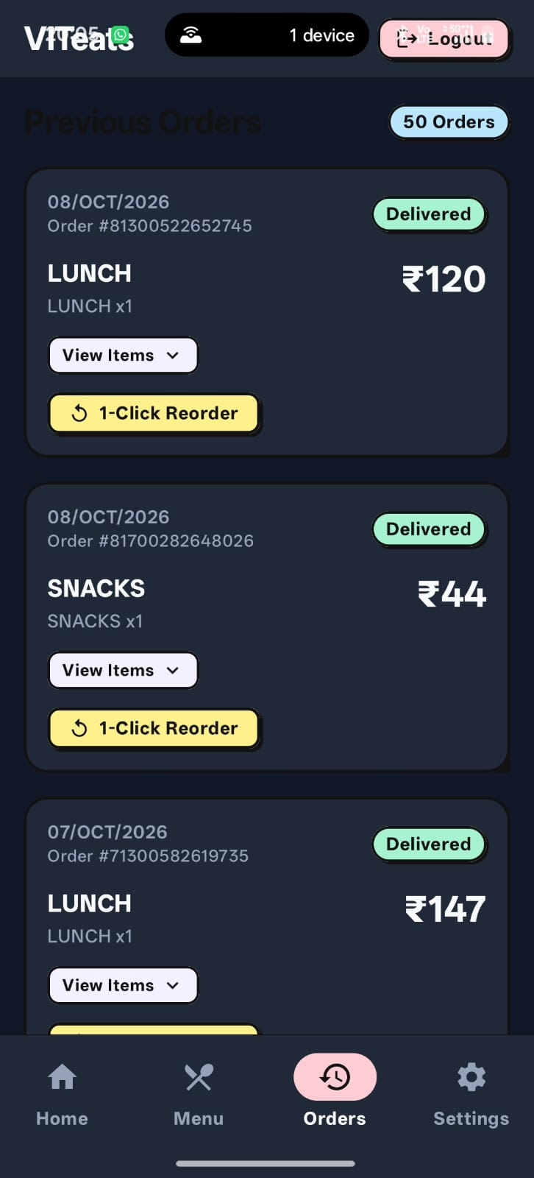
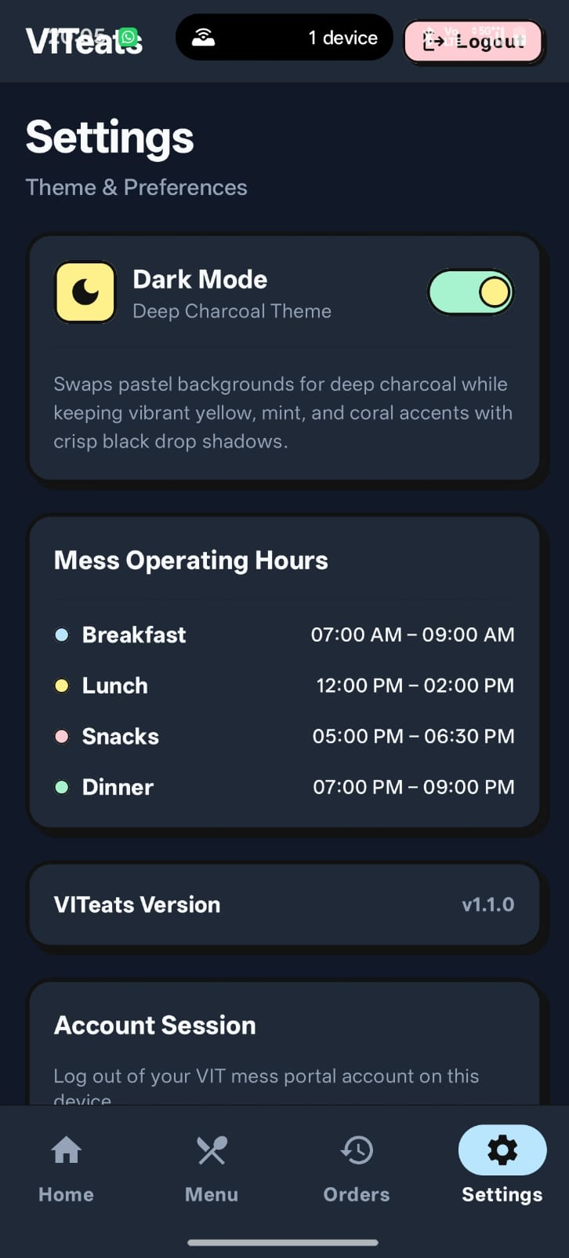
Review 2: Orders and Settings
Previous orders
Settings
Order status, item details and reorder shortcut
Dark mode, mess hours and app version
05
Notes:
Source: user-supplied updated app screenshot, C:/Users/hardi/Downloads/ec29cd24-d0a9-44dc-8246-74ef9ef77c44.jpg
Source: user-supplied updated app screenshot, C:/Users/hardi/Downloads/9c854df0-c068-4da7-a653-993a9dc6d109.jpg
Screenshots show the current interface. Sample account amounts are not campus-wide results.

Slide 7
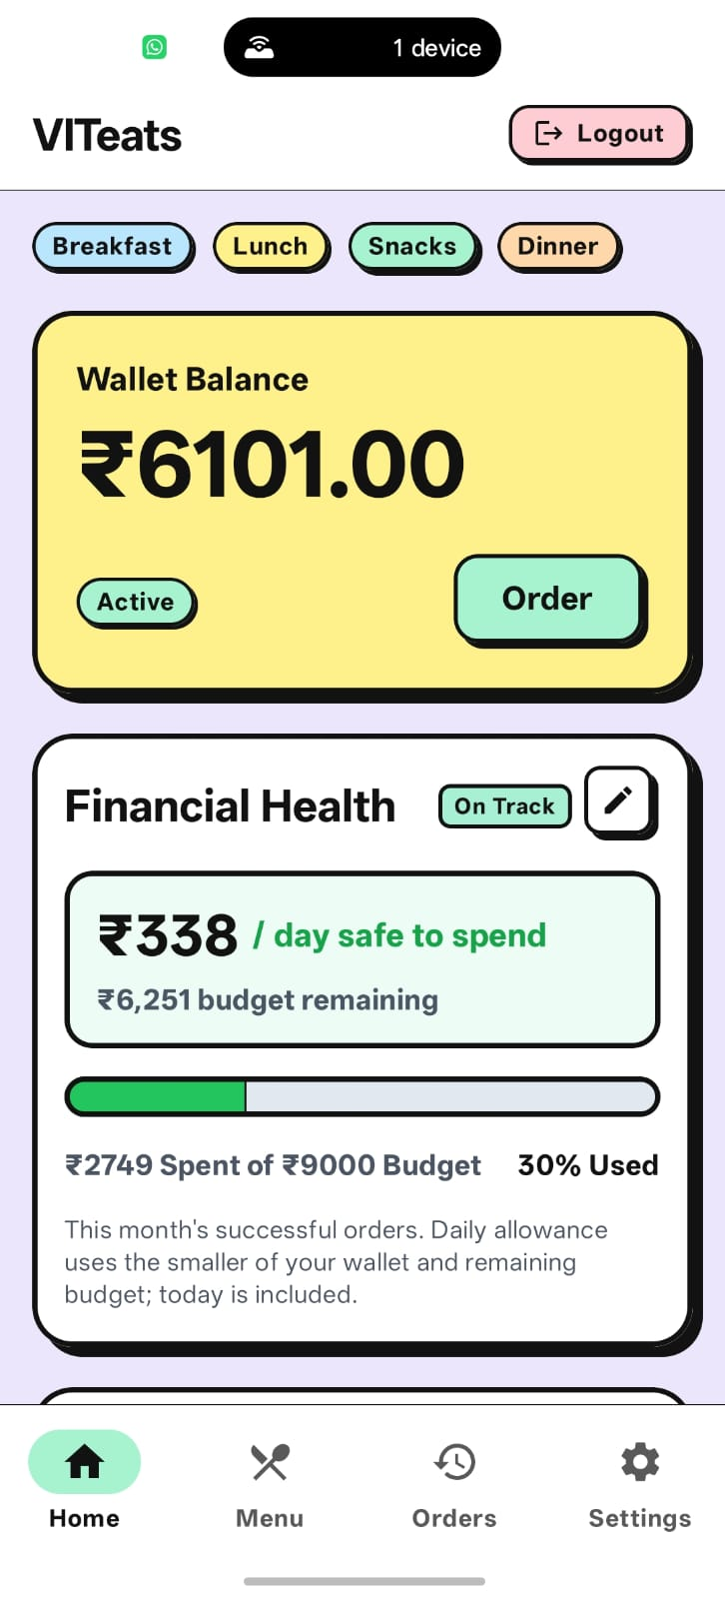
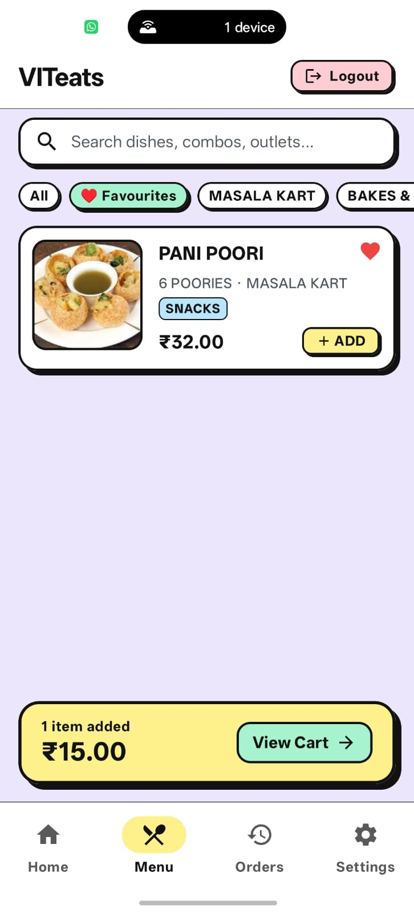
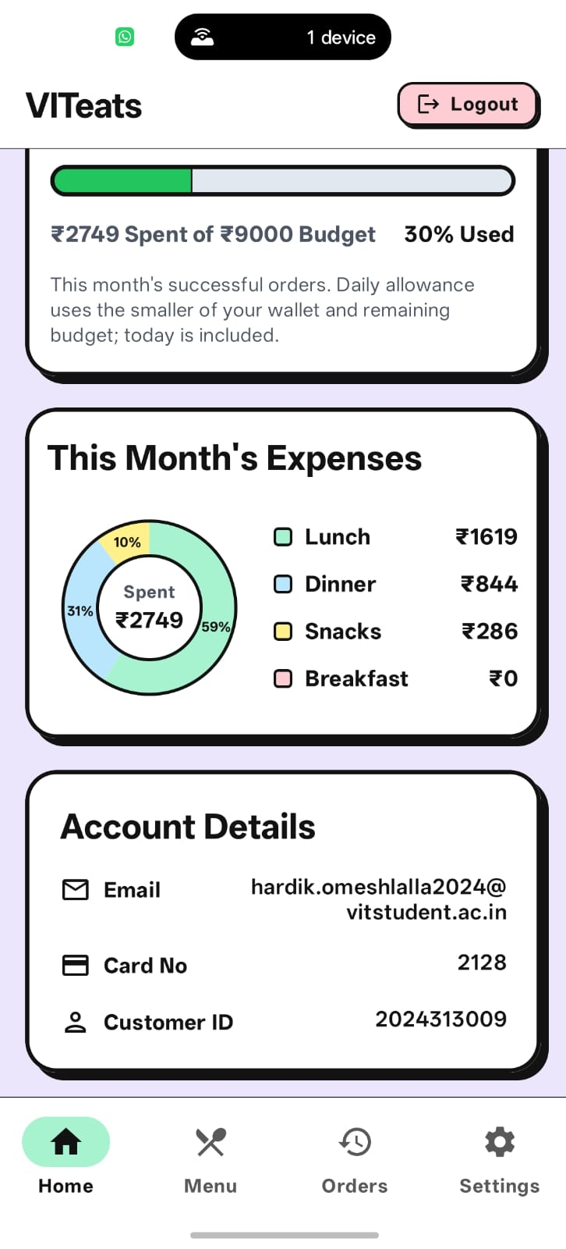
Latest App Display
05
Notes:
Source: user-supplied updated app screenshot, C:/Users/hardi/Downloads/ec29cd24-d0a9-44dc-8246-74ef9ef77c44.jpg
Source: user-supplied updated app screenshot, C:/Users/hardi/Downloads/9c854df0-c068-4da7-a653-993a9dc6d109.jpg
Screenshots show the current interface. Sample account amounts are not campus-wide results.

Slide 8
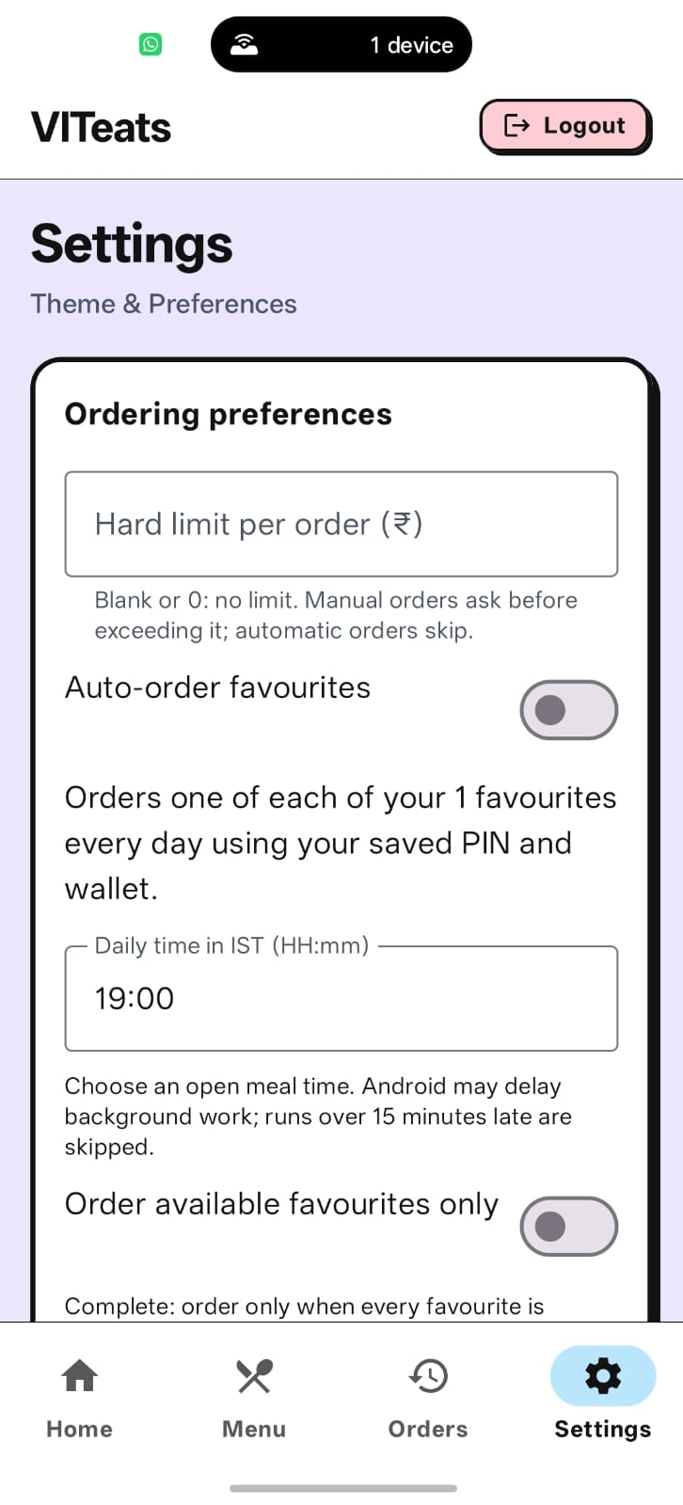
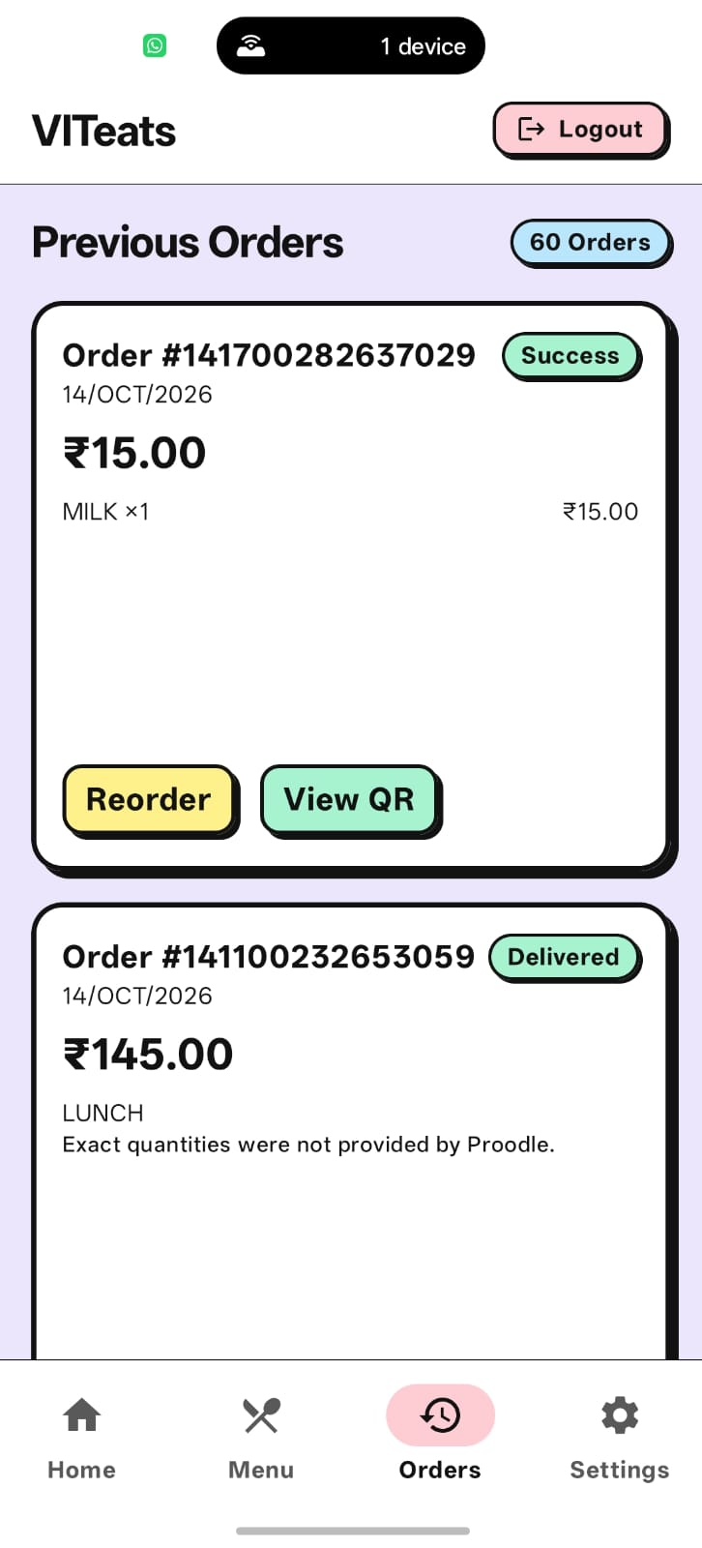
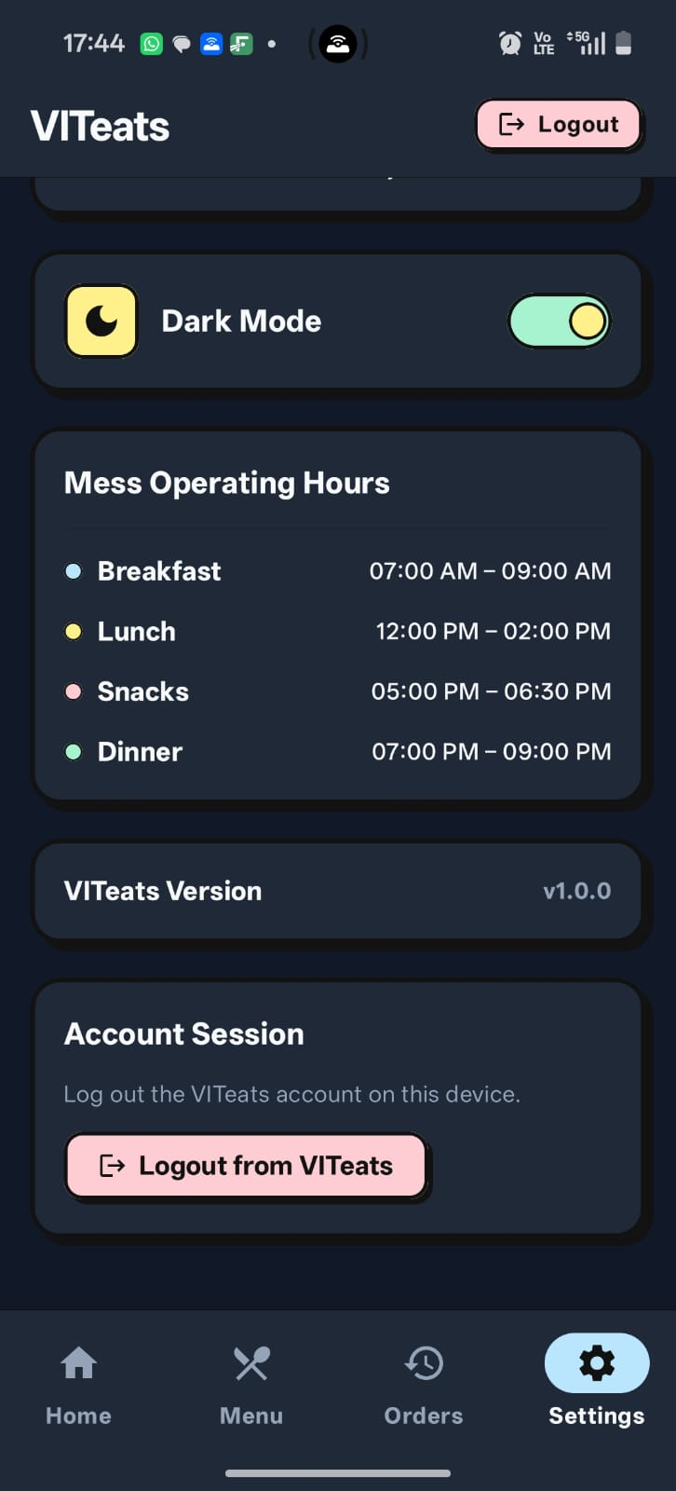
Latest App Display
05
Notes:
Source: user-supplied updated app screenshot, C:/Users/hardi/Downloads/ec29cd24-d0a9-44dc-8246-74ef9ef77c44.jpg
Source: user-supplied updated app screenshot, C:/Users/hardi/Downloads/9c854df0-c068-4da7-a653-993a9dc6d109.jpg
Screenshots show the current interface. Sample account amounts are not campus-wide results.

Slide 9
Literature Survey: Existing solutions
Solution | Features described in Review 1 | Project relevance
Proodle | Authentication, menu information and food ordering | Existing backend used by VITeats
Swiggy | Discovery, ordering, payments, tracking and order history | Commercial food delivery model
Zomato | Discovery, ordering, pickup, delivery and payments | General food marketplace
Source: Review 1, Section 3: Review of Related Works
06
Notes:
Source: C:/Users/hardi/Downloads/Project-Review1-1.pdf. Review 1 is the historical project baseline. Its proposed features are not evidence of completed implementation. Section 3, pages 2-3, is the sole source for this literature survey. These are the existing solutions reviewed in Review 1.

Slide 10
Literature Survey: Limitations
Solution | Gap identified in Review 1 | VITeats response proposed
Proodle | Basic functionality and limited user experience | Improve the student interface using the same API
Swiggy | Delivery logistics and variable charges | Focus on direct collection at the mess
Zomato | General marketplace complexity | Simplify frequent campus food ordering
Wider campus integration remains a project goal. Review 2 currently uses Proodle.
07
Notes:
Source: C:/Users/hardi/Downloads/Project-Review1-1.pdf. Review 1 is the historical project baseline. Its proposed features are not evidence of completed implementation. Section 3 Gap Analysis, pages 2-3. The limitations and proposed responses summarize the team’s Review 1 analysis. They are historical project observations, not new claims from outside studies.

Slide 11
Research Gap
Student experience
Improve the basic Foodpark interface with meal discovery and easier ordering.
Campus fragmentation
Different mess platforms motivate a common application for VIT students.
Campus workflow
Direct mess collection needs a simpler flow than commercial delivery.
Daily food management
Combine favourites, quick reordering, order history, QR access and budget tracking.
08
Notes:
Source: C:/Users/hardi/Downloads/Project-Review1-1.pdf. Review 1 is the historical project baseline. Its proposed features are not evidence of completed implementation. Section 3 Gap Analysis and Section 4 Novelty and Value Proposition, pages 2-3. The research gap carries forward the Review 1 rationale. Implementation status appears in Results.

Slide 12
Objectives
Improve daily use
Offer meal-time information, menu search and favourite dishes.
Complete ordering
Provide cart review, PIN authorization, history and order QR display.
Support spending plans
Show monthly spending, remaining budget and daily allowance guidance.
Improve resilience
Complete offline QR access and validate the app with campus users.
09
Notes:
Source: C:/Users/hardi/Downloads/Project-Review1-1.pdf. Review 1 is the historical project baseline. Its proposed features are not evidence of completed implementation. Objectives preserve the original direction, while status is shown later. Offline QR caching, safe current-menu reordering and wider institutional adoption are targets rather than completed outcomes.

Slide 13
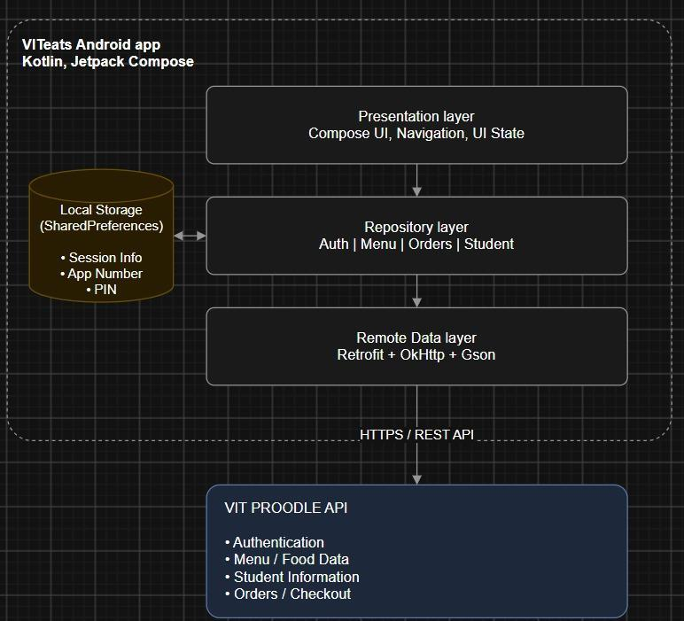
Methodology: Architecture
Review 1 architecture retained
Compose screens and ViewModels
Repositories separate UI and data
Retrofit, OkHttp and Gson connect
to the existing Proodle API
Review 2 adds encrypted session values
and local budget / favourite preferences.
10
Notes:
Source: C:/Users/hardi/Downloads/Project-Review1-1.pdf. Review 1 is the historical project baseline. Its proposed features are not evidence of completed implementation. Page 4 supplies the original architecture image, reproduced without changes. Current implementation extends local preferences to budget/favourites and uses Android Keystore for encrypted session values. No dedicated local database or durable offline QR cache is present. Sources: SessionManager.kt, security/CryptoManager.kt, BudgetManager.kt and FavouritesManager.kt.

Slide 14
Methodology: Order Workflow
01
02
03
04
Select
Review
Submit
Collect
Search the menu
and choose quantities
Check the total
and confirm the PIN
Create the order
and request payment
Retrieve the order QR
for counter verification
After an uncertain payment, check order history and wallet before retrying.
11
Notes:
Source: C:/Users/hardi/Downloads/Project-Review1-1.pdf. Review 1 is the historical project baseline. Its proposed features are not evidence of completed implementation. The Review 1 cart/checkout plan on pages 7-8 now maps to CartRepository, CartViewModel, CartScreen and OrderRepository. Source checkout obtains an order number, inserts items and processes wallet payment. It expects a 1|reference response. Backend payment and QR semantics require live acceptance testing.

Slide 15
Results: Progress since Review 1
Review 1 deliverable | Review 2 implementation
Secure PIN storage | Android Keystore encryption for saved session values
Menu search and favourites | Dish/outlet search and locally saved favourite IDs
Cart and checkout | Quantity controls, total review and PIN payment flow
Budget management | Monthly allocation, spending summary and daily allowance
Settings and personalization | Settings screen with persistent dark-mode preference
Implementation evidence now extends beyond the Review 1 foundation.
12
Notes:
Source: C:/Users/hardi/Downloads/Project-Review1-1.pdf. Review 1 is the historical project baseline. Its proposed features are not evidence of completed implementation. Pages 7-8 listed these items as pending deliverables. Current code contains the listed capabilities. Implemented means present in the repository, not production accepted. Sources: CryptoManager.kt, AuthScreen.kt, MenuScreen.kt, FavouritesManager.kt, CartRepository.kt, CartScreen.kt, OrderRepository.kt, BudgetManager.kt, StudentViewModel.kt, SettingsScreen.kt and ThemeManager.kt.

Slide 16
Results: Partially completed objectives
Order QR
Retrieval and rendering exist. Persistent offline caching remains pending.
Quick reorder
Shortcut exists. Current-menu matching needs correction and validation.
Budget limits
Spending feedback exists. Checkout does not enforce a spending limit.
Campus coverage
The client integrates Proodle. Support for other systems remains future scope.
13
Notes:
Source: C:/Users/hardi/Downloads/Project-Review1-1.pdf. Review 1 is the historical project baseline. Its proposed features are not evidence of completed implementation. Pages 1-2 promise offline QR caching and budget enforcement. Current OrdersViewModel fetches QR from the API and stores temporary state only. OrderDetailsScreen renders it. Reorder code can create a fallback product when matching fails. BudgetSummary calculates guidance but checkout has no budget gate. Wider integration beyond Proodle is not implemented.

Slide 17
Results: Remaining work and hostel rollout
Complete commitments
Add offline QR caching, safe reordering and remaining history/receipt tools.
Validate transactions
Test session recovery, meal/outlet mapping and payment/collection exceptions.
Evaluate with users
Run Foodpark UAT and a supervised hostel pilot with agreed metrics.
Prepare wider adoption
Approve a signed release, support ownership and vendor capacity before expansion.
14
Notes:
Source: C:/Users/hardi/Downloads/Project-Review1-1.pdf. Review 1 is the historical project baseline. Its proposed features are not evidence of completed implementation. Pages 7-8 identify integration testing, UAT, documentation and release APK as remaining milestones. Source review also shows missing persistent QR caching, reorder fallback issues, fixed meal-session/outlet mappings and no date/meal filtering or dedicated receipt workflow. Existing usage DOCX and presentations are support documentation, not a final approved academic report or release sign-off.

Slide 18
Sources
Review 1 report
VITeats Software Engineering Project: Review-1 Report
Hrishikesh D. Nayak and Hardik Lalla
Project-Review1-1.pdf
Literature survey and research gap
Section 3: Review of Related Works, pages 2-3
Section 4: Novelty and Value Proposition, page 3
Review 2 results
VITeats source code and recorded unit-test reports
15
Notes:
Source: C:/Users/hardi/Downloads/Project-Review1-1.pdf. Review 1 is the historical project baseline. Its proposed features are not evidence of completed implementation. The literature survey and gap analysis use only Section 3 of the supplied Review 1 report. No external studies are included. Review 2 implementation and recorded test results come from the project repository.

