Slide 1
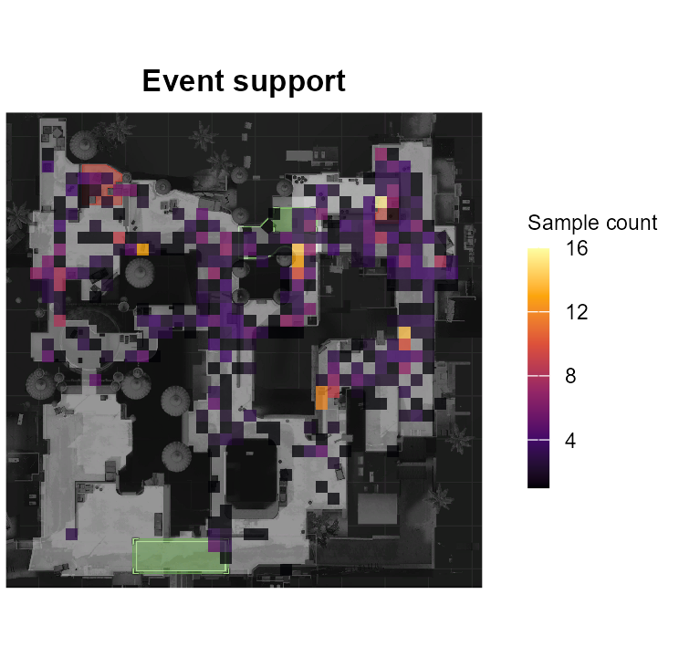
Expected damage
in CS:GO
DA2 project review
Conditional damage prediction
and spatial diagnostics in R
Hrishikesh Damodar Nayak 24BDS1007
Hardik Omesh Lalla 24BDS1010
Faculty guide Dr. Vijayalakshmi A
Notes:
Opening, about 45 seconds. We estimate the expected health-plus-armor damage for a recorded hostile-player hit, then compare observed damage with that expectation on map grids. For example, a rifle chest hit delivering 30 points may be ordinary, while the same amount has a different meaning for another weapon and hitbox. The measurable objective is conditional expected damage, xD. The dataset does not supply the opportunity and lethal outcome labels needed for calibrated expected kills. Explain this scope clearly if asked about the original xK idea. Related work: Anzer and Bauer, 2021, doi:10.3389/fspor.2021.624475 for the expected-outcome analogy. Xenopoulos et al., arXiv:2011.01324 for CS:GO action valuation. Source support image: local paper/figures/panels/XGBoost_events.png, from held-out cached events and the archive radar. Project evidence: results/run_manifest.json, results/model_comparison.csv, results/import_audit.csv, paper/CSGO_xD_Research_Paper.docx. DA2 criteria: Project Plan (1).ppt, slides 11 and 12.

Slide 2
Dataset and SQLite retrieval
Damage events | Count
Raw CSV rows | 10,538,182
Retained rows | 10,279,321
Model sample | 59,763
Data source
Kaggle ESEA damage parts 1 and 2
Metadata links each match to a map
Weapon, hitbox, time and positions
DBI and RSQLite connect R to SQLite
Cleaning and memory
SELECT map, wp, total_damage
FROM events
WHERE file = ? LIMIT 5
Keep usable hostile-player events
Stream 50,000 CSV rows at a time
Store full data on disk
The live demo retrieves stored rows through a read-only connection
2 / 8
Notes:
About 65 seconds. The CSV archive contains two damage parts. We do not concatenate all rows in RAM. readr streams required columns and data.table cleans each chunk. DBI writes clean rows inside a per-file SQLite transaction, which allows an interrupted file to roll back. Cleaning excludes missing or nonfinite values, invalid damage ranges, same-side events, unusable coordinates and invalid context. Explain that cleaning defines a population and may exclude unusual legitimate records. SQLite stores events and an imports audit table, with an index on file for retrieval. SQL sampling uses parameterized queries. Production has 10,279,321 retained rows. The memory-oriented analysis samples 59,763 events and fits on 20,000 training rows. The sample is map-balanced and capped per match, not a population frequency estimator. The stored database is about 2.17 GB, which is disk usage rather than measured RAM. Demonstrate demo_database() to show dbConnect, dbListTables and actual dbGetQuery results. Data source https://www.kaggle.com/datasets/skihikingkevin/csgo-matchmaking-damage. Sources: database.R, pipeline.R, results/import_audit.csv. Project evidence: results/run_manifest.json, results/model_comparison.csv, results/import_audit.csv, paper/CSGO_xD_Research_Paper.docx. DA2 criteria: Project Plan (1).ppt, slides 11 and 12.

Slide 3
Feature engineering and selection
Engineered predictors
Distance between attacker and victim
Log distance and timing bins
Bomb context and map identity
Training-only preprocessing
Encode categorical levels
Remove constant and redundant features
Apply saved scaling to validation and test
Retain 56 encoded predictors
Shuffling a predictor measures its
validation MAE increase in damage points
3 / 8
Notes:
About 70 seconds. Target y equals hp_dmg plus arm_dmg. This target and its components never enter the input feature matrix. Distance is sqrt((att_x-vic_x)^2 + (att_y-vic_y)^2). log1p handles distance without a log-zero problem. Time bins use 20 and 60 seconds, but parser time has not been independently verified as a tactical phase. Categorical features include map, weapon, weapon class, observed hitbox, attacker side, bomb site and time bin. Each field retains up to 25 training levels with an omitted reference level. Unseen or rare levels get the reference encoding. We remove zero-variance columns and sequentially remove numeric columns with absolute correlation above .98. We standardize using training means and standard deviations. The frozen preprocessor has 56 features. Permutation importance shuffles one selected model feature on validation rows and measures the increase in MAE. It is a diagnostic, not an additional test-driven selection stage or causal explanation. Highly dependent predictors can distort importance. Sources: R/preprocess.R, config.R, results/selected_features.csv, results/permutation_importance.csv. Project evidence: results/run_manifest.json, results/model_comparison.csv, results/import_audit.csv, paper/CSGO_xD_Research_Paper.docx. DA2 criteria: Project Plan (1).ppt, slides 11 and 12.

Slide 4
Twelve regression methods and tuning
Linear methods
Trees and ensembles
Other methods
OLS
Ridge
Lasso
Elastic net
CART
Random forest
Extra trees
GBM
XGBoost
MARS
GAM
Neural network
Validation MAE chooses hyperparameters and the final method
Examples: XGBoost depth 3 or 5, early stopping after 20 rounds
CART complexity 0.005 or 0.02, neural network size 5 or 10
4 / 8
Notes:
About 75 seconds. All twelve methods completed. The additional training-only weapon-by-hitbox mean is a baseline and remains eligible for selection. Twelve methods include related ridge/lasso/elastic-net variants and two forest variants. Do not describe them as twelve unrelated model families or claim a deep network. stats::lm.fit supplies OLS; glmnet supplies the regularized models; rpart supplies CART; ranger supplies random forest and extra trees; gbm supplies gradient boosting; xgboost supplies XGBoost; earth supplies MARS; mgcv::bam supplies GAM; nnet supplies a shallow neural network. Tuning details: choose lambda from the glmnet path on validation MAE, alpha fixed at 0/1/.5. CART cp .005/.02 and depth <=8. Forest node size 10/30 with 150 trees and depth <=12. GBM depth 2/4 with 200 trees. XGBoost depth 3/5, learning rate .05, at most 250 rounds, patience 20, histogram method, two threads, row/column sampling .8. Selected depth is 5. MARS degree 1/2 and at most 40 candidate basis terms. GAM uses small bases and exact prediction after discretized fitting. Neural net has 5/10 hidden units, 150 iterations and decay .05. Small grids bound runtime. These are chosen bounds, not exhaustive optimization. Source R/models.R and models/XGBoost_tuning.json. Project evidence: results/run_manifest.json, results/model_comparison.csv, results/import_audit.csv, paper/CSGO_xD_Research_Paper.docx. DA2 criteria: Project Plan (1).ppt, slides 11 and 12.

Slide 5
Validation on separate matches
20,000 fitting rows 8,000 validation rows 8,000 test rows
32 test matches stay outside fitting and tuning
Test metric | XGBoost | Baseline
MAE | 9.116 | 9.167
RMSE | 14.692 | 14.674
R squared | 0.701 | 0.702
XGBoost test MAE 95% interval: 8.764 to 9.465
500 bootstrap resamples preserve match clusters
MAE measures typical absolute error in damage points
5 / 8
Notes:
About 85 seconds. Seed 42 fixes sampling and splitting. We split match identities, approximately 70/15/15 within each map where possible. All events of one sampled match share a partition. The training partition contains 43,763 rows from 176 matches, but the common fitting subset caps at 20,000 rows. Validation and test have 8,000 rows from 32 matches each. Train-only preprocessing protects validation and test. Validation MAE selects XGBoost at 8.897. Test MAE is 9.116, RMSE 14.692 and R2 .701. MAE is mean absolute error in damage points. RMSE penalizes large errors more strongly. R2 compares squared error with predicting the test mean and is not 70.1 percent classification accuracy. The decile chart is regression calibration: average actual versus average predicted damage, not probability calibration. Each decile contains 800 events. Bootstrap resamples 32 test matches with replacement 500 times, preserving within-match dependence and recombining sufficient statistics. Intervals are conditional on this fitted model and sample and exclude refitting uncertainty. Source R/statistics.R, pipeline.R, results/model_comparison.csv, results/baseline_metrics.json, results/eda/regression_calibration.csv. Project evidence: results/run_manifest.json, results/model_comparison.csv, results/import_audit.csv, paper/CSGO_xD_Research_Paper.docx. DA2 criteria: Project Plan (1).ppt, slides 11 and 12.

Slide 6
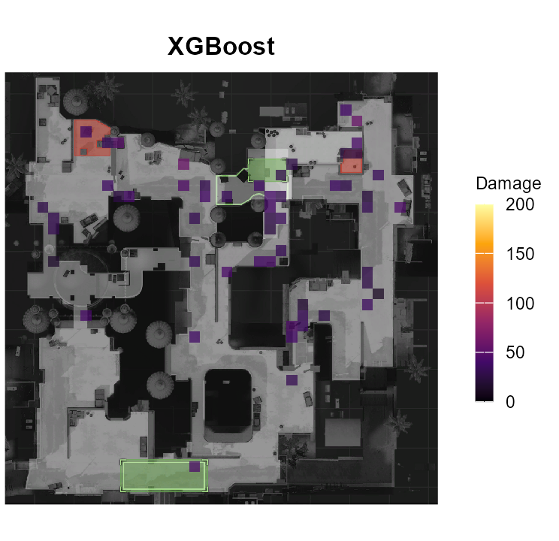
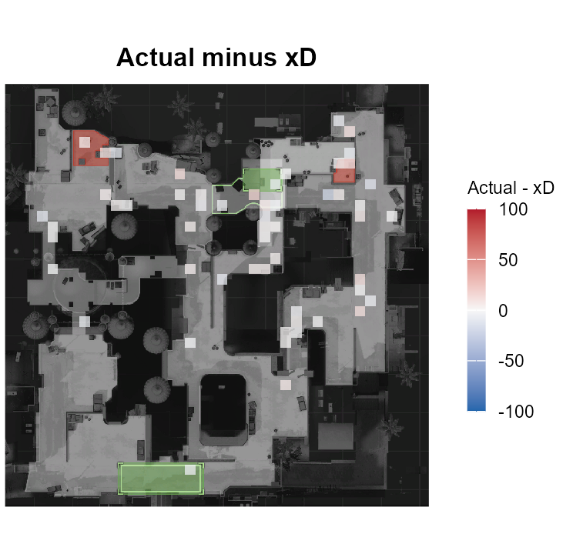
Expected damage and residual heatmaps
40 by 40 grid at attacker positions
Mean cells need at least 5 events from 2 matches
6 / 8
Notes:
About 70 seconds. Each map uses an independent 40 by 40 grid and calibrated world-coordinate bounds from map_data.csv. X and Y scales are independent and game Y points upward. We aggregate held-out predicted damage, actual damage and actual-minus-predicted residuals at attacker locations. Actual/expected layers share a 0 to 200 display range and residuals share -100 to 100. Colors are display clipping only, not edits to numerical results. Red residuals mean actual exceeded predicted. Blue residuals mean actual was below predicted. We omit mean cells with fewer than five events or fewer than two distinct matches. Blank cells can mean insufficient evidence, not zero danger. Count maps show recorded sampled hits, not time spent or exposure. We produce 224 PNGs across eight maps for twelve methods plus the baseline, including shared actual/count layers and per-model expected/residual layers. Nuke lacks archive calibration and appears as a world-coordinate schematic. Planar maps cannot separate floors. This does not establish that a location causes damage or player skill. Source heatmaps.R, results/heatmap_support.csv and results/heatmaps/. Project evidence: results/run_manifest.json, results/model_comparison.csv, results/import_audit.csv, paper/CSGO_xD_Research_Paper.docx. DA2 criteria: Project Plan (1).ppt, slides 11 and 12.

Slide 7
Model comparison and exploratory data
Baseline improvement: 0.051 points
95% interval: -0.018 to 0.123
Holm-adjusted p-value: 0.6866
This run does not establish
superiority over the baseline
12 EDA plots and 3 interactive Plotly charts
7 / 8
Notes:
About 80 seconds. The comparison covers every successful method on the same held-out rows. Selection still uses validation MAE, not whichever test metric is best. XGBoost's measured test improvement over the weapon-hitbox mean is only .050768 damage points, about .55 percent of baseline MAE. The paired improvement interval crosses zero and the Holm-adjusted p-value is .6866. Therefore this run does not establish superiority. The baseline RMSE and R2 are slightly better, illustrating that different losses rank models differently. We apply a match-level paired sign-flip test with 500 repeats and Holm correction across twelve comparisons. Some learners are significantly worse; a low p-value alone does not mean improvement. The EDA chart describes the map-balanced capped sample: rifles account for 30,168 events or about 50.48 percent. It does not estimate full-population weapon shares. Separate ordinary plots cover distributions, boxplots, distance, timing, correlations, feature importance, residuals and regression calibration. Three Plotly charts support hover and interaction offline. ROC, precision-recall and confusion matrices require labeled classes and probabilities, so converting this continuous target to an arbitrary class would change the task. Source visualizations.R, results/model_comparison.csv, results/eda/summary_wide.csv, R/statistics.R. Project evidence: results/run_manifest.json, results/model_comparison.csv, results/import_audit.csv, paper/CSGO_xD_Research_Paper.docx. DA2 criteria: Project Plan (1).ppt, slides 11 and 12.

Slide 8
Progress and Windows RStudio demonstration
Live demonstration
DA2 evidence is implemented
Open csgo_xD.Rproj
source("presentation/live_demo.R")
demo_database()
demo_predict(10)
demo_plot("expected")
demo_gallery()
SQLite retrieval and 56 features
12 models with bounded tuning
Metrics and comparative graphics
Report, code and result snapshot
Limitations and next work
Single split and sparse map support
Native Linux and peak RAM checks
Opportunity labels for true xK
github.com/Caust2c/csgo-xd
Prepare the local database and trained models before class
8 / 8
Notes:
About 50 seconds plus a 3 to 4 minute live demonstration. This is a status review: the core DA2 items are implemented and we show concrete artifacts, rather than assign an invented project-completion percentage. Open the RStudio project before the presentation. Run source("presentation/live_demo.R"), demo_preflight(), demo_database(), demo_predict(10), demo_results(), demo_plot("expected"), demo_plot("residual") and demo_gallery() one at a time. demo_database uses a real read-only SQLite connection, and demo_predict performs fresh inference using the saved model and frozen preprocessing on previously held-out rows. Explain that inference is live while the expensive fitting happened during preparation. The plots and committed metrics are production artifacts. The ten-row batch MAE is a demonstration value and must not replace the 8,000-row test MAE. A fresh GitHub clone contains the snapshot but excludes the large database, raw archive and models. Prepare them locally with the documented production run. Do not install packages, import millions of rows or train all twelve learners during a short classroom slot. This device uses Windows R 4.6.1. Native Linux execution and peak native RAM remain unverified. Future xK requires reliable player linkage, lethal/nonlethal opportunity labels, misses, exposure, pre-hit health and armor. The original damage-only data cannot support that claim. Sources: presentation/live_demo.R, README.md, VALIDATION.md, GitHub repository https://github.com/Caust2c/csgo-xd. Project evidence: results/run_manifest.json, results/model_comparison.csv, results/import_audit.csv, paper/CSGO_xD_Research_Paper.docx. DA2 criteria: Project Plan (1).ppt, slides 11 and 12.

