Slide 1



2026
BRAND
GUIDELINE
www.cavbot.io

Slide 2
www.cavbot.io
ABOUT THE BRAND
CavBot is a reliability copilot and analytics control-plane for the modern web — built to protect route integrity, improve recovery from 404s, maintain SEO continuity, and keep runtime feel stable as products evolve.
CORE VALUES
Clarity • Control • Confidence
Through CavCore Console, teams can review signals, trends, and recovery paths as a structured system — designed for clear action rather than noisy dashboards.

Slide 3
VISION & MISSION
VISION
To make every serious website feel calm, predictable, and monitored—without turning small teams into SRE departments.
MISSION
In other words: if you run a serious site, you shouldn’t be guessing whether routes are breaking or SEO is quietly dying. CavBot becomes the quiet copilot always watching the map.
CavBot builds opinionated tools that turn routes, 404s, SEO, and runtime feel into a single, readable signal for modern web teams.
www.cavbot.io

Slide 4
LOGO
MEANING
The CavBot logo combines a circular “C-eye” control ring and a calm sans-serif wordmark to express a quiet, precise reliability copilot watching over every route.
www.cavbot.io

Slide 5


www.cavbot.io
LOGO VARIATIONS
Use alternative versions only when suitable and always maintain clear space and proper proportions.
HORIZONTAL LAYOUT
ICON
WORDMARK

Slide 6








www.cavbot.io
LOGO MONOCHROME
Use monochrome versions only when suitable and always maintain clear space and proper proportions.
HORIZONTAL LAYOUT
ICON
WORDMARK

Slide 7





SYMBOLS & MEANINGS
CavBot’s logo pairs a circular “C-eye” symbol with a calm sans-serif wordmark.
The broken outer C represents a control ring watching over routes and systems.
The centered inner circle is the sensor/brain at the core, expressing quiet, precise reliability.
Parts of the CavBot Logo
www.cavbot.io

Slide 8

EXCLUSION
ZONES
clear space
clear space
clear space
SAFE DISTANCE
When placing our logo, it's crucial to leave enough space around it to ensure visibility and impact. This exclusion zone prevents visual clutter and maintains the logo's integrity.
clear space
www.cavbot.io

Slide 9

LOGO POSITIONING
When positioning our logo, it is essential to consider the safe distance around it to ensure optimal visibility and recognition. This exclusion zone helps prevent visual clutter and maintains the logo's clarity and impact. By leaving adequate space around the logo, you can ensure that it stands out effectively in various applications and settings.
www.cavbot.io
SQUARE
LANDSCAPE
PORTRAIT

Slide 10



REMINDERS
Rules on logo use to keep in mind
DO NOT
change the color. Use colors in the palette
DO NOT
crop the logo
DO NOT
add shadows or effects
DO NOT
rotate the logo
DO NOT
put over another illustration
DO NOT
use tint or opacity
www.cavbot.io

Slide 11
COLOR PALETTE
Color Philosophy
Violet expresses calm intelligence, lime highlights key signals, and deep graphite grounds everything in a stable control-room feel.
100%
90%
80%
70%
60%
50%
40%
30%
20%
10%
100%
90%
80%
70%
60%
50%
40%
30%
20%
10%
100%
90%
80%
70%
60%
50%
40%
30%
20%
10%
100%
90%
80%
70%
60%
50%
40%
30%
20%
10%
www.cavbot.io

Slide 12
TYPOGRAPHY
Primary Typeface
Inter regular
Inter Weighted
A B C D E F G H I J K L M N O P Q R S T U V W X Y Z
a b c d e f g h i j k l m n o p q r s t u v w x y z
1234567890 !@#$%^&*()_+
A B C D E F G H I J K L M N O P Q R S T U V W X Y Z
a b c d e f g h i j k l m n o p q r s t u v w x y z
1234567890 !@#$%^&*()_+
Typography Style
CavBot’s type system stays deliberately simple: Inter for everything. Personality comes from spacing, casing, and control.
www.cavbot.io

Slide 13



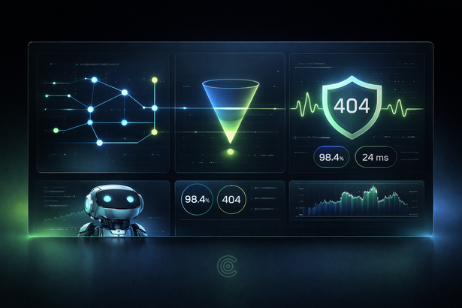

VISUAL STYLE
Photography & Graphics
Use focused, interface-led imagery with subtle robotics and control-room environments. Avoid cartoonish robots, heavy filterrs, or cluttered sci-fi effects.
www.cavbot.io
Tone & Mood
Calm • Technical • Assuring

Slide 14
“RELIABILITY COPILOT FOR THE MODERN WEB”
© 2026 CavBot
www.cavbot.io

Slide 15

THANK YOU
CavBot Press & Media Inquiries
pr@cavbot.io
www.cavbot.io

