Slide 1
IoT with ESP8266
Week of Learning 2018

Slide 2
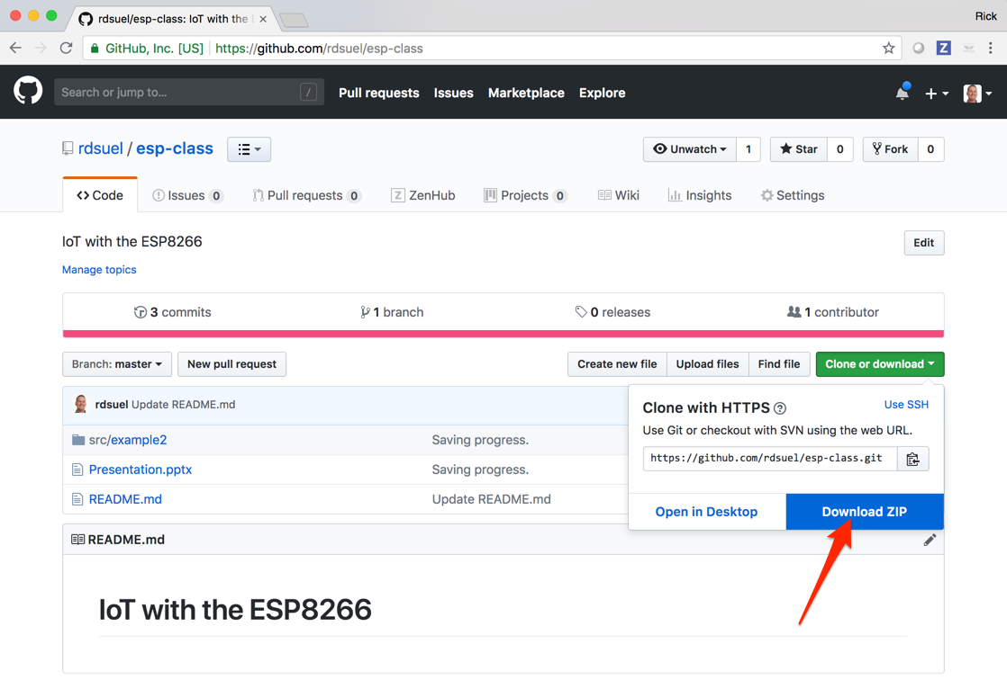
Class Materials
The source code and presentation for this course can be found here: https://github.com/rdsuel/esp-class

Slide 3
The ESP8266
TBD – Add some background on the device

Slide 4
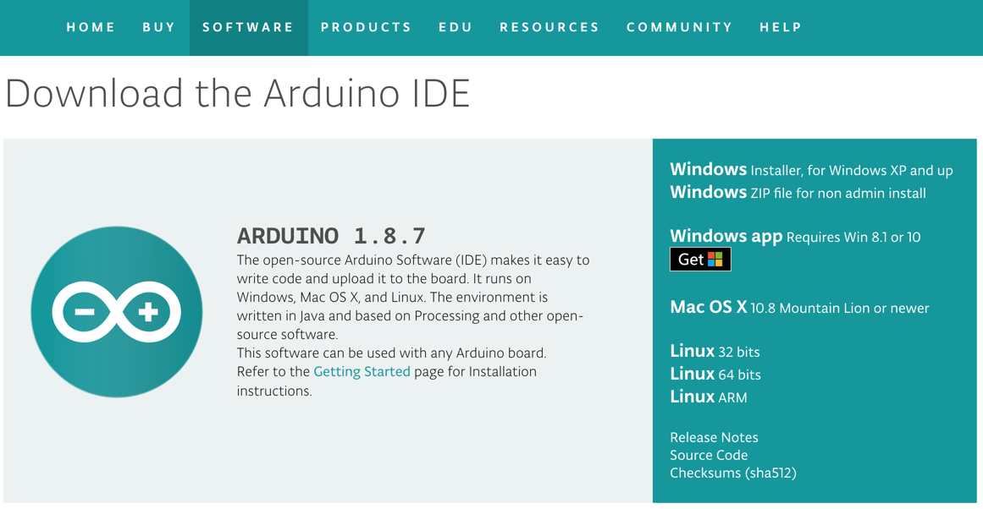
Setup
Install latest Arduino software from: https://www.arduino.cc/en/Main/Software
Install the Silicon Labs VCP Drivers:
https://www.silabs.com/products/development-tools/software/usb-to-uart-bridge-vcp-drivers
Install the drivers for your operating system.
These drivers allow your computer to recognize the ESP8266 device as a “Virtual Com Port” when you plug it in via USB.

Slide 5
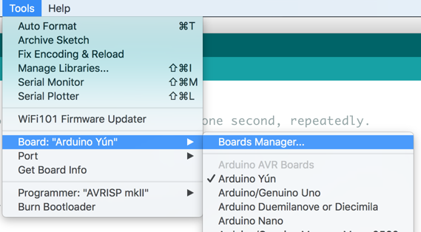
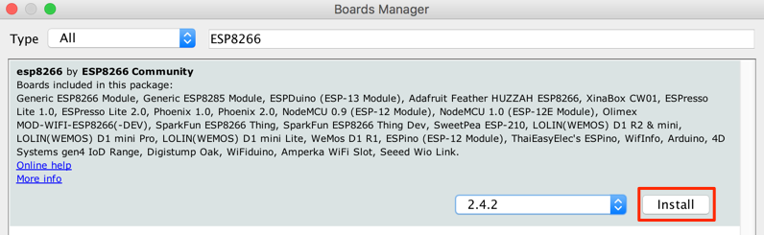
Setup (Continued)
Install the ESP8266 boards package:
Tools → Board → Boards Manager

Slide 6
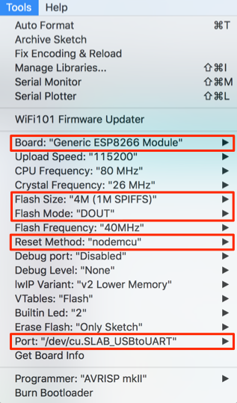
Setup (Continued)
Configure the connection parameters for the device:
Board: “Generic ESP8266 Module”
Flash Size: 4M (1M SPIFFS)
Flash Mode: “DOUT”
Reset Method: “nodemcu”
Port: choose the one for your device

Slide 7
Exercise 1 - Blinky
Goal:
Load the built in “blink” application for the ESP8266 to your device and confirm that blue LED blinks.
This exercise confirms that everything is configured properly and ensures you can download and run an application.

Slide 8
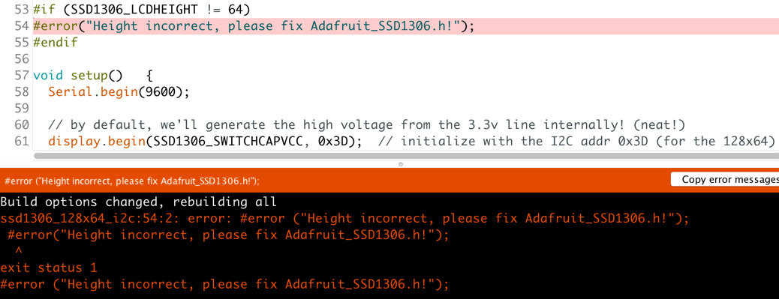
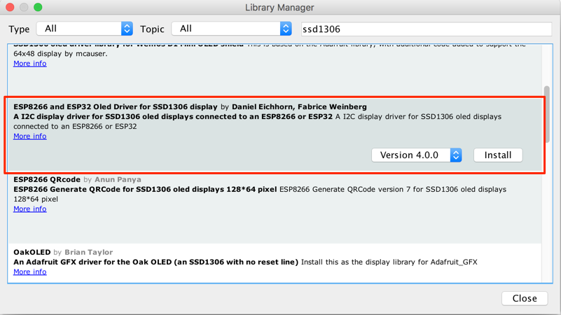
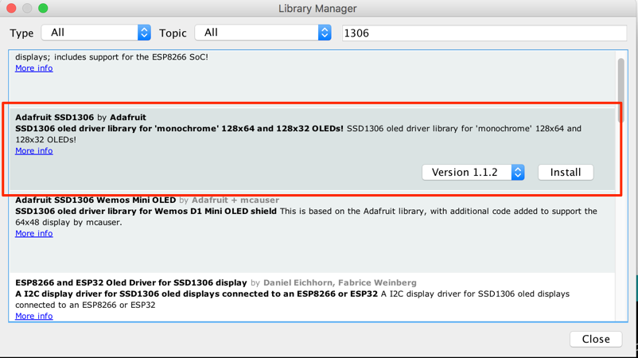
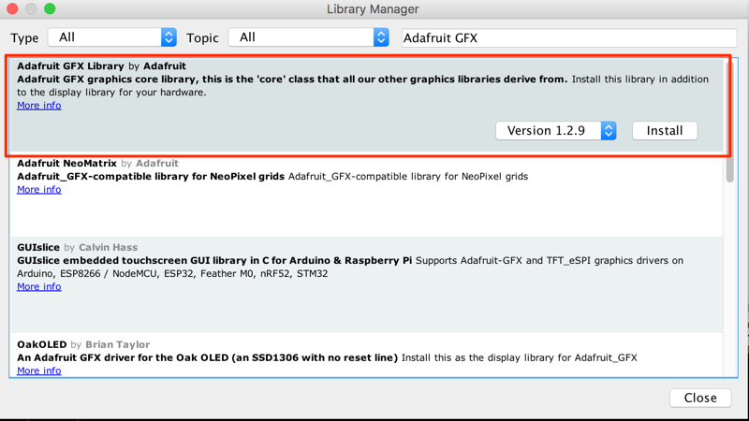
Exercise 2: OLED Display
Goal:
Get the OLED display connected and display your name on it.
Libraries:
SSD_1306

Slide 9
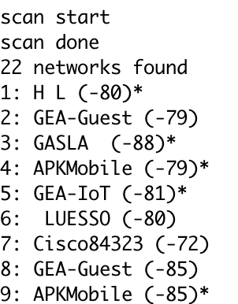
Exercise 3: Connect to Wifi
First let’s make sure that the wifi actually works….select the ESP8266 wifi scan example from the list and uploading it – it will build and upload.
Run the serial monitor, making sure that it is set to 115200 baud
You should see results like this:

Slide 10

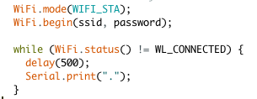

So first we need the wifi library
Now we need the wifi network SSID and password:
Now we have to connect using those:
Finally let’s print out the IP address we were given:

Slide 11
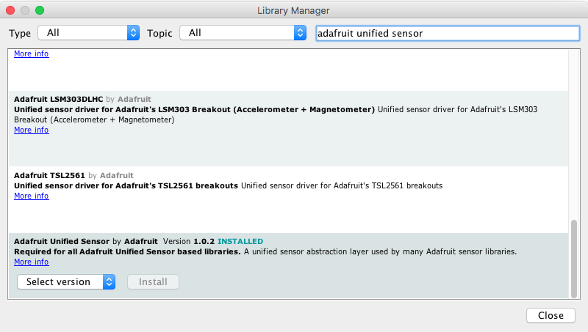
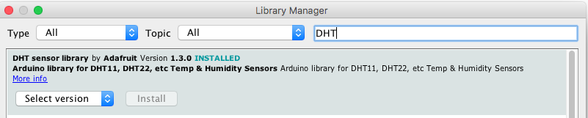
Exercise 4: DHT22 Sensor
To connect to the sensor you need the DHT library as well as the unified sensor library:

Slide 12
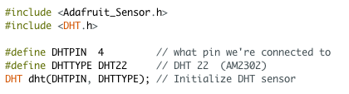



Connect the GND to GND, VCC to 3.3v and DAT to GPIO4 with the wires
Add the libraries to the code and set it up
Add code to start the sensor up
Add variables to stick the data in
And get the data from the sensor
So you should be able to print out the temperature and humidity now

Slide 13
Exercise 5: Cloud Platform

Slide 14
Exercise 6: IFTTT

