Slide 1
IoT with ESP8266
Week of Learning 2018

Slide 2
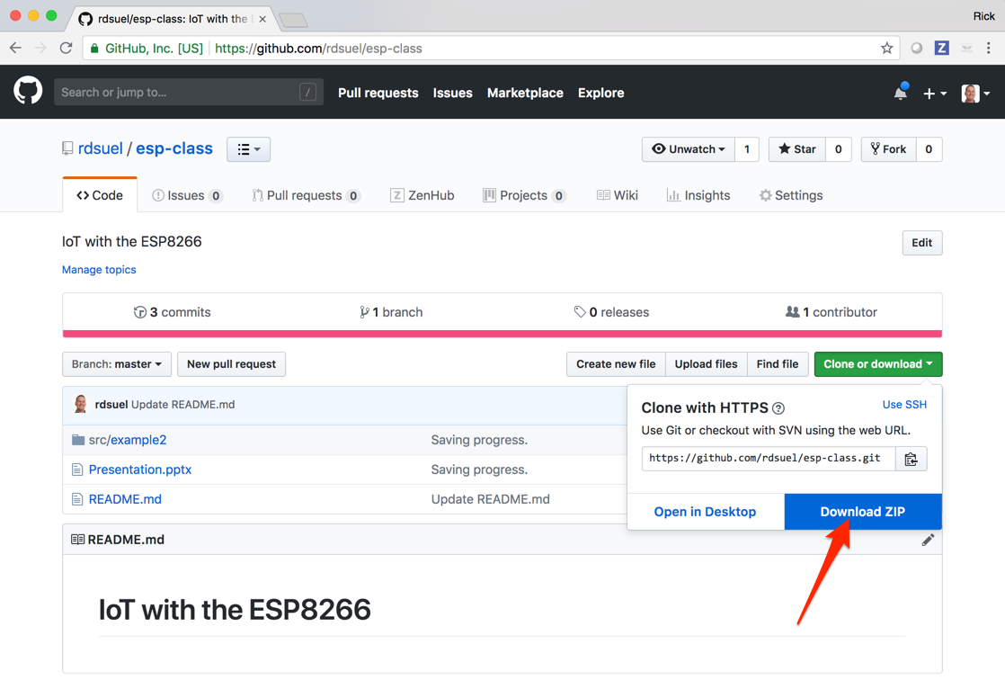
Class Materials
The source code and presentation for this course can be found here: https://github.com/rdsuel/esp-class

Slide 3
The ESP8266
TBD – Add some background on the device

Slide 4
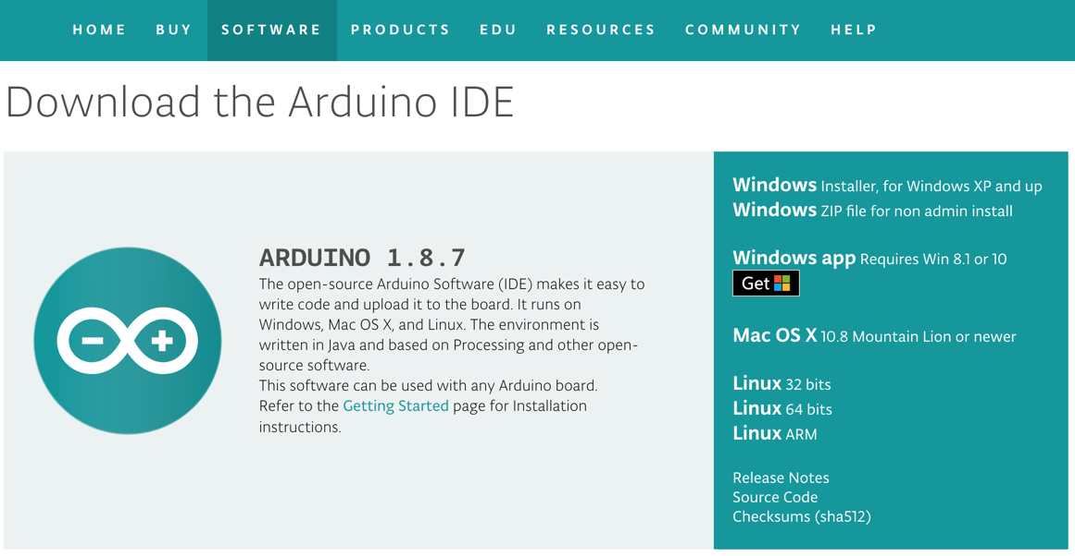
Setup
Install latest Arduino software from: https://www.arduino.cc/en/Main/Software
Install the Silicon Labs VCP Drivers:
https://www.silabs.com/products/development-tools/software/usb-to-uart-bridge-vcp-drivers
Install the drivers for your operating system.
These drivers allow your computer to recognize the ESP8266 device as a “Virtual Com Port” when you plug it in via USB.

Slide 5
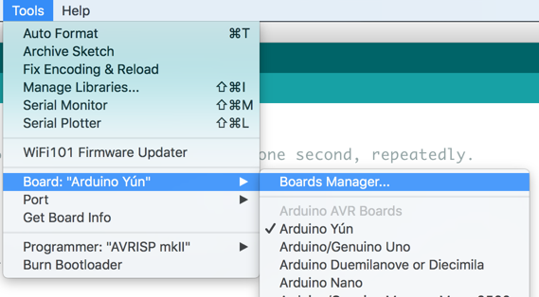
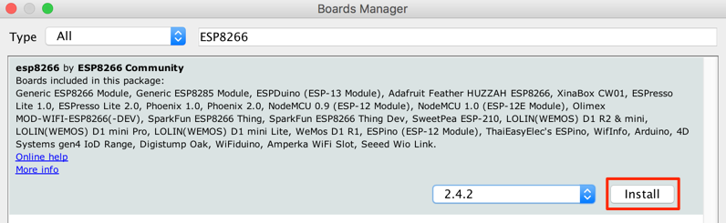
Setup (Continued)
Install the ESP8266 boards package:
Tools → Board → Boards Manager

Slide 6
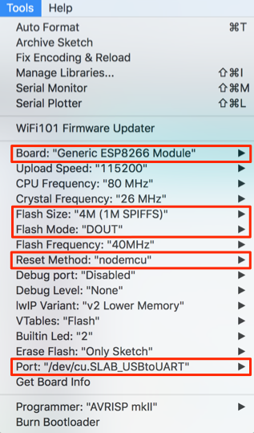
Setup (Continued)
Configure the connection parameters for the device:
Board: “Generic ESP8266 Module”
Flash Size: 4M (1M SPIFFS)
Flash Mode: “DOUT”
Reset Method: “nodemcu”
Port: choose the one for your device

Slide 7
Exercise 1 - Blinky
Goal:
Load the built in “blink” application for the ESP8266 to your device and confirm that blue LED blinks.
This exercise confirms that everything is configured properly and ensures you can download and run an application.

Slide 8
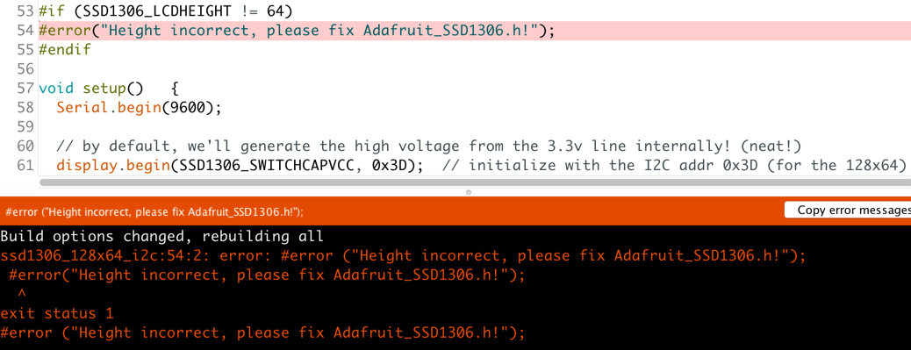
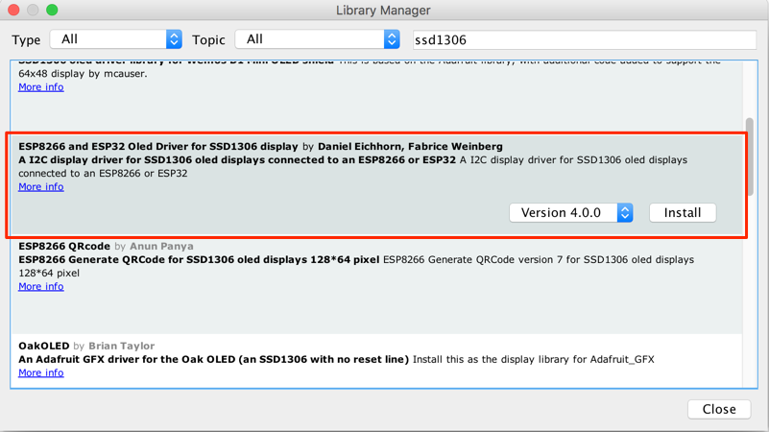
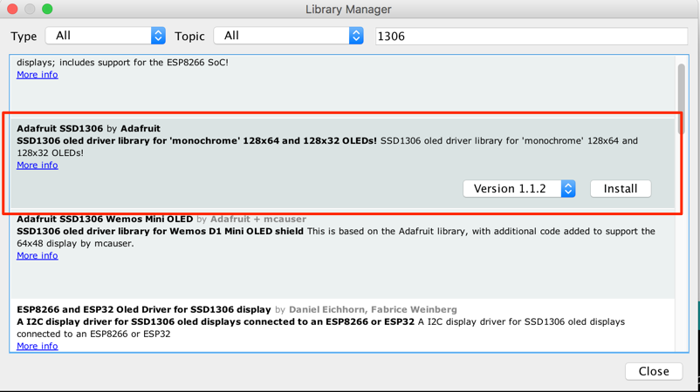
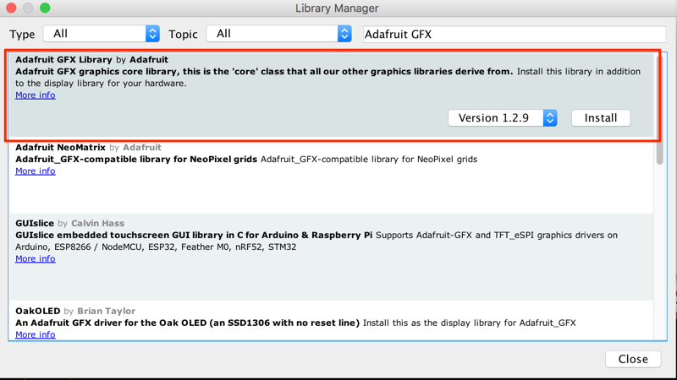
Exercise 2: OLED Display
Goal:
Get the OLED display connected and display your name on it.
Libraries:
SSD_1306

Slide 9
Exercise 3: Connect to Wifi

Slide 10
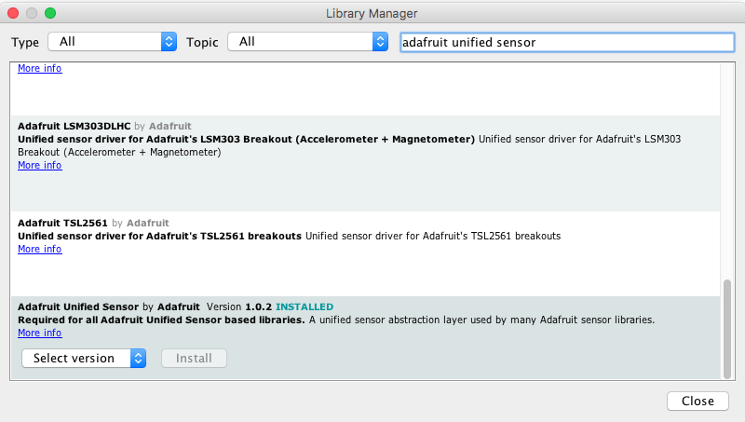
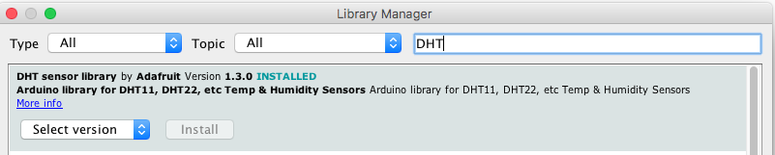
Exercise 4: DHT22 Sensor
To connect to the sensor you need the DHT library as well as the unified sensor library:

Slide 11
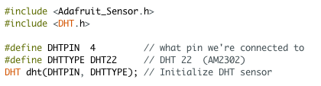



Connect the GND to GND, VCC to 3.3v and DAT to GPIO4 with the wires
Add the libraries to the code and set it up
Add code to start the sensor up
Add variables to stick the data in
And get the data from the sensor
So you should be able to print out the temperature and humidity now

Slide 12
Exercise 5: Cloud Platform

Slide 13
Exercise 6: IFTTT

