Slide 1
Sprint 5 Presentation
Hidden page/puzzle

Slide 2
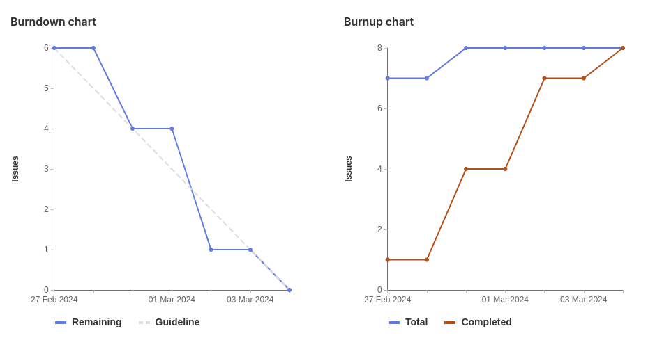
Milestone Burndown Chart

Slide 3
What worked well/What did not work well
The tickets/tasks were split well
Tickets got completed in a timely manner
Updating the team on discord when a task is completed
Improvements:
Marking the ticket completed as soon as it’s done

Slide 4
Tehreem
Word puzzle research
Back end of the puzzle
Hiding the puzzle in our webpage
Total Weights: 12

Slide 5
Kalindu
Puzzle Implementation (Server side code)
Creating games page
Word Puzzle research
Total weight: 12

Slide 6
Cavaari
Worked on hidden page design & implementation
Designed and styled front-end visuals
Styled gaming page
Word puzzle research
Total Weights: 12

Slide 7
Karina
Added contact info to about me page
Worked on hidden page design
Total weights: 12

Slide 8
Egor
Wordle Game
Riddle Chat back-end and front-end
Visual Improvements
Total weights : 14

Slide 9
Muhammad
Worked on hidden page implementation
Designing front end visuals and components
Total weights : 14

Slide 10
Eric
Puzzle Implementation (Server side code)
Creating games page
Word Puzzle research
Total weight: 12

