Slide 1

Multimedia Data Security
Catch The Mark 2020
Group name:
atuttabirra
Members:
Lucrezia Tosato
Remi Chierchia
Lorenzo Cavada

Slide 2
Embedding
Defining the informative capacity
Calculating the informative power of an image using entropy and applying a threshold for setting the most informative point to 255 and the other ones to 0.
Division in block
Insertion of watermark
1
Dividing the image in N blocks of a fixed size calculating the information capacity of each block and creating a list with the index of each block ordered in a decrescent way.
Division of the watermark in pieces and embedding using DCT in the most informative blocks in a weighted way.
5
2
4
3
Division of the top left component
Division of the AC component in N blocks.
Application of the DWT

Slide 3
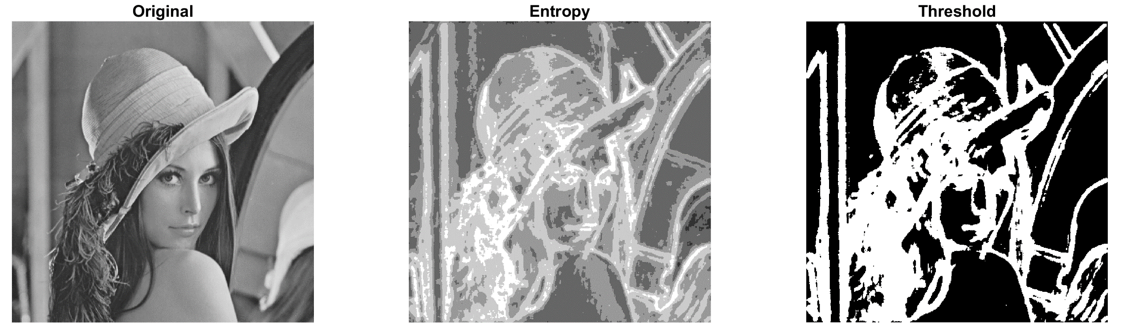
1. Entropy and Threshold

Slide 4
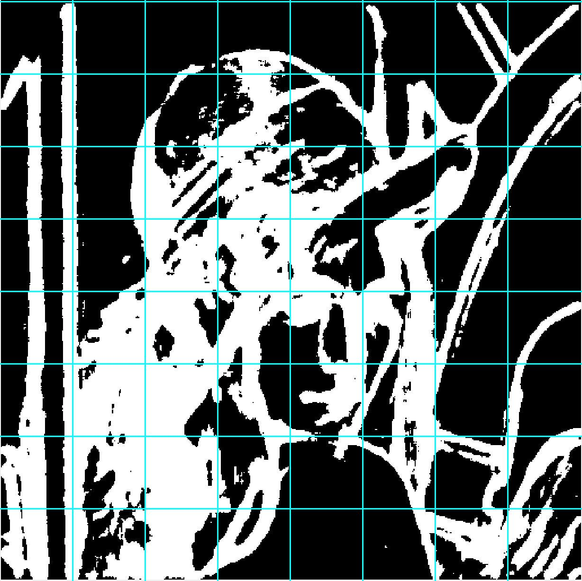
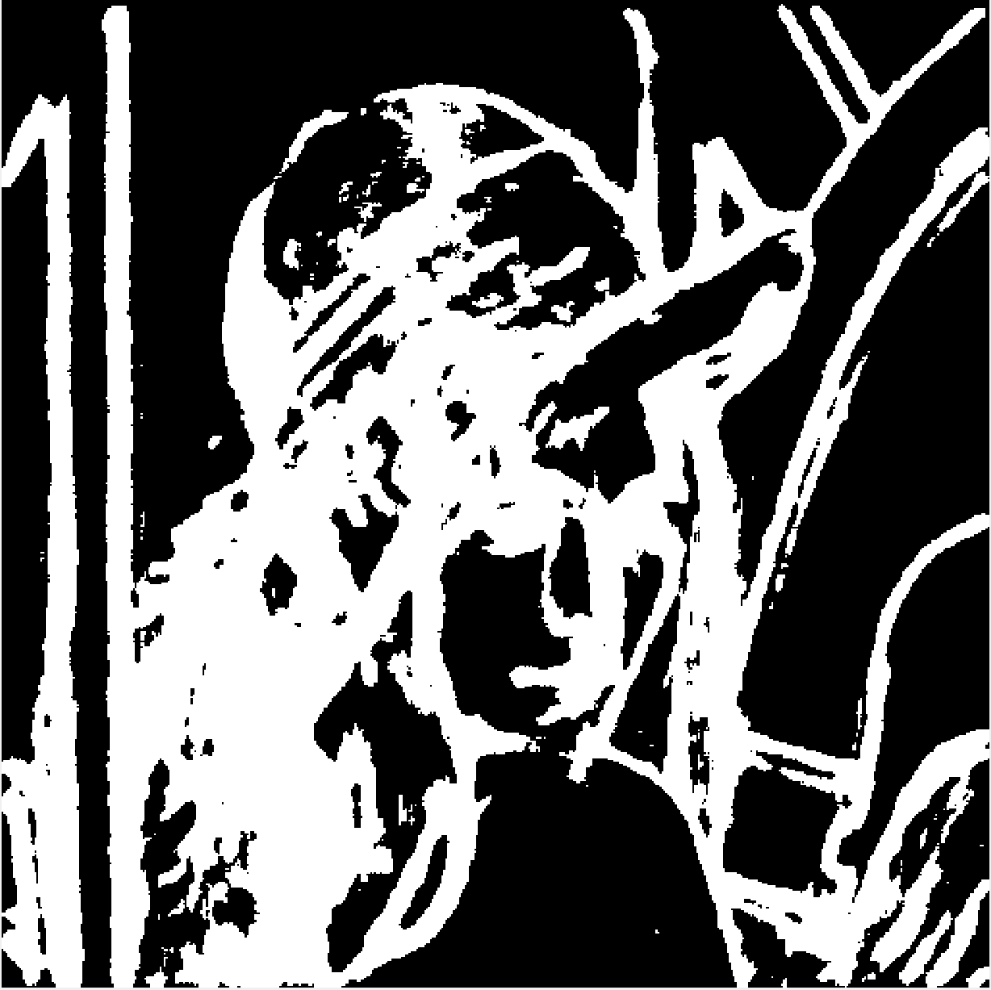
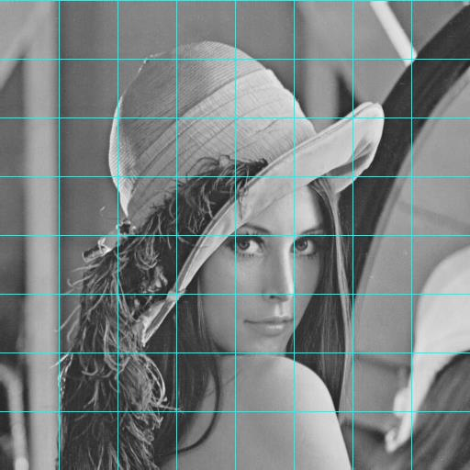

2. Division in block
117
617
0
1325
305
3005
2403
2997
0

Slide 5
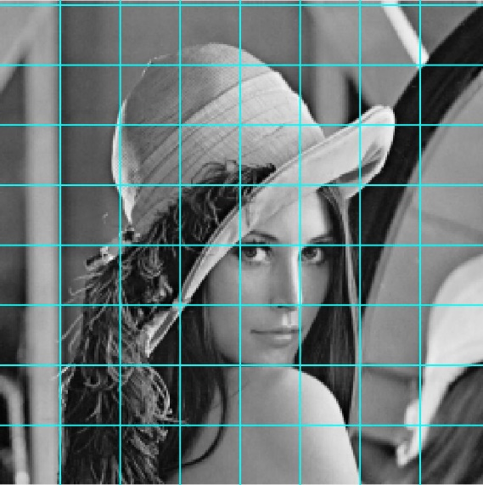
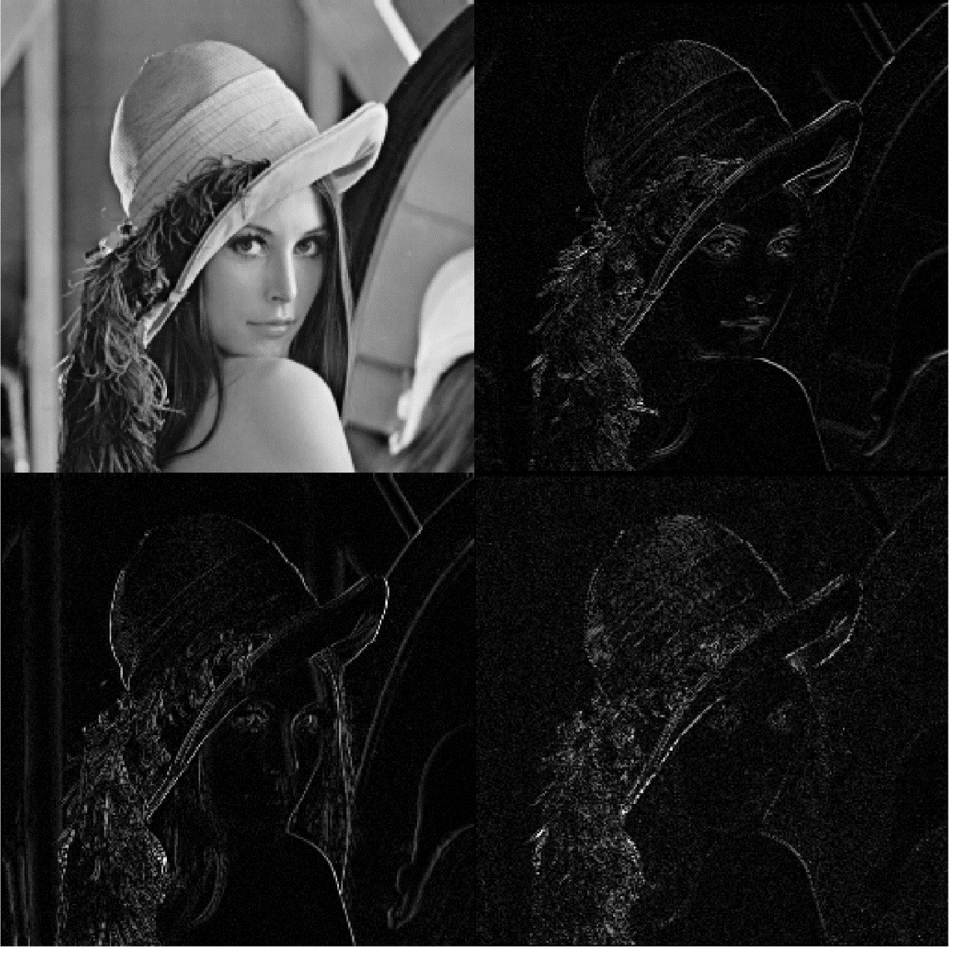
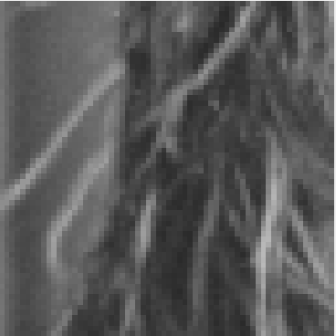
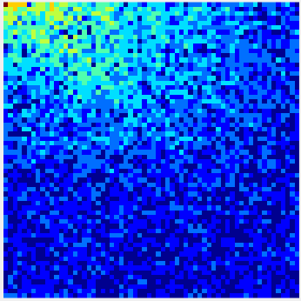
3 - 4. Applying of the DWT
DCT

Slide 6



5. Inserting the Watermark
$$Size of a WatBlock=\frac{Block^{′}s Informative Capacity }{∂}$$
$$∂=\frac{Tot Informative Capacity}{1024}$$

Slide 7
Detection
Defining the informative capacity of original Image
Calculating the informative power of an image using entropy and applying a threshold for setting the most informative point to 255 and the other ones to 0.
Division in block
Dividing the original image in N blocks of a fixed size calculating the information capacity of each block and creating a list with the index of each block ordered in a decrescent way.
1
Detection of watermark
Detection of the watermark using the inverse of the DCT applied in the most significative blocks.
5
2
4
3
Division of the top left component
Application of the DWT
Division of the AC component in N blocks.
Application of the DWT to the watermarked image.

Slide 8
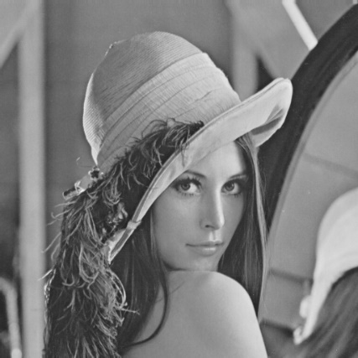
Other strategies 1
Divide the watermark
Divide the watermark and use ore create some error-detection code to add some control bit.
Divide the image
Divide the watermark
Embed the watermarks
Divide the image
Embed the watermarks
Divide the image in blocks and calculate entropy and threshold.
Embed one or more times the watermarks using DWT.

Slide 9
Other strategies 1
Detection
In detection get all the watermarks inserted.
Detection
Error correction
Error correction
Exploit the control bits to detect errors and rebuild the watermark as similar as possible to the original.

Slide 10
Other strategies 2
Normal embedding with DCT
Changing the mark values from {0.1} to {-1.1} in the Embedding
Embedding in blocks using DCT
Embedding using Slant Transform
DCT with quantizzation
Using FFT instead of DWT
Error correction code
Trying DCT embedding with different coefficent selection

Slide 11
Attack
Attack 1
Dichotomic Logic
At first, variation of half average
In the end, variation of smaller steps
3 Stages
Attack 2
Same logic as the embedding, the idea is to attack more but in smaller areas

Slide 12
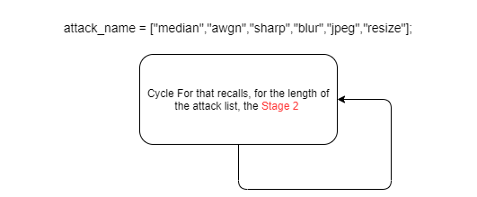
Attack 1: Stage 1

Slide 13
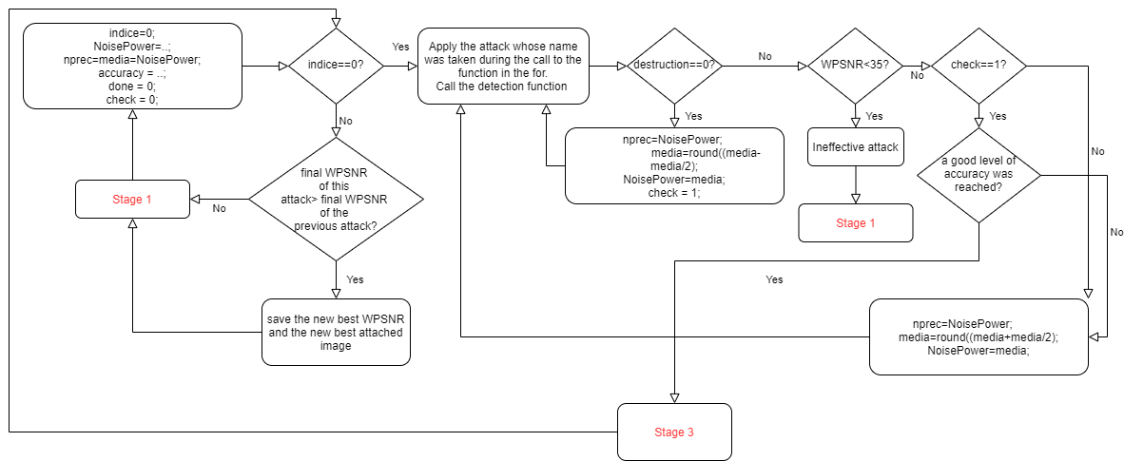
Attack 1: Stage 2

Slide 14
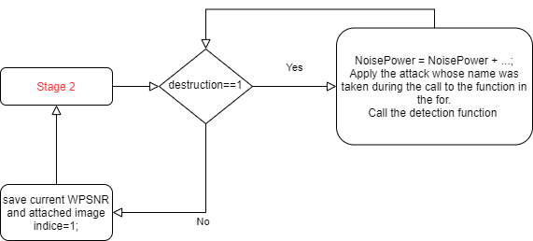
Attack 1: Stage 3

Slide 15
Attack 1: Stage 1

Slide 16
Attack
Attack 1
Dichotomic Logic
At first, variation of half average
In the end, variation of smaller steps
3 Stages
Attack 2
Same logic as the embedding, the idea is to attack more but in smaller areas

Slide 17
Attack 2
Division
Main cicle
Inner cicle
Repeat
Divide the original image into blocks and evaluate their informative capacity using entropy combined with a certain threshold.
Continue cycling until the mark is found.
For N iterations, attack the most informative block using a specific attack each time stronger.
After N iterations restart attacking the 2 more informative blocks and so on.
Repeat the process with a different type of attack.

Slide 18
Thank you for your attention

