Slide 1
Linux Network Services
DNS

Slide 2
DNS
Domain Name System (DNS)
Provides human readable names to ip addresses
Google.com: 209.85.225.106
Theendoftheinternet.com: 69.25.27.173
Forms the foundation of mail server lookups
Provides reverse name lookups (ip to name)
Both Linux and Windows have this service as an option
Notes:
Basics (Semi-review): What is DNS?

Slide 3
DNS Basics
Domain: an area over which rule and control is exercised.
When a domain is purchased, the customer has control over their domain to do what they want with it.
However, domain names need to be centrally managed by the root “.” servers. Roots control TLDs
TLD: Top Level Domain: .com, .net, .org, .co.uk, etc…
TLDs manage second-level domains such as “dunwoody.edu”, “google.com”, and “microsoft.com”.

Slide 4
DNS Basics
Comon TLDs:
.com commercial
.net network
.org non-profits
.mil US Military
.gov US Government
.co.uk U.K. company

Slide 5
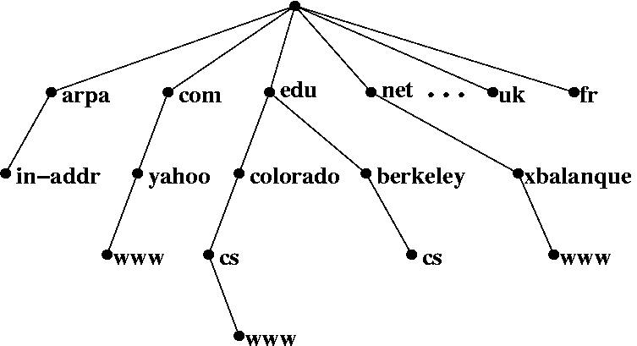
DNS Basics
Source: http://bio3d.colorado.edu/tor/sadocs/dns/dns.html

Slide 6
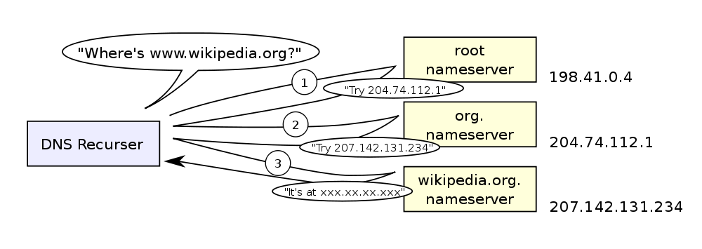
DNS Basics
Basic Example of DNS request:

Slide 7
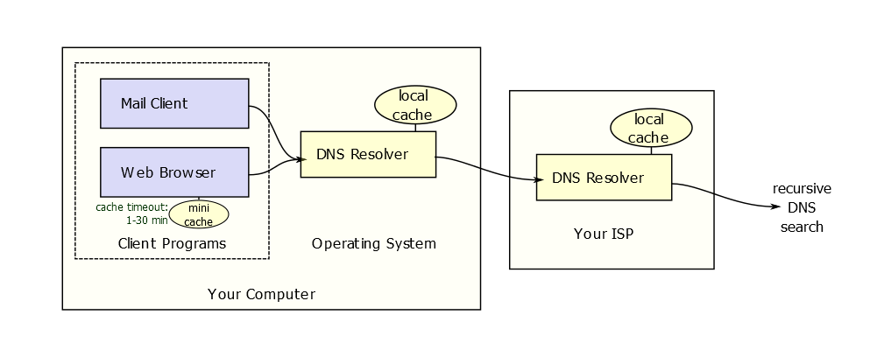
Local Resolver

Slide 8
DNS Basics
DNS Caching
Requests are retained in a local server that responds
TTL (time to live) sets the amount of time that the local server will used its saved cache for a particular domain.
After the TTL expires requests will be forwarded to an external DNS.

Slide 9
HOSTS file
File stored locally to resolve names to IP addresses
Stored in /etc/hosts
Used as the original solution to name resolution before networks got too big.

Slide 10
Explain lab

Slide 11
BIND
Started in the early 80s at Berkeley
It is short for:
Berkeley Internet Name Domain
BIND is the most popular implementation of DNS in the world.

Slide 12
BIND
Can be installed by using the command: apt-get install bind9
Once the server is installed it needs to be configured
Edit /etc/bind/named.conf.options with editor to include forwarders
Start BIND: /etc/init.d/named start
Check BIND: /etc/init.d/named status
Edit local resolver to point to local DNS service
Edit /etc/resolv.conf with editor to include: nameserver 127.0.0.1
In Ubuntu modify the interfaces file to make it perminant

Slide 13
Record Types
Tells DNS what kind of information it is storing.
Types can be queried directly.
Address
Pointer (PTR)
CNAME
MX
NS
SOA

Slide 14
Start of Authority
Contains the core information about a zone
The primary DNS for the zone
That the zone is authoritative for the domain
Contact info
Secondary updates
SOA server is stated as a name not an IP
Hostmaster is the email address of the technical contact
Source: http://rscott.org/dns/soa.html

Slide 15
Start of Authority
Serial Number: states the iteration of the DNS records.
Must be changed when file is edited. Emacs does it for you.
YYYYmmDD## or 2010100613
Refresh Rate: how often to check for updates in sec.
Others: Retry Rate, Expiry Time, and TTL.
NS: name server (required). States the primary server

Slide 17
Mail Exchange
AKA: MX record
Allows for an entry for the email server to be explicitly stated.
Without this record email will not flow in and out of the domain
Has a priority number for multiple entries
1= high

Slide 18
Address and Alias Records
Address Record
An address book entry: hostname=IP
AKA: a record
Most common record type
CNAME Record
An alias for another hostname

Slide 19
Zones
It is a domain containing any subdomains
Primary zone: dunwoody.edu
Subdomain: www
A database of records
Zone files are text files in /etc/bind
Zones are defined in /etc/bind/named.conf.local which point to the zone files

Slide 20
Adding a zone
After a zone file has been created in
Ubuntu: /etc/bind/db.zone
SuSE: /var/lib/named/zone
Open named.conf.local using vi or emacs
(named.conf in SuSE)
zone “testnet.org” (
type master;
file “/etc/bind/db.testnet.org”;
);
Reload DNS: /etc/init.d/bind9 restart
Use dig to test

Slide 21
Reverse Zone
IP to Hostname resolution
Similar to a forward zone
Records are called pointers (PTRs)
Only possible on IPs you control
Internal non-routeable
Records look like: 0.168.192.in-addr.arpa

Slide 22
BIND
dig
Included with the bind package
Replaces nslookup (nslookup is depreciated)
Can specify DNS record types to query with -t
mx mail
ns name server
a address (default)

Slide 23
BIND
dig
Output comprises of a question, answer, and authority section
Question: what you asked from the DNS (mx, ns, a)
Answer: the response from the question sent to the DNS
Authority: the controlling server (aka authoritative server)
host
Simpler command to find domain IPs

