Slide 1
CS499 - Open Source software development
Code Review – Guidelines
Dr. Igor Steinmacher
e-mail: igorfs@utfpr.edu.br
Twitter: @igorsteinmacher

Slide 2



What is Peer Code Review?
Manually analyzing a software artifact from other team members
It is a Quality Assurance practice
Looks good! What about removing that comment and treating the exception?
Here is the code!

Slide 3
Code Review – What to review
Correct Syntax
Indentation
Alignment
Removing commented (non-useful comments)
Grammar / Naming
Spelling mistakes
Correct English
Variable, Function, Method names

Slide 4
Code Review – What to review
Duplicate Code
DRY (Don’t Repeat Yourself)
Maintaining duplicate code is hard
Technical Quality
Code Logic
Code conventions
Follow project conventions for style/naming
Is it possible to condense code?
Security vulnerabilities

Slide 5
Code Review – What to review
Error Handling
Are exceptions being captured/treated correctly?
Human readable messages being displayed
Test coverage/Unit tests
Code review is a learning experience.
Pay attention to what other people are saying. Ask questions!

Slide 6
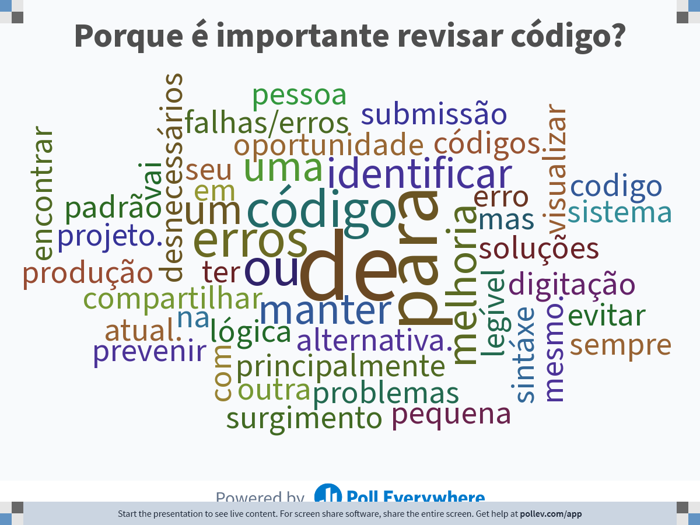
Notes:
Do not modify the notes in this section to avoid tampering with the Poll Everywhere activity. More info at polleverywhere.com/support Porque é importante revisar código?
https://www.polleverywhere.com/free_text_polls/stoooJEjh1Tkv40zNcjyi

Slide 7
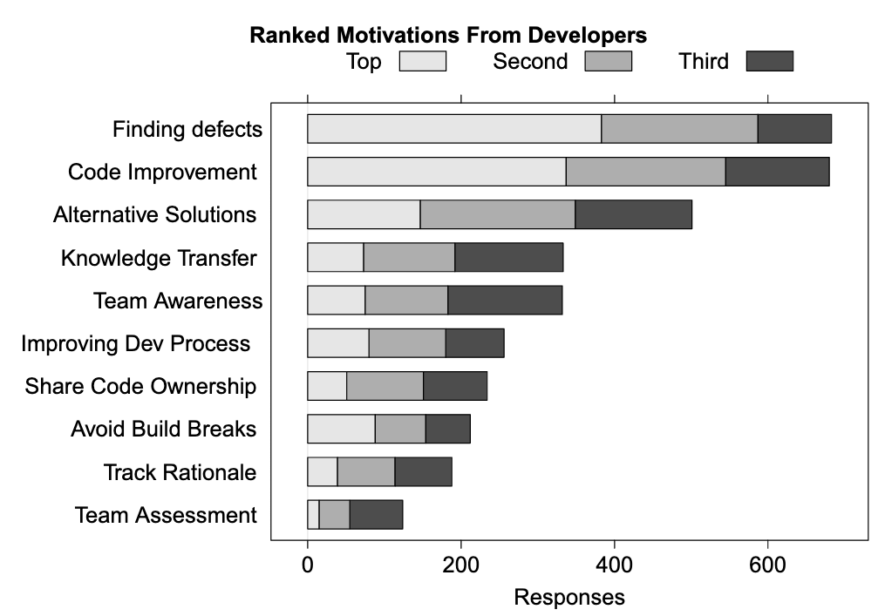
At Microsoft
A. Bachelli and C. Bird, “Expectations, Outcomes, and Challenges Of Modern Code Review,” ICSE 2013

Slide 8
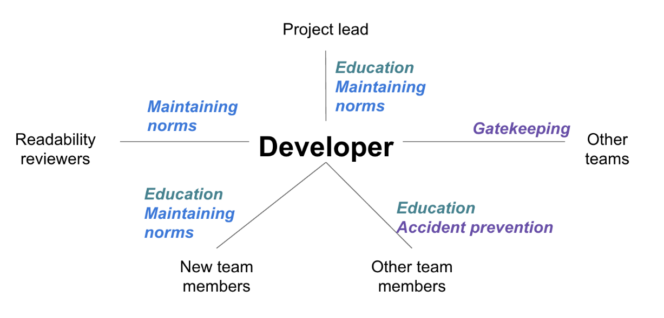
At Google
C. Sadowski, E. Söderberg, L. Church, M. Sipko, and A. Bacchelli, “Modern Code Review: A Case Study at Google,” ICSE-SEIP 2018

Slide 9
Why??
Average defect detection rates
Unit testing: 25%
Function testing: 35%
Integration testing: 45%
Design and code inspections: 55% and 60%.
11 programs developed by the same group of people
First 5 without reviews: average 4.5 errors per 100 lines of code
Next 6 with reviews: average 0.82 errors per 100 lines of code
Errors reduced by > 80 percent
Steve McConnell, 2004, “Code Complete: A Practical Handbook of Software Construction”, Microsoft Press, second edition

Slide 10
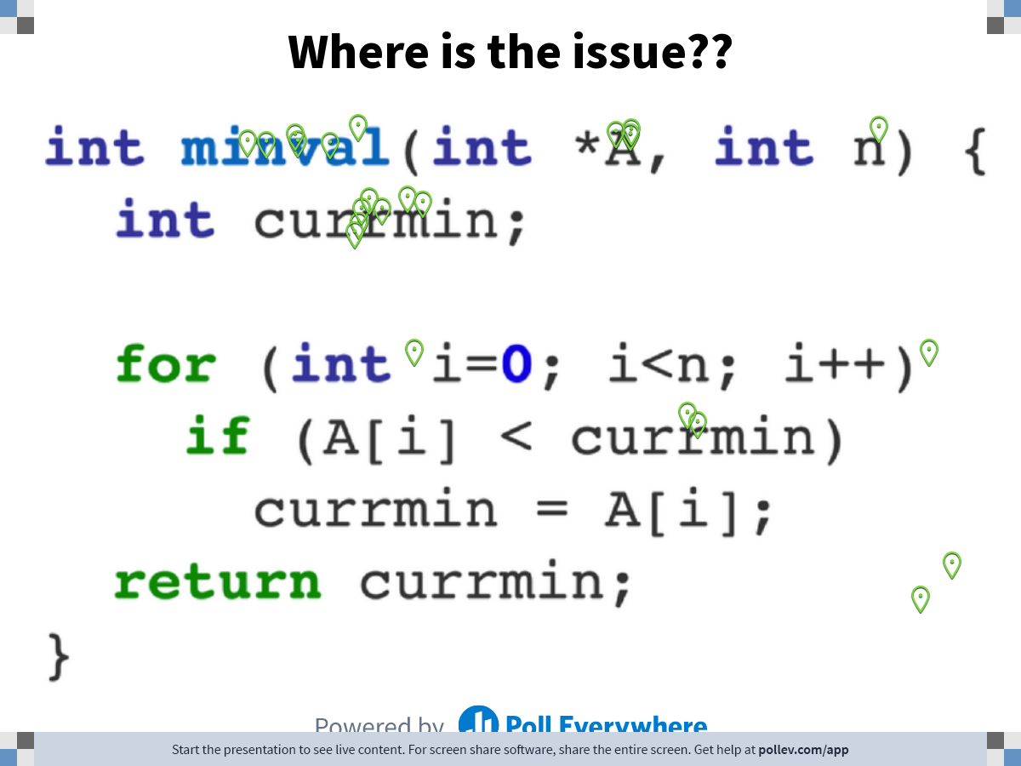
Notes:
Do not modify the notes in this section to avoid tampering with the Poll Everywhere activity. More info at polleverywhere.com/support Where is the issue??
https://www.polleverywhere.com/clickable_images/HzIzh6iG4Wx64mvZ2ka7o

Slide 11
Why???
Knowledge Transfer
Newcomers can learn
Team members can receive new information
Team Awareness
Sharing and updating the team with news and changes
Share Code Ownership
The code with more people knowledgeable

Slide 12
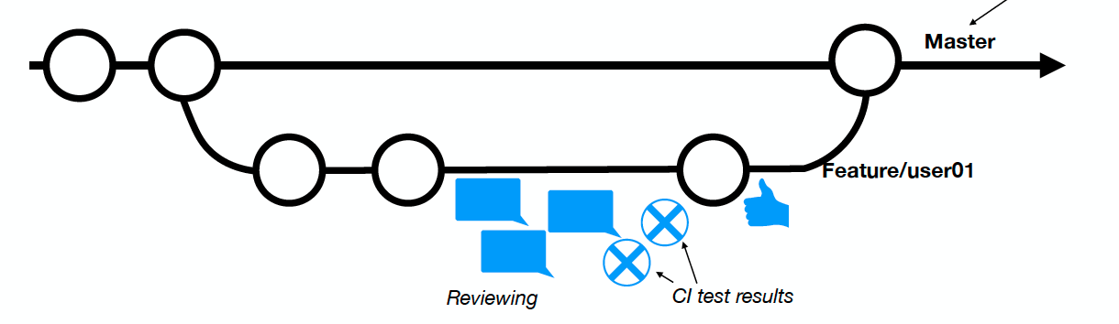
How?

Slide 13
How?
As a team, you should
Build and maintain a positive review culture.
Develop, reflect on, and revise code-reviewing policies.
Ensure that time spent is counted and expected, but watch for negative impacts of assessments.
Ensure that the appropriate tools are available and used.
Promote the development of appropriate review checklists.
Have sufficient training in place for code review activities.
Develop a mechanism to watch for bottlenecks in the process

Slide 14
Code Review – Questions
Does this code accomplish the purpose?
How would you have solved the problem?
How was the “reading” experience?
Does the code follow to coding guidelines/style?
Does this code introduce the risk of breaking builds?

Slide 15
Code Review – Questions
Does this code break existing tests?
Does the code need more tests?
Was the documentation created/updated?
Are there security vulnerabilities?
Is this an efficient way? Any O(n²) or worse algorithm?

Slide 16
Writing the Review
Don't make it personal.
Be nice
Be constructive
Be specific
Justify your points
Ask questions

Slide 17
HOW?
As a code author, you should
Carefully check the code changes (including a sanity check) for a review
Cluster only related changes
Describe your changes and the motivation for them
Notify reviewers as early as possible
Promote an ongoing dialogue with reviewers
Track the suggested changes and confirm that they’re fixed
Confirm that the decisions are documented
L. MacLeod, M. Greiler, M.-A. Storey, C. Bird, and J. Czerwonka, “Code Reviewing in the Trenches,” IEEE Software., vol. 35, pp. 34–42, 2018. 33

Slide 18
HOW?
As a reviewer, you should
Set aside dedicated, bounded time for reviews
Review frequently, doing fewer changes at a time
Provide feedback to authors as soon as possible
Focus on core issues first; avoid nitpicking
Give constructive, respectful feedback
Choose communication channels carefully; talk face-to-face for contentious issues (Don’t forget to document the conclusion!)
Be prepared to iterate and review again
L. MacLeod, M. Greiler, M.-A. Storey, C. Bird, and J. Czerwonka, “Code Reviewing in the Trenches,” IEEE Software., vol. 35, pp. 34–42, 2018. 33

Slide 19
Resources and More Resources
There are many resources out there. These slides are based on some of them
https://mtlynch.io/human-code-reviews-1/
https://medium.com/palantir/code-review-best-practices-19e02780015f
https://smartbear.com/learn/code-review/best-practices-for-peer-code-review/
https://code.likeagirl.io/the-7-steps-to-a-complete-code-review-abdfd39e75f1
https://towardsdatascience.com/teaching-code-review-in-university-courses-using-peer-feedback-5625fe039f2a
https://en.wikipedia.org/wiki/Code_review
http://web.mit.edu/6.005/www/fa15/classes/04-code-review/

