Slide 1
Computation of Group Invariants with Magma and GAP
Benjamin Hughes
University of Virginia

Slide 2
Project & Motivation
Goal: Convert and optimize GAP programs to Magma, thereby
making it possible to tackle bigger groups
Many of the programs we use are at least 6 years old
Unverified Code
Explore the functionality & features Magma has to offer

Slide 3
Magma and GAP Basic Info
Computational Algebra Systems, both written in C with strong focus in Group Theory
Magma: Released in 1993 from University of Sydney, Australia
Propriety, made available to Universities by the Simons Foundation
GAP: Released in 1983 from Lehrstuhl D für Mathematik, Germany
Open Source, over 50 user contributed packages

Slide 4
Pros & Cons
GAP
MAGMA
Excellent Documentation and
helpful community
Functions ‘good enough,’ some packages provide less guarantees
Practical: Can use from anywhere!
Black Box
Good documentation, significantly
less discussions/ external resources
Excellent implementation for available functions ( Fast!!)
Practical: Restricted to registered computers
Locked Black Box

Slide 5
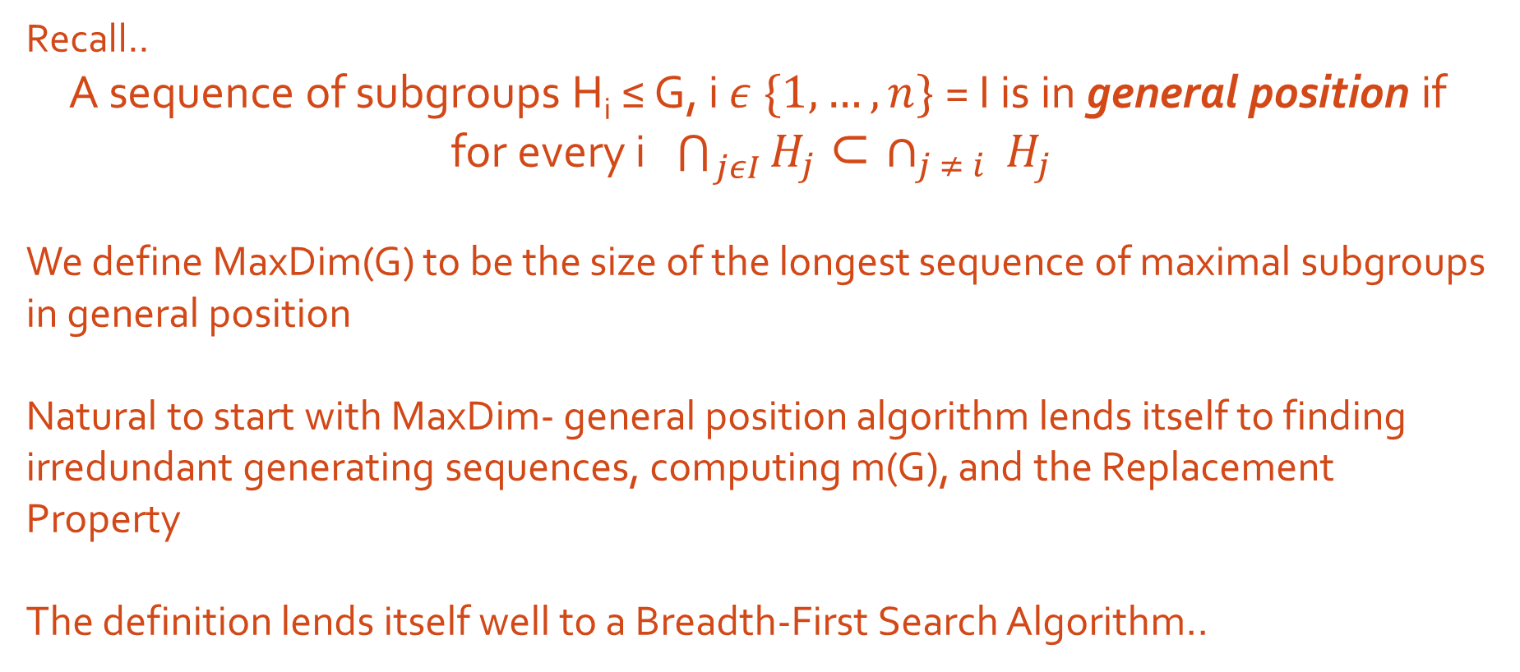
Process
Recall..
A sequence of subgroups H_{i} ≤ G, i $ε \{1, …, n\}$ = I is in general position if
for every i $\bigcap_{jεI}{H_{j} }$⊂$∩_{j ≠ i }H_{j}$
We define MaxDim(G) to be the size of the longest sequence of maximal subgroups in general position
Natural to start with MaxDim- general position algorithm lends itself to finding irredundant generating sequences, computing m(G), and the Replacement Property
The definition lends itself well to a Breadth-First Search Algorithm..

Slide 6
Model 1:
Code idea:
Create list of sequences of maximals in gen. pos., called GenPos
for M in Maximals
Intersect M with all elts in GenPos
On these new intersections check if all subsets properly contain M ⋂ elt
If so, append GenPos. Else, throw it away
This guarantees you don’t make unnecessary intersections- however after every pass of the main loop need some overhead to sort/organize appended list.

Slide 7
Say we have 5 maximal subgroups:
GenPos :=
[ [] ]
[ [], [1] ]
[ [], [1], [2], [1, 2] ]
[ [], [1], [2], [1,2], [3], [1, 3], [2, 3], [1, 2, 3] ]
[ [], [1], [2], [1,2], [3], [1, 3], [2, 3], [1, 2, 3], [4], [1, 4], [1, 2, 4], [3, 4], [1, 3, 4],
[2, 3, 4], [1, 2, 3, 4] ]
[ [], [1], [2], [1,2], [3], [1, 3], [2, 3], [1, 2, 3], [4], [1, 4], [3, 4], [1, 3, 4], [2, 3, 4],[5], …… ]

Slide 8
Model 2:
Code idea:
Create list of all possible size two intersections
while length of intersections ≤ maxdim
create all length + 1 intersections based off of last list
Check if these elts are larger than each of their subsets, and
that those subsets are in GenPos
If so, add them to create new list

Slide 9
[ [1, 2], [1, 3], [2, 3], [1, 4], [2, 4], [3, 4], [1, 5], [2, 5], [3, 5], [4,5] ]
Create next size list..
[ [1, 2, 3], [1, 2, 4], [1, 2, 5], [1, 3, 4], [1, 3, 5], [2, 3, 4], [2, 3, 5], [1, 4, 5], [2, 4, 5],
[3, 4, 5] ]
Create next size list..
[ [1, 2, 3, 4], [1, 2, 3, 5], [1, 3, 4, 5], [2, 3, 4, 5], [2, 3, 4, 5] ]
return MaxDim := 3;

Slide 10
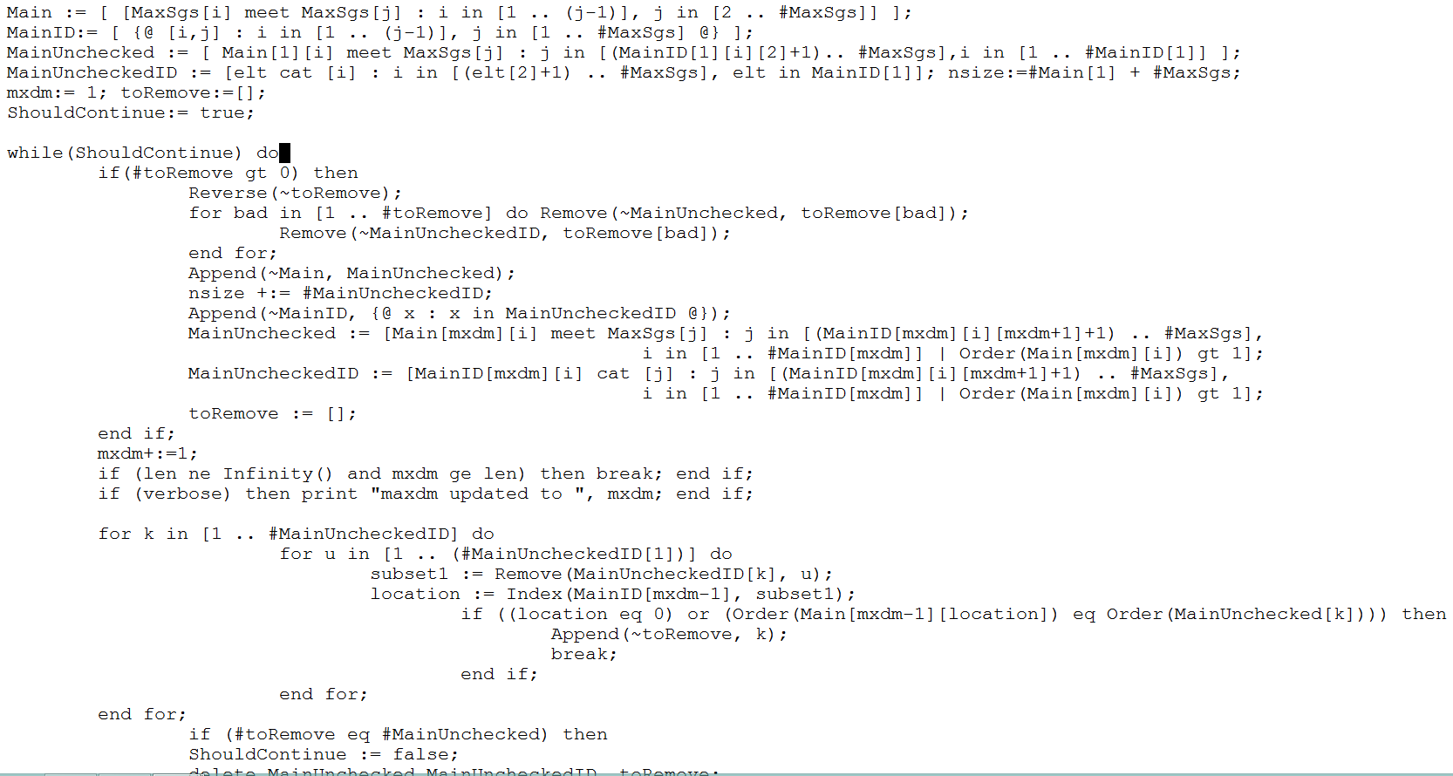

Slide 11
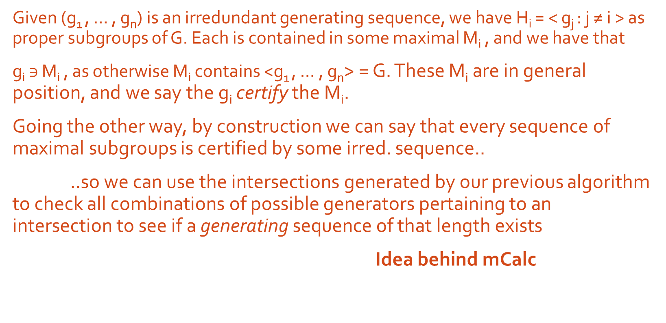
Given (g₁ , … , g_{n}) is an irredundant generating sequence, we have H_{i} = < g_{j} : j ≠ i > as proper subgroups of G. Each is contained in some maximal M_{i} , and we have that
g_{i} $∋$ M_{i} , as otherwise M_{i} contains <g₁ , … , g_{n}> = G. These M_{i} are in general position, and we say the g_{i} certify the M_{i}.
Going the other way, by construction we can say that every sequence of maximal subgroups is certified by some irred. sequence..
..so we can use the intersections generated by our previous algorithm to check all combinations of possible generators pertaining to an intersection to see if a generating sequence of that length exists
Idea behind mCalc

Slide 12
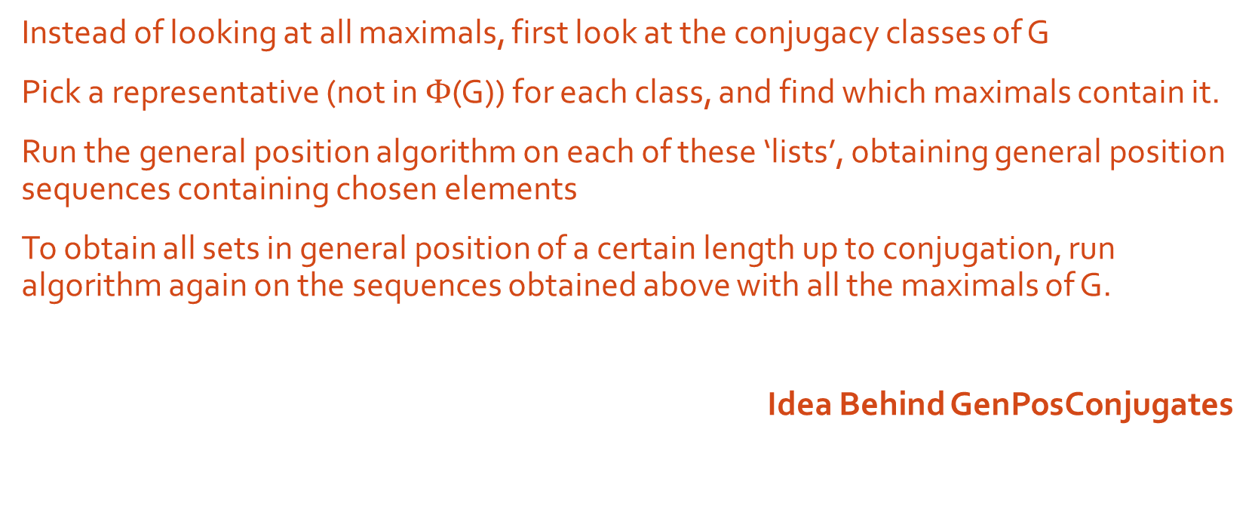
Instead of looking at all maximals, first look at the conjugacy classes of G
Pick a representative (not in $Φ$(G)) for each class, and find which maximals contain it.
Run the general position algorithm on each of these ‘lists’, obtaining general position sequences containing chosen elements
To obtain all sets in general position of a certain length up to conjugation, run algorithm again on the sequences obtained above with all the maximals of G.
Idea Behind GenPosConjugates

Slide 13
Results: (%’s relative to best previous program)
Function | % Speed-up*
MaxDimV1
MaxDimV2
MaxDimV3
MaxDimV4
MaxDimV5
GenPosConjugates
FindIrredGenSeq
MCalc
~12500% slower
~900% slower
Model 1
~90% slower
~90 % faster
~240% faster
~450% faster
Model 2
~500% faster
~450% faster
*Averaged over SmallGroups

Slide 14
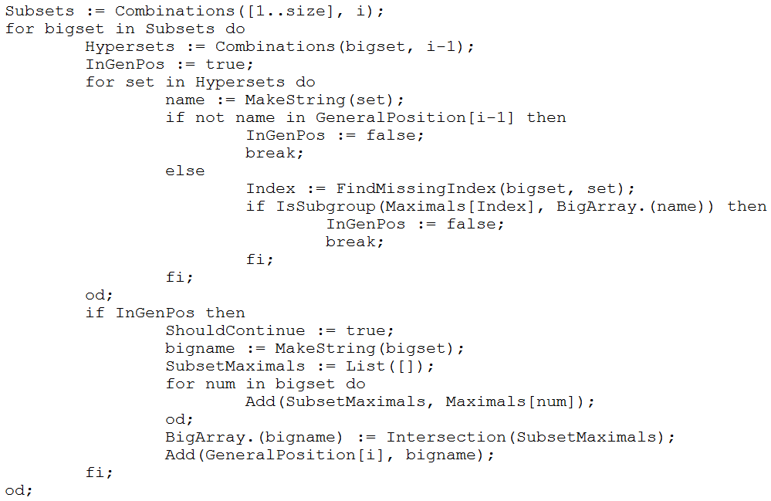
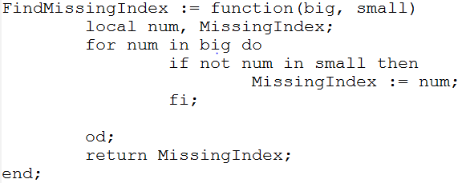
Linear Searches!

Slide 15
#Comments, //Comments, and /* COMMENTS */

Slide 16
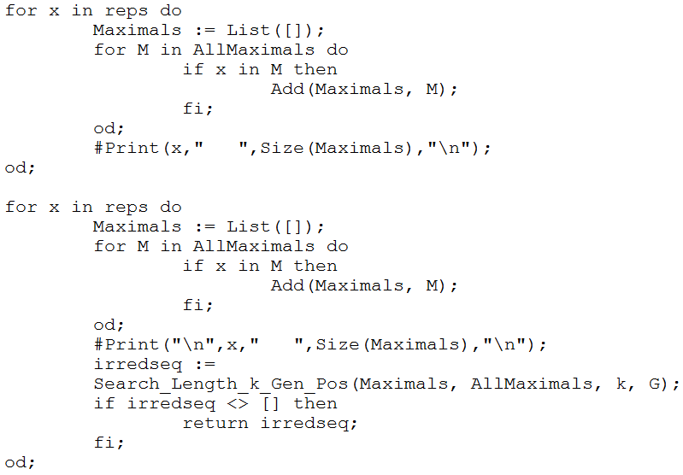
Genius or Madness?

Slide 17
“Pre-optimization is the root of all evil”

Slide 18
Giving user options
From this
To this

Slide 19
Unimplemented Features & Future Improvements
Replacement Property algorithm
Optimizations for conjugacy
Data ‘slim’ version
No real understanding of the Big-O asymptotic complexity of the algorithms
Implementing more theoretical results

Slide 20
Questions? //Comments?

