Slide 1
RAGE
PROFESSOR: RODRIGO
BALTAZAR
CURSO: INGLES INSTRUMENTAL
AULA 1
Ab UNIT 1
READING SPOTLIGHT
ab

Slide 2
UNIT 1 – Reading spotlight
TECNICAS DE LEITURA EM LINGUA INGLESA
Nesta unidade, você aprenderá os conceitos de Cognates, Scanning and Skimming. Além disso, estudaremos a forma verbal Present simple.

Slide 3
palavras Cognatas
COGNATES
Cognatos são palavras em idiomas distintos que possuem significados, pronúncia e divisão silábica semelhantes.
Etimologicamente possuem uma origem comum.

Slide 4



Veja alguns exemplos abaixo entre as linguas inglesa e portuguesa:
Activate
Analytic
History
Ethic
Traditional
Conventional
Cultural
Experimental
commercial
Ativar
Analítico
Historia
ético
Tradicional
Convencional
Cultural
Experimental
comercial

Slide 5
Técnicas de scanning e skimming
SCANNING
Scanning é uma técnica de leitura que consiste em correr rapidamente os olhos pelo texto até localizar a informação específica desejada. O scanning é prática rotineira na vida das pessoas. Alguns exemplos típicos são o uso do dicionário para obter o significado de palavras ou a utilização do índice para encontrar um artigo ou capítulo de interesse. Essa técnica não exige leitura completa nem detalha do texto
SKIMMING
Skimming consiste em observamos rapidamente o texto completo apenas para detectar o assunto geral do mesmo, sem nos preocuparmos com os detalhes. Para tanto, é necessário prestar atenção ao layout do texto, título, subtítulo, cognatos, primeiras e/ou últimas linhas de cada parágrafo, bem como à informação não-verbal (figuras, gráficos e tabelas).

Slide 6
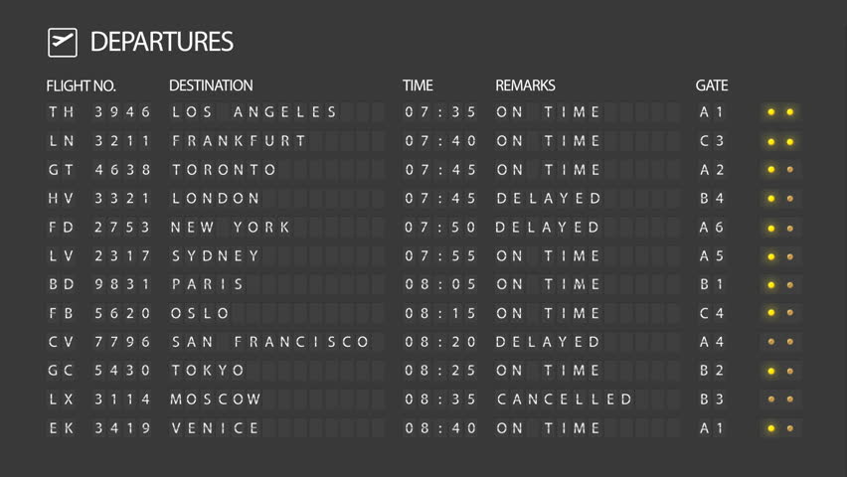
COMO EXEMPLO, IMAGINE QUE VOCE ESTA NO AEROPORTO COMPANHANDO O FLIGHT STATUS. AO OBESERVAR A TIMETABLE, VOCE UTILIZA TECNICAS DE SCANNING E SKIMMING

Slide 7
PARA EXERCITAR, OBSERVE O TEXTO ABAIXO UTILIZANDO AS TECNICAS SCANNING E SKIMMING. A IDEIA E DESTACAR OS COGNATOS, NOMES DE PESSOAS, CIDADES, EMPRESAS OU OBJETOS E AS PALAVRAS JÁ CONHECIDAS
Understanding Operating Systems
Did you know that you and your computer speak different languages? It doesn´t speak Spanish or Swedish, or Chinese. It speaks in ones and zeroes. You can´t communicate directly with your computer; that´s where your operating system comes in. The operating system is the program that lets you interact with your computer. Together the operating system and computer hardware form a complete system that determines what your computer can do. There are many different operating systems. Two of the most common ones are Microsoft Windows and Mac OS X. Windows comes preloaded on most personal computers; Mac OS X runs on all new Macs. Operating Systems aren´t just for computers and laptops, though. Mobile devices run mobile operating systems like Apple iOS or Google Android. Operating Systems for mobile devices are designed for interactions with smaller touch-screens. Before downloading new sofware, or applications, to your computer or mobile device, you should check to see if the application is compatible with your operating system. Some applications work on all operating systems, but others only work on certain ones. So, get to know your operating system to see how it works and what it can do.

Slide 8
destacando os cognatos
Understanding Operating Systems
Did you know that you and your computer speak different languages? It doesn´t speak Spanish or Swedish, or Chinese. It speaks in ones and zeroes. You can´t communicate directly with your computer; that´s where your operating system comes in. The operating system is the program that lets you interact with your computer. Together the operating system and computer hardware form a complete system that determines what your computer can do. There are many different operating systems. Two of the most common ones are Microsoft Windows and Mac OS X. Windows comes preloaded on most personal computers; Mac OS X runs on all new Macs. Operating Systems aren´t just for computers and laptops, though. Mobile devices run mobile operating systems like Apple iOS or Google Android. Operating Systems for mobile devices are designed for interactions with smaller touch-screens. Before downloading new sofware, or applications, to your computer or mobile device, you should check to see if the application is compatible with your operating system. Some applications work on all operating systems, but others only work on certain ones. So, get to know your operating system to see how it works and what it can do.

Slide 9
destacando os nomes de pessoas, cidades, empresas ou objetos
Understanding Operating Systems
Did you know that you and your computer speak different languages? It doesn´t speak Spanish or Swedish, or Chinese. It speaks in ones and zeroes. You can´t communicate directly with your computer; that´s where your operating system comes in. The operating system is the program that lets you interact with your computer. Together the operating system and computer hardware form a complete system that determines what your computer can do. There are many different operating systems. Two of the most common ones are Microsoft Windows and Mac OS X. Windows comes preloaded on most personal computers; Mac OS X runs on all new Macs. Operating Systems aren´t just for computers and laptops, though. Mobile devices run mobile operating systems like Apple iOS or Google Android. Operating Systems for mobile devices are designed for interactions with smaller touch-screens. Before downloading new sofware, or applications, to your computer or mobile device, you should check to see if the application is compatible with your operating system. Some applications work on all operating systems, but others only work on certain ones. So, get to know your operating system to see how it works and what it can do.

Slide 10
destacando as palavras JA conhecidas.
Understanding Operating Systems
Did you know that you and your computer speak different languages? It doesn´t speak Spanish or Swedish, or Chinese. It speaks in ones and zeroes. You can´t communicate directly with your computer; that´s where your operating system comes in. The operating system is the program that lets you interact with your computer. Together the operating system and computer hardware form a complete system that determines what your computer can do. There are many different operating systems. Two of the most common ones are Microsoft Windows and Mac OS X. Windows comes preloaded on most personal computers; Mac OS X runs on all new Macs. Operating Systems aren´t just for computers and laptops, though. Mobile devices run mobile operating systems like Apple iOS or Google Android. Operating Systems for mobile devices are designed for interactions with smaller touch-screens. Before downloading new sofware, or applications, to your computer or mobile device, you should check to see if the application is compatible with your operating system. Some applications work on all operating systems, but others only work on certain ones. So, get to know your operating system to see how it works and what it can do.

Slide 11
Enfim, destacando cognatos, nomes e palavras jA conhecidas, VERIFICAMOS QUE GRANDE PARTE DO TEXTO JÁ FOI IDENTIFICADA.
Understanding Operating Systems
Did you know that you and your computer speak different languages? It doesn´t speak Spanish or Swedish, or Chinese. It speaks in ones and zeroes. You can´t communicate directly with your computer; that´s where your operating system comes in. The operating system is the program that lets you interact with your computer. Together the operating system and computer hardware form a complete system that determines what your computer can do. There are many different operating systems. Two of the most common ones are Microsoft Windows and Mac OS X. Windows comes preloaded on most personal computers; Mac OS X runs on all new Macs. Operating Systems aren´t just for computers and laptops, though. Mobile devices run mobile operating systems like Apple iOS or Google Android. Operating Systems for mobile devices are designed for interactions with smaller touch-screens. Before downloading new sofware, or applications, to your computer or mobile device, you should check to see if the application is compatible with your operating system. Some applications work on all operating systems, but others only work on certain ones. So, get to know your operating system to see how it works and what it can do.

Slide 12
Grammar spotlight Present Simple
He, She, It – Verb + S
“She likes grape”
affirmative
I, You, We, They – Verb
“I like grape”
Present simple
He, She, It – Does + not + verb
“She doesn’t like grape”
negative
I, You, We, They – Do + not + verb
“I don’t like grape”
He, She, It – Does + subj. + verb
“Does she like grape?”
Yes/no
questions
I, You, We, They – Do + subj. + verb
“Do you like grape?”
Habits
Routines
jobs
He, She, It – WQ + does + subj. + verb
“Why does she like grape?”
W questions
Where When Who Why Whose What Which
I, You, We, They – WQ + do + subj. + verb
“Why do you like grape?”

Slide 13
Exemplos de aplicação:
I, You, We, They – Verb
“I like grape”
He, She, It – Verb + S
“She likes grape”
I usually go to school.
They visit us often.
You play basketball once a week.
Martha and Kevin swim twice a week.
In this club people usually dance a lot.
We live in the city most of the year.
I bake cookies twice a month.
You always teach me new things.
He always tells us funny stories.
She never helps me with that!
Tom works every day.
Linda takes care of her sister.
John rarely leaves the country.
Lorie travels to Paris every Sunday.
She helps the kids of the neighborhood.

Slide 14
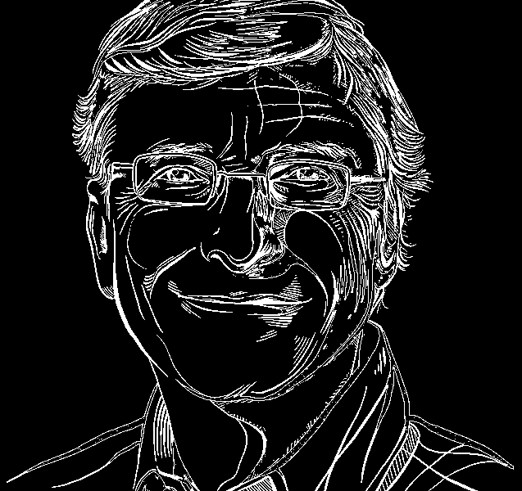
Quotes spotlight
“SUCCESS IS A LOUSY TEACHER; IT SEDUCES SMART PEOPLE INTO THINKING THEY CAN’T LOSE.”
Bill Gates

