Slide 1
RAGE
PROFESSOR: RODRIGO
BALTAZAR
CURSO: INGLES INSTRUMENTAL
AULA 2
Ab UNIT 2
PRESENT CONTINUOUS
ab

Slide 2
Grammar spotlight
+ am + verb + ing
“I am eating right now”
I
PRESENT CONTINUOUS
AFFIRMATIVE
He, She, It
+ is + verb + ing
“She is sleeping now”
You, We, They
+ are + verb + ing
“They are sleeping at this moment”
ACTIVITIES IN PROGRESS;
TEMPORARY.

Slide 3
Grammar spotlight
+ am + not + verb + ing
“I’m not eating now”
I
PRESENT CONTINUOUS
NEGATIVE
He, She, It
+ is + not + verb + ing
“She isn’t sleeping well”
You, We, They
+ are + not + verb + ing
“They aren’t working now”
ACTIVITIES IN PROGRESS;
TEMPORARY.

Slide 4
Grammar spotlight
am + subj + verb + ing
“Am I talking too loud?”
I
PRESENT CONTINUOUS
YES/NO QUESTIONS
He, She, It
is + subj + verb + ing
“Is she sleeping at this moment?”
You, We, They
are + subj + verb + ing
“Are they studying now?”
ACTIVITIES IN PROGRESS;
TEMPORARY.

Slide 5
Grammar spotlight
W + am + subj + verb + ing
“Why am I listening to this?”
I
PRESENT CONTINUOUS
W QUESTIONS
He, She, It
W + is + subj + verb + ing
“Where is she living today?”
You, We, They
W + are + subj + verb + ing
“Why are they studying now?”
ACTIVITIES IN PROGRESS;
TEMPORARY.

Slide 6
EXEMPLOS DE APLICACAO:
I
I'm working for them now.
I'm watering the plants.
Why am I listening to this?
Am I talking too loud?
He, She, It
She's driving fast today.
Be quiet please. (he) The baby is sleeping.
At the moment my wife (she) is feeding the dogs.
The sky (it) is getting dark. You'd better take an umbrella.
John (he) is not studying at the moment. He is reading a comic book.
Where is Carla? She is sitting in the living room. What is she doing? She is watching television.
You, We, They
The children (they) are playing in the garden.
They aren't talking to each other today.
Why are you reading the letter again? Because I'm checking for spelling mistakes.
What a nice dress you are wearing today.
Where are we staying this week? In a hotel.
Why are you always shouting at me?

Slide 7
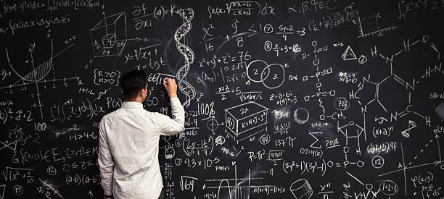
Quotes spotlight
“I’M NOT THE BEST,
BYT I’M TRYING MY BEST.”
.

