Slide 1
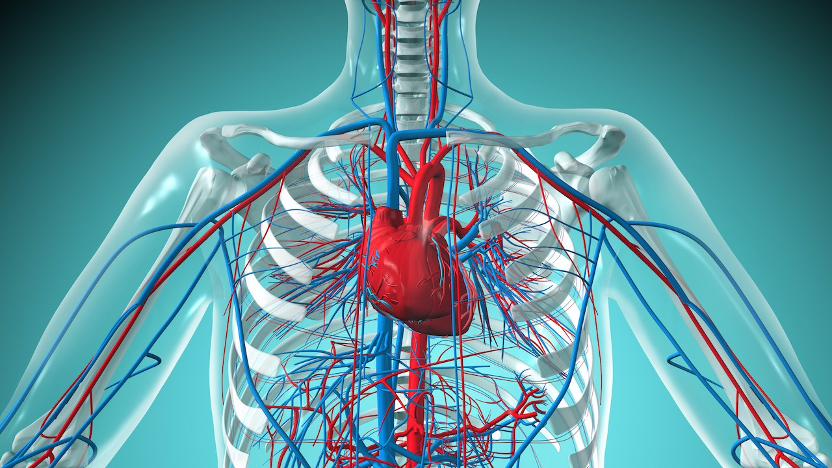
Predicting Heart Disease

Slide 2

Cardiovascular disease is the leading cause of death worldwide.
Heart disease is a cardiovascular disease.

Slide 3
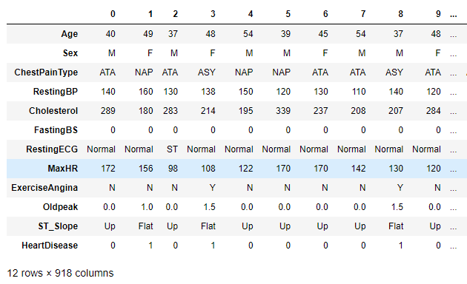
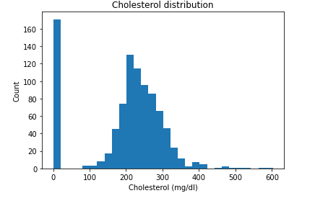
Data Wrangling

Slide 4
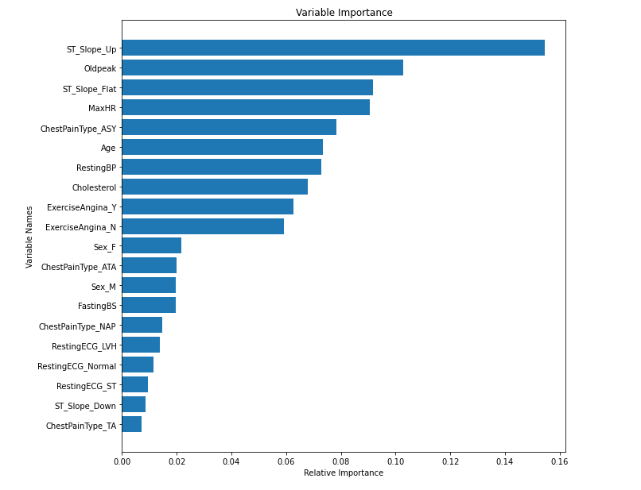
Feature importances

Slide 5
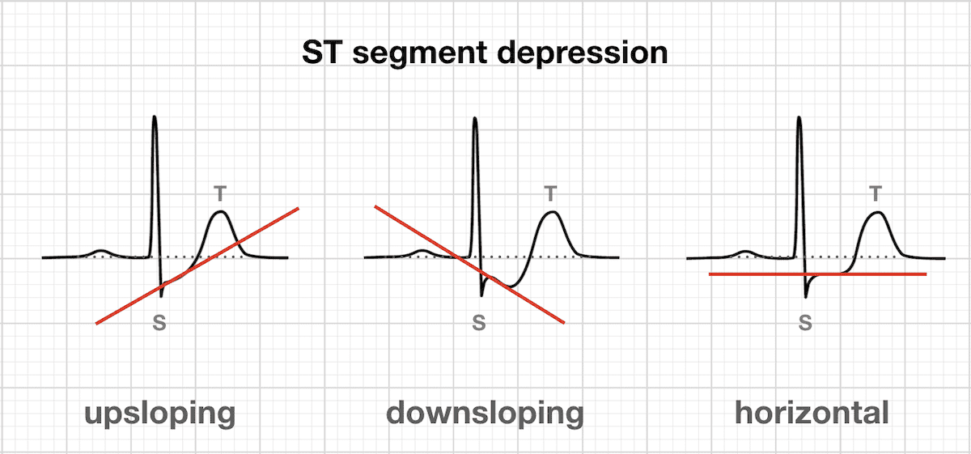
The ST segment

Slide 6
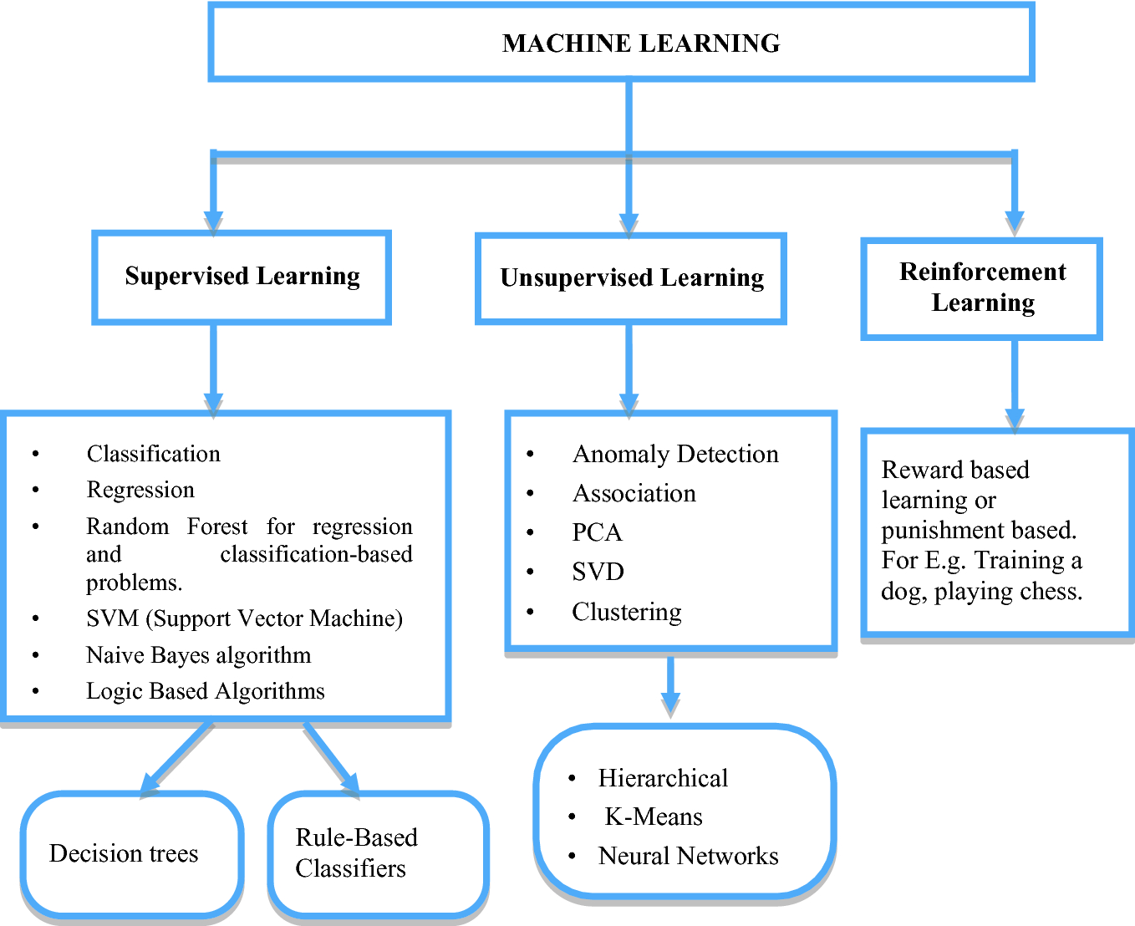
ML algorithms

Slide 7
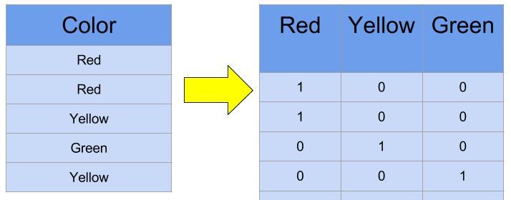
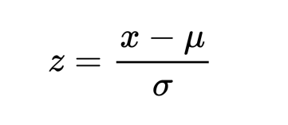
Preprocessing
OneHot Encoding
Standardizing

Slide 8
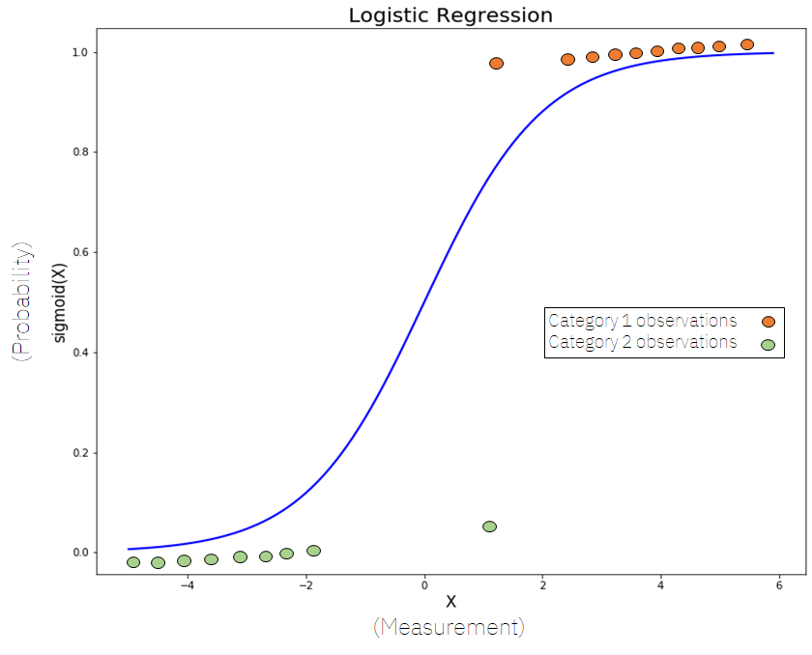

Random Forest

Slide 9
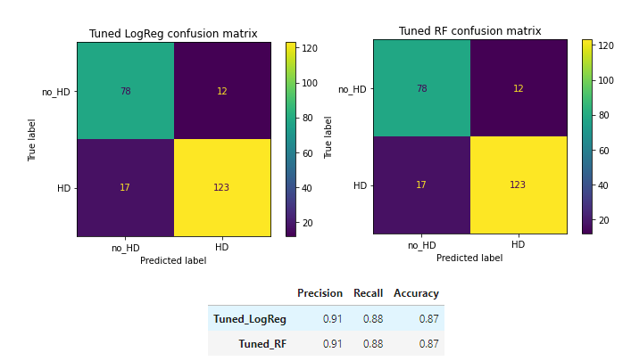
Scoring Metrics

Slide 10
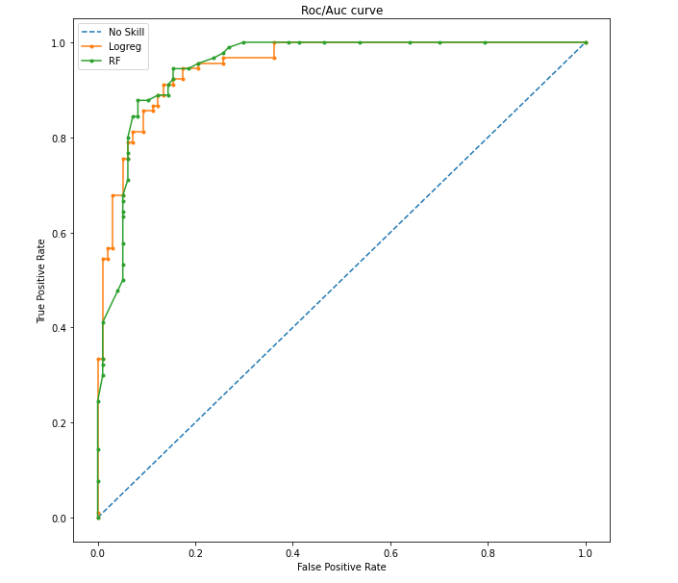


Slide 11
Recommendations…
Affecting your ST segment is a question for the cardiologists.
ST segment is an important part of heart disease screening.

Slide 12
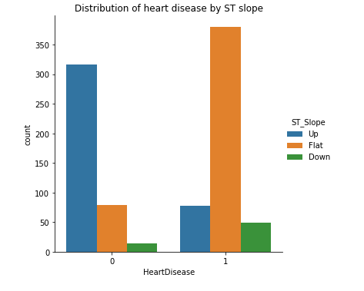
Further Questions…
SVM model?
By region analysis?
Data from more regions?
Dietary cholesterol?
High ST slope flat correlation?

