Slide 1
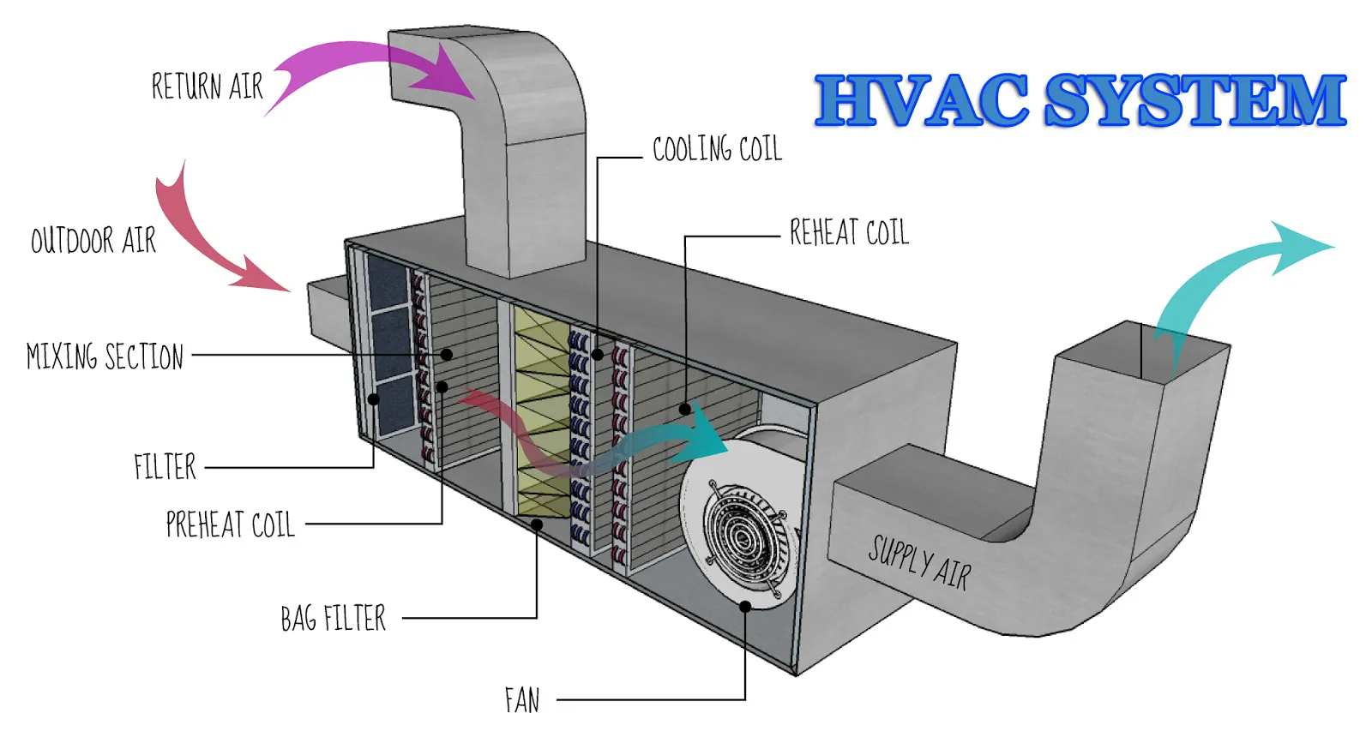
Home Temperature Time Series Forecasting

Slide 2
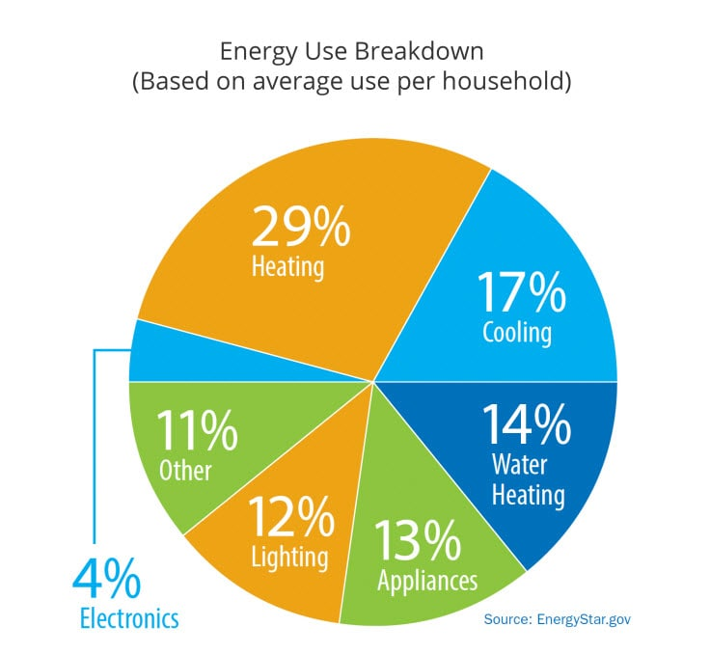
HVAC accounts for a significant portion home use energy.
Aiming for rmse of 0.05 C or less.
Data comes from one house in Spain during spring months.

Slide 3
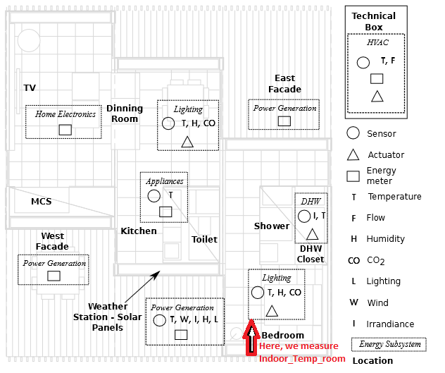
2764 observations.
Every 15 min.
18 features including temperature.
CO2, rain, light levels, etc.
How best to model this as a time series?

Slide 4
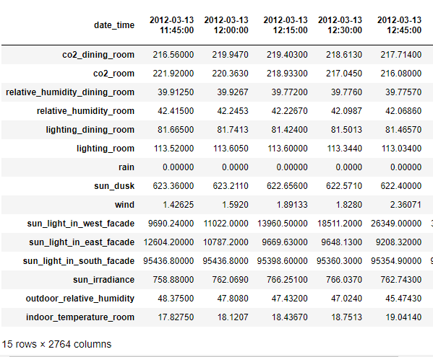
Data Cleaning
Down to 15 columns
Data already quite clean
Changes mostly superficial

Slide 5
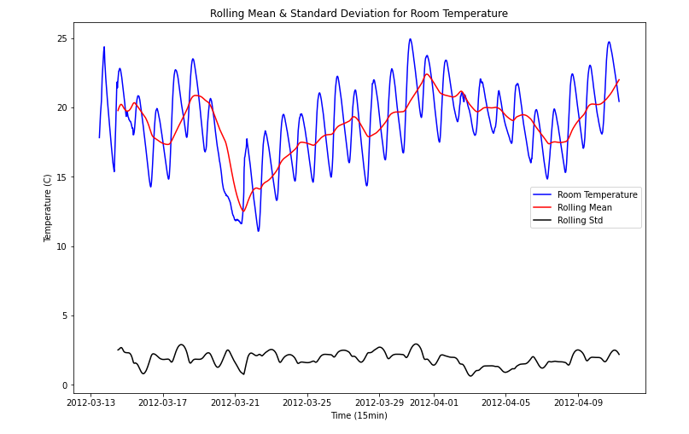
Exploratory Data Analysis
Column values over time
Column correlations with the room temperature
Room Temperature over time
Stationarity

Slide 6
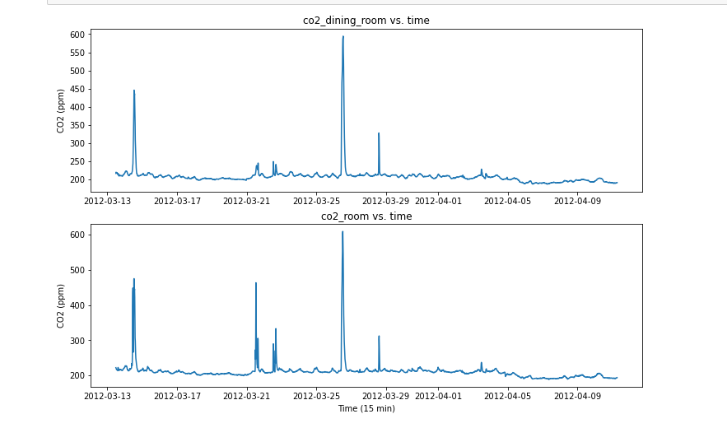
Column Values Over Time
High cyclicality to lighting columns
Rained twice: categorical
Sun dusk: categorical
Standard Scaling

Slide 7
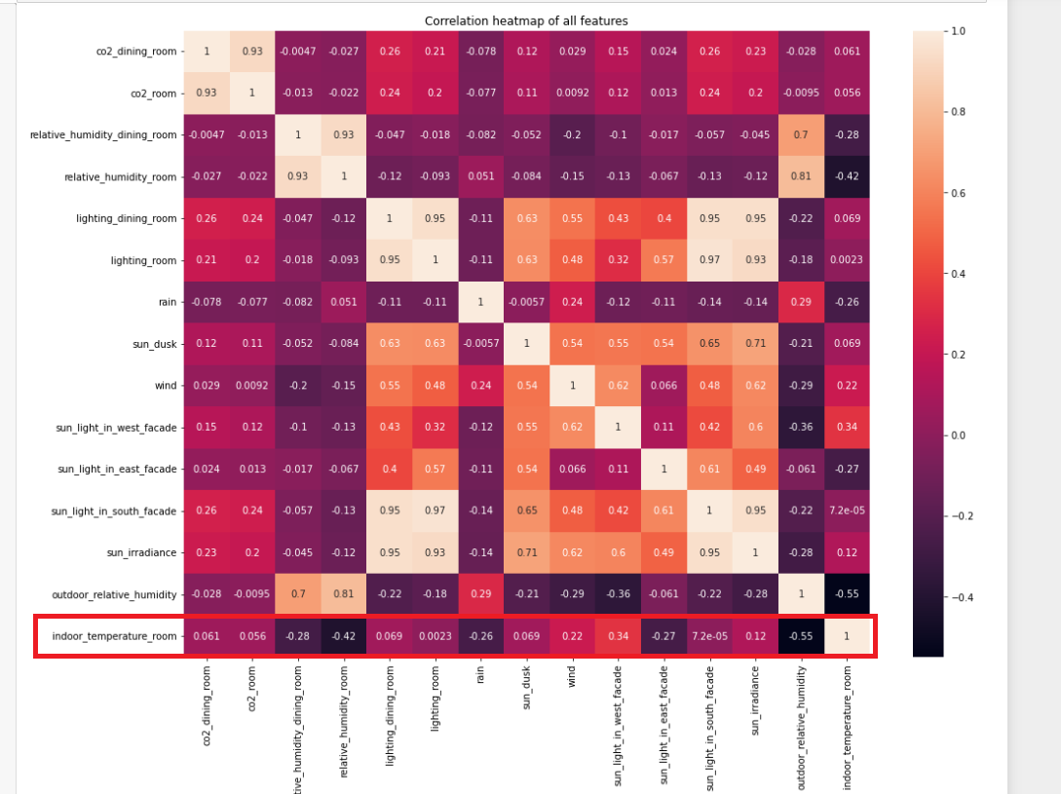
Column correlations with the room temperature
-0.55 with outdoor humidity
-0.42 with indoor room humidity
0.34 with sunlight in west facade

Slide 8
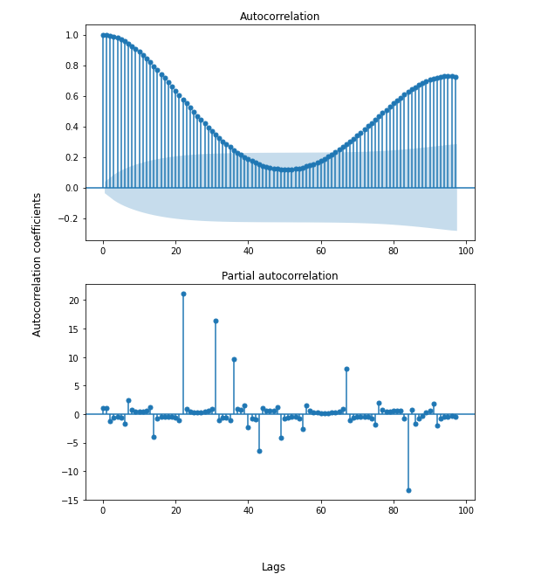
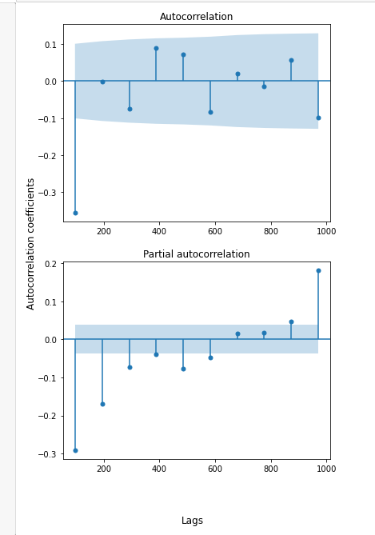
Room Temperature Over Time: Determine Order Parameters for SARIMAX Model

Slide 9
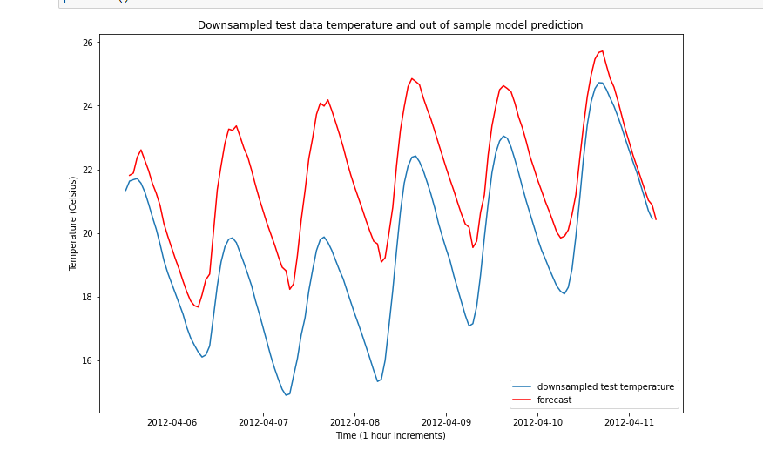
SARIMAX: (0, 1, 0), (0, 1, 1, 24)
Downsampled to hourly
Exogenous variables included
Better than auto_arima’s (1, 1, 0), (3, 1, 0, 24)
~ 2.65 C RMSE

Slide 10
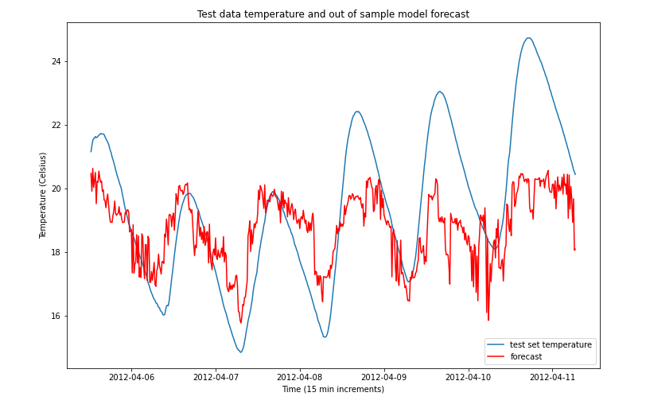
Random Forest Regressor: (50 branches, max depth 60)
~ 2.0 C RMSE
High degree of overfit (~1.87 train/test rmse difference)

Slide 11
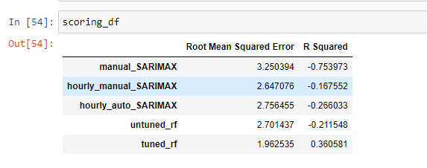
Final Recommendation: Random Forest Regressor

Slide 12
Suggestions for Improvement
Test more regression models
Long Short-Term Memory (LTSM) recurrent neural network
More data at a lower sample
Yearly seasonality
Better scores with hourly sample rate
Dimensionality reduction

