Slide 1


Slide 2
Carbon dioxide monitoring system
Iot (Internet of things) Based project

Slide 3
Components:
Arduino Genuino Board
Mq135 Gas sensor
Buzzer(Alarm)
Python script

Slide 4
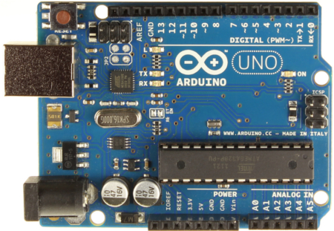
Arduino:
Arduino is an open-source electronics platform based on easy-to-use hardware and software. Arduino boards are able to read inputs - light on a sensor, a finger on a button, or a Twitter message - and turn it into an output - activating a motor, turning on an LED, publishing something online.

Slide 5
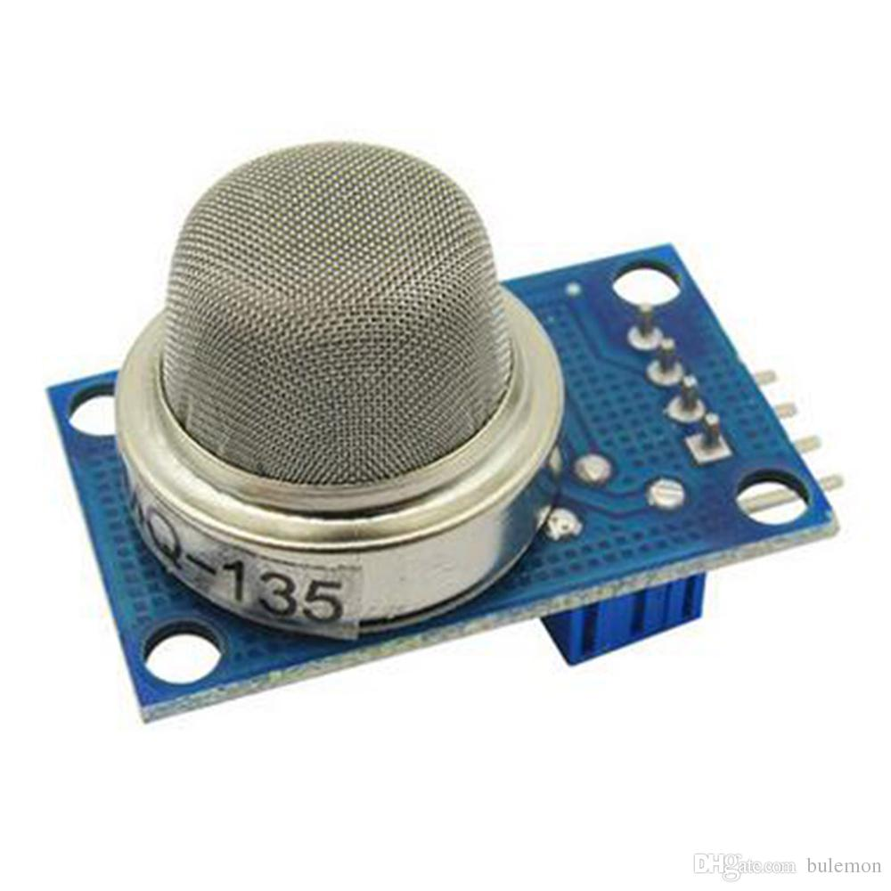
Mq135 gas sensor:
The MQ-135 Gas sensors are used in air quality control equipments and are suitable for detecting or measuring of NH3, NOx, Alcohol, Benzene, Smoke, CO2. The MQ-135 sensor module comes with a Digital Pin which makes this sensor to operate even without a microcontroller and that comes in handy when you are only trying to detect one particular gas. If you need to measure the gases in PPM the analog pin need to be used. The analog pin is TTL driven and works on 5V and so can be used with most common microcontrollers.

Slide 6
Working principle:
Gas sensor
Arduino
USB Port “COM4”
Python program
Thingspeak cloud server

