Slide 1
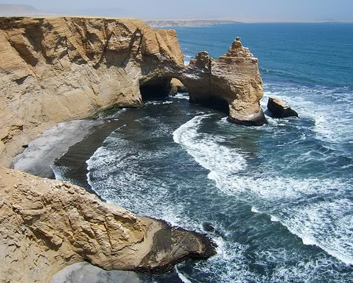
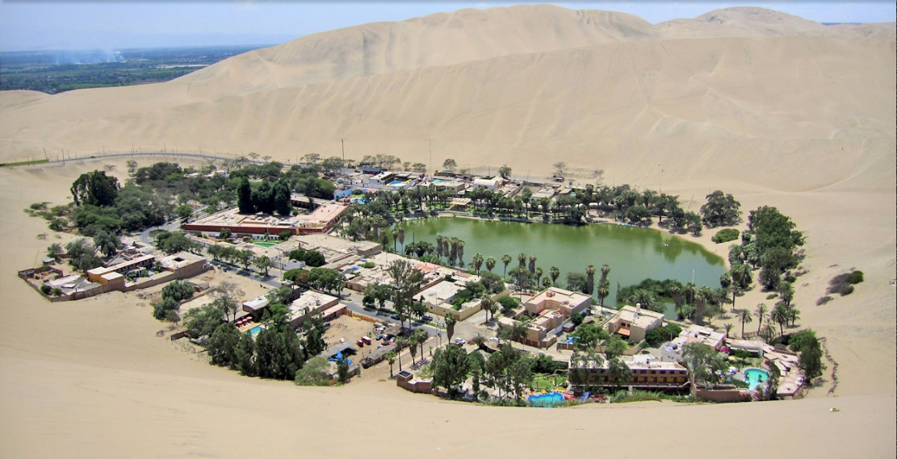
Paracas national reserve
Paracas has the most beautiful sights like sea and desert of Peru. It covers 335.000 hectares in the department of Ica. The best you can see are aquatic species like sea lions, Humboldt penguins (they are endangered species) and guano birds. This ecosystem is the most productive because the sea is very cold.

Slide 2

The Candelabro
Candelabro, located northwest of Paracas Bay is a hieroglyph that has an extension of 120 meters.
The Candelabro is engraved on a cream rock, but mostly covered with sand. The sand never gets to completely erase the chandelier because of the winds that are always removing excess sand channels

Slide 3

huacachina
Huacachina is the most famous oasis located to 5 km of the city of Ica. It has beautiful sights surrounded of huge sand dunes. After hiking the trail we can start the sand board sport. You’ll never forget the sight.

Slide 4
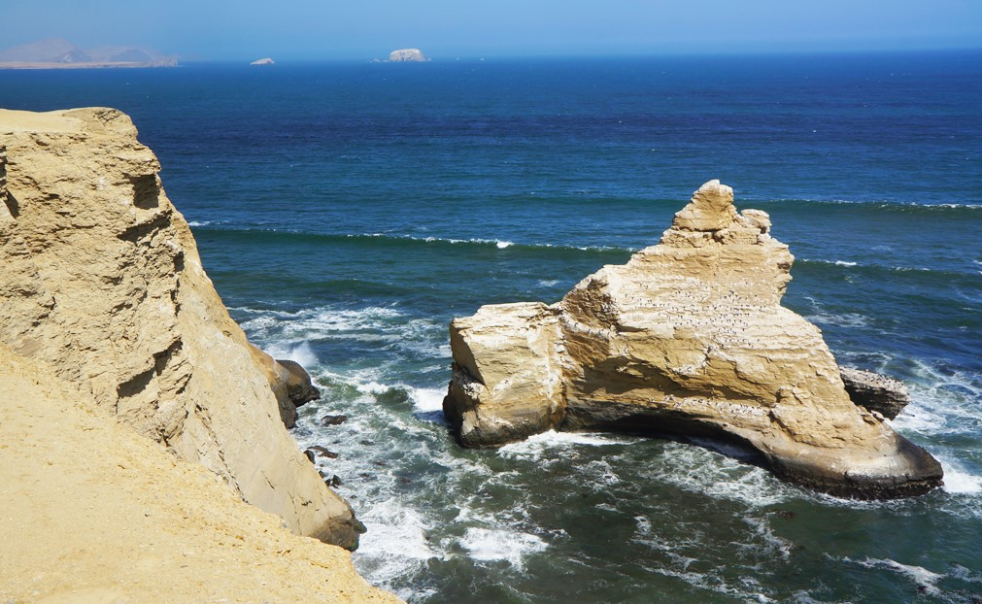
The cathedral
The cathedral is a rock formation caused by sea erosion and wind. It has a concave shape that is reminiscent of the domes of the cathedrals.
It is located between Supay Yumaque and beaches.
Inside the cathedral are some marine living chingungos cats and some seabirds.

