Slide 1
Global Terrorism Data Project
Group name: ComputerPizzazz
Group members: Evan Pennebaker, Cayden Dunn,
Ezekiel Murphy

Slide 2
The Data Set
The Global Terrorism Database is an open-source database. The Global Terrorism Database includes systematic data on domestic as well as international terrorist incidents.
Definition of terrorism - "The threatened or actual use of illegal force and violence by a non-state actor to attain a political, economic, religious, or social goal through fear, coercion, or intimidation."
This database was created by researchers at the National Consortium for the Study of Terrorism and Responses to Terrorism.

Slide 3
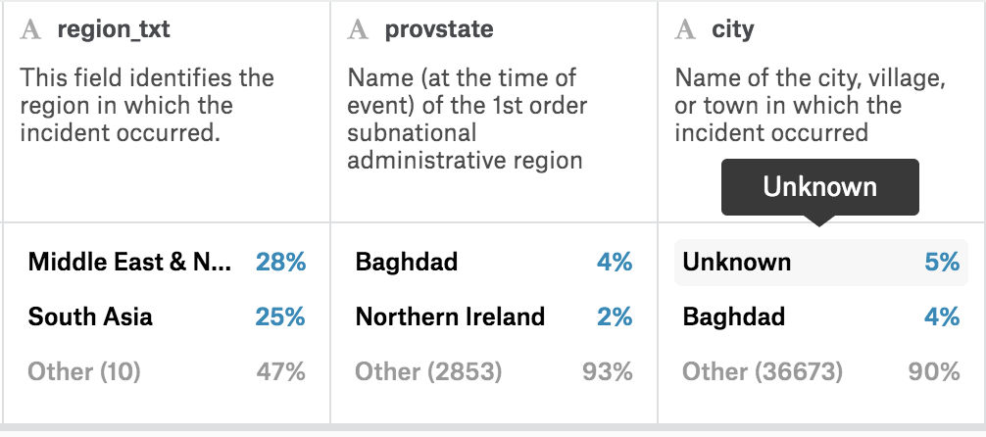

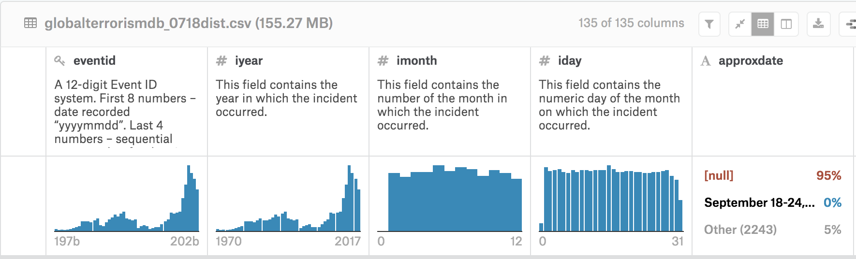
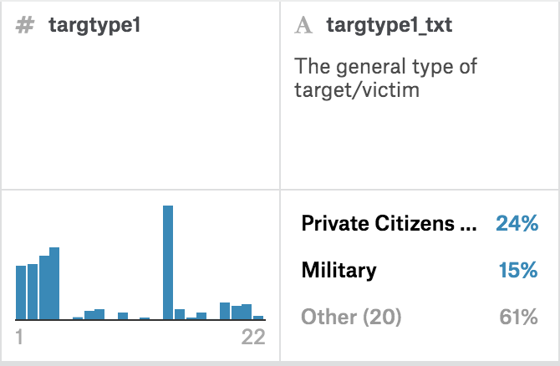
Looking at the Data
This Data set had some very interesting columns that really grabbed our attention
Eventid
Target type
Attack type
Success
Suicide
Latitude and longitude

Slide 4
Questions
Question 1 - Which terrorist group has the performed the highest amount of terrorist acts since 1970? Which of these terrorist groups is responsible for the most deaths since 1970?
Question 2 - How deadly is a certain type of attack? Use different features from the data set to determine the deadliness or effectiveness of attacks to help prescribe policy making
Question 3 - Is terrorism increasing? What region is attacked the most? How are terrorist attacking us?

Slide 5
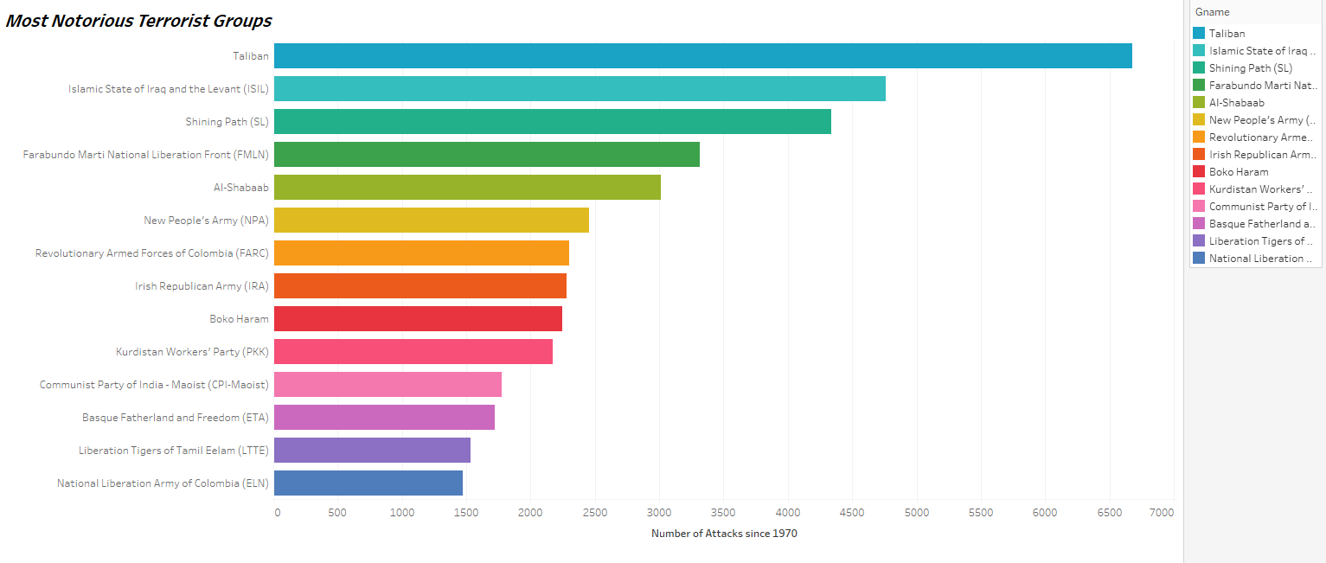
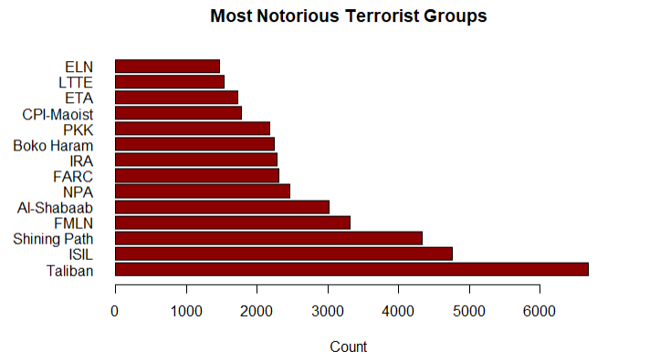
Which terrorist group has the performed the highest amount of terrorist acts since 1970?
The Taliban has performed the most terrorist acts out of all terrorist organizations with 6, 680 successful terrorist acts between 1970 and 2017. The Islamic State of Iraq and the Levant (ISIL) and Shining Path (SL) were the next two highest terrorist groups, with 4,759 and 4,337 successful terrorist acts performed between 1970 and 2017.
R markdown: used barplot function to graph number of successful attacks for the top 14 notorious terrorist groups with custom parameters/margins, “las” for group names, dark red for the column color

Slide 6
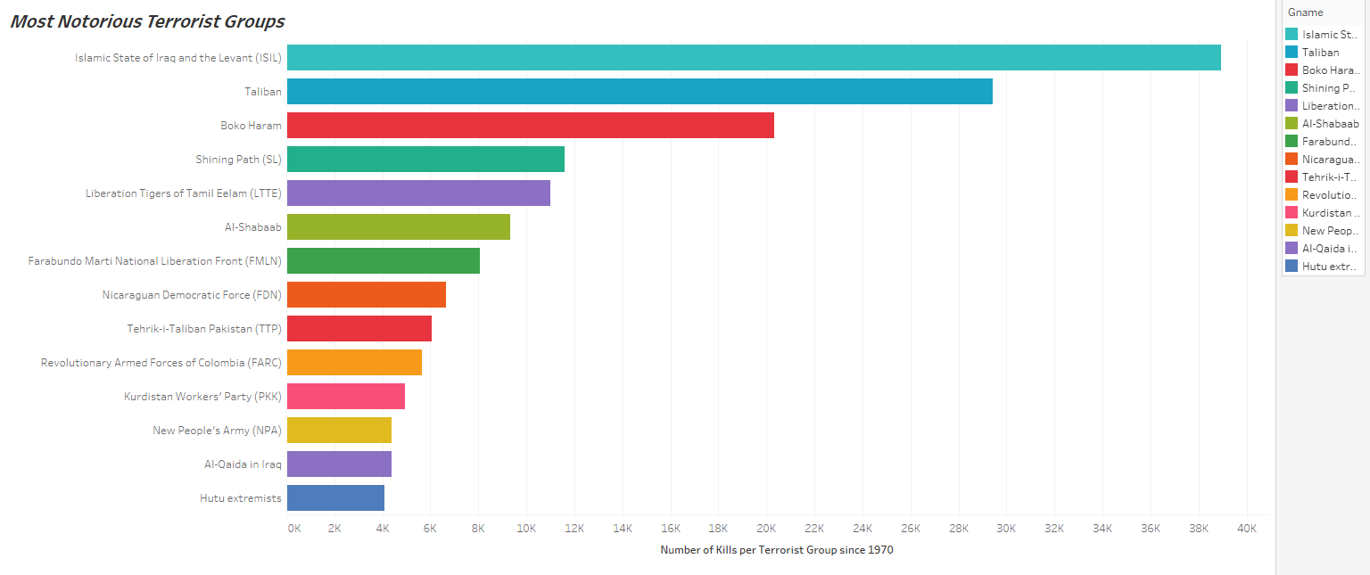
Which of these terrorist groups is responsible for the most deaths since 1970?
Although the group was only second in number of terrorist acts performed, The Islamic State of Iraq and the Levant (ISIL) is responsible for the most casualties since 1970 at a whopping 38,923. The Taliban is responsible for 29,410 casualties; Boko Haram for 20,328 casualties and Shining Path for 11,601. This is interesting because Boko Haram has performed only half as many terrorist acts as Shining Path, but is responsible for almost double the amount of casualties.

Slide 7
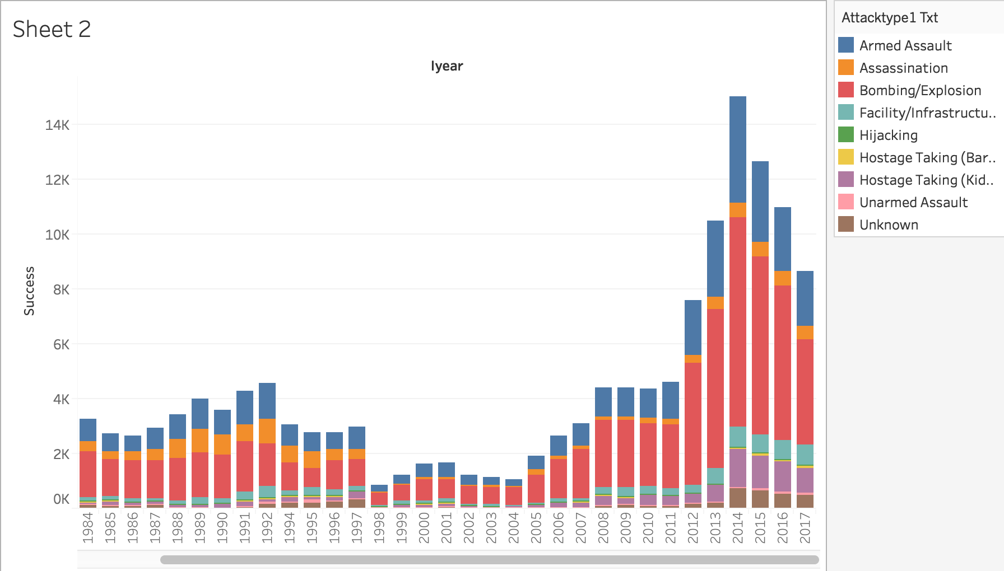
How Successful Have Terrorist Attacks Been?
Successful attacks have been on the decline since 2014 (peak of successful attacks). There were more armed assault attacks in 2017 than attacks in general in 1998. Bombings were consistent until roughly 1992, then started to drastically increase since 2006. There were 14, 876 successful attacks in 2014. In recent years, there have been roughly 1,000 kidnappings each year. This model includes years 1980 - 2017 and each attack type.

Slide 8
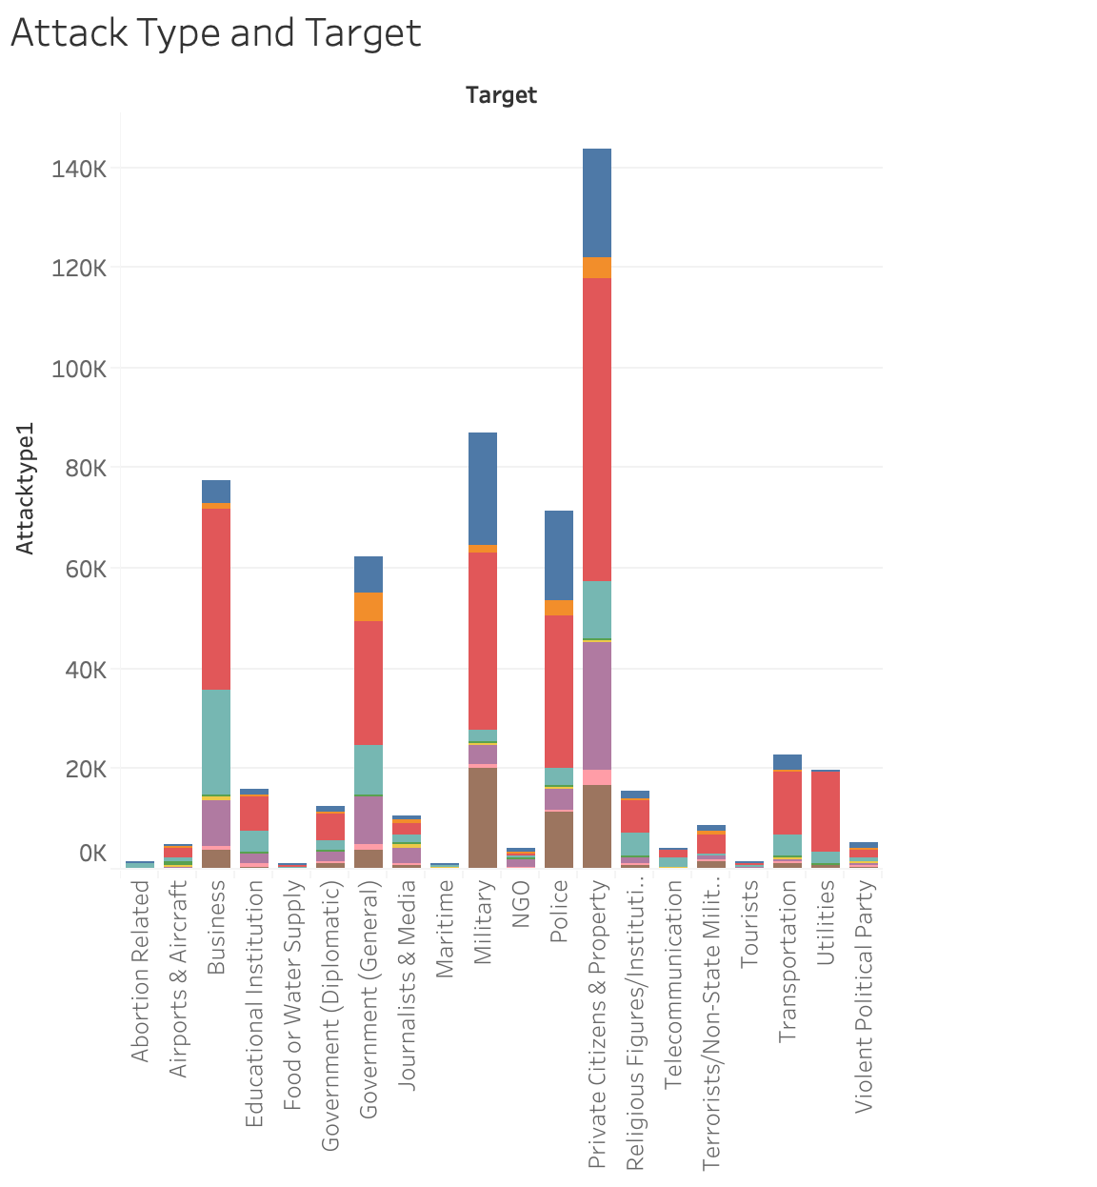
How Are People Attacking Specific Targets?
Private Citizens are the number one target in the world. Bombings/Explosions are the most common weapon type used against them. Over 140,000 private citizens have been killed by terrorists since 1970.

Slide 9
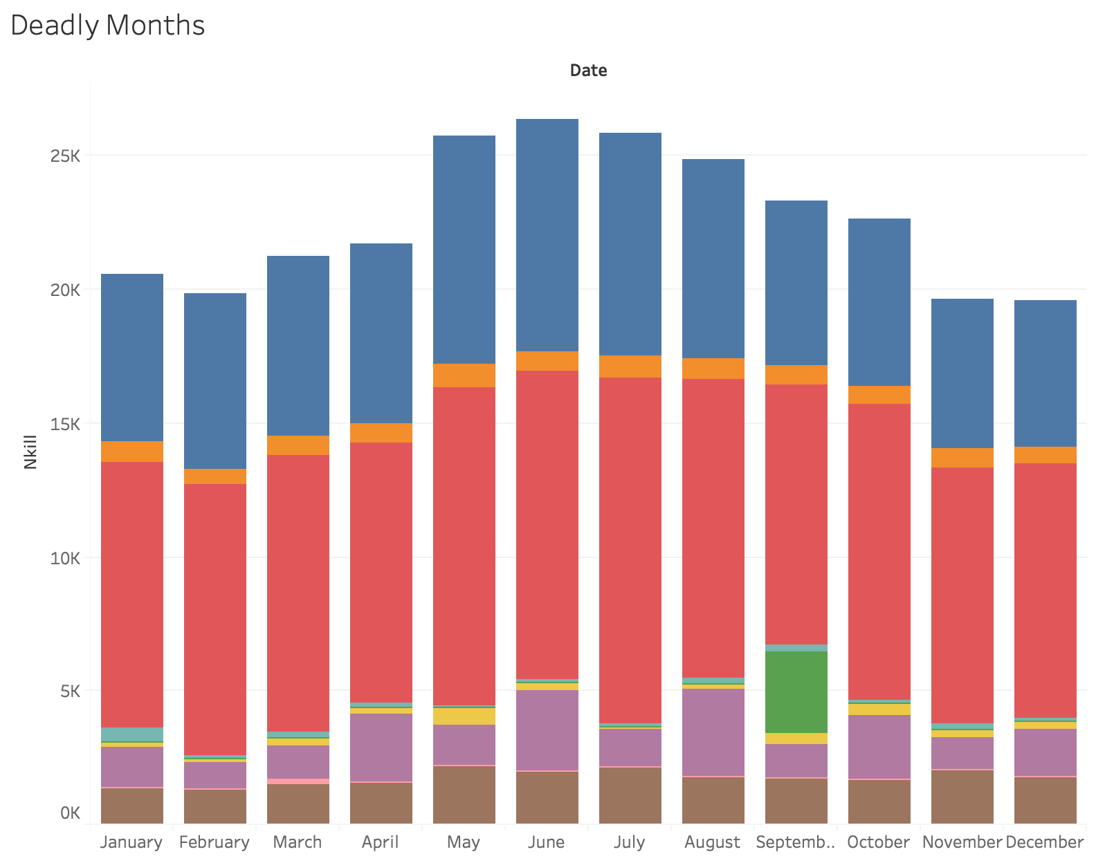
What Months Are the Deadliest?
This model looks at every month of every year since 2000. June of 2014 was the deadliest month of terrorism recorded. There were 1,800 kidnappings, 2400 armed assaults, and 1600 bombings in that month alone. June, July, and August tend to have more deaths than the rest of the months. The 9/11 attack was the deadliest month until May 2014.

Slide 10
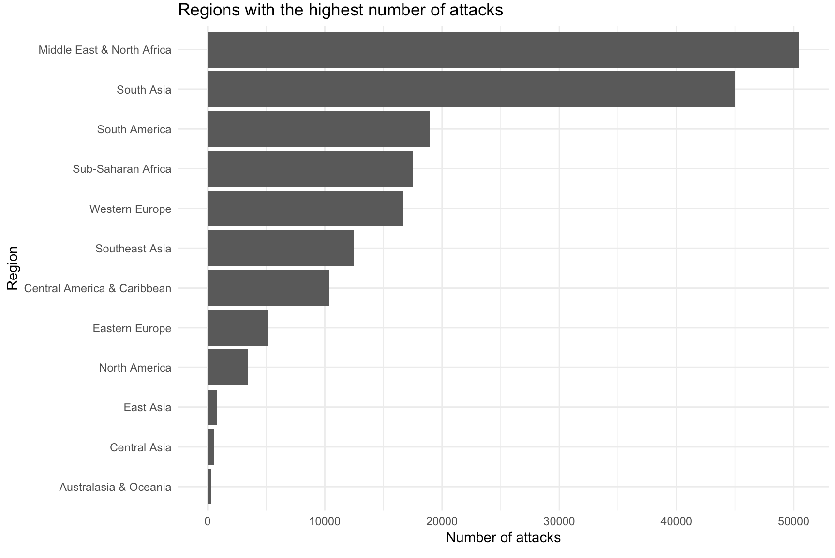
Has terrorism increased over the years
Looking at this graphic we can conclude that the The Middle East and North Africa is a hotbed for terrorist activity as it has more than 10,000 more attacks then the second most terrorised region of South Africa. This graphic shows which regions experience the highest concentration of terrorist activity and therefore which need the most help from the global community to rid it of this excessive terrorist activity.

Slide 11
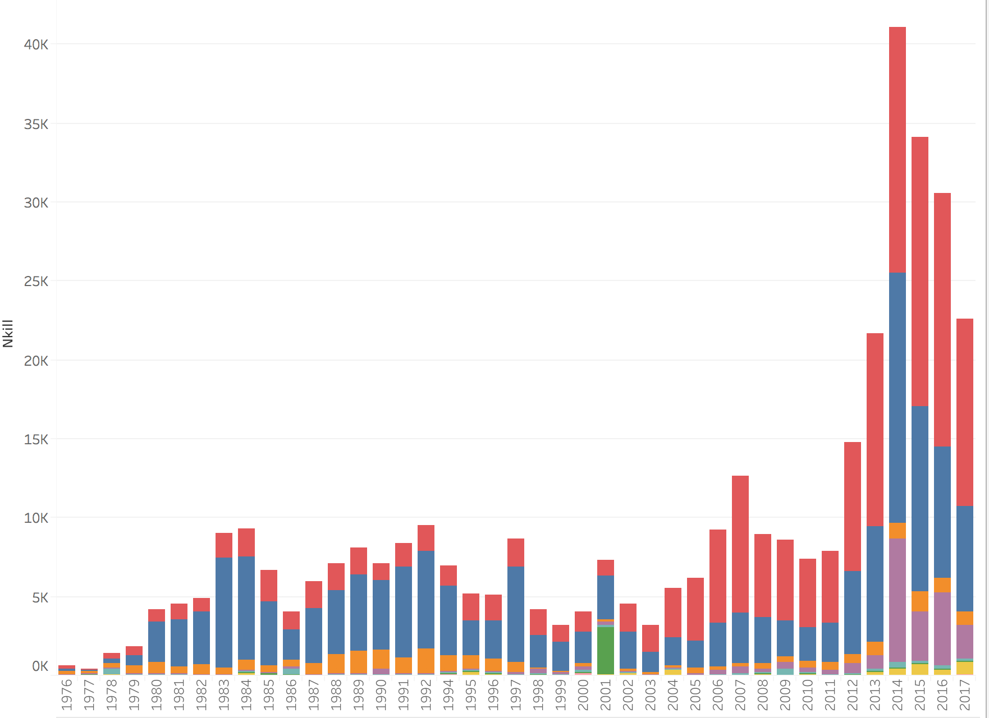
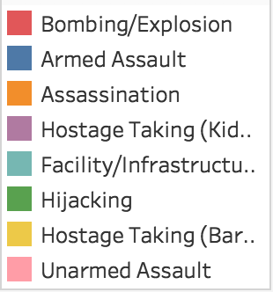
Has terrorism increased over the years with attack type
This graphic clearly displays the fact that after the year 2011 there was a significant spike in terrorist attacks. In fact after 2011 terrorist attacks nearly triple before seeing a quick decline.
This is the same model created in Tableau instead of R. This model also includes the type of attack that was used the most.

Slide 12
Tableau
Link to models
Dashboard 1 - https://public.tableau.com/profile/cayden.dunn#!/vizhome/GlobalTerrorismMapandBarFORCOMPUTER/Cayden?publish=yes
Dashboard 2 - https://public.tableau.com/profile/cayden.dunn#!/vizhome/GlobalTerrorismMapandBarwoundedFORCOMPUTER/Dashboard2?publish=yes
Dashboard 3- https://public.tableau.com/profile/evan.pennebaker#!/vizhome/AttacktypeTargetTypeandDeadlyMonths/Dashboard3?publish=yes

Slide 13
Conclusion
The Taliban has committed more attacks than any other group in history. ISIL has killed more people however.
In 2014, the world experienced the most terrorist activity in history. Successful attacks have been on the decline since then. The summer months of the year are the deadliest.
The Middle East and North Africa is the hotbed for terrorism. Australia & Oceania is the “safest” region in the world.
Terrorism has been on the decline since 2012.

