Slide 1


DataStream API
Windows & Time
Apache Flink® Training
Flink v1.2 – 05.05.2017

Slide 2
Windows and Aggregates

Slide 3
Windows
Aggregations on DataStreams are different from aggregations on DataSets
You cannot count all records of an unbounded stream
Aggregations make sense on windowed streams
A window is a finite subset of stream elements

Slide 4
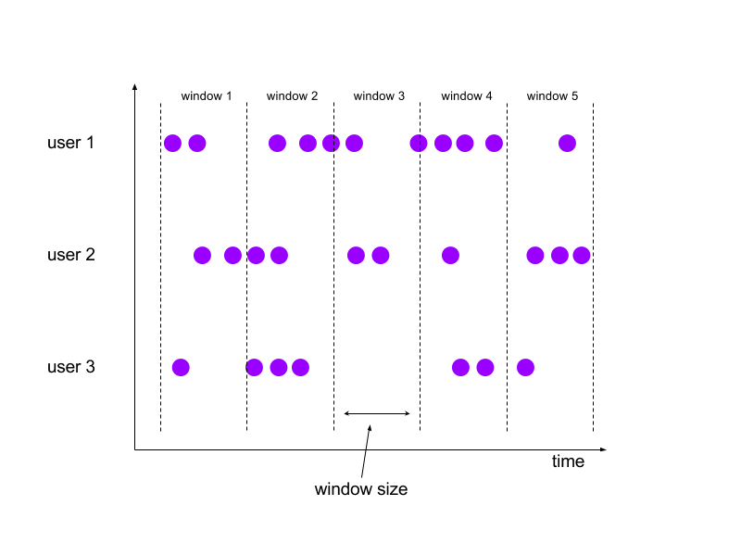
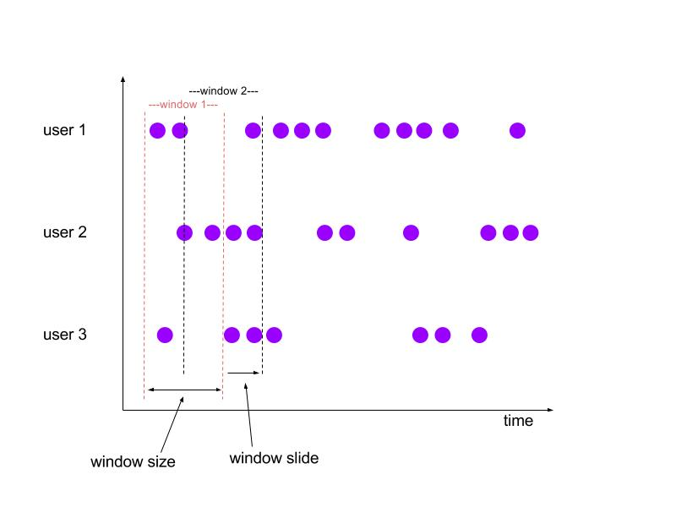
Tumbling and Sliding Windows
Tumbling:
aligned, fixed length,
non-overlapping windows
Sliding:
aligned, fixed length,
overlapping windows

Slide 5
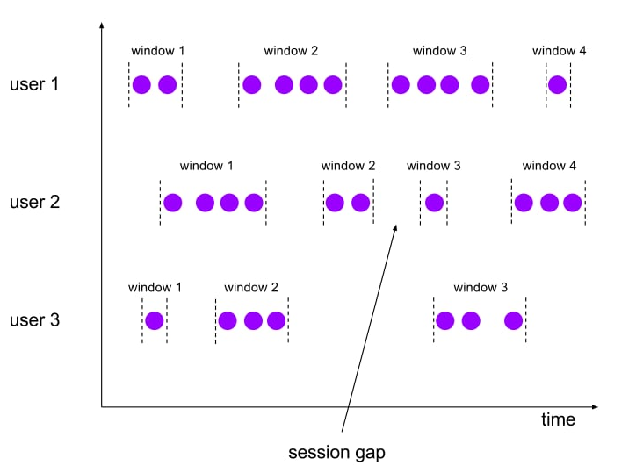
Session Windows
Non-aligned, variable length windows.

Slide 6
Specifying Windowing
stream
.keyBy(…) / keyed vs non-keyed windows
.window(…) / “Assigner”
.trigger(…) / each Assigner has a default Trigger
.evictor(…) / default: no Evictor
.allowedLateness() / default: zero
.reduce/apply() / window function

Slide 7
Predefined Keyed Windows
Tumbling time window
.timeWindow(Time.minutes(1))
Sliding time window
.timeWindow(Time.minutes(1), Time.seconds(10))
Tumbling count window
.countWindow(100)
Sliding count window
.countWindow(100, 10)
Session window
.window(SessionWindows.withGap(Time.minutes(30)))

Slide 8
Non-keyed Windows
Windows on non-keyed streams are not processed in parallel!
stream.windowAll(…)…
stream.timeWindowAll(Time.seconds(10))…
stream.countWindowAll(20, 10)…

Slide 9
Aggregations on Windowed Streams
DataStream<SensorReading> input = …
input
.keyBy(“key”)
.timeWindow(Time.minutes(1))
.apply(new MyWastefulMax());
public static class MyWastefulMax implements WindowFunction<
SensorReading, // input type
Tuple3<String, Long, Integer>, // output type
Tuple, // key type
TimeWindow> { // window type @Override public void apply( Tuple key, TimeWindow window, Iterable<SensorReading> events, Collector<Tuple3<String, Long, Integer>> out) {
int max = 0;
for (SensorReading e : events) { if (e.f1 > max) max = e.f1; } out.collect(new Tuple3<>(Tuple1<String>key).f0, window.getEnd(), max)); } }

Slide 10
Window State during Aggregation
state
7

Slide 11
Window State during Aggregation
state
9
7

Slide 12
Window State during Aggregation
state
3
9
7

Slide 13
Window State during Aggregation
state
8
3
9
7

Slide 14
Window State during Aggregation
state
8
3
9
7
9
window trigger

Slide 15
Incremental Window Aggregation
DataStream<SensorReading> input = …
input
.keyBy(“key”)
.timeWindow(Time.minutes(1))
.reduce(new MyReducingMax(), new MyWindowFunction());
private static class MyReducingMax implements ReduceFunction<SensorReading> {
public SensorReading reduce(SensorReading r1, SensorReading r2) {
return r1.value() > r2.value() ? r1 : r2;
}
}
private static class MyWindowFunction implements WindowFunction<
SensorReading, Tuple2<Long, SensorReading>, String, TimeWindow> {
public void apply(String key,
TimeWindow window,
Iterable<SensorReading> maxReadings,
Collector<Tuple2<Long, SensorReading>> out) {
SensorReading max= maxReadings.iterator().next();
out.collect(new Tuple2<Long, SensorReading>(window.getStart(), max));
}
}

Slide 16
Incremental Aggregation
state
8, 3, 9, 7
7

Slide 17
Incremental Aggregation
state
8, 3, 9
7
9
8, 3, 9

Slide 18
Incremental Aggregation
state
8, 3
9
9
3

Slide 19
Incremental Aggregation
state
8
9
9
3

Slide 20
Incremental Aggregation
9
9
window trigger

Slide 21
Operations on Windowed Streams
reduce(reduceFunction)
Apply a functional reduce function to the window
fold(initialVal, foldFunction)
Apply a functional fold function with a specified initial value to the window
Aggregation functions
sum(), min(), max(), and others
Notes:
Folding has been deprecated, and will eventually be removed.

Slide 22
Custom window logic
The DataStream API allows you to define very custom window logic
GlobalWindows
a flexible, low-level window assignment scheme that can be used to implement custom windowing behaviors
only useful if you explicitly specify triggering, otherwise nothing will happen
Trigger
defines when to evaluate a window
whether to purge the window or not
Careful! This part of the API requires a good understanding of the windowing mechanism!

Slide 23
Handling Time Explicitly

Slide 24
The biggest change in moving from batch to streaming is handling time explicitly

Slide 25
Different Notions of Time
Event Producer
Message Queue
Flink Data Source
Flink Window Operator
partition 1
partition 2
Event Time
Ingestion Time
Window Processing Time
Notes:
There’s also Kafka ingestion time (or stream storage time), which has the advantage (compared to Flink injestion time) of being consistent when replayed.

Slide 26

Event Time vs Processing Time
This is called event time
Episode V:
The Empire
Strikes Back
Episode VI:
Return of
the Jedi
Episode I:
The Phantom
Menace
Episode II:
Attach of
the Clones
Episode III:
Revenge of
the Sith
Episode VII:
The Force
Awakens
Episode IV:
A New Hope
1977
1980
1983
1999
2002
2005
2015
This is called processing time

Slide 27
Setting the StreamTimeCharacteristic
final StreamExecutionEnvironment env =
StreamExecutionEnvironment.getExecutionEnvironment(); env.setStreamTimeCharacteristic(TimeCharacteristic.EventTime); // alternatively: // env.setStreamTimeCharacteristic(TimeCharacteristic.IngestionTime); // env.setStreamTimeCharacteristic(TimeCharacteristic.ProcessingTime);

Slide 28
Choosing Event Time has Consequences
With event time, Flink needs to know
how to extract timestamps from stream elements
when enough event time has elapsed that a time window should be triggered

Slide 29
Watermarks
Watermarks mark the progress of event time
They flow with the data stream and carry a timestamp
Watermarks assert that all earlier events have (probably) arrived
Stream (in order)
25
23
22
20
19
17
15
13
12
10
9
6
5
W(20)
W(10)
Watermark
Event
Event timestamp
29

Slide 30
Perfect Watermarks
When stream elements are in order (or in order by key), we can achieve perfect watermarking
Stream (in order)
25
23
22
20
19
17
15
13
12
10
9
6
5
W(20)
W(10)
Watermark
Event
Event timestamp
30

Slide 31
Bounded out-of-orderness
When events are out-of-order, we often assume there is some bound to how out-of-order they can be
Stream (out of order)
23
19
22
24
21
14
17
13
12
15
9
11
7
W(3)
maxOutOfOrderness = 4
31

Slide 32
Bounded out-of-orderness
Each time a new maximum timestamp arrives, we have enough info to emit a new Watermark
Stream (out of order)
23
19
22
24
21
14
17
13
12
15
9
11
7
W(7)
W(3)
maxOutOfOrderness = 4
32

Slide 33
Bounded out-of-orderness
Each time a new maximum timestamp arrives, we have enough info to emit a new Watermark
Stream (out of order)
23
19
22
24
21
14
17
13
12
15
9
11
7
W(11)
W(7)
W(3)
maxOutOfOrderness = 4
33

Slide 34
Bounded out-of-orderness
Each time a new maximum timestamp arrives, we have enough info to emit a new Watermark
Stream (out of order)
23
19
22
24
21
14
17
13
12
15
9
11
7
W(20)
W(17)
W(13)
W(11)
W(7)
W(3)
34

Slide 35
How often to emit Watermarks?
Here we are emitting an new Watermark as often as possible
However, it is best to avoid generating too many Watermarks
Stream (out of order)
23
19
22
24
21
14
17
13
12
15
9
11
7
W(20)
W(17)
W(13)
W(11)
W(7)
W(3)
35

Slide 36
Watermarks define Lateness
Elements where timestamp < currentWatermark are late
Late Event
Stream (out of order)
23
19
22
24
21
14
17
13
12
15
9
11
7
W(20)
W(17)
W(13)
W(11)
W(7)
W(3)
36

Slide 37
Two Styles of Watermark Generation
Periodic Watermarks
Based on a timer
BoundedOutOfOrdernessGenerator is an example
ExecutionConfig.setAutoWatermarkInterval(msec) controls the interval at which your periodic watermark generator is called
Punctuated Watermarks
Based on something in the event stream
37

Slide 38
Pre-defined timestamp extractors / watermark emitters
AscendingTimestampExtractor
For special case when timestamps are in ascending order
BoundedOutOfOrdernessTimestampExtractor
Periodically emits watermarks that lag a fixed amount of time behind the max timestamp seen so far

Slide 39
Example
stream
.assignTimestampsAndWatermarks(new MyTSExtractor())
.keyBy(...)
.timeWindow(...)
.addSink(...);
public static class MyTSExtractor extends
BoundedOutOfOrdernessTimestampExtractor<TaxiRide> {
public TaxiRideTSExtractor() {
super(Time.seconds(MAX_EVENT_DELAY));
}
@Override
public long extractTimestamp(TaxiRide ride) {
return ride.startTime.getMillis();
}
}

Slide 40
public class BoundedOutOfOrdernessGenerator extends
AssignerWithPeriodicWatermarks<MyEvent> {
private final long maxOutOfOrderness = 3500; // 3.5 seconds
private long currentMaxTimestamp;
@Override
public long extractTimestamp(MyEvent element, long previousElementTimestamp) {
long timestamp = element.getCreationTime();
currentMaxTimestamp = Math.max(timestamp, currentMaxTimestamp);
return timestamp;
}
@Override
public Watermark getCurrentWatermark() {
// watermark is current highest timestamp minus the out-of-orderness bound
return new Watermark(currentMaxTimestamp - maxOutOfOrderness);
}
}

Slide 41
public class PunctuatedAssigner extends AssignerWithPunctuatedWatermarks<MyEvent> {
@Override
public long extractTimestamp(MyEvent element, long previousElementTimestamp) {
return element.getCreationTime();
}
@Override
public Watermark checkAndGetNextWatermark(MyEvent lastElement,
long extractedTimestamp) {
return lastElement.hasWatermarkMarker() ?
new Watermark(extractedTimestamp) : null;
}
}

Slide 42

Watermarks in Parallel
Event
[id|timestamp]
Watermark
Source (1)
29
14
map (1)
29
window (1)
Q|44
N|39
M|39
K|35
B|31
A|30
W(33)
14
C|30
Watermark Generation
D|15
Event Time
at input streams
W(17)
E|30
29
Source (2)
17
14
map (2)
window (2)
H|20
G|18
F|15
R|37
O|23
L|22
W(17)
14
Event Time
at the operator

Slide 43
Per-Kafka-Partition Watermarks
N|39
L|35
33
29
14
Source (1)
map (1)
29
window (1)
K|77
B|73
A|30
O|97
M|89
W(33)
C|33
14
Watermark Generation
D|18
W(17)
E|31
29
17
17
14
Q|23
I|21
Source (2)
map (2)
window (2)
H|94
G|91
F|15
T|99
S|97
W(17)
14

Slide 44
Watermarking
Perfect
(Un)comfortably bounded by fixed delay
too slow: results are delayed
too fast: some data is late
Heuristic
allow windows to produce results as soon as meaningfully possible, and then continue with updates during the allowed lateness interval

Slide 45
References
The Dataflow Model: A Practical Approach to Balancing Correctness, Latency, and Cost in Massive-Scale, Unbounded, Out-of-Order Data Processing
https://research.google.com/pubs/pub43864.html
Documentation
https://ci.apache.org/projects/flink/flink-docs-release-1.2/dev/event_time.html
https://ci.apache.org/projects/flink/flink-docs-release-1.2/dev/event_timestamps_watermarks.html
https://ci.apache.org/projects/flink/flink-docs-release-1.2/dev/windows.html
Blog posts
http://flink.apache.org/news/2015/12/04/Introducing-windows.html
http://data-artisans.com/how-apache-flink-enables-new-streaming-applications-part-1/
https://www.mapr.com/blog/essential-guide-streaming-first-processing-apache-flink
http://data-artisans.com/session-windowing-in-flink/

