Slide 1


DataStream API
State & Failure Recovery
Apache Flink® Training
Flink v1.3 – 20.06.2017

Slide 2
Working with (Rescalable) State

Slide 3
Stateful Functions
All DataStream functions can be stateful
Flink manages state so that it can be redistributed/rescaled
State is checkpointed and restored in case of a failure (if checkpointing is enabled)
Flink manages two types of state:
Operator (non-keyed) state
Keyed state
Flink supports rescaling the state it manages

Slide 4
Operator vs Keyed State
Operator (non-keyed)
Keyed
State bound only to operator
E.g. source state
State bound to an operator + key
E.g. Keyed UDF and window state
"SELECT count(*) FROM t GROUP BY t.key"

Slide 5

Repartitioning Operator State
partitionId: 1, offset: 42
partitionId: 3, offset: 10
partitionId: 6, offset: 27
Operator state: a list of state elements
which can be freely repartitioned

Slide 6
Scaling out
partitionId: 1, offset: 42
partitionId: 3, offset: 10
partitionId: 6, offset: 27

Slide 7
Repartitioning Keyed State
Split key space into key groups
Every key falls into exactly one key group
Assign key groups to tasks
Maximum parallelism defined by #key groups
Key space
Key group #1
Key group #2
Key group #4
Key group #3
One key

Slide 8
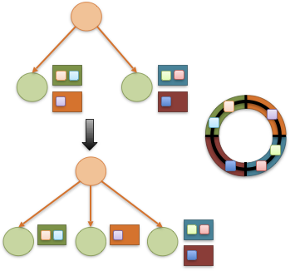
Rescaling changes key group assignment

Slide 9
Types of Keyed State
ValueState<T>
ListState<T>
ReducingState<T>
MapState<UK, UV> (new in 1.3)
FoldingState<T> (deprecated in 1.3)
AggregatingState<IN, OUT>

Slide 10
Using Key-Partitioned State
DataStream<Tuple2<String, String>> strings = … DataStream<Long> lengths = strings .keyBy(0) .map(new MapWithCounter());
public static class MapWithCounter extends RichMapFunction<Tuple2<String, String>, Long> {
// state object
private ValueState<Long> totalLengthByKey;
@Override public void open (Configuration conf) { // obtain state object
ValueStateDescriptor<Long> descriptor = new ValueStateDescriptor<>(
"totalLengthByKey", Long.class);
totalLengthByKey = getRuntimeContext().getState(descriptor);
}
@Override public Long map (Tuple2<String, String> value) throws Exception {
long length = totalLengthByKey.value(); // fetch state for current key
if (length == null) length = 0;
long newTotalLength = length + value.f1.length();
totalLengthByKey.update(newTotalLength); // update state of current key
return totalLengthByKey.value();
}
}

Slide 11
Fault Tolerance via Snapshotting

Slide 12
Fault tolerance: simple case
How to ensure exactly-once semantics for the state?
periodically snapshot the memory
event log
main memory
single process

Slide 13
Fault tolerance: simple case
Recovery: restore snapshot and replay events since snapshot
event log
persists events
(temporarily)
single process

Slide 14
State fault tolerance
Fault tolerance concerns for a stateful stream processor:
How to ensure exactly-once semantics for the state?
How to create consistent snapshots of distributed embedded state?
More importantly, how to do it efficiently without interrupting computation?

Slide 15
State fault tolerance (II)
Consistent snapshotting:
Your Code
Your Code
State
Your Code
...
State
State
Your Code
State

Slide 16
State fault tolerance (II)
Consistent snapshotting:
Your Code
Your Code
State
Your Code
...
State
State
Your Code
File System
State
Checkpoint
checkpointed
state
checkpointed
state
checkpointed
state

Slide 17
State fault tolerance (III)
Recover all embedded state
Reset position in input stream
Your Code
Your Code
State
Your Code
...
State
State
Your Code
File System
State
Restore
checkpointed
state
checkpointed
state
checkpointed
state

Slide 18
Checkpoints

Slide 19
Checkpointing in Flink
Asynchronous Barrier Snapshotting
checkpoint barriers are inserted into the stream and flow through the graph along with the data
this avoids a "global pause" during checkpointing
Checkpoint barriers cause ...
replayable sources to checkpoint their offsets
operators to checkpoint their state
sinks to commit open transactions
The program is rolled back to the latest completed checkpoint in case of a failure.

Slide 20
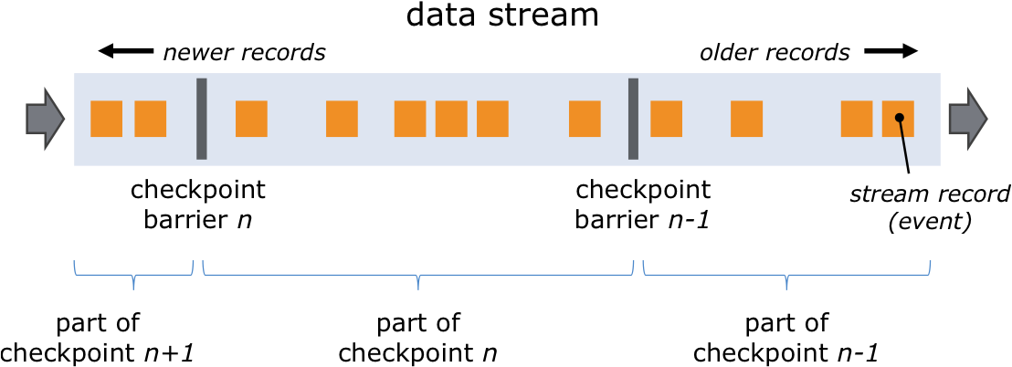
Checkpoint Barriers

Slide 21
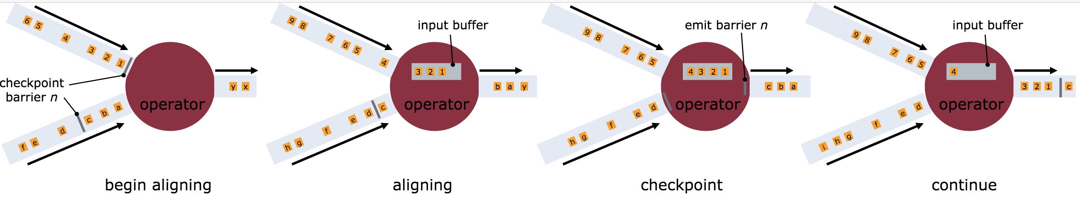
Asynchronous Barrier Snapshotting

Slide 22
Distributed snapshots
Events flow without replication or synchronous writes
State index
(Hash Table or RocksDB)
source
stateful operation

Slide 23
Distributed snapshots
Inject checkpoint barrier
Trigger checkpoint
source
stateful operation

Slide 24
Distributed snapshots
Trigger state copy-on-write
Take state snapshot
source
stateful operation

Slide 25
Distributed snapshots
Durably persist snapshots asynchronously
Processing pipeline continues
DFS
source
stateful operation

Slide 26
Enabling Checkpointing
Checkpointing is disabled by default.
Enable checkpointing with exactly once consistency: // checkpoint every 5 seconds env.enableCheckpointing(5000)
Configure at least once consistency (for lower latency): env.getCheckpointConfig() .setCheckpointingMode(CheckpointingMode.AT_LEAST_ONCE);
Most applications perform well with a few seconds checkpointing interval.

Slide 27
Restart Strategies
How often and fast does a job try to restart?
Available strategies
No restart (default)
Fixed delay
Failure rate
// Fixed Delay restart strategy
env.setRestartStrategy(
RestartStrategies.fixedDelayRestart(
3, // no of restart attempts
Time.of(10, TimeUnit.SECONDS) // restart interval
));

Slide 28
State Backends

Slide 29
State in Flink
There are several sources of state in Flink
Windows
User functions
Sources and Sinks
Timers
State is persisted during checkpoints, if checkpointing is enabled
Internal representation and storage location depend on the configured State Backend

Slide 30
Choosing a State Backend
Name | Working state | State backup | Snapshotting
RocksDBStateBackend | Local disk (tmp directory) | Distributed file system | Asynchronously
Good for state larger than available memory 10x slower than memory-based backends
FsStateBackend | JVM Heap | Distributed file system | Synchronous / Async option in Flink 1.3
Fast, requires large heap
MemoryStateBackend | JVM Heap | JobManager JVM Heap | Synchronous / Async option in Flink 1.3
Good for testing and experimentation with small state (locally)

Slide 31
State Backend Configuration
Configuration of default state backend in ./conf/flink-conf.yaml
State backend configuration in job env.setStateBackend(
new FsStateBackend( "hdfs://namenode:40010/flink/checkpoints” ));

Slide 32
Savepoints

Slide 33
State management
Two important management concerns for a long-running job:
Can I change / fix bugs in my streaming pipeline? How do I handle job downtime?
Can I rescale (change parallelism of) my computation?

Slide 34
State management: Savepoints
A persistent snapshot of all state
When starting an application, state can be initialized from a savepoint
In-between savepoint and restore we can update Flink version or user code

Slide 35
Savepoints
A Checkpoint is a globally consistent point-in-time snapshot of a streaming application (point in stream, state)
Savepoints are user-triggered, retained checkpoints
Rescaling (currently) requires restarting from a savepoint
Currently, Flink can only restore to the same state backend that created the savepoint

Slide 36
Evolution of Flink (w.r.t. Stateful Stream Processing)

Slide 37
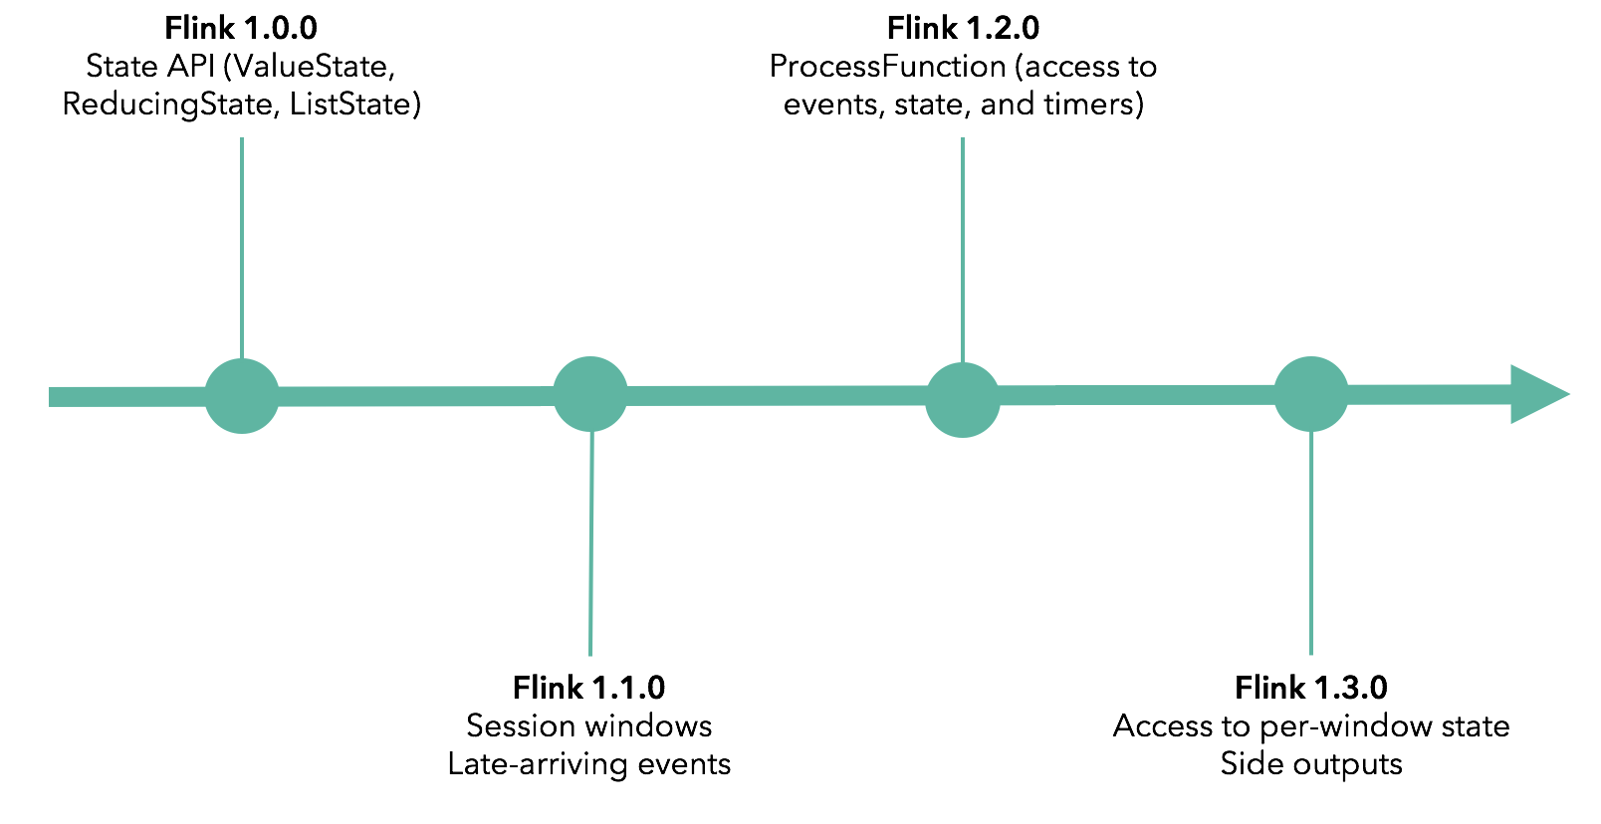
Evolution of Programming APIs

Slide 38
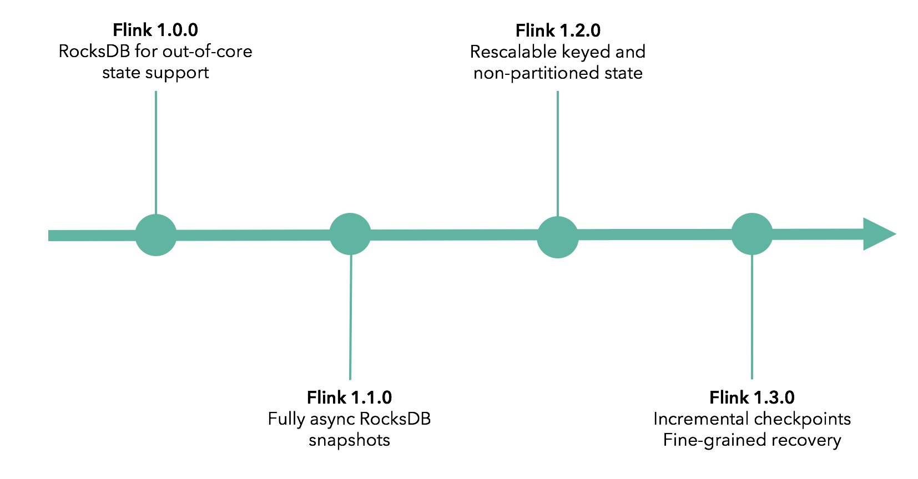
Evolution of Large State Handling

