Slide 1
Apache Flink® Training
DataSet API Advanced

Slide 2
Slides for approx. 35-45 Mins
Reuse slides if possible
All examples in Java
Aim to make it interactive

Slide 3
Apache Flink Type System
Let the system efficiently handle your data

Slide 4
Why has Flink its own Type system?
Flink has its own type serialization system
Serialization is the process of turning a Java object into a binary representation
Existing frameworks:
Kryo, Google Protocol Buffers, Apache Thrift ..
Flink’s serialization framework is
Generating a schema from your types
Generating serializers for the schema
→Fast & efficient execution

Slide 5
Why should I care about it?
Good for understanding error messages
Big impact on performance (Generic (Kryo) Types vs Flink special types)
Good usability of POJO types (compared to Generic)
You can provide your own serialization methods if needed

Slide 6
Type Extraction in the “Pre-Flight” Phase
“Pre-Flight” Phase:
Scala API
Flink Java Program
Type Extraction
Plan Translation
Optimizer
Plan Post-pass
Cluster
Python API
Type Extraction using Java Reflection /
Scala Compiler
Validation are the sorting/grouping/joining keys sortable?
are joining keys compatible?
Serializer creation for the specified types.
The serializer includes comparators as well

Slide 7

Type Extraction Example
Type Extraction
Validation
Serializer creation
DataSet<Tuple3<Integer, Long, String>> countries = …;
DataSet<Tuple2<Integer, Person>> users = …;
countries.join(users).where(0).equalTo(0).with(…);
DS1 (countries)
TupleType<Tuple3>
BasicType<Integer>
BasicType<Long>
BasicType<String>
DS2 (users)
TupleType<Tuple2>
BasicType<Integer>
PojoType<Person>
BasicType<Integer>
BasicType<String>
Join Keys:
Comparable Types:
Comparable:
Extracted Types

Slide 8
Available Types
AtomicTypes
Composite Types
BasicTypes
Integer, String, Long, …
ArrayTypes
Writable (Hadoop Interface)
Value (Flink Interface)
GenericTypes (Unknown)
TupleType (Flink Tuple1…Tuple25)
PojoType (“Bean-style” Java objects)
CaseClassType (Scala tuples)

Slide 9
Atomic Types
Comparable?
Serialization methods
Default (full) serialization
Optional efficient binary operations
BasicTypes
Integer, String, Long, …
ArrayTypes
Writable (Hadoop Interface)
GenericTypes (Unknown)

Slide 10
Atomic Types
 | Basic Type | Array Type | Writable Type | GenericType
Comparable | always | No | If type implements (Writable)Comparable | If type implements Comparable
Default Serializer | Yes (Flink serializer) | Yes (Flink serializer) | Yes (using write(), readFields()) | Yes (Kryo or Avro)
Efficient Binary Operations | Yes | No | No | No

Slide 11
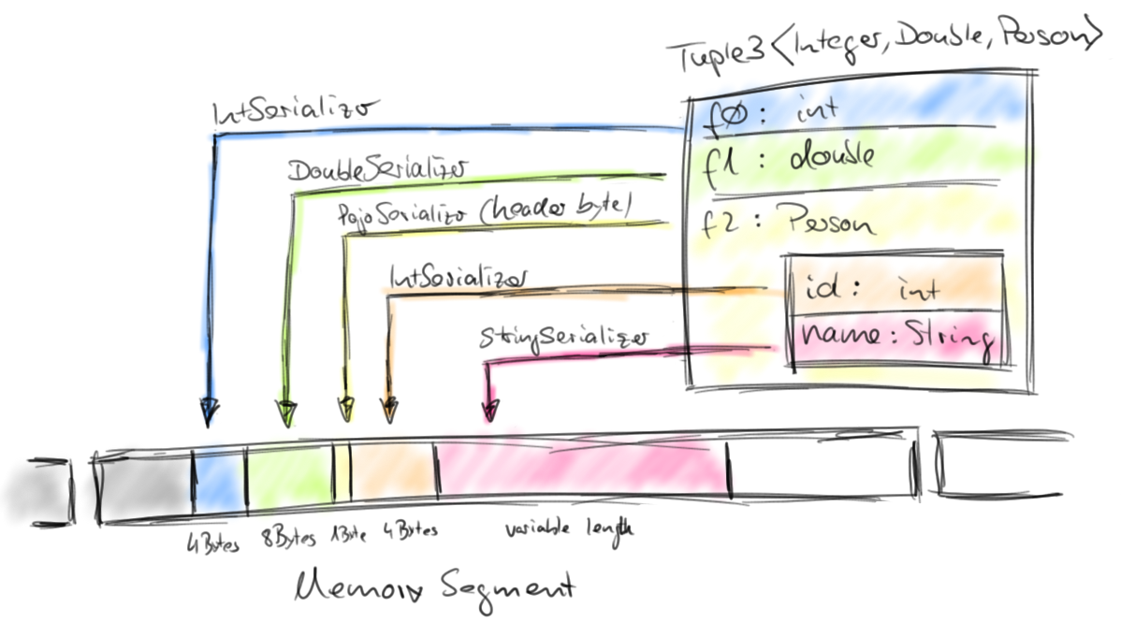
Composite Types
POJOs, Flink Tuples, Scala case classes
Composition of other composite or atomic types.

Slide 12
Defining Keys
Work with Types

Slide 13
Keyed Operations on Composite Types
Keyed Operations: Grouping, joining, sorting
Only possible on comparable types
Joining: Join keys must have same type

Slide 14
An Example: Join
public static class Person {
public int country;
public String name;
}
DataSet<Tuple3<Integer, Long, String>> countries = … ;
DataSet<Tuple2<Integer, Person>> … ;
countries.join(users).where(JOINKEY1).equalTo(JOINKEY2).with( … );
2 potential keys (same type: Integer)
DS1 (countries)
TupleType<Tuple3>
BasicType<Integer>
BasicType<Long>
BasicType<String>
DS2 (users)
TupleType<Tuple2>
BasicType<Integer>
PojoType<Person>
BasicType<Integer>
BasicType<String>
1 potential key (same type: String)

Slide 15
An Example: Join
public static class Person { public int country; public String name; }
DataSet<Tuple3<Integer, Long, String>> countries = … ;
DataSet<Tuple2<Integer, Person>> … ;
countries.join(users).where(0).equalTo(0).with( … );
Key definition using position keys:
DS1 (countries)
TupleType<Tuple3>
BasicType<Integer>
BasicType<Long>
BasicType<String>
DS2 (users)
TupleType<Tuple2>
BasicType<Integer>
PojoType<Person>
BasicType<Integer>
BasicType<String>

Slide 16
An Example: Join
public static class Person { public int country; public String name; }
DataSet<Tuple3<Integer, Long, String>> countries = … ;
DataSet<Tuple2<Integer, Person>> … ;
countries.join(users).where(0).equalTo(“f0”).with( … );
Key definition using expression keys:
Tuple fields are addressable by “f0”, “f1”, …
DS1 (countries)
TupleType<Tuple3>
BasicType<Integer>
BasicType<Long>
BasicType<String>
DS2 (users)
TupleType<Tuple2>
BasicType<Integer>
PojoType<Person>
BasicType<Integer>
BasicType<String>

Slide 17
An Example: Join
public static class Person { public int country; public String name; }
DataSet<Tuple3<Integer, Long, String>> countries = … ;
DataSet<Tuple2<Integer, Person>> … ;
countries.join(users).where(2).equalTo(“f1.name”).with( … );
Key definition using expression keys:
DS1 (countries)
TupleType<Tuple3>
BasicType<Integer>
BasicType<Long>
BasicType<String>
DS2 (users)
TupleType<Tuple2>
BasicType<Integer>
PojoType<Person>
BasicType<Integer>
BasicType<String>
Expression keys allow “navigation” into nested fields
f0:
f1:
country:
name:

Slide 18
An Example: Join
public static class Person { public int country; public String name; }
DataSet<Tuple3<Integer, Long, String>> countries = … ;
DataSet<Tuple2<Integer, Person>> … ;
countries.join(users).where(“f0”, ”f2”).equalTo(“f0”, “f1.name”).with( … );
Composite Key definition using expression keys:
DS1 (countries)
TupleType<Tuple3>
BasicType<Integer>
BasicType<Long>
BasicType<String>
DS2 (users)
TupleType<Tuple2>
BasicType<Integer>
PojoType<Person>
BasicType<Integer>
BasicType<String>
Expression keys allow “navigation” into nested fields
f0:
f1:
country:
name:

Slide 19
An Example: Join
public static class Person { public int country; public String name; }
DataSet<Tuple3<Integer, Long, String>> countries = … ;
DataSet<Tuple2<Integer, Person>> … ;
countries.join(users).where(new KeySelector<Tuple3<Integer,Long,String>, Integer>() {
@Override
public Integer getKey(Tuple3<Integer, Long, String> value) throws Exception {
return value.f0;
}
}).equalTo(“f0”).with( … );
Key definition using extraction function:

Slide 20
An Example: Join
public static class Person { public int country; public String name; }
DataSet<Tuple3<Integer, Long, String>> countries = … ;
DataSet<Tuple2<Integer, Person>> … ;
countries.join(users).where(1).equalTo(“f1.name”).with( … );
Incompatible key definition:
Incompatible types
→ Exception
DS1 (countries)
TupleType<Tuple3>
BasicType<Integer>
BasicType<Long>
BasicType<String>
DS2 (users)
TupleType<Tuple2>
BasicType<Integer>
PojoType<Person>
BasicType<Integer>
BasicType<String>
f0:
f1:
country:
name:

Slide 21
An Example: Join
public static class Person { public int country; public String name; }
DataSet<Tuple3<Integer, Long, String>> countries = … ;
DataSet<Tuple2<Integer, Person>> … ;
countries.join(users).where(“*”).equalTo(“f1.*”).with( … );
Wildcard key definition using expression keys:
Again, incompatible keys
DS1 (countries)
TupleType<Tuple3>
BasicType<Integer>
BasicType<Long>
BasicType<String>
DS2 (users)
TupleType<Tuple2>
BasicType<Integer>
PojoType<Person>
BasicType<Integer>
BasicType<String>
f0:
f1:
country:
name:

Slide 22
Plain Old Java Objects (POJO)
Constructor without arguments
Fields have to be:
public
OR
private with getter & setter for the field.
Turn on logging to get messages why the system (TypeExtractor) is not accepting classes.

Slide 23
Advanced Sources and Sinks
Getting your data in

Slide 24
Data Access Stack in Flink
InputFormats
OutputFormats
Avro, CSV, Text, Parquet, ORC
File System
Local, HDFS, …

Slide 25



File Systems
Flink build-in File Systems:
LocalFileSystem (file://)
Hadoop Distributed File System (hdfs://)
Amazon S3 (s3://)
MapR FS (maprfs://)
Support for all Hadoop File Systems
NFS, Kosmos, FTP, har (Hadoop Archive), …

Slide 26
Input/Output Formats
Build-in Input/Outputformats
FileInputFormat
AvroInputFormat (Read Avro POJOs)
DelimitedInputFormat
TextInputFormat
CsvInputFormat (Specify fields + types)
BinaryInputFormat
JDBCInputFormat (Process results of a SQL query)
HadoopInputFormat (Use any existing InputFormat from Hadoop)

Slide 27
The power of our Hadoop InputFormat support
Flink supports reading and writing to
MongoDB
Apache Parquet
ORC
Kafka (for batch)
Compressed file formats (.gz, .zip, ...)
This list is just examples, there are more ….

Slide 28
Final notes
You can easily implement your own Input- and OutputFormats
Flink’s FileInputFormat supports reading entire directory structures recursively
Using an InputFormat from the API:
final ExecutionEnvironment env =
ExecutionEnvironment.getExecutionEnvironment();
DataSet<Tuple> databaseData = env.createInput(new JdbcInputFormat());

Slide 29
Transformations & Functions

Slide 30
Available Transformations
Map, FlatMap, Filter
GroupReduce
Reduce
AllReduce/AllGroupReduce
Combine
Join
GroupSort
CoGroup
MapPartition
PartitionByHash, Custom Partitioner
SortPartition
Union
→ See Documentation for details

Slide 31
map-transformations
map(): Takes one element and produces one element.
data.map(new MapFunction<String, Integer>() {
public Integer map(String value) {
return Integer.parseInt(value); } });
flatMap(): Takes one element and produces zero, one, or more elements.
data.flatMap(new FlatMapFunction<String, String>() {
public void flatMap(String value, Collector<String> out) {
for (String s : value.split(" ")) {
out.collect(s); } } });
mapPartition(): Allows to access an entire partition in one call (via an Iterator). Output via Collector
public void mapPartition(Iterable<String> values,
Collector<Long> out)

Slide 32
Grouping and Reducing
Functional Reduce
data.reduce(new ReduceFunction<Integer> {
public Integer reduce(Integer a, Integer b) {
return a + b;
} });
Group Reduce (Hadoop-style)
data.reduceGroup(new GroupReduceFunction<Integer, Integer> {
public void reduce(Iterable<Integer> values, Collector<Integer> out) {
int sum= 0;
for (Integer i : values) {
sum+= i;
}
out.collect(prefixSum); } });

Slide 33
Functional Reduce
DataSet
5
2
3
1
reduce(5,2) = 7
reduce(7,3) = 10
reduce(10, 1) = 11
OR
reduce(reduce(reduce(5,2),3) , 1) = 11
Systems can execute functional reduces more efficiently (using a HashTable) (no runtime support currently)
Some developers prefer to express their algorithms like this

Slide 34
Group Reduce
DataSet
5
2
3
1
reduce(Iterator elements) = {
int c = 0;
while(elements) { c+= element }
return c;
} = 11
Note that Flink is giving you an Iterator over the group into the function.
Data can come from disk / network / …
→ Group size can exceed available Java heap space

Slide 35
AllReduce
Grouping without key
Send everything to one machine (will automatically run with parallelism of 1)
DO NOT do this on large data sets (or at least use a Combiner)
Simple approach to sort everything (use sortPartition() for sorting in parallel)

Slide 36
CoGroup
Operator needed for Left/Outer/.. Joins
Its like a group reduce with two inputs
Input DataSets:
Resulting Groups:
DataSet 1
5
5
5
5
5
3
1
3
3
1
1
DataSet 2
5
3
2
1
2

Slide 37
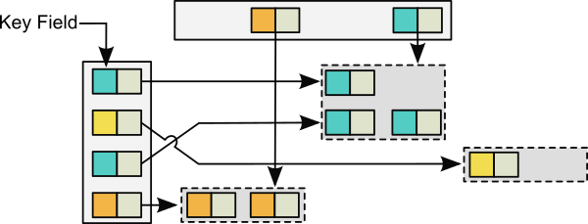
CoGroup in other words

Slide 38
Combiner
Group Reduce, CoGroup benefit from that
Similar to Hadoop combiners.
Word Count without Combiner:
expensive network transfer
this, 1
Reducer for “a”
is, 1
This is a tree
a, 1
Map
tree, 1
a tree, a house
a, 1
Reducer for “tree”
tree, 1
a, 1
Splitting
house, 1
Input

Slide 39
Combiner
Word Count with Combiner:
Reduced network transfer
this, 1
Reducer for “a”
is, 1
this, 1
This is a tree
a, 1
Map
is, 1
tree, 1
a, 3
a tree, a house
a, 1
Reducer for “tree”
tree, 2
tree, 1
house, 1
a, 1
Splitting
house, 1
Input
Combining
Combiners perform local pre-aggregations
Often significant performance improvements

Slide 40
RichFunctions
The default functions are SAMs (Single abstract method). Interfaces with one method (for Java8 Lambdas)
There is a “Rich” variant for each function.
RichFlatMapFunction, …
Methods
open(Configuration c) & close()
getRuntimeContext()

Slide 41
RichFunctions & RuntimeContext
The RuntimeContext provides some useful methods
getIndexOfThisSubtask () / getNumberOfParallelSubtasks()
getExecutionConfig()
Accumulators
DistributedCache

Slide 42
Further Concepts

Slide 43
Broadcast Variables
Example: Tag words with ids in big text corpus
(huge) stream of text input data
map
map
map
broadcast dictionary to all mappers
← Dictionary with word to id mapping

Slide 44
Broadcast variables
register any DataSet as a broadcast variable
available on all parallel instances
// 1. The DataSet to be broadcasted
DataSet<Integer> toBroadcast = env.fromElements(1, 2, 3);
// 2. Broadcast the DataSet
flatMap().withBroadcastSet(toBroadcast, "broadcastSetName");
// 3. inside user defined function
getRuntimeContext().getBroadcastVariable("broadcastSetName");

Slide 45
Accumulators
Example: Count words in big text corpus
(huge) stream of text input data
map
long counter++
JobManager
counter =
4 +
18 +
22 =
44
map
long counter++
map
long counter++
Send local counts from parallel instances to JobManager

Slide 46
Accumulators - Usage
Useful to verify your assumptions about the data
class Tokenizer extends RichFlatMapFunction<String, String>> {
@Override
public void flatMap(String value, Collector<String> out) {
getRuntimeContext()
.getLongCounter("elementCount").add(1L);
// do more stuff.
} }
Use “Rich*Functions” to get RuntimeContext

Slide 47
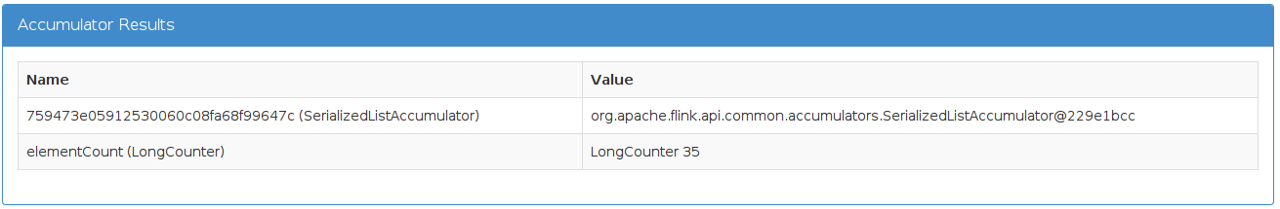
Accumulators – Get Results
Where can I get the accumulator results?
returned by env.execute()
displayed when executed with /bin/flink
in the JobManager web frontend
JobExecutionResult result = env.execute("WordCount");
long ec = result.getAccumulatorResult("elementCount");

Slide 48
Accumulators
Known as “Counters” from Hadoop MapReduce
Lightweight
Build in
Long
Int
Histogramm
Easily customizable

Slide 49
Table API

Slide 50
Filtered “Word Count” with Table API
SQL-style programming in Java and Scala
Simplify everyday tasks
More examples:
Table filtered = table.groupBy("word")
.select("word.count as count, word")
.filter("count = 2");
books.filter("price > 10 && author ===‘Foo‘");
books.select("author.substring(0, price.avg + 5)");
This does not make so much sense but shows the power

Slide 51
The full WordCount example
public static class WC {
public String word;
public int count;
}
Table API works currently only on POJOs and Tuples

Slide 52
The full WordCount example
public static class WC {
public String word;
public int count;
}
public static void main(String[] args) throws Exception {
TableEnvironment tableEnv = new TableEnvironment();
DataSet<WC> input = env.fromElements(new WC("Hello", 1), new WC("Ciao", 1), new WC("Hello", 1));
Table table = tableEnv.toTable(input);
Convert regular DataSet to Table abstraction

Slide 53
The full WordCount example
public static class WC {
public String word;
public int count;
}
public static void main(String[] args) throws Exception {
TableEnvironment tableEnv = new TableEnvironment();
DataSet<WC> input = env.fromElements(new WC("Hello", 1), new WC("Ciao", 1), new WC("Hello", 1));
Table table = tableEnv.toTable(input);
Table filtered = table.groupBy("word").select("word.count as count, word").filter("count = 2");
}
The initial example code

Slide 54
The full WordCount example
public static class WC {
public String word;
public int count;
}
public static void main(String[] args) throws Exception {
TableEnvironment tableEnv = new TableEnvironment();
DataSet<WC> input = env.fromElements(new WC("Hello", 1), new WC("Ciao", 1), new WC("Hello", 1));
Table table = tableEnv.toTable(input);
Table filtered = table.groupBy("word").select("word.count as count, word").filter("count = 2");
DataSet<WC> result = tableEnv.toSet(filtered, WC.class);
}
Convert back from Table to DataSet

Slide 55
Table API
TableEnvironment
toTable().as()
fromTable()
Row
Pojo
Table Transfomrations
select()
groupBy()
filter()
join()

Slide 56
Table API - Highlights
Generates Flink code on the fly for good performance
Documentation in ScalaDocs
Supported in Java and Scala APIs

