Slide 1


DataStream API
State & Failure Recovery
Apache Flink® Training
Flink v1.2.0 – 13.03.2017

Slide 2
Fault Tolerance and Checkpointing

Slide 3
Fault Tolerance
What happens if a worker thread goes down?
Flink supports different guarantee levels for failure recovery:
Exactly once
Each event affects the declared state of a program exactly once.
Note: This does not mean that events are processed exactly once!
At least once
Each event affects the declared state of a program at least once
Deactivated / None / At most once
All state is lost in case of a failure

Slide 4
Source & Sink Requirements
“Exactly once” & “at least once” guarantees require replayable sources
Data must be replayed in case of a failure
“End-to-End exactly once” guarantees require
Transactional sinks, or
Idempotent writes

Slide 5
Guarantees of Data Sources
Source | Guarantee
Apache Kafka | Exactly once
AWS Kinesis Streams | Exactly once
RabbitMQ | None (v 0.10) / Exactly once (v 1.0)
Twitter Streaming API | None
Collections | Exactly once
Files | Exactly once
Sockets | None

Slide 6
Guarantees of Data Sinks
Sink | Guarantee
HDFS rolling sink | Exactly once
Cassandra | Exactly once for idempotent updates
Elasticsearch | Exactly once for idempotent indexing
Kafka | At least once
AWS Kinesis Streams | At least once
File sinks | At least once
Socket sinks | At least once
Standard output | At least once
Redis | At least once

Slide 7
Checkpointing in Flink
Asynchronous Barrier Snapshotting
checkpoint barriers are inserted into the stream and flow through the graph along with the data
this avoids a "global pause" during checkpointing
Checkpoint barriers cause ...
replayable sources to checkpoint their offsets
operators to checkpoint their state
sinks to commit open transactions
The program is rolled back to the latest completed checkpoint in case of a failure.

Slide 8
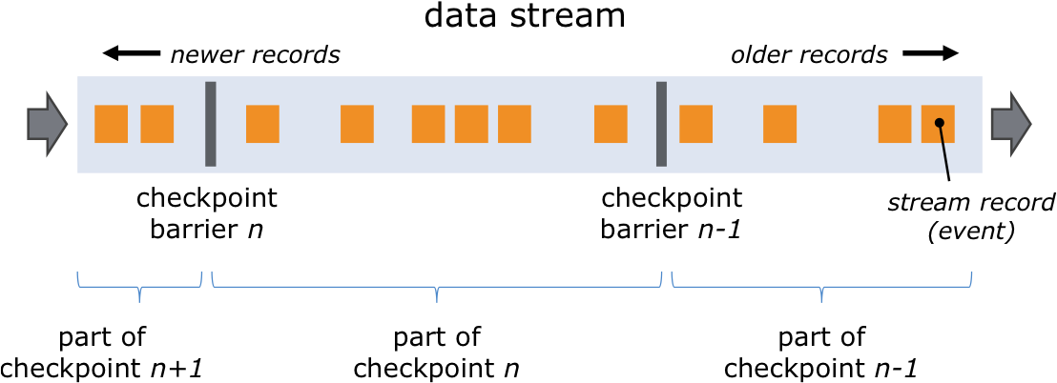
Checkpoint Barriers

Slide 9
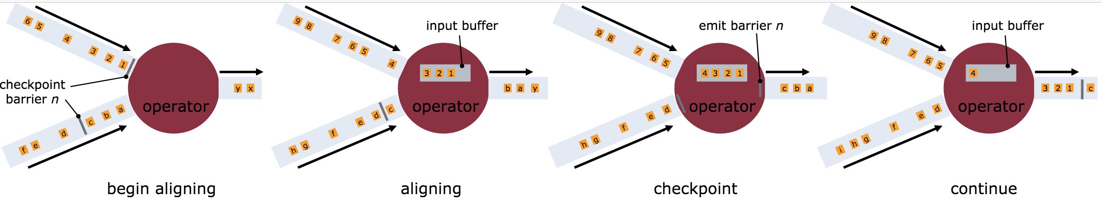
Asynchronous Barrier Snapshotting

Slide 10
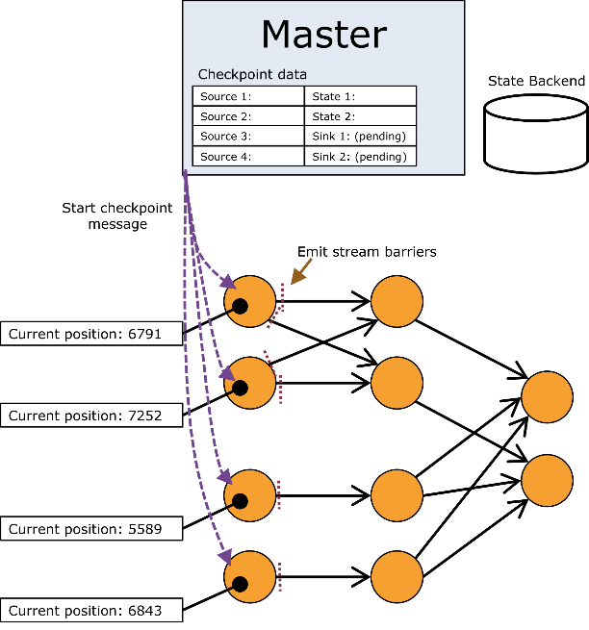
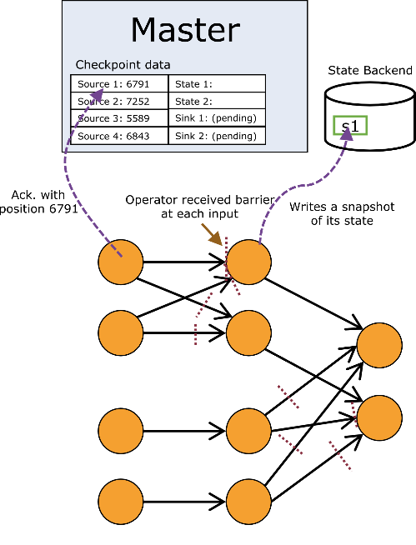
Checkpoint Procedure

Slide 11
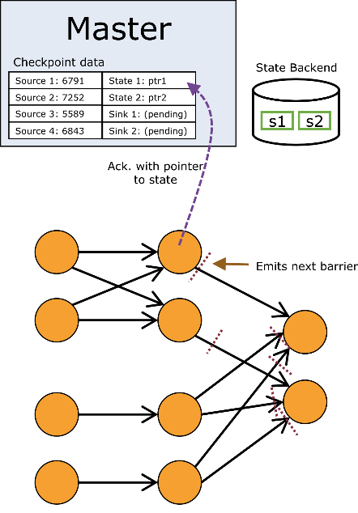
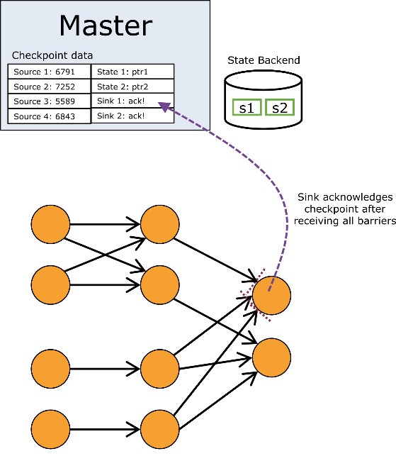
Checkpoint Procedure

Slide 12
Enabling Checkpointing
Checkpointing is disabled by default.
Enable checkpointing with exactly once consistency: // checkpoint every 5 seconds env.enableCheckpointing(5000)
Configure at least once consistency (for lower latency): env.getCheckpointConfig() .setCheckpointingMode(CheckpointingMode.AT_LEAST_ONCE);
Most applications perform well with a few seconds checkpointing interval.

Slide 13
Restart Strategies
How often and fast does a job try to restart?
Available strategies
No restart (default)
Fixed delay
Failure rate
// Fixed Delay restart strategy
env.setRestartStrategy(
RestartStrategies.fixedDelayRestart(
3, // no of restart attempts
Time.of(10, TimeUnit.SECONDS) // restart interval
));
See the docs for details https://ci.apache.org/projects/flink/flink-docs-release-1.2/setup/fault_tolerance.html#restart-strategies

Slide 14
Working with State

Slide 15
Stateful Functions
All DataStream functions can be stateful
Flink manages state so that it can be redistributed/rescaled
State is checkpointed and restored in case of a failure (if checkpointing is enabled)
Flink supports two types of state:
Operator (non-keyed) state
Keyed state

Slide 16
Operator vs Keyed State
Operator (non-keyed)
Keyed
State bound only to operator
E.g. source state
State bound to an operator + key
E.g. Keyed UDF and window state
"SELECT count(*) FROM t GROUP BY t.key"

Slide 17

Repartitioning Operator State
partitionId: 1, offset: 42
partitionId: 3, offset: 10
partitionId: 6, offset: 27
Operator state: a list of state elements
which can be freely repartitioned

Slide 18
Repartitioning Keyed State
Split key space into key groups
Every key falls into exactly one key group
Assign key groups to tasks
Rescaling changes key group assignment
Key space
Key group #1
Key group #2
Key group #4
Key group #3
One key

Slide 19
Types of Keyed State
ValueState<T>
ListState<T>
ReducingState<T>
FoldingState<T>
AggregatingState<IN, OUT>

Slide 20
Using Key-Partitioned State
DataStream<Tuple2<String, String>> strings = … DataStream<Long> lengths = strings .keyBy(0) .map(new MapWithCounter());
public static class MapWithCounter extends RichMapFunction<Tuple2<String, String>, Long> {
// state object
private ValueState<Long> totalLengthByKey;
@Override public void open (Configuration conf) { // obtain state object
ValueStateDescriptor<Long> descriptor = new ValueStateDescriptor<>(
"totalLengthByKey", Long.class, 0L);
totalLengthByKey = getRuntimeContext().getState(descriptor);
}
@Override public Long map (Tuple2<String, String> value) throws Exception {
long length = totalLengthByKey.value(); // fetch state for current key
long newTotalLength = length + value.f1.length();
totalLengthByKey.update(newTotalLength); // update state of current key
return totalLengthByKey.value();
}
}

Slide 21
State Backends

Slide 22
State in Flink
There are several sources of state in Flink
Windows gather elements and aggregates until they are triggered
User-functions use key-partitioned state or implement the Checkpointed interface
Sources and Sinks persist state
Which checkpointing enabled, state is persisted upon checkpoints.
Internal representation, storage location and method depends on the configured State Backend.

Slide 23
State Backends
MemoryStateBackend (default)
State is hold as objects on worker JVM heap
Checkpoints are stored on master JVM heap
Suitable for development and tiny state. Not highly-available
FsStateBackend
State is hold on worker JVM heap (limited by heap size)
Checkpoints are written to a configured filesystem URI (hdfs, s3, file)
Suitable for jobs with large state and/or high-availability requirements
RocksDBStateBackend
State is hold in RocksDB instance on worker filesystem (limited by disk size)
Checkpoints are written to a configured filesystem URI (hdfs, s3, file)
Suitable for jobs with very large state and/or high-availability requirements

Slide 24
State Backend Configuration
Configuration of default state backend in ./conf/flink-conf.yaml
State backend configuration in job env.setStateBackend(
new FsStateBackend( "hdfs://namenode:40010/flink/checkpoints” ));
See the docs for details
https://ci.apache.org/projects/flink/flink-docs-release-1.2/dev/state_backends.html

Slide 25
Savepoints

Slide 26
Savepoints
A "Checkpoint" is a globally consistent point-in-time snapshot of a streaming application (point in stream, state)
Savepoints are user-triggered, retained checkpoints
A program can be started from a savepoint
Initializes the operator state
Savepoints are useful for
Application updates
Updating a Flink version
Maintenance & migration
A/B testing
Rescaling

Slide 27
References
Documentation
https://ci.apache.org/projects/flink/flink-docs-release-1.2/internals/stream_checkpointing.html
https://ci.apache.org/projects/flink/flink-docs-release-1.2/dev/stream/state.html
https://ci.apache.org/projects/flink/flink-docs-release-1.2/setup/fault_tolerance.html
https://ci.apache.org/projects/flink/flink-docs-release-1.2/setup/savepoints.html
https://ci.apache.org/projects/flink/flink-docs-release-1.2/setup/cli.html
Blog posts
http://data-artisans.com/how-apache-flink-enables-new-streaming-applications/

