Slide 1
Apache Flink® Training
System Overview

Slide 2

Apache Flink
A stream processor
with many applications
Streaming dataflow runtime

Slide 3
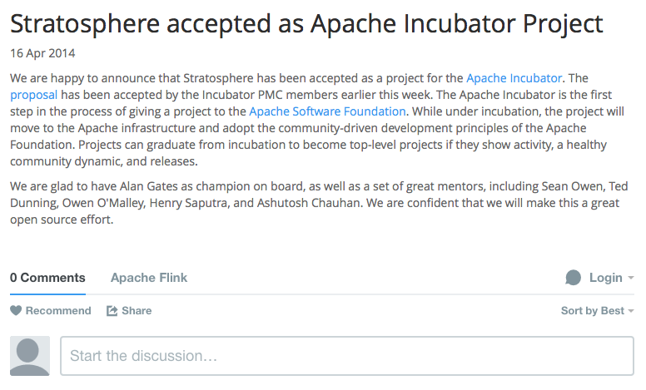
1 year of Flink - code
April 2014
April 2015

Slide 4
Flink Community
#unique contributor ids by git commits
In top 5 of Apache's big data projects after one year in the Apache Software Foundation
Notes:
dev list: 300-400 messages/month. record 1000 messages on

Slide 5

The Apache Way
Flink is an Apache top-level project
Independent, non-profit organization
Community-driven open source software development approach
Public communication and open to new contributors

Slide 6
What is Apache Flink?
Cascading
MRQL
Table
Dataflow/Beam
Gelly
SAMOA
Table
ML
Hadoop M/R
Dataflow/Beam
DataSet (Java/Scala/Python)
DataStream (Java/Scala)
Streaming dataflow runtime
Local
Remote
Yarn
Tez
Embedded

Slide 7
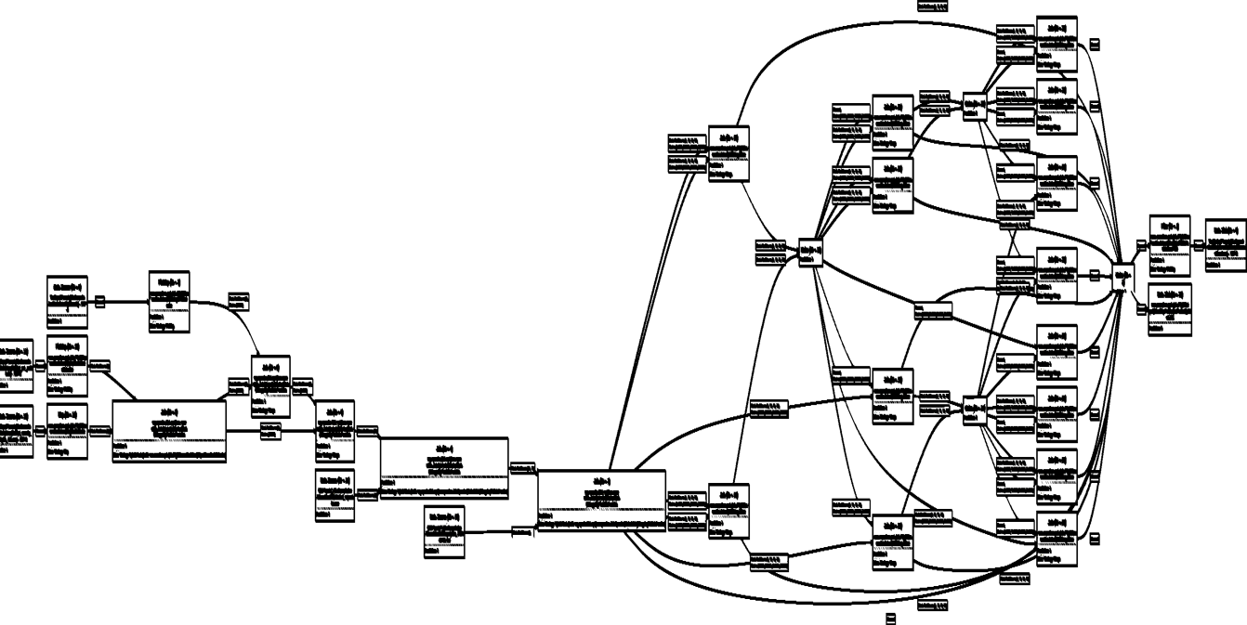
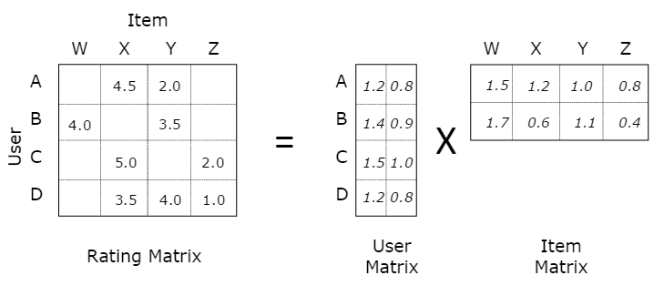
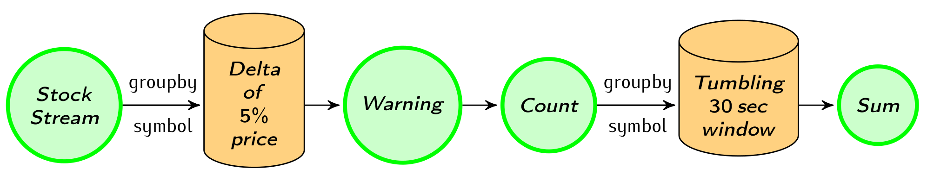
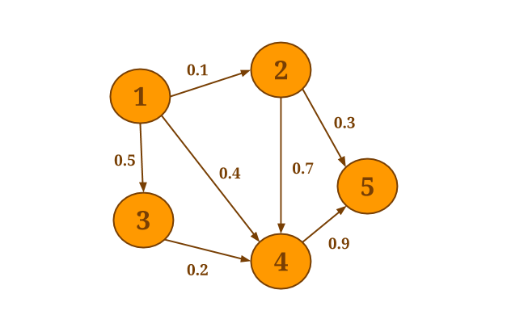
Native workload support
Heavy
batch jobs
Machine Learning at scale
Streaming
topologies
Flink
How can an engine natively support all these workloads?
And what does native mean?

Slide 8


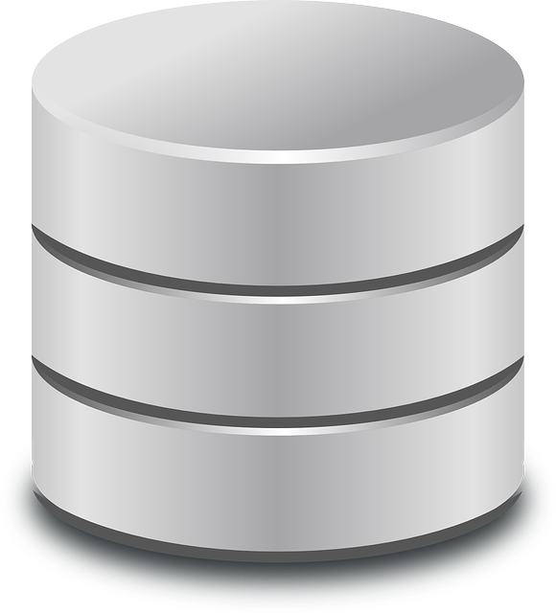
E.g.: Non-native iterations
for (int i = 0; i < maxIterations; i++) {
// Execute MapReduce job
}
Client
Step
Step
Step
Step
Step

Slide 9
E.g.: Non-native streaming
stream
discretizer
while (true) {
// get next few records
// issue batch job
}
Job
Job
Job
Job

Slide 10
Native workload support
Batch
processing
Machine Learning at scale
Stream
processing
Graph Analysis
Flink
How can an engine natively support all these workloads?
And what does "native" mean?

Slide 11
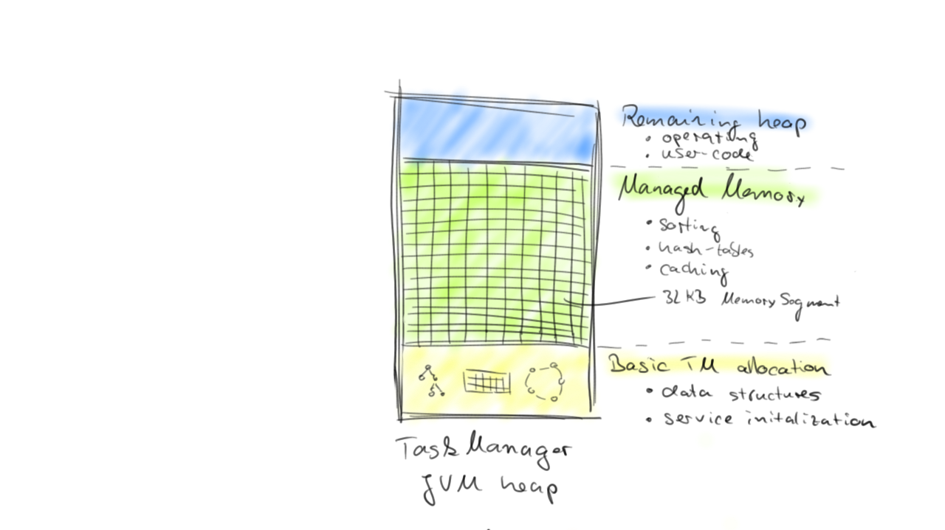
Flink Engine
Execute everything as streams
Iterative (cyclic) dataflows
Mutable state
Operate on managed memory
Special code paths for batch
State + Computation

Slide 12
What is a Flink Program?

Slide 13
Flink stack
Cascading (WiP)
MRQL
Table
Dataflow (WiP)
Gelly
SAMOA
Table
ML
Hadoop M/R
Dataflow
DataSet (Java/Scala/Python)
DataStream (Java/Scala)
Streaming dataflow runtime
Local
Remote
Yarn
Tez
Embedded

Slide 14
Basic API Concept
Source
Data Stream
Operation
Data Stream
Sink
Source
Data Set
Operation
Data Set
Sink
How do I write a Flink program?
Bootstrap sources
Apply operations
Output to source

Slide 15
Batch & Stream Processing
DataSet API
Example: Map/Reduce paradigm
b | h
2 | 1
3 | 5
7 | 4
… | …
a
12
…
Map
Reduce
DataStream API
Example: Live Stock Feed
Alert if Microsoft > 120
Write event to database
Stock Feed
Name | Price
Microsoft | 124
Google | 516
Apple | 235
… | …
Microsoft | 124
Google | 516
Apple | 235
Sum every 10 seconds
Alert if sum > 10000
Microsoft | 124
Apple | 235
Google | 516

Slide 16
Streaming & Batch
Streaming
Batch
Input
infinite
finite
Data transfer
pipelined
blocking or pipelined
Latency
low
high

Slide 17
Scaling out
Source
Data Set
Operation
Data Set
Sink
Source
Data Set
Operation
Data Set
Sink
Source
Data Set
Operation
Data Set
Sink
Source
Data Set
Operation
Data Set
Sink
Source
Data Set
Operation
Data Set
Sink
Source
Data Set
Operation
Data Set
Sink
Source
Data Set
Operation
Data Set
Sink
Source
Data Set
Operation
Data Set
Sink

Slide 18
Scaling up

Slide 19
Sources (selection)
Collection-based
fromCollection
fromElements
File-based
TextInputFormat
CsvInputFormat
Other
SocketInputFormat
KafkaInputFormat
Databases

Slide 20
Sinks (selection)
File-based
TextOutputFormat
CsvOutputFormat
PrintOutput
Others
SocketOutputFormat
KafkaOutputFormat
Databases

Slide 21
Hadoop Integration
Out of the box
Access HDFS
Yarn Execution (covered later)
Reuse data types (Writables)
With a thin wrapper
Reuse Hadoop input and output formats
Reuse functions like Map and Reduce

Slide 22
What’s the Lifecycle of a Program?

Slide 23

From Program to Dataflow
case class Path (from: Long, to: Long)
val tc = edges.iterate(10) {
paths: DataSet[Path] =>
val next = paths
.join(edges)
.where("to")
.equalTo("from") {
(path, edge) =>
Path(path.from, edge.to)
}
.union(paths)
.distinct()
next
}
Type extraction stack
GroupRed
sort
Dataflow Graph
forward
Join
Hybrid Hash
Optimizer
buildHT
probe
hash-part [0]
hash-part [0]
Map
DataSource
lineitem.tbl
Pre-flight (Client)
Filter
Data Source
orders.tbl
Program
deploy operators
Dataflow metadata
Task scheduling
track intermediate results
Master
Workers

Slide 24
Architecture Overview
Client
Master (Job Manager)
Worker (Task Manager)
Client
Job Manager
Task Manager
Task Manager
Task Manager

Slide 25
Client
Optimize
Construct job graph
Pass job graph to job manager
Retrieve job results
case class Path (from: Long, to: Long)
val tc = edges.iterate(10) {
paths: DataSet[Path] =>
val next = paths
.join(edges)
.where("to")
.equalTo("from") {
(path, edge) =>
Path(path.from, edge.to)
}
.union(paths)
.distinct()
next
}
GroupRed
Type extraction
sort
forward
Job Manager
Join
Hybrid Hash
Optimizer
buildHT
probe
hash-part [0]
hash-part [0]
Map
DataSource
lineitem.tbl
Filter
Client
Data Source
orders.tbl

Slide 26
Job Manager
Parallelization: Create Execution Graph
Scheduling: Assign tasks to task managers
State: Supervise the execution
Task Manager
GroupRed
GroupRed
GroupRed
GroupRed
sort
GroupRed
sort
sort
sort
sort
Task Manager
forward
forward
forward
forward
Join
Hybrid Hash
forward
Join
Hybrid Hash
Join
Hybrid Hash
Join
Hybrid Hash
Join
Hybrid Hash
probe
buildHT
probe
buildHT
probe
buildHT
probe
buildHT
probe
buildHT
hash-part [0]
hash-part [0]
hash-part [0]
hash-part [0]
hash-part [0]
DataSource
lineitem.tbl
hash-part [0]
hash-part [0]
Map
hash-part [0]
hash-part [0]
hash-part [0]
Map
DataSource
lineitem.tbl
Map
DataSource
lineitem.tbl
Map
DataSource
lineitem.tbl
Task Manager
Filter
DataSource
lineitem.tbl
Map
Filter
Filter
Filter
Data Source
orders.tbl
Filter
Data Source
orders.tbl
Data Source
orders.tbl
Data Source
orders.tbl
Data Source
orders.tbl
Job Manager
Task Manager

Slide 27
Task Manager
Operations are split up into tasks depending on the specified parallelism
Each parallel instance of an operation runs in a separate task slot
The scheduler may run several tasks from different operators in one task slot
Task Manager
Task Manager
Task Manager
Slot
Slot
Slot

Slide 28
Execution Setups

Slide 29
Ways to Run a Flink Program
Cascading (WiP)
MRQL
Table
Dataflow/Beam
Gelly
SAMOA
Table
ML
Hadoop M/R
Dataflow/Beam
DataSet (Java/Scala/Python)
DataStream (Java/Scala)
Streaming dataflow runtime
Local
Remote
Yarn
Tez
Embedded

Slide 30
Local Execution
Starts local Flink cluster
All processes run in the same JVM
Behaves just like a regular Cluster
Very useful for developing and debugging
Job Manager
Task Manager
Task Manager
Task Manager
Task Manager
JVM

Slide 31
Embedded Execution
Runs operators on simple Java collections
Lower overhead
Does not use memory management
Useful for testing and debugging

Slide 32
Remote Execution
Job Manager
Client
Submit job
Submit a Job remotely
Monitor the status of a job
Task Manager
Task Manager
Task Manager
Task Manager
Cluster

Slide 33

YARN Execution
Multi-user scenario
Resource sharing
Uses YARN containers to run a Flink cluster
Easy to setup
Resource Manager
Node Manager
Node Manager
Job Manager
Task Manager
Node Manager
Node Manager
Task Manager
Other Application
Client
YARN Cluster

Slide 34

Execution
Leverages Apache Tez’s runtime
Built on top of YARN
Good YARN citizen
Fast path to elastic deployments
Slower than native Flink

Slide 35
Flink compared to other projects

Slide 36



Batch & Streaming projects
Batch only
Streaming only
Hybrid

Slide 37
Batch comparison
API | low-level | high-level | high-level
Data Transfer | batch | batch | pipelined & batch
Memory Management | disk-based | JVM-managed | Active managed
Iterations | file system cached | in-memory cached | streamed
Fault tolerance | task level | task level | job level
Good at | massive scale out | data exploration | heavy backend & iterative jobs
Libraries | many external | built-in & external | evolving built-in & external

Slide 38
Streaming comparison
Streaming | “true” | mini batches | “true”
API | low-level | high-level | high-level
Fault tolerance | tuple-level ACKs | RDD-based (lineage) | coarse checkpointing
State | not built-in | external | internal
Exactly once | at least once | exactly once | exactly once
Windowing | not built-in | restricted | flexible
Latency | low | medium | low
Throughput | medium | high | high

Slide 39
Thank you for listening!

