Slide 1


Apache Flink® Training
System Overview
Apache Flink® Training
Flink v1.2.0 – 13.03.2017

Slide 2
What is Flink?

Slide 3

Apache Flink®
A stream processor
with many applications
Streaming dataflow runtime

Slide 4
What is Stream Processing?
Today, most data is continuously produced
web logs, sensors, database transactions, …
The common approach so far
Record stream to stable storage (DBMS, HDFS, …)
Analyze data with periodic batch jobs
Stream processors analyze data as it arrives

Slide 5
Distributed streaming
Computations on never-ending “streams” of data records (“events”)
A stream processor distributes the computation in a cluster
Low latency, high throughput
Your code
Your code
Your code
Your code

Slide 6
Stateful streaming
Your code
Computation and state
E.g., counters, windows of past events, state machines, trained ML models
Results depend on history of stream
Fault-tolerant, with exactly-once consistency
A stateful stream processor provides tools to manage state
Recover, roll back, version, upgrade, …
state

Slide 7
Event-time streaming
t4
t3
t1
t2
t1-t2
t3-t4
Your code
Makes the time dimension of data explicit
Processing depends on timestamps
An event-time stream processor gives you the tools to reason about time
E.g., handle streams that are out of order
state

Slide 8



app state
event log
app state
Query
service
app state

Slide 9
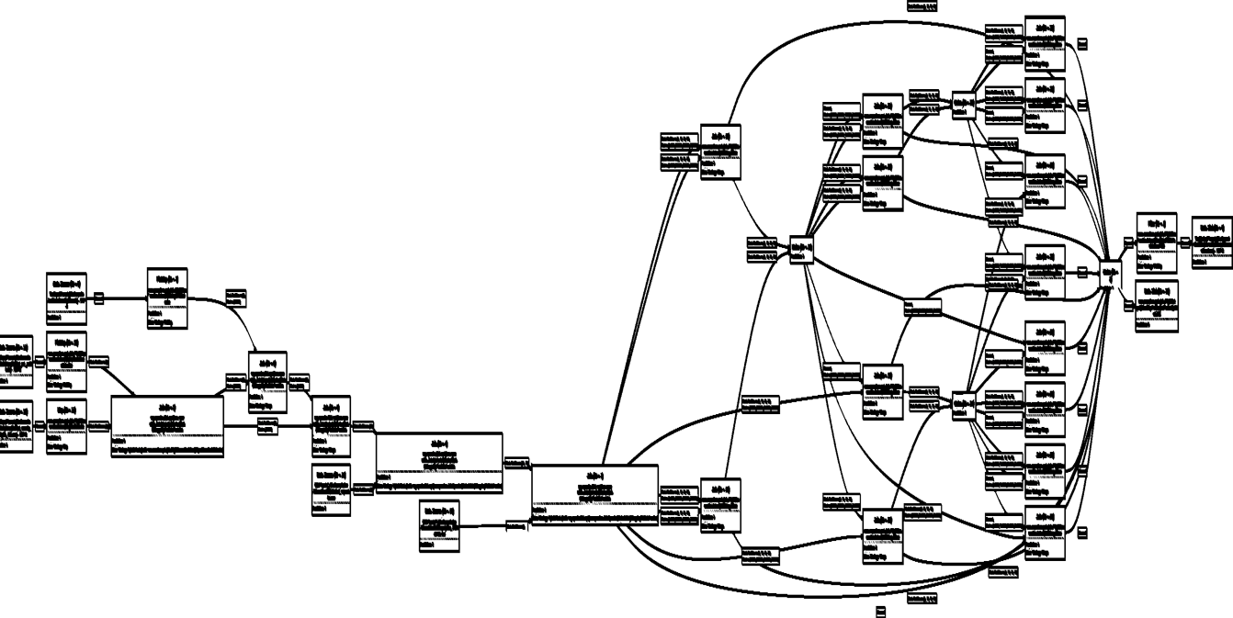
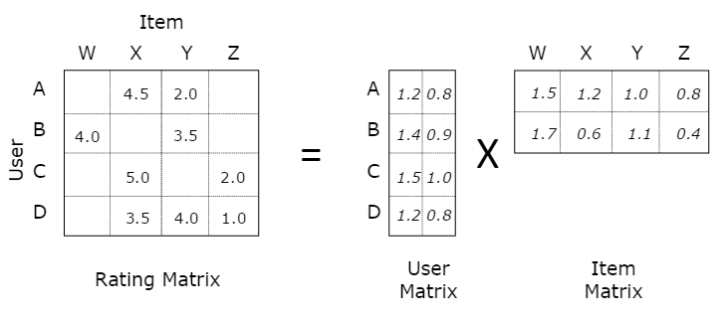
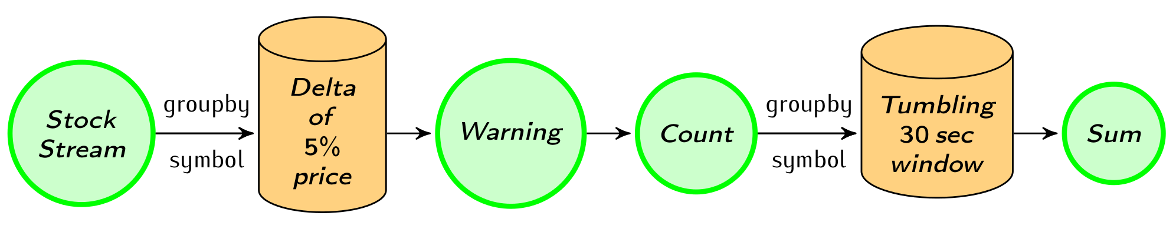
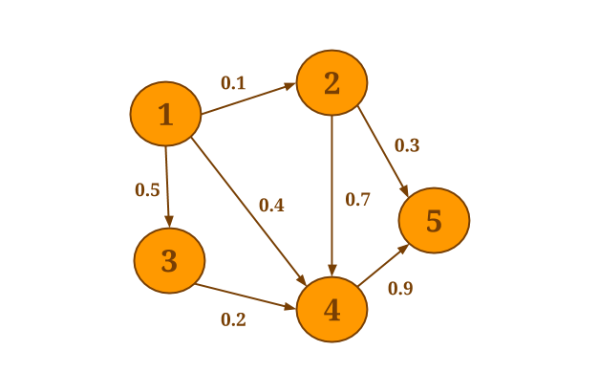
Native support for various workloads
Batch
processing
Machine Learning at scale
Stream
processing
Graph Analysis
Flink

Slide 10
Benefits of a streaming architecture
More real-time reaction to events
Robust continuous applications
Continuous batch apps are duck-taped together from many tools
Process both real-time and historical data
Using exactly the same application

Slide 11
(Re)processing data (in batch)
Re-processing data (what-if exploration, to correct bugs, etc.)
Usually by running a batch job with a set of old files
Tools that map files to times
2016-3-1 12:00 am
2016-3-1 1:00 am
2016-3-1 2:00 am
2016-3-11 10:00pm
2016-3-11 11:00pm
2016-3-12 12:00am
2016-3-12 1:00am
…
Collection of files, by ingestion time
To the batch processor

Slide 12
Unclear Batch Boundaries
2016-3-1 12:00 am
2016-3-1 1:00 am
2016-3-1 2:00 am
2016-3-11 10:00pm
2016-3-11 11:00pm
2016-3-12 12:00am
2016-3-12 1:00am
…
To the batch processor
?
?
What about sessions across batches?

Slide 13
(Re)processing data (streaming)
Draw savepoints at times that you will want to start new jobs from (daily, hourly, …)
Reprocess by starting a new job from a savepoint
Defines start position in stream (for example Kafka offsets)
Initializes pending state (like partial sessions)
Run new streaming program from savepoint
Savepoint

Slide 14
Accurate computation
Batch processing is not an accurate computation model for continuous data
Misses the right concepts and primitives
Time handling, state across batch boundaries
Stateful stream processing a better model
Can achieve high throughput and low latency while robustly delivering accurate results
Real-time/low-latency is the icing on the cake

Slide 15
How does Flink execute my application?

Slide 16
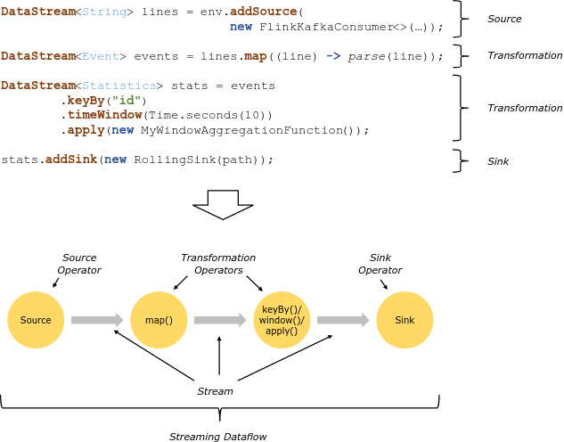

Slide 17
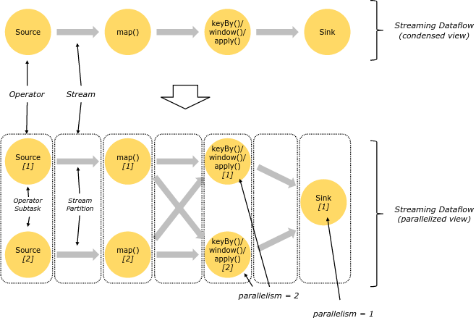
Parallelism

Slide 18
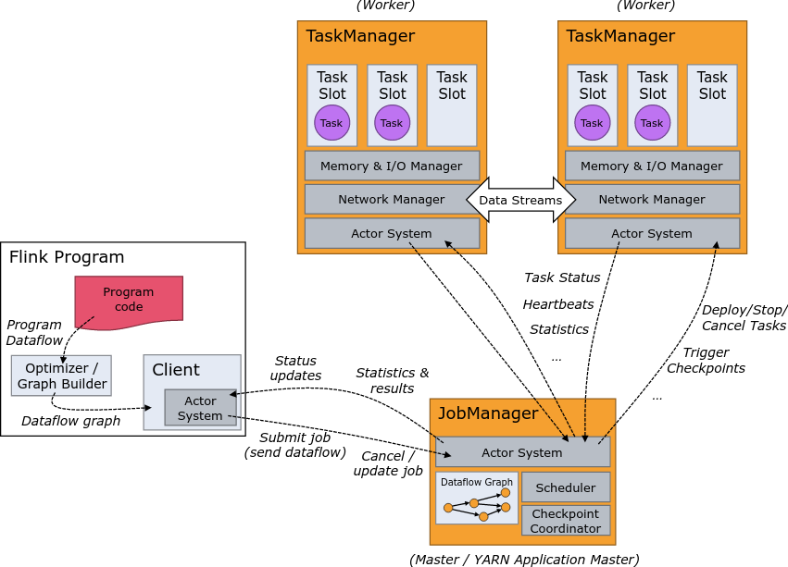
Distributed Execution

Slide 19
Deployment Options

Slide 20

Local Execution
Starts local Flink cluster
All processes run in the same JVM
Behaves just like a regular Cluster
Local cluster can be started in your IDE!
Very useful for developing and debugging
Job Manager
Task Manager
Task Manager
Task Manager
Task Manager
JVM

Slide 21
Remote Execution
Job Manager
Client
Submit job
Submit a Job to a remotely running cluster
Monitor the status of a job
Task Manager
Task Manager
Task Manager
Task Manager
Cluster

Slide 22

YARN Job Mode
Brings up a Flink cluster in YARN to run a single job
Better isolation than session mode
Resource Manager
Node Manager
Node Manager
Job Manager
Task Manager
Node Manager
Node Manager
Task Manager
Other Application
Client
YARN Cluster

Slide 23
YARN Session Mode
Starts a Flink cluster in YARN containers
Multi-user scenario
Resource sharing
Easy to setup
Resource Manager
Node Manager
Node Manager
Job Manager
Task Manager
Node Manager
Node Manager
Task Manager
Other Application
Client
YARN Cluster

Slide 24
Other Deployment Options
Apache Mesos
Either with or without DC/OS
Amazon Elastic MapReduce
Available in EMR 5.1.0
Google Compute Engine
Available via bdutil

Slide 25
Flink in the real world

Slide 26
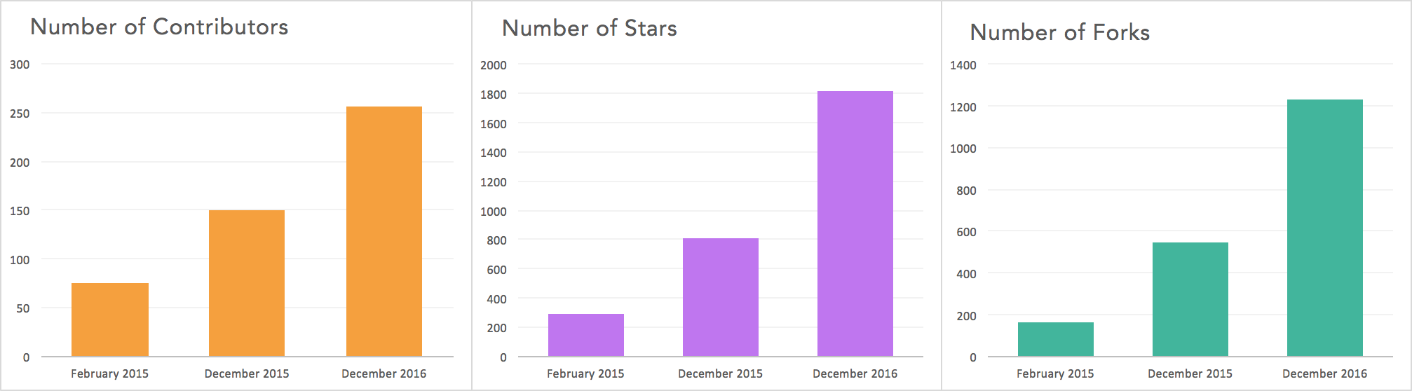
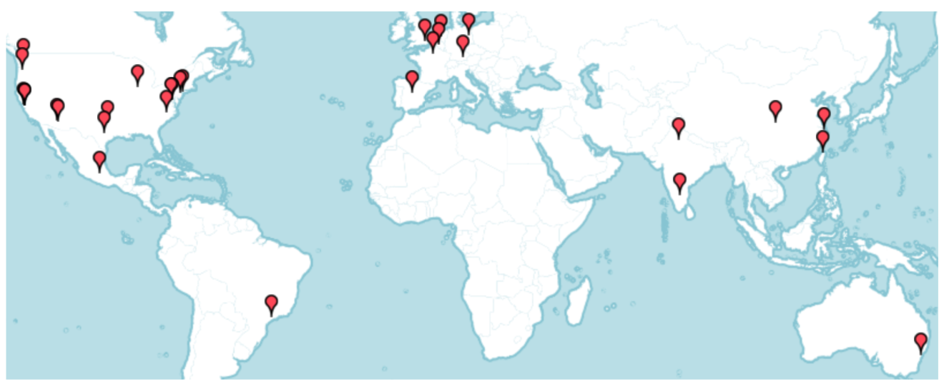
Flink community
Github
41 meetups
16,544 members

Slide 27


























Flink Forward 2016

Slide 28




Powered by Flink
Zalando, one of the largest ecommerce companies in Europe, uses Flink for real-time business process monitoring.
King, the creators of Candy Crush Saga, uses Flink to provide data science teams with real-time analytics.
Alibaba, the world's largest retailer, built a Flink-based system (Blink) to optimize search rankings in real time.
Bouygues Telecom uses Flink for real-time event processing over billions of Kafka messages per day.
See more at flink.apache.org/poweredby.html

Slide 29


Slide 30
Largest job has > 20 operators, runs on > 5000 vCores in 1000-node cluster, processes millions of events per second
Complex jobs of > 30 operators running 24/7, processing 30 billion events daily, maintaining state of 100s of GB with exactly-once guarantees
30 Flink applications in production for more than one year. 10 billion events (2TB) processed daily

Slide 31
http://dataartisans.github.io/flink-training/

