Slide 1


DataStream API
State & Failure Recovery
Apache Flink® Training
Flink v1.2.0 – 13.03.2017

Slide 2
Checkpoints

Slide 3
Checkpointing in Flink
Asynchronous Barrier Snapshotting
checkpoint barriers are inserted into the stream and flow through the graph along with the data
this avoids a "global pause" during checkpointing
Checkpoint barriers cause ...
replayable sources to checkpoint their offsets
operators to checkpoint their state
sinks to commit open transactions
The program is rolled back to the latest completed checkpoint in case of a failure.

Slide 4
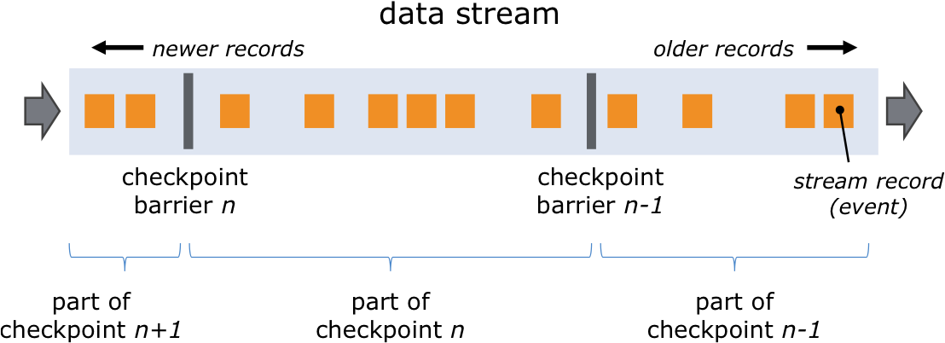
Checkpoint Barriers

Slide 5
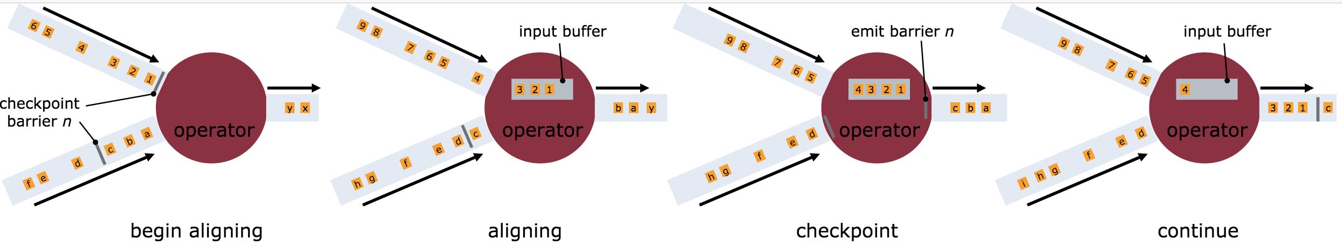
Asynchronous Barrier Snapshotting

Slide 6
Enabling Checkpointing
Checkpointing is disabled by default.
Enable checkpointing with exactly once consistency: // checkpoint every 5 seconds env.enableCheckpointing(5000)
Configure at least once consistency (for lower latency): env.getCheckpointConfig() .setCheckpointingMode(CheckpointingMode.AT_LEAST_ONCE);
Most applications perform well with a few seconds checkpointing interval.

Slide 7
Restart Strategies
How often and fast does a job try to restart?
Available strategies
No restart (default)
Fixed delay
Failure rate
// Fixed Delay restart strategy
env.setRestartStrategy(
RestartStrategies.fixedDelayRestart(
3, // no of restart attempts
Time.of(10, TimeUnit.SECONDS) // restart interval
));
See the docs for details https://ci.apache.org/projects/flink/flink-docs-release-1.2/setup/fault_tolerance.html#restart-strategies

Slide 8
Working with State

Slide 9
Stateful Functions
All DataStream functions can be stateful
Flink manages state so that it can be redistributed/rescaled
State is checkpointed and restored in case of a failure (if checkpointing is enabled)
Flink manages two types of state:
Operator (non-keyed) state
Keyed state
Flink supports rescaling the state it manages

Slide 10
Operator vs Keyed State
Operator (non-keyed)
Keyed
State bound only to operator
E.g. source state
State bound to an operator + key
E.g. Keyed UDF and window state
"SELECT count(*) FROM t GROUP BY t.key"

Slide 11

Repartitioning Operator State
partitionId: 1, offset: 42
partitionId: 3, offset: 10
partitionId: 6, offset: 27
Operator state: a list of state elements
which can be freely repartitioned

Slide 12
Scaling out
partitionId: 1, offset: 42
partitionId: 3, offset: 10
partitionId: 6, offset: 27

Slide 13
Repartitioning Keyed State
Split key space into key groups
Every key falls into exactly one key group
Assign key groups to tasks
Maximum parallelism defined by #key groups
Key space
Key group #1
Key group #2
Key group #4
Key group #3
One key

Slide 14
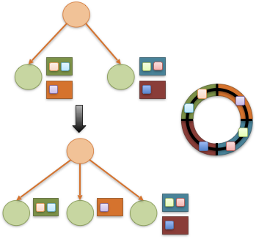
Rescaling changes key group assignment

Slide 15
Types of Keyed State
ValueState<T>
ListState<T>
ReducingState<T>
FoldingState<T>
AggregatingState<IN, OUT>

Slide 16
Using Key-Partitioned State
DataStream<Tuple2<String, String>> strings = … DataStream<Long> lengths = strings .keyBy(0) .map(new MapWithCounter());
public static class MapWithCounter extends RichMapFunction<Tuple2<String, String>, Long> {
// state object
private ValueState<Long> totalLengthByKey;
@Override public void open (Configuration conf) { // obtain state object
ValueStateDescriptor<Long> descriptor = new ValueStateDescriptor<>(
"totalLengthByKey", Long.class, 0L);
totalLengthByKey = getRuntimeContext().getState(descriptor);
}
@Override public Long map (Tuple2<String, String> value) throws Exception {
long length = totalLengthByKey.value(); // fetch state for current key
long newTotalLength = length + value.f1.length();
totalLengthByKey.update(newTotalLength); // update state of current key
return totalLengthByKey.value();
}
}

Slide 17
State Backends

Slide 18
State in Flink
There are several sources of state in Flink
Windows
User functions
Sources and Sinks
State is persisted during checkpoints, if checkpointing is enabled
Internal representation and storage location depend on the configured State Backend

Slide 19
State Backends
MemoryStateBackend (default)
State is hold as objects on worker JVM heap
Checkpoints are stored on master JVM heap
Suitable for development and tiny state. Not highly-available
FsStateBackend
State is hold on worker JVM heap (limited by heap size)
Checkpoints are written to a configured filesystem URI (hdfs, s3, file)
Suitable for jobs with large state and/or high-availability requirements
RocksDBStateBackend
State is held in RocksDB instance on worker filesystem (limited by disk size)
Checkpoints are written to a configured filesystem URI (hdfs, s3, file)
Suitable for jobs with very large state and/or high-availability requirements
Only backend that supports fully async state snapshots

Slide 20
State Backend Configuration
Configuration of default state backend in ./conf/flink-conf.yaml
State backend configuration in job env.setStateBackend(
new FsStateBackend( "hdfs://namenode:40010/flink/checkpoints” ));
See the docs for details
https://ci.apache.org/projects/flink/flink-docs-release-1.2/dev/state_backends.html

Slide 21
Savepoints

Slide 22
Savepoints
A "Checkpoint" is a globally consistent point-in-time snapshot of a streaming application (point in stream, state)
Savepoints are user-triggered, retained checkpoints
Applications can be re-started from savepoints
Savepoints are useful for
Application updates
Updating a Flink version
Maintenance & migration
A/B testing
Rescaling
Currently, Flink can only restore to the same state backend that created the savepoint

Slide 23
References
Documentation
https://ci.apache.org/projects/flink/flink-docs-release-1.2/internals/stream_checkpointing.html
https://ci.apache.org/projects/flink/flink-docs-release-1.2/dev/stream/state.html
https://ci.apache.org/projects/flink/flink-docs-release-1.2/setup/fault_tolerance.html
https://ci.apache.org/projects/flink/flink-docs-release-1.2/setup/savepoints.html
https://ci.apache.org/projects/flink/flink-docs-release-1.2/setup/cli.html
Blog posts
http://data-artisans.com/how-apache-flink-enables-new-streaming-applications/

