Slide 1


DataStream API
Fault Tolerance
Apache Flink® Training
Flink v1.3 – 8.9.2017

Slide 2
Fault Tolerance via Snapshotting

Slide 3
Fault tolerance: simple case
How to ensure exactly-once semantics for the state?
periodically snapshot the memory
event log
main memory
single process

Slide 4
Fault tolerance: simple case
Recovery: restore snapshot and replay events since snapshot
event log
persists events
(temporarily)
single process

Slide 5
State fault tolerance
Fault tolerance concerns for a stateful stream processor:
How to ensure exactly-once semantics for the state?
How to create consistent snapshots of distributed embedded state?
More importantly, how to do it efficiently without interrupting computation?

Slide 6
State fault tolerance (II)
Consistent snapshotting:
Your Code
Your Code
State
Your Code
...
State
State
Your Code
State

Slide 7
State fault tolerance (II)
Consistent snapshotting:
Your Code
Your Code
State
Your Code
...
State
State
Your Code
File System
State
Checkpoint
checkpointed
state
checkpointed
state
checkpointed
state

Slide 8
State fault tolerance (III)
Recover all embedded state
Reset position in input stream
Your Code
Your Code
State
Your Code
...
State
State
Your Code
File System
State
Restore
checkpointed
state
checkpointed
state
checkpointed
state

Slide 9
Checkpoints

Slide 10
Checkpointing in Flink
Asynchronous Barrier Snapshotting
checkpoint barriers are inserted into the stream and flow through the graph along with the data
this avoids a "global pause" during checkpointing
Checkpoint barriers cause ...
replayable sources to checkpoint their offsets
operators to checkpoint their state
sinks to commit open transactions
The program is rolled back to the latest completed checkpoint in case of a failure.

Slide 11
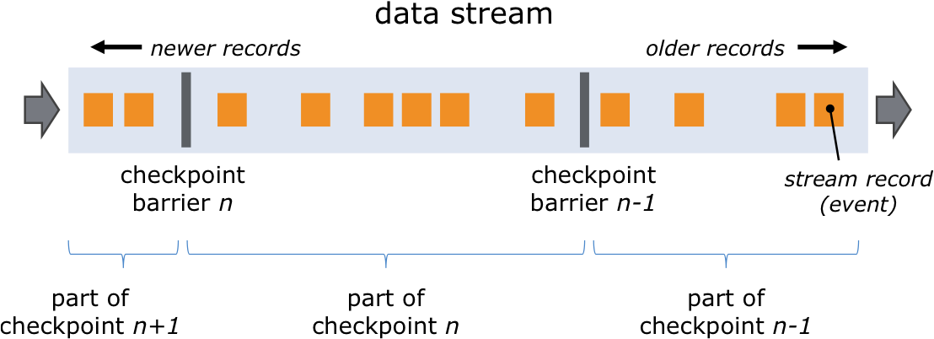
Checkpoint Barriers

Slide 12
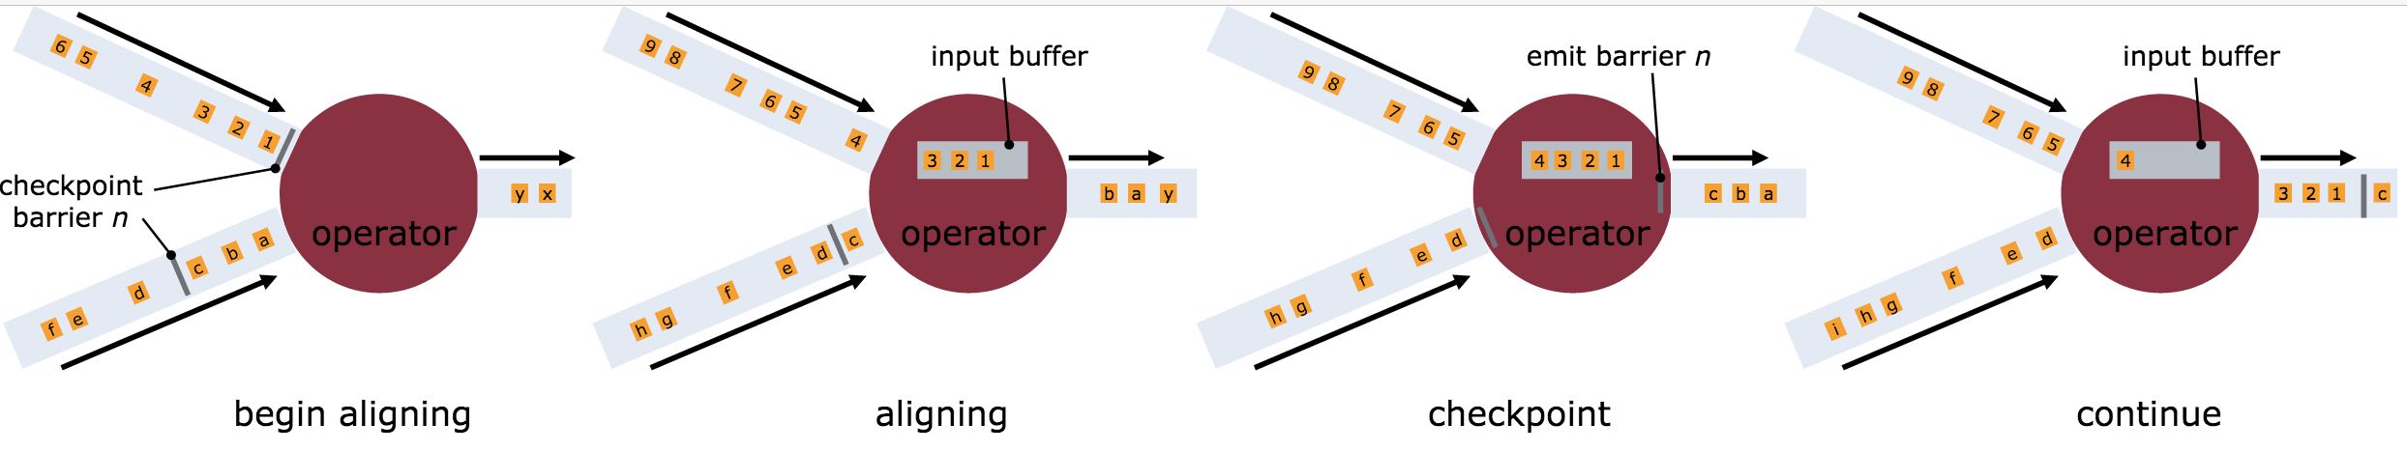
Asynchronous Barrier Snapshotting

Slide 13
Distributed snapshots
Events flow without replication or synchronous writes
State index
(Hash Table or RocksDB)
source
stateful operation

Slide 14
Distributed snapshots
Inject checkpoint barrier
Trigger checkpoint
source
stateful operation

Slide 15
Distributed snapshots
Trigger state copy-on-write
Take state snapshot
source
stateful operation

Slide 16
Distributed snapshots
Durably persist snapshots asynchronously
Processing pipeline continues
DFS
source
stateful operation

Slide 17
Enabling Checkpointing
Checkpointing is disabled by default.
Enable checkpointing with exactly once consistency: // checkpoint every 5 seconds env.enableCheckpointing(5000)
Configure at least once consistency (for lower latency): env.getCheckpointConfig() .setCheckpointingMode(CheckpointingMode.AT_LEAST_ONCE);
Most applications perform well with a few seconds checkpointing interval.

Slide 18
Restart Strategies
How often and fast does a job try to restart?
Available strategies
No restart (default)
Fixed delay
Failure rate
// Fixed Delay restart strategy
env.setRestartStrategy(
RestartStrategies.fixedDelayRestart(
3, // no of restart attempts
Time.of(10, TimeUnit.SECONDS) // restart interval
));

Slide 19
State Backends

Slide 20
State in Flink
There are several sources of state in Flink
Windows
User functions
Sources and Sinks
Timers
State is persisted during checkpoints, if checkpointing is enabled
Internal representation and storage location depend on the configured State Backend

Slide 21
Choosing a State Backend
Name | Working state | State backup | Snapshotting
RocksDBStateBackend | Local disk (tmp directory) | Distributed file system | Asynchronously
Good for state larger than available memory 10x slower than memory-based backends
FsStateBackend | JVM Heap | Distributed file system | Synchronous / Async option in Flink 1.3
Fast, requires large heap
MemoryStateBackend | JVM Heap | JobManager JVM Heap | Synchronous / Async option in Flink 1.3
Good for testing and experimentation with small state (locally)

Slide 22
State Backend Configuration
Configuration of default state backend in ./conf/flink-conf.yaml
State backend configuration in job env.setStateBackend(
new FsStateBackend( "hdfs://namenode:40010/flink/checkpoints” ));

Slide 23
Savepoints

Slide 24
State management
Two important management concerns for a long-running job:
Can I change / fix bugs in my streaming pipeline? How do I handle job downtime?
Can I rescale (change parallelism of) my computation?

Slide 25
State management: Savepoints
A persistent snapshot of all state
When starting an application, state can be initialized from a savepoint
In-between savepoint and restore we can update Flink version or user code

Slide 26
Savepoints
A Checkpoint is a globally consistent point-in-time snapshot of a streaming application (point in stream, state)
Savepoints are user-triggered, retained checkpoints
Rescaling (currently) requires restarting from a savepoint
Currently, Flink can only restore to the same state backend that created the savepoint

