Slide 1


Apache Flink® Training
Flink v1.3 – 9.9.2017
DataStream API
Working with State

Slide 2
Stateful Functions
All DataStream functions can be stateful
State is checkpointed and restored in case of a failure (if checkpointing is enabled)
Flink manages two types of state
Operator (non-keyed) state
Keyed state
Flink supports rescaling the state it manages

Slide 3
Operator vs Keyed State
Operator (non-keyed)
Keyed
State bound only to operator
E.g. source state
State bound to an operator + key
E.g. Keyed UDF and window state
"SELECT count(*) FROM t GROUP BY t.key"

Slide 4
Managed State
Operator State
Keyed State
ListState<T>
ValueState<T>
ListState<T>
ReducingState<T>
MapState(UK, UV)
FoldingState<T> (deprecated)
AggregatingState<IN, OUT> (1.4)

Slide 5
Using Key-Partitioned State
DataStream<Tuple2<String, String>> strings = … DataStream<Long> lengths = strings.keyBy(0).map(new MapWithCounter());
public static class MapWithCounter extends RichMapFunction<Tuple2<String, String>, Long> {
private ValueState<Long> totalLengthByKey;
@Override public void open (Configuration conf) {
ValueStateDescriptor<Long> descriptor = new ValueStateDescriptor<>(”sum of lengths", Long.class);
totalLengthByKey = getRuntimeContext().getState(descriptor);
}
@Override public Long map (Tuple2<String, String> value) throws Exception {
long length = totalLengthByKey.value(); // fetch state for current key
if (length == null) length = 0;
long newTotalLength = length + value.f1.length();
totalLengthByKey.update(newTotalLength); // update state for current key
return newTotalLength;
}
}

Slide 6
Rescalable State

Slide 7

Repartitioning Operator State
partitionId: 1, offset: 42
partitionId: 3, offset: 10
partitionId: 6, offset: 27
Operator state: a list of state elements
which can be freely repartitioned

Slide 8
Scaling out
partitionId: 1, offset: 42
partitionId: 3, offset: 10
partitionId: 6, offset: 27

Slide 9
Operator State
CheckpointedFunction methods
void snapshotState(FunctionSnapshotContext context)
void initializeState(FunctionInitializationContext context)
Context methods
boolean isRestored()
OperatorStateStore getOperatorStateStore()
KeyedStateStore getKeyedStateStore()

Slide 10
OperatorStateStore
getListState() – round-robin redistribution
getUnionListState() – union broadcast

Slide 11
Repartitioning Keyed State
Split key space into key groups
# of key groups is kept constant
Every key falls into exactly one key group
Assign key groups to tasks
Maximum parallelism defined by number of key groups
Key space
Key group #1
Key group #2
Key group #4
Key group #3
One key

Slide 12
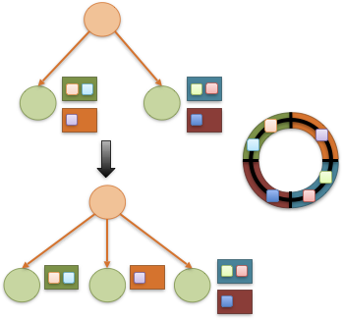
Rescaling changes key group assignment

