Slide 1


DataStream API
Windows
Apache Flink® Training
Flink v1.3 – 8.9.2017

Slide 2
Windows and Aggregates

Slide 3
Windows
Aggregations on streams are different from aggregations on batched data
You cannot count all records of an unbounded stream
Aggregations do make sense on windowed streams, e.g.,
Number of transactions per minute

Slide 4
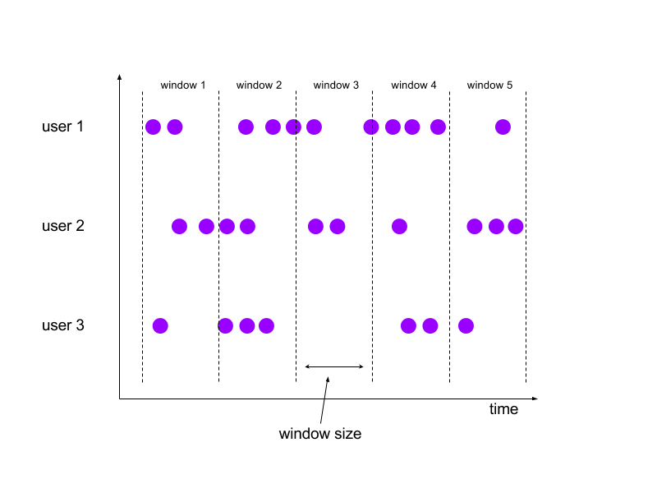
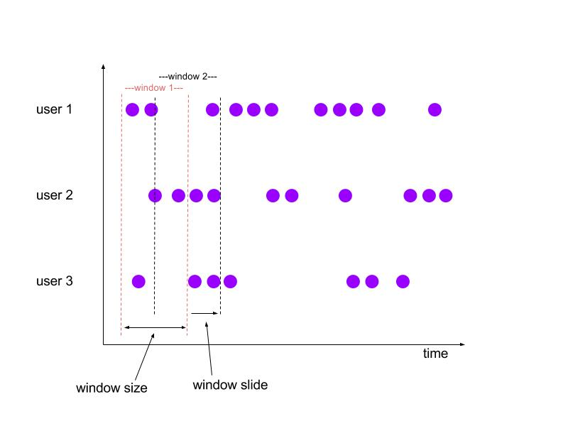
Tumbling and Sliding Windows
Tumbling:
aligned, fixed length,
non-overlapping windows
Sliding:
aligned, fixed length,
overlapping windows

Slide 5
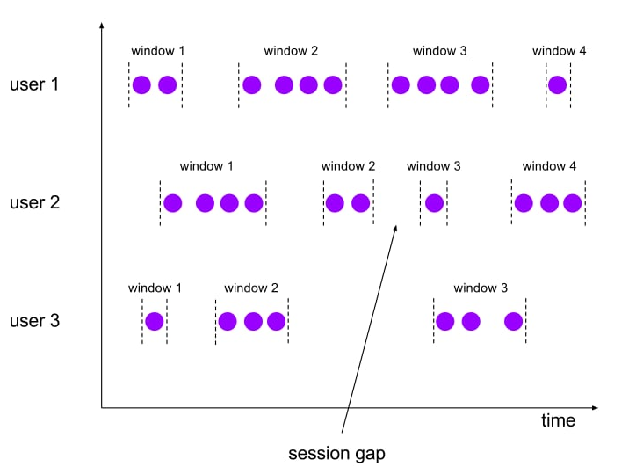
Session Windows
Non-aligned, variable length windows.

Slide 6
Specifying Windowing
stream
.keyBy(…) / keyed vs non-keyed windows
.window(…) / “Assigner”
.trigger(…) / each Assigner has a default Trigger
.evictor(…) / default: no Evictor
.allowedLateness() / default: zero
.process|apply|reduce() / window function

Slide 7
Predefined Keyed Windows
Tumbling time window
.timeWindow(Time.minutes(1))
Sliding time window
.timeWindow(Time.minutes(1), Time.seconds(10))
Tumbling count window
.countWindow(100)
Sliding count window
.countWindow(100, 10)
Session window
.window(SessionWindows.withGap(Time.minutes(30)))

Slide 8
Non-keyed Windows
Windows on non-keyed streams are not processed in parallel!
stream.windowAll(…)…
stream.timeWindowAll(Time.seconds(10))…
stream.countWindowAll(20, 10)…

Slide 9
Aggregations on Windowed Streams
DataStream<SensorReading> input = …
input
.keyBy(“key”)
.timeWindow(Time.minutes(1))
.apply(new MyWastefulMax());
public static class MyWastefulMax implements WindowFunction<
SensorReading, // input type
Tuple3<String, Long, Integer>, // output type
Tuple, // key type
TimeWindow> { // window type @Override public void apply( Tuple key, TimeWindow window, Iterable<SensorReading> events, Collector<Tuple3<String, Long, Integer>> out) {
int max = 0;
for (SensorReading e : events) { if (e.f1 > max) max = e.f1; } out.collect(new Tuple3<>((Tuple1<String>)key).f0, window.getEnd(), max)); } }

Slide 10
Window State during Aggregation
state
7

Slide 11
Window State during Aggregation
state
9
7

Slide 12
Window State during Aggregation
state
3
9
7

Slide 13
Window State during Aggregation
state
8
3
9
7

Slide 14
Window State during Aggregation
state
8
3
9
7
9
window trigger

Slide 15
Incremental Window Aggregation
DataStream<SensorReading> input = …
input
.keyBy(“key”)
.timeWindow(Time.minutes(1))
.reduce(new MyReducingMax(), new MyWindowFunction());
private static class MyReducingMax implements ReduceFunction<SensorReading> {
public SensorReading reduce(SensorReading r1, SensorReading r2) {
return r1.value() > r2.value() ? r1 : r2;
}
}
private static class MyWindowFunction implements WindowFunction<
SensorReading, Tuple2<Long, SensorReading>, String, TimeWindow> {
public void apply(String key,
TimeWindow window,
Iterable<SensorReading> maxReadings,
Collector<Tuple2<Long, SensorReading>> out) {
SensorReading max= maxReadings.iterator().next();
out.collect(new Tuple2<Long, SensorReading>(window.getStart(), max));
}
}

Slide 16
Incremental Aggregation
state
8, 3, 9, 7
7

Slide 17
Incremental Aggregation
state
8, 3, 9
7
9
8, 3, 9

Slide 18
Incremental Aggregation
state
8, 3
9
9
3

Slide 19
Incremental Aggregation
state
8
9
9
3

Slide 20
Incremental Aggregation
9
9
window trigger

Slide 21
Window Operations
Passed an Iterable containing all elements of a Window:
apply(windowFunction)
process(processWindowFunction)
new in 1.3
Notes:
Folding has been deprecated, and will eventually be removed.

Slide 22
ProcessWindowFunction()
public abstract class ProcessWindowFunction<IN, OUT, KEY, W extends Window> extends AbstractRichFunction { /** * Evaluates the window and outputs none or several elements. * * @param key The key for which this window is evaluated. * @param context The context in which the window is being evaluated. * @param elements The elements in the window being evaluated. * @param out A collector for emitting elements. * */ public abstract void process(
KEY key,
Context context,
Iterable<IN> elements,
Collector<OUT> out) throws Exception; // The context holding window metadata. public abstract class Context implements java.io.Serializable { public abstract W window(); public abstract long currentProcessingTime(); public abstract long currentWatermark(); public abstract KeyedStateStore windowState(); // per-key per-window state public abstract KeyedStateStore globalState(); // per-key global state } }

Slide 23
Incremental Window Operations
Passed each element of a window, which is aggregated into a single result:
reduce(reduceFunction)
aggregate(aggregateFunction)
Notes:
Folding has been deprecated, and will eventually be removed.

Slide 24
Other Aggregations
sum(key), min(key), max(key)
return the value
sumBy(key), minBy(key), maxBy(key)
return an element with the value
These are available on KeyedStreams as well as WindowedStreams
Notes:
Folding has been deprecated, and will eventually be removed.

Slide 25
Custom window logic
The DataStream API allows you to define very custom window logic
GlobalWindows
very basic WindowAssigner; assigns every element to the same global window
only useful if you explicitly specify triggering, otherwise nothing will happen
Trigger
defines when to evaluate a window
whether to purge the window or not
Careful! This part of the API requires a good understanding of the windowing mechanism!

Slide 26
Session windows (and merging)
Session windows are based on an abstraction of windows than can merge
Each element is initially assigned to a new window
Windows are then merged if the gap between them is small enough
Requires a merging Trigger and a merging WindowFunction

