Slide 1


Apache Flink® Training
Flink v1.3 – 8.9.2017
Table API & SQL

Slide 2
Overview & Basic Concepts

Slide 3
What are Table API and SQL?
Unified APIs for batch & streaming data
A query specifies exactly the same result regardless whether its input is static batch data or streaming data.
ANSI SQL Syntax
Table API is a language-integrated query API
Java and Scala

Slide 4
Examples
“clicks” can be a - file - database table,
- stream, …
val tableApiResult: Table = tEnv .scan("clicks")
.filter('url.like("https://www.xyz.com%")
.groupBy('user)
.select('user, 'url.count as 'cnt)
val sqlResult: Table = tEnv.sql("""
|SELECT user,
| COUNT(url) AS cnt
|FROM clicks |WHERE url LIKE 'https://www.xyz.com%'
|GROUP BY user
""".stripMargin)

Slide 5
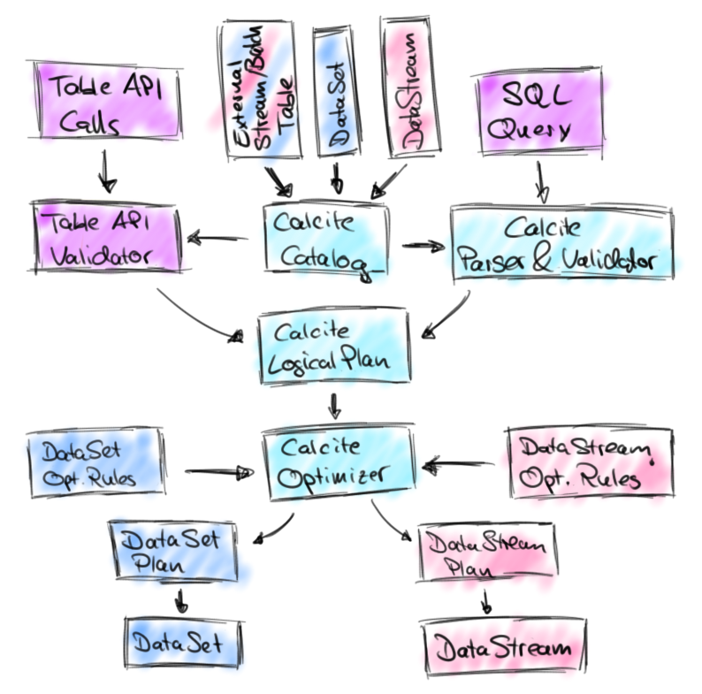
How do the APIs relate to each other?
Table API and SQL are two APIs for the same library
Common code base
Translation with Apache Calcite
Type system & code-generation
Table sources & sinks
User-defined functions
Tight integration with DataStream & DataSet APIs

Slide 6
Dependencies
Table API & SQL dependency
Stream Processing
<dependency> <groupId>org.apache.flink</groupId>
<artifactId>flink-table_2.10</artifactId>
<version><!– FLINK VERSION --></version>
</dependency>
Batch Procession
<dependency> <groupId>org.apache.flink</groupId>
<artifactId>flink-scala_2.10</artifactId>
<version><!– FLINK VERSION --></version>
</dependency>
<dependency> <groupId>org.apache.flink</groupId>
<artifactId>flink-streaming-scala_2.10</artifactId>
<version><!– FLINK VERSION --></version>
</dependency>

Slide 7
Table API Query Example
// get a DataStream StreamExecutionEnvironment
StreamExecutionEnvironment env = StreamExecutionEnvironment.getExecutionEnvironment();
// get a TableEnvironment StreamTableEnvironment tableEnv = TableEnvironment.getTableEnvironment(env);
// register a TableSource as “persons” table tableEnv.registerTableSource("persons", new TableSource());
// Scan persons table. Result is a Table
Table persons = tableEnv.scan("persons")
// Query persons table. Result is a Table Table result = persons.where("age > 20").select("name, age")
// emit a the result Table
tableEnv.writeToSink(result, new TableSink());
// execute program
env.execute();

Slide 8
TableEnvironment
Responsible for table definition, access, and emission
Accesses registered tables
Emits tables
Converts DataStream/DataSet ↔ Table
Manages the catalog
Registers a TableSource, DataStream, DataSet, or Table
Registers user-defined functions

Slide 9
TableEnvironment
// get a DataStream StreamExecutionEnvironment
StreamExecutionEnvironment env = StreamExecutionEnvironment.getExecutionEnvironment();
// get a TableEnvironment StreamTableEnvironment tableEnv = TableEnvironment.getTableEnvironment(env);
// register a TableSource as “persons” table tableEnv.registerTableSource("persons", new TableSource());
// Scan persons table. Result is a Table
Table persons = tableEnv.scan("persons")
// Query persons table. Result is a Table Table result = persons.where("age > 20").select("name, age")
// emit a the result Table
tableEnv.writeToSink(result, new TableSink());
// execute program
env.execute();

Slide 10
Table
Represents a relational table
Schema with field names and types
Can be processed by Table API operations
Operations result in a new Table
Result of a SQL query
Can be static (batch) or dynamic (streaming)

Slide 11
Table
// get a DataStream StreamExecutionEnvironment
StreamExecutionEnvironment env = StreamExecutionEnvironment.getExecutionEnvironment();
// get a TableEnvironment StreamTableEnvironment tableEnv = TableEnvironment.getTableEnvironment(env);
// register a TableSource as “persons” table tableEnv.registerTableSource("persons", new TableSource());
// Scan persons table. Result is a Table
Table persons = tableEnv.scan("persons")
// Query persons table. Result is a Table Table result = persons.where("age > 20").select("name, age")
// emit a the result Table
tableEnv.writeToSink(result, new TableSink());
// execute program
env.execute();

Slide 12
Stream Processing with Table API & SQL

Slide 13
Queries on streams
Streams are not queried, BUT tables which are derived from streams
Core concept is a “Dynamic Table”
A dynamic table is changing over time
Stream is interpreted as changelog
A table is the materialization of a changelog stream

Slide 14
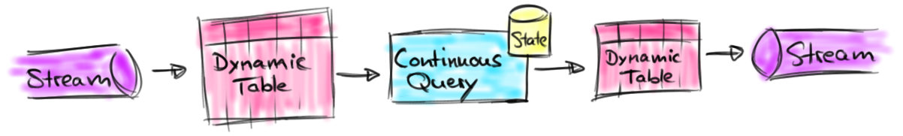
Queries on dynamic tables
Queries on dynamic tables
produce new dynamic tables, which are automatically updated based on input
do not terminate
Stream ↔ Dynamic table conversions

Slide 15
Stream → Dynamic Table
Stream records are appended to table
Table grows as more data arrives
user | rowtime | url
Mary | 12:00:00 | ./home
Bob | 12:00:00 | ./cart
Mary | 12:00:05 | ./prod?id=1
Liz | 12:01:00 | ./home
Bob | 12:01:30 | ./prod?id=3
Mary | 12:01:45 | ./prod?id=7
… | …
Mary, 12:00:00, ./home
Bob, 12:00:00, ./cart
Mary, 12:00:05, ./prod?id=1
Liz, 12:01:00, ./home
Bob, 12:01:30, ./prod?id=3
Mary, 12:01:45, ./prod?id=7

Slide 16
Querying a Dynamic Table
clicks
user | cTime | url
result
Mary | 12:00:00 | ./home
SELECT
user,
COUNT(url) as cnt FROM clicks GROUP BY user
user | cnt
Bob | 12:00:00 | ./cart
u1 | 2
u1 | 3
u1 | 1
Mary | 12:00:05 | ./prod?id=1
u2 | 1
u3 | 1
Liz | 12:01:00 | ./home
u3 | 2
Liz | 12:01:30 | ./prod?id=3
Mary | 12:01:45 | ./prod?id=7
Rows of result table are updated.

Slide 17
Dynamic Table → Stream
clicks
user | link
Mary | ./home
Bob | ./cart
Mary | ./prod?id=1
Liz | ./home
Liz | ./prod?id=3
Mary | ./prod?id=7
… | …
SELECT
user,
COUNT(url) as cnt FROM clicks GROUP BY user
+ INSERT / - DELETE
+ M,3
- M,2
+ L,2
- L,1
+ L,1
+ M,2
- M,1
+ B,1
+ M,1

Slide 18
Append-only queries
Some queries produce only appends to result table
Many window queries are append-only queries
Append-only table can be directly converted to stream
SELECT url, name
FROM clicks
WHERE url LIKE ‘%blog%’

Slide 19
Timestamps & Watermarks
Table API & SQL require explicit time attributes
In contrast to DataStream API which ”hides” timestamps
Table can have special time attributes
Processing time attribute
Row time attribute
watermarked event time timestamps
Windows can only be defined on time attributes

Slide 20
Table API

Slide 21
Table API
Centered around the Table class
Table API operations
are applied to Tables
result in a Table

Slide 22
Table API Operations
scan()
select()
Table clicks = tableEnv.scan("clicks");
Table urls = clicks.select("url, ip");

Slide 23
Table API Operations
where() / filter()
groupBy().select()
Table blogClicks = clicks.where("url LIKE ‘%blog%’");
Table urlCnts = clicks
.groupBy("ip")
.select("ip, url.count() AS urlCnt");

Slide 24
Table API Operations
window().groupBy().select()
Time Attribute
Table urlClicksPerHour = clicks
.window(
Tumble.over("1.hour").on("rowtime").as("w")) .groupBy("url, w")
.select("url, w.start, ip.count() AS cnt");

Slide 25
Scala Table API
Expressions are not specified as Strings
Tighter language integration
Fields are references with Scala symbols
Scala symbol
Table urlCnts = clicks
.groupBy(‘ip)
.select(‘ip, ‘url.count() as ‘urlCnt);

Slide 26
Table API Operations
More operations
Over windows
Inner & Outer Joins (not in streaming yet)
Set operations (not in streaming yet)
Built-in functions
Logic functions
Arithmetic functions
String functions
Nested type access
…
Check Flink documentation for
complete feature list and details.

Slide 27
SQL

Slide 28
SQL
ANSI SQL Syntax
Based on Apache Calcite’s parser
Not all operation are supported yet
Queries are specified with TableEnvironment.sql()
Referenced tables must be registered
Query returns a Table
Table urls =
tableEnv.sql("SELECT urls FROM clicks");

Slide 29
Stream Support
SELECT: Projection
WHERE: Selection
GROUP BY: Grouping
GROUP BY [TUMBLE, HOP, SESSION]: Grouping windows
UNION ALL: Union without duplicate elimination
OVER: Over windows (w/o FOLLOWING)

Slide 30
Group Window Exampe
Table ipCntPerUrlAndHour = tableEnv.sql( "SELECT url, " +
" TUMBLE_END(rowtime, INTERVAL '1' HOURS) AS endT, " +
" COUNT(ip) AS ipCnt " + "FROM clicks " + "GROUP BY " +
" TUMBLE(rowtime, INTERVAL '1' HOURS), " +
" url"
);
Time Attribute

Slide 31
Batch support
Same as stream (without OVER)
JOIN: inner & outer equi-joins
UNION, INTERSECT, EXCEPT: set operations
ORDER BY, LIMIT: sorting
GROUPING SET, CUBE, ROLLUP: aggregations
Check Flink documentation for
complete feature list and details.

Slide 32
DataStream & DataSet Integration

Slide 33
DataStream → Table
Conversion via TableEnvironment
Schema of Table is inferred from DataStream type
Fields can be named
DataStream<Tuple3<String, Long, String>> clicks = …
Table clicksTable = tableEnv.fromDataStream(
clicks, // stream to convert "ip, url, clicktime.rowtime"); // name fields
“rowtime” marks row time field

Slide 34
Table → DataStream
Conversion via TableEnvironment
Type of resulting DataStream must be specified
Row is generic type
Result stream has Boolean flag indicating insert or delete
Table urlCntsTable = …
DataStream<<Tuple2<Boolean, Row>>> urlCnts = tableEnv.toRetractStream(urlCntsTable, Row.class);

Slide 35
Table → DataStream
Converting an append-only table does not require flag
Table clicksTable = …
DataStream<Row> clicks =
tableEnv.toAppendStream(clicksTable, Row.class);

Slide 36
DataSet Conversions
Conversion from and to DataSet works identically
Same table schema type inference

Slide 37
User-defined Functions

Slide 38
User-defined Functions (UDFs)
Extensive support for UDFs
Scalar UDF
Table UDF
Aggregation UDF
UDFs are implemented in Java or Scala
extend abstract classes

Slide 39
Use a Scalar Function
Register UDF in TableEnvironment
Use scalar UDF in query
IpResolver resolveIp = new IpResolver();
tableEnv.registerFunction(“resolveIp”, resolveIp);
tableEnv.scan("clicks").select("resolveIp(ip)");
tableEnv.sql("SELECT resolveIp(ip) FROM clicks");

Slide 40
Summary

Slide 41
Table API & SQL Summary
Unified API for streaming and batch
Same query + same [stream|batch] data = same result
Tight integration with other APIs & libraries (CEP, Gelly)
Many operations & lots of features
Check out the documentation for the complete picture
https://ci.apache.org/projects/flink/flink-docs-release-1.3/dev/table/index.html

