Slide 1


Apache Flink® Training
System Overview
Apache Flink® Training
Flink v1.1.3 – 8.11.2016

Slide 2
What is Flink?

Slide 3

Apache Flink®
A stream processor
with many applications
Streaming dataflow runtime

Slide 4
(Distributed) streaming
Computations on never-ending “streams” of data records (“events”)
A stream processor distributes the computation in a cluster
Your code
Your code
Your code
Your code

Slide 5
Stateful streaming
Computation and state
E.g., counters, windows of past events, state machines, trained ML models
Results depend on history of stream
A stateful stream processor provides tools to manage state
Recover, roll back, version, upgrade, etc.
Your code
state

Slide 6
Event-time streaming
Data records associated with timestamps (time series data)
Processing depends on timestamps
An event-time stream processor gives you the tools to reason about time
E.g., handle streams that are out of order
t4
t3
t1
t2
t1-t2
t3-t4
Your code
state

Slide 7



app state
event log
app state
Query
service
app state

Slide 8
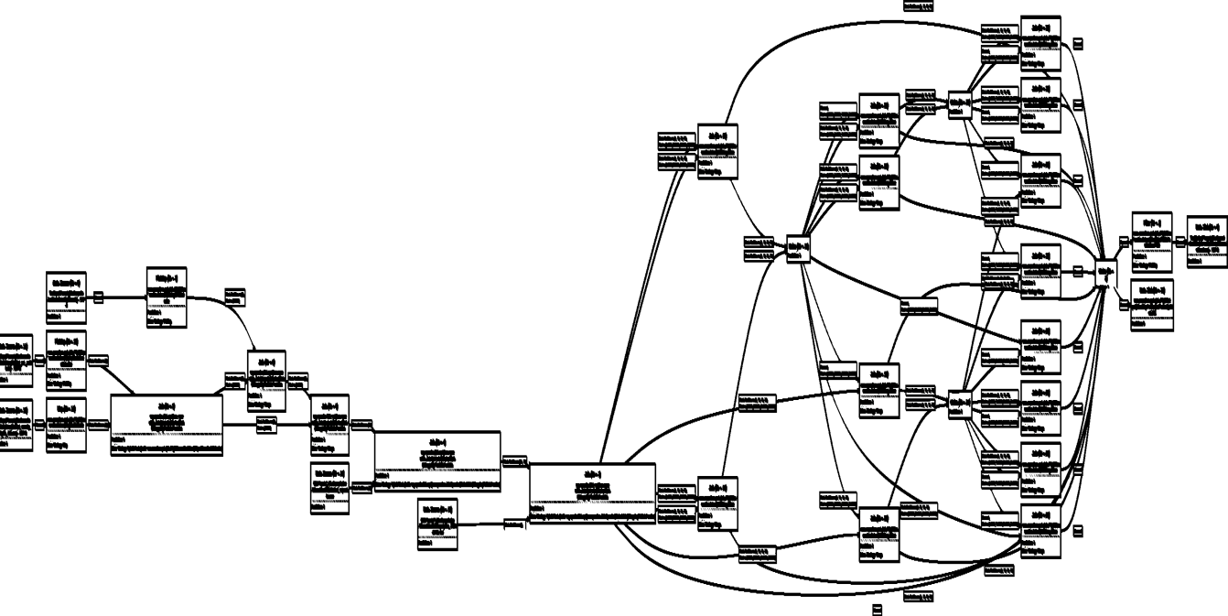
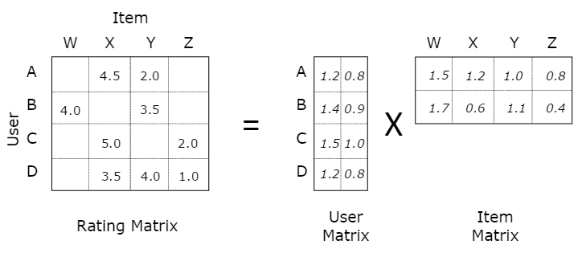
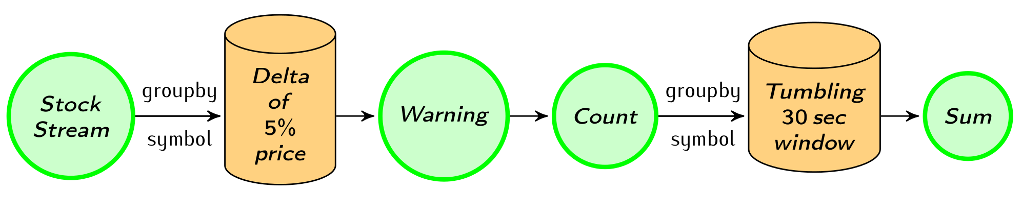
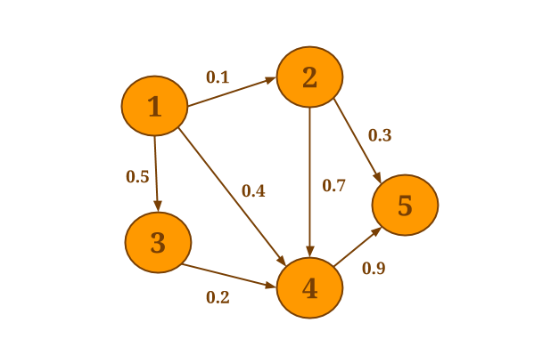
Native support for various workloads
Batch
processing
Machine Learning at scale
Stream
processing
Graph Analysis
Flink

Slide 9
Benefits of a streaming architecture
More real-time reaction to events
Robust continuous applications
Continuous batch apps are duck-taped together from many tools
Process both real-time and historical data
Using exactly the same application

Slide 10
Accurate computation
Batch processing is not an accurate computation model for continuous data
Misses the right concepts and primitives
Time handling, state across batch boundaries
Stateful stream processing a better model
Can achieve high throughput and low latency while robustly delivering accurate results
Real-time/low-latency is the icing on the cake

Slide 11
How does Flink execute my application?

Slide 12
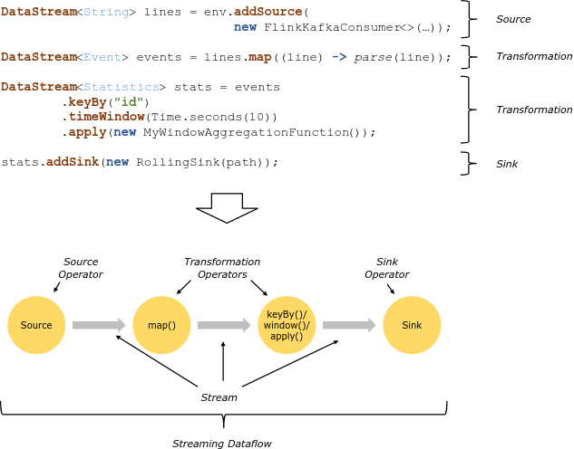

Slide 13
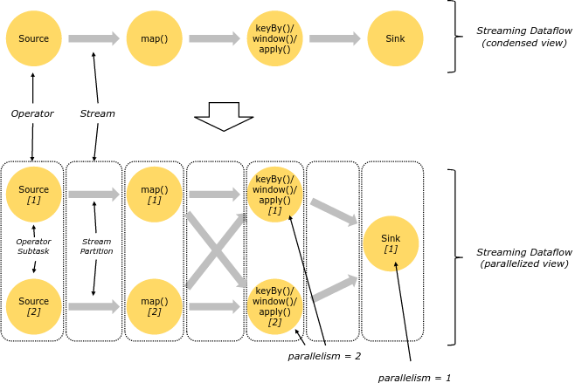
Parallelism

Slide 14
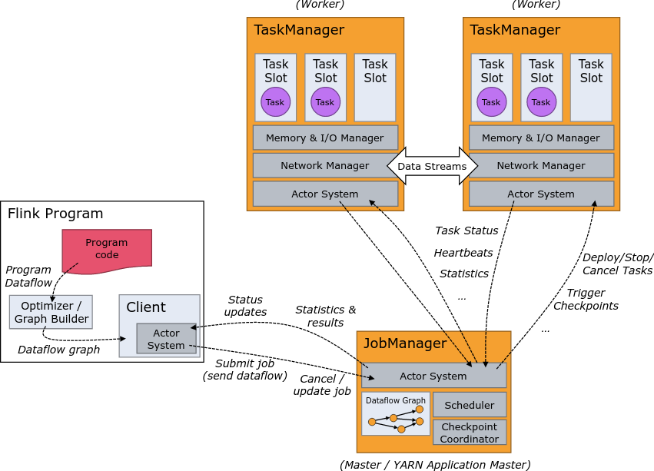
Distributed Execution

Slide 15
Deployment Options

Slide 16

Local Execution
Starts local Flink cluster
All processes run in the same JVM
Behaves just like a regular Cluster
Local cluster can be started in your IDE!
Very useful for developing and debugging
Job Manager
Task Manager
Task Manager
Task Manager
Task Manager
JVM

Slide 17
Remote Execution
Job Manager
Client
Submit job
Submit a Job to a remotely running cluster
Monitor the status of a job
Task Manager
Task Manager
Task Manager
Task Manager
Cluster

Slide 18

YARN Session Mode
Starts a Flink cluster in YARN containers
Multi-user scenario
Resource sharing
Easy to setup
Resource Manager
Node Manager
Node Manager
Job Manager
Task Manager
Node Manager
Node Manager
Task Manager
Other Application
Client
YARN Cluster

Slide 19
YARN Job Mode
Brings up a Flink cluster in YARN to run a single job
Better isolation than session mode
Resource Manager
Node Manager
Node Manager
Job Manager
Task Manager
Node Manager
Node Manager
Task Manager
Other Application
Client
YARN Cluster

Slide 20
Other Deployment Options
Amazon Elastic MapReduce
Available in EMR 5.1.0
Google Compute Engine
Available via bdutil
Apache Mesos
Coming in Flink 1.2.0

Slide 21
Flink in the real world

Slide 22
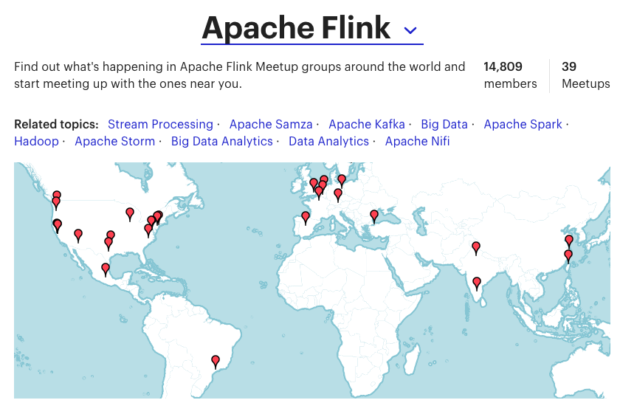
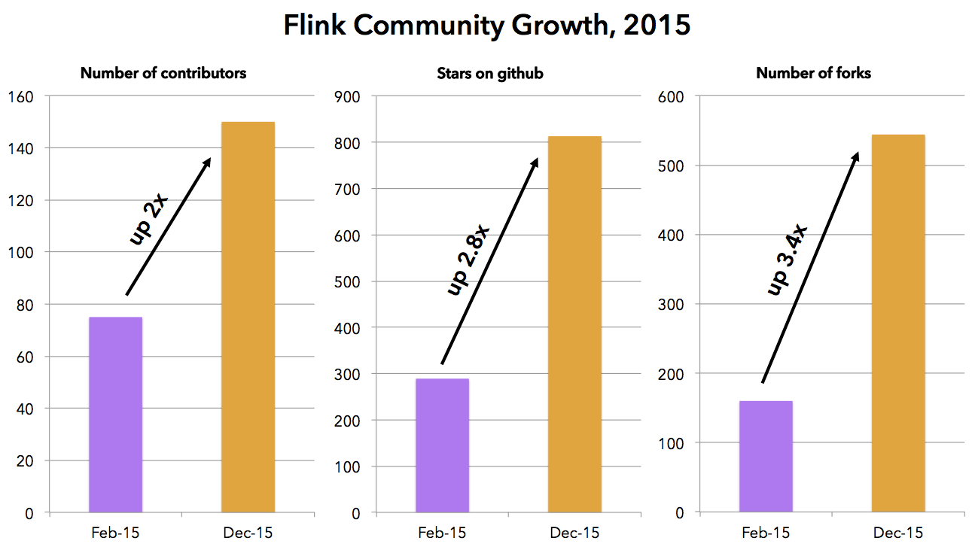
Flink community
> 240 contributors, 95 contributors in Flink 1.1
42 meetups around the world with > 15,000 members
2x-3x growth in 2015, similar in 2016

Slide 23




Powered by Flink
Zalando, one of the largest ecommerce companies in Europe, uses Flink for real-time business process monitoring.
King, the creators of Candy Crush Saga, uses Flink to provide data science teams with real-time analytics.
Alibaba, the world's largest retailer, built a Flink-based system (Blink) to optimize search rankings in real time.
Bouygues Telecom uses Flink for real-time event processing over billions of Kafka messages per day.
See more at flink.apache.org/poweredby.html

Slide 24


Slide 25



Largest job has > 20 operators, runs on > 5000 vCores in 1000-node cluster, processes millions of events per second
Complex jobs of > 30 operators running 24/7, processing 30 billion events daily, maintaining state of 100s of GB with exactly-once guarantees
30 Flink applications in production for more than one year. 10 billion events (2TB) processed daily

Slide 26























Flink Forward 2016

Slide 27
Current work in Flink

Slide 28
Flink 1.1
Metric System
Library enhancements
Connectors
(Stream) SQL
Session Windows

Slide 29
Flink 1.1 + ongoing development
Dynamic Scaling
Metric System
Metrics & Visualization
Dynamic Resource Management
Fine grained recovery
Savepoint compatibility
Operations
Checkpoints to savepoints
Large state Maintenance
Authentication
Security
Library enhancements
Mesos & others
Ecosystem
Broader Audience
Application Features
Side in-/outputs
Connectors
Window DSL
Queryable State
More connectors
Stream SQL Windows
(Stream) SQL
Session Windows

Slide 30
Request/response applications
Queryable state: query Flink state directly instead of pushing results in a database
Large state support and query API coming in Flink
queries

