Slide 1
Apache Flink® Training
Outlook & Closing
June 3rd, 2015

Slide 2
There is much more!
Flink Streaming
APIs & libraries
Interactive data analysis
Distributed cluster execution

Slide 3
Flink Streaming

Slide 4
DataStream API
Abstraction is called DataStream
Equivalent to DataSet
Transformations are very similar to DataSet API
Flexible window operations

Slide 5
Counting Words in Batch and Stream
case class WordCount (word: String, count: Int)
DataSet API (batch):
val lines: DataSet[String] = env.readTextFile(...)
lines.flatMap {line => line.split(" ")
.map(word => WordCount(word,1))}
.groupBy("word").sum("count")
.print()
DataStream API (streaming):
val lines: DataStream[String] = env.fromSocketStream(...)
lines.flatMap {line => line.split(" ")
.map(word => WordCount(word,1))}
.window(Count.of(1000)).every(Count.of(100))
.groupBy("word").sum("count")
.print()

Slide 6
Flink’s APIs & Libraries

Slide 7
APIs & Libraries
Flink offers more APIs than we covered
DataSet Iterations
Gelly
FlinkML
Python API

Slide 8
DataSet Iterations
Two dedicated iteration operators
Bulk iterations are similar to for-loops
Delta iterations are very efficient for certain types of problems (graphs!)
Flink executes iterations natively
Operators are scheduled once and maintain state
Data flows in cycles
Static parts of a loop are optimized

Slide 9
Gelly
API and library for Graph analysis
Offers primitives for graph processing
And graph processing algorithms
Builds on Java DataSet API
Scala DataSet API is WiP
Seamless integration with DataSet API
Preprocess your data with DataSet API
Transform into graph & analyze
Continue processing with DataSet API

Slide 10
FlinkML
API and library for Machine Learning
ML pipelines inspired by SciKitLearn
Comes with
Optimizers
Cross Validation
… (TILL)
Rapidly evolving

Slide 11
Python DataSet API
Write DataSet batch programs in Python
Runs on Flink’s robust runtime
Memory-safe execution
Out-of-core algorithms
Data is handed to Python functions
Similar to Hadoop Streaming
Still in early stage

Slide 12
Interactive Data Analysis

Slide 13
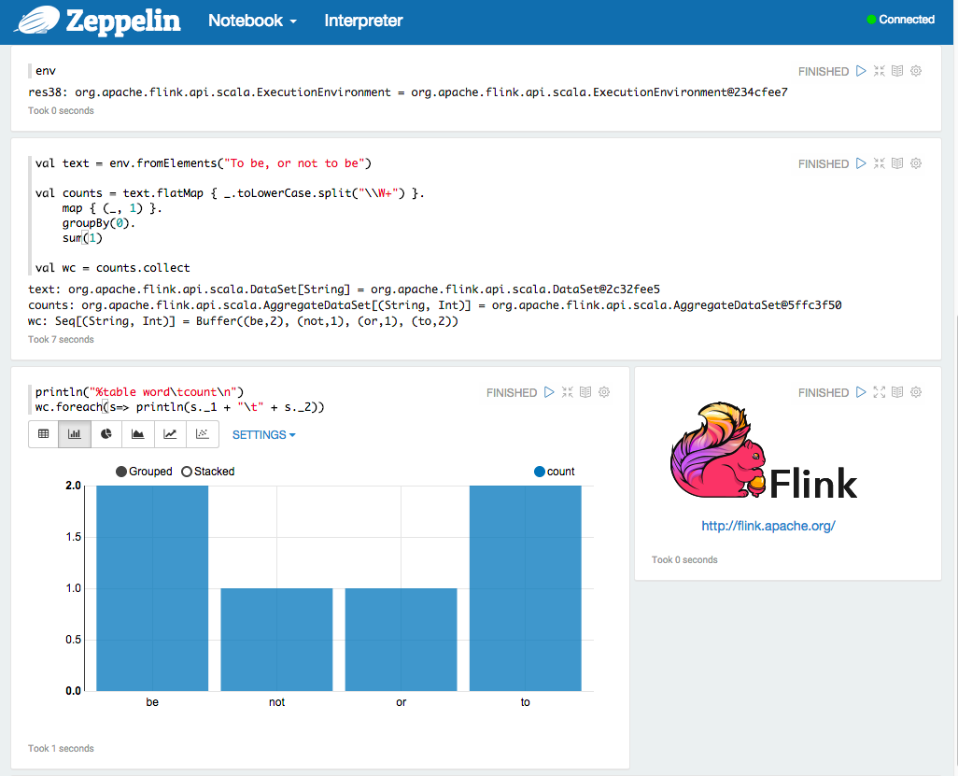
Apache Zeppelin

Slide 14
Scala Repl
./bin/start-scala-shell.sh
Complete Scala API available
Syntax completion
Build your jobs incrementally
Upcoming: Caching of intermediate results (WIP)

Slide 15
Distributed Setups

Slide 16
Flink in the Cloud
Standalone, but also
YARN (incl. Amazon EMR)
bdutil for Google Compute Engine
→ flink.apache.org/docs/

