Slide 1
Apache Flink® Training
System Overview
June 15th, 2015

Slide 2

What is Apache Flink?
A Top-Level project of the Apache Software Foundation
Cascading (WiP)
MRQL
Table
Dataflow (WiP)
Gelly
SAMOA
Table
ML
Hadoop M/R
Dataflow
DataSet (Java/Scala/Python)
DataStream (Java/Scala)
Streaming dataflow runtime
Local
Remote
Yarn
Tez
Embedded

Slide 3
What is Apache Flink?
Large-scale data processing engine
Easy and powerful APIs for batch and streaming analysis (Java / Scala / Python)
Backed by a robust execution backend
with true streaming capabilities,
sophisticated windowing mechanisms,
custom memory manager,
native iteration execution,
and a cost-based optimizer.

Slide 4
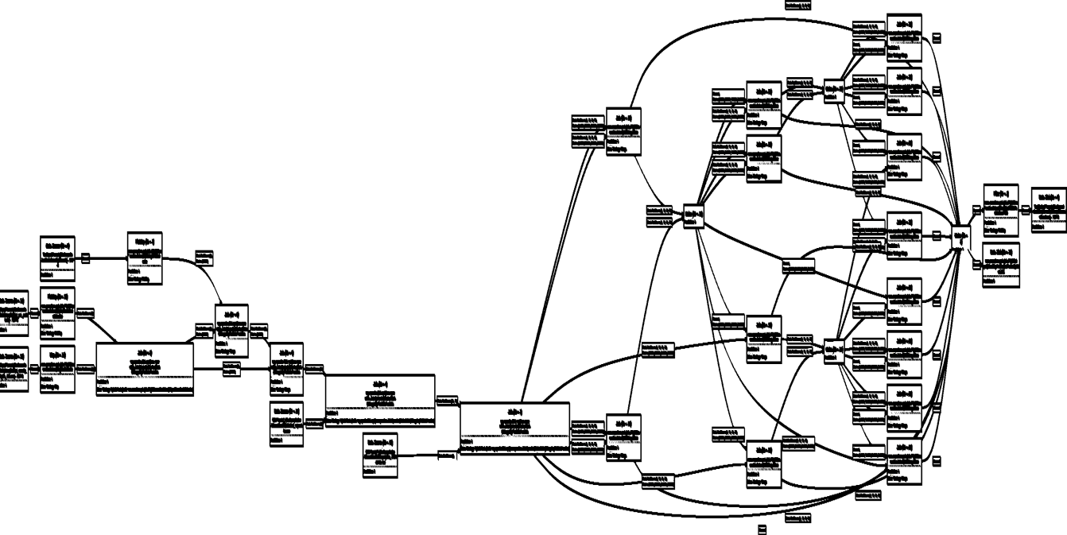
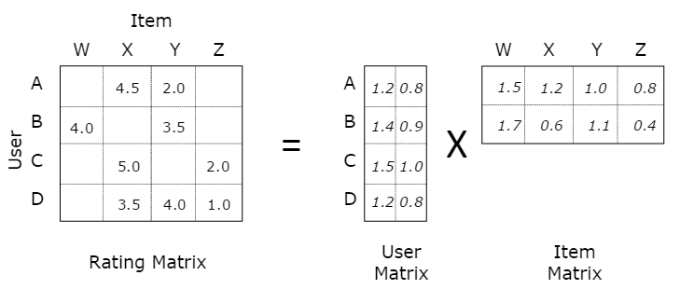
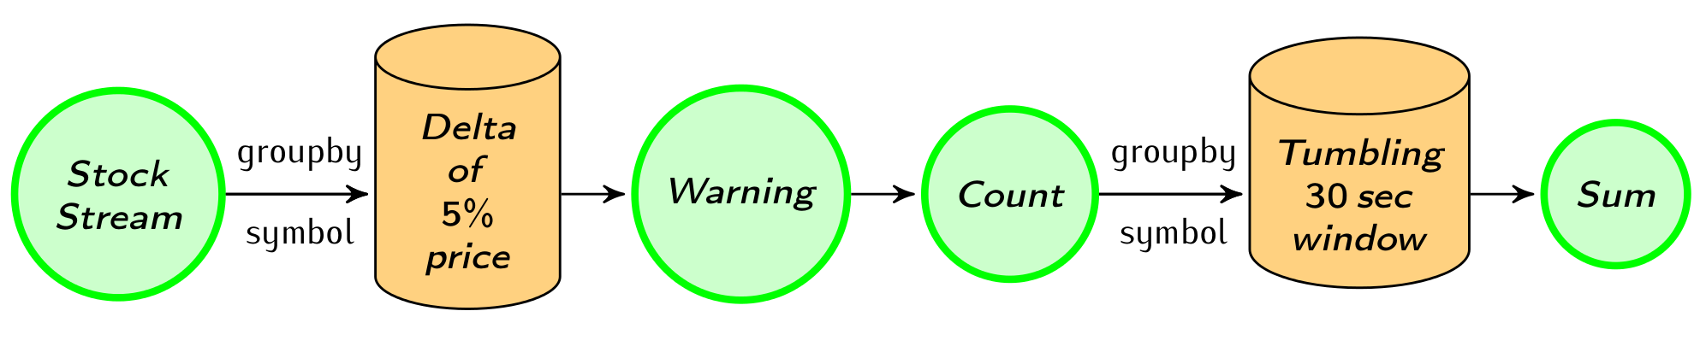
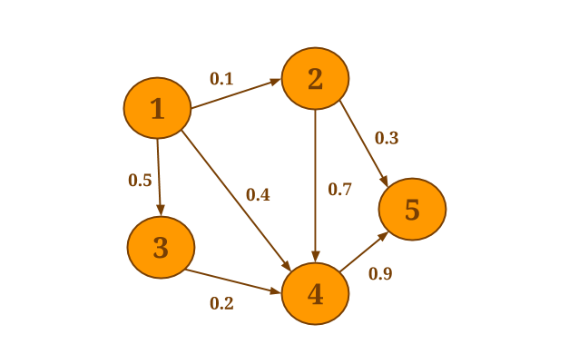
Native workload support
Batch
processing
Machine Learning at scale
Stream
processing
Graph Analysis
Flink
How can an engine natively support all these workloads?
And what does "native" mean?

Slide 5


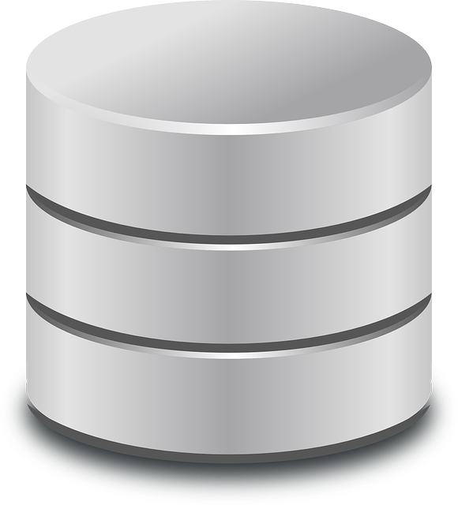
E.g.: Non-native iterations
for (int i = 0; i < maxIterations; i++) {
// Execute MapReduce job
}
Client
Step
Step
Step
Step
Step

Slide 6
E.g.: Non-native streaming
stream
discretizer
while (true) {
// get next few records
// issue batch job
}
Job
Job
Job
Job

Slide 7
Native workload support
Heavy
batch jobs
Machine Learning at scale
Streaming
topologies
Flink
How can an engine natively support all these workloads?
And what does native mean?

Slide 8
Flink Engine
Execute everything as streams
Allow some iterative (cyclic) dataflows
Allow some mutable state
Operate on managed memory
Special code paths for batch

Slide 9
What is a Flink Program?

Slide 10
Flink stack
Cascading (WiP)
MRQL
Table
Dataflow (WiP)
Gelly
SAMOA
Table
ML
Hadoop M/R
Dataflow
DataSet (Java/Scala/Python)
DataStream (Java/Scala)
Streaming dataflow runtime
Local
Remote
Yarn
Tez
Embedded

Slide 11
DataSet
Used for Batch Processing
Source
Data Set
Operation
Data Set
Sink
Example: Map and Reduce operation
b | h
2 | 1
3 | 5
7 | 4
… | …
Map
Reduce
a
12
…

Slide 12
Scaling out
Scale out arbitrarily by setting the parallelism
Source
Data Set
Operation
Data Set
Sink
1
Source
Data Set
Operation
Data Set
Sink
Source
Data Set
Operation
Data Set
Sink
2
Source
Data Set
Operation
Data Set
Sink
Source
Data Set
Operation
Data Set
Sink
Source
Data Set
Operation
Data Set
Sink
4
Source
Data Set
Operation
Data Set
Sink
Source
Data Set
Operation
Data Set
Sink
Source
Data Set
Operation
Data Set
Sink
Source
Data Set
Operation
Data Set
Sink
Source
Data Set
Operation
Data Set
Sink
8
Source
Data Set
Operation
Data Set
Sink
Source
Data Set
Operation
Data Set
Sink
Source
Data Set
Operation
Data Set
Sink

Slide 13
Scaling up

Slide 14
DataStream
Real-time event streams
Source
Data Stream
Operation
Data Stream
Sink
Example: Stream from a live stock feed
Alert if Microsoft > 120
Write event to database
Stock Feed
Name | Price
Microsoft | 124
Google | 516
Apple | 235
… | …
Microsoft | 124
Google | 516
Apple | 235
Sum every 10 seconds
Alert if sum > 10000
Microsoft | 124
Apple | 235
Google | 516

Slide 15
Sources (selection)
File-based
TextInputFormat
CsvInputFormat
Collection-based
fromCollection
fromElements

Slide 16
Sinks (selection)
File-based
TextOuputFormat
CsvOutputFormat
PrintOutput

Slide 17
Hadoop Integration
Out of the box
Access HDFS
Yarn Execution (covered later)
Reuse data types (Writables)
With a thin wrapper
Reuse Hadoop input and output formats
Reuse functions like Map and Reduce

Slide 18
What’s the Lifecycle of a Program?

Slide 19

From Program to Dataflow
case class Path (from: Long, to: Long)
val tc = edges.iterate(10) {
paths: DataSet[Path] =>
val next = paths
.join(edges)
.where("to")
.equalTo("from") {
(path, edge) =>
Path(path.from, edge.to)
}
.union(paths)
.distinct()
next
}
Type extraction stack
GroupRed
sort
Dataflow Graph
forward
Join
Hybrid Hash
Optimizer
buildHT
probe
hash-part [0]
hash-part [0]
Map
DataSource
lineitem.tbl
Pre-flight (Client)
Filter
Data Source
orders.tbl
Program
deploy operators
Dataflow metadata
Task scheduling
track intermediate results
Master
Workers

Slide 20
Architecture Overview
Client
Master (Job Manager)
Worker (Task Manager)
Client
Job Manager
Task Manager
Task Manager
Task Manager

Slide 21
Client
Optimize
Construct job graph
Pass job graph to job manager
Retrieve job results
case class Path (from: Long, to: Long)
val tc = edges.iterate(10) {
paths: DataSet[Path] =>
val next = paths
.join(edges)
.where("to")
.equalTo("from") {
(path, edge) =>
Path(path.from, edge.to)
}
.union(paths)
.distinct()
next
}
GroupRed
Type extraction
sort
forward
Job Manager
Join
Hybrid Hash
Optimizer
buildHT
probe
hash-part [0]
hash-part [0]
Map
DataSource
lineitem.tbl
Filter
Client
Data Source
orders.tbl

Slide 22
Job Manager
Parallelization: Create Execution Graph
Scheduling: Assign tasks to task managers
State tracking: Supervise the execution
Task Manager
GroupRed
GroupRed
GroupRed
GroupRed
sort
GroupRed
sort
sort
sort
sort
Task Manager
forward
forward
forward
forward
Join
Hybrid Hash
forward
Join
Hybrid Hash
Join
Hybrid Hash
Join
Hybrid Hash
Join
Hybrid Hash
probe
buildHT
probe
buildHT
probe
buildHT
probe
buildHT
probe
buildHT
hash-part [0]
hash-part [0]
hash-part [0]
hash-part [0]
hash-part [0]
DataSource
lineitem.tbl
hash-part [0]
hash-part [0]
Map
hash-part [0]
hash-part [0]
hash-part [0]
Map
DataSource
lineitem.tbl
Map
DataSource
lineitem.tbl
Map
DataSource
lineitem.tbl
Task Manager
Filter
DataSource
lineitem.tbl
Map
Filter
Filter
Filter
Data Source
orders.tbl
Filter
Data Source
orders.tbl
Data Source
orders.tbl
Data Source
orders.tbl
Data Source
orders.tbl
Job Manager
Task Manager

Slide 23
Task Manager
Operations are split up into tasks depending on the specified parallelism
Each parallel instance of an operation runs in a separate task slot
The scheduler may run several tasks from different operators in one task slot
Task Manager
Task Manager
Task Manager
Slot
Slot
Slot

Slide 24
Execution Setups

Slide 25
Ways to Run a Flink Program
Cascading (WiP)
MRQL
Table
Dataflow (WiP)
Gelly
SAMOA
Table
ML
Hadoop M/R
Dataflow
DataSet (Java/Scala/Python)
DataStream (Java/Scala)
Streaming dataflow runtime
Local
Remote
Yarn
Tez
Embedded

Slide 26
Local Execution
Starts local Flink cluster
All processes run in the same JVM
Behaves just like a regular Cluster
Very useful for developing and debugging
Job Manager
Task Manager
Task Manager
Task Manager
Task Manager
JVM

Slide 27
Embedded Execution
Runs operators on simple Java collections
Lower overhead
Does not use memory management
Useful for testing and debugging

Slide 28
Remote Execution
Job Manager
Client
Submit job
The cluster mode
Submit a Job remotely
Monitors the status of the job
Task Manager
Task Manager
Task Manager
Task Manager
Cluster

Slide 29

YARN Execution
Multi user scenario
Resource sharing
Uses YARN containers to run a Flink cluster
Very easy to setup Flink
Resource Manager
Node Manager
Node Manager
Job Manager
Task Manager
Node Manager
Node Manager
Task Manager
Other Application
Client
YARN Cluster

Slide 30

Execution
Leverages Apache Tez’s runtime
Built on top of YARN
Good YARN citizen
Fast path to elastic deployments
Slower than Flink

Slide 31
Flink compared to other projects

Slide 32




Batch & Streaming projects
Batch only
Streaming only
Hybrid

Slide 33
Batch
Apache Hadoop Map Reduce
Low-Level API
Batch data transfer
Mainly disk based operations
File system cached iterations
Massive scale out parallelism
External libraries
Task level fault tolerance
Apache Spark
High-level API
Batch data transfer
JVM managed memory
In memory cached iterations
Interactive Data exploration
Libraries
Task level fault tolerance
Apache Flink
High-level API
Pipelined and batch data transfer
Active memory management
Natively streamed iterations
Heavy load backend jobs, iterative data flows
Evolving libraries
Job level fault tolerance

Slide 34
Streaming
Apache Storm
“True” streaming
Low-Level API
Costly fault tolerance
No built-in state handling
At least once semantics
No built-in windowing
Low Latency
Medium throughput
Apache Spark
Mini batch streaming
High-level API
RDD-based fault tolerance (lineage)
External state handling
Exactly once semantics
Restricted windowing
Medium latency
High throughput
Apache Flink
“True” streaming
High-level API
Checkpointing
Built-in operator state handling
Exactly once semantics
Flexible windowing
Low latency
High throughput

Slide 35
Batch comparison
API | low-level | high-level | high-level
Data Transfer | batch | batch | pipelined & batch
Memory Management | disk-based | JVM-managed | Active managed
Iterations | file system cached | in-memory cached | streamed
Fault tolerance | task level | task level | job level
Good at | massive scale out | data exploration | heavy backend & iterative jobs
Libraries | many external | built-in & external | evolving built-in & external

Slide 36
Streaming comparison
Streaming | “true” | mini batches | “true”
API | low-level | high-level | high-level
Fault tolerance | tuple-level ACKs | RDD-based (lineage) | coarse checkpointing
State | not built-in | external | internal
Exactly once | at least once | exactly once | exactly once
Windowing | not built-in | restricted | flexible
Latency | low | medium | low
Throughput | medium | high | high

Slide 37
Thank you for listening!

