Slide 1


DataStream API
Windows & Time
Apache Flink® Training
Flink v1.1.2 – 14.09.2016

Slide 2
Windows and Aggregates

Slide 3
Windows
Aggregations on DataStreams are different from aggregations on DataSets
You cannot count all records of an infinite stream
DataStream aggregations make sense on windowed streams
A finite subset of stream elements

Slide 4
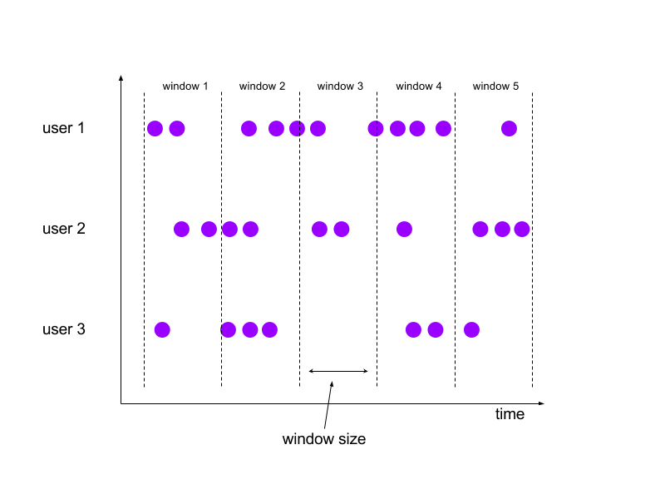
Tumbling Windows
Aligned, fixed length, non-overlapping windows.

Slide 5
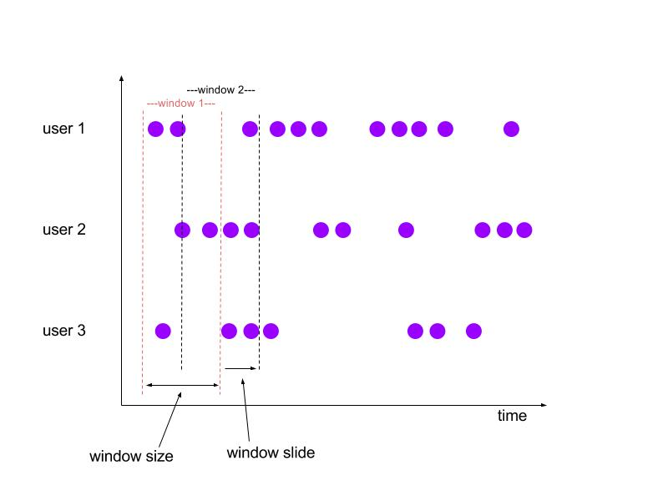
Sliding Windows
Aligned, fixed length, overlapping windows.

Slide 6
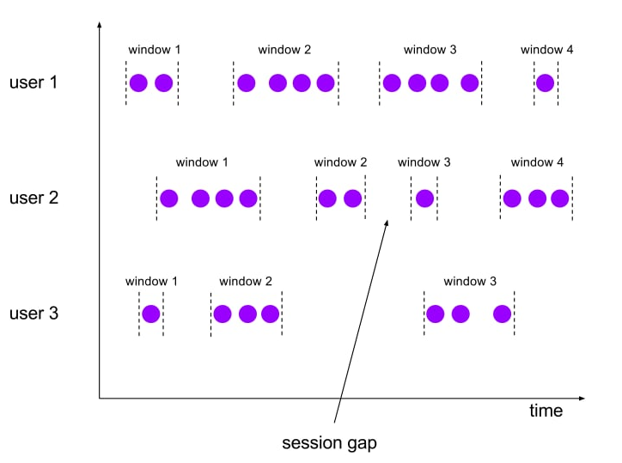
Session Windows
Non-aligned, variable length windows.

Slide 7
Specifying Windowing
// (name, age) of passengers
DataStream<Tuple2<String, Integer>> passengers = …
passengers
// group by second field (age)
.keyBy(1)
// window definition: tumbling window of 1 minute
.timeWindow(Time.minutes(1))

Slide 8
Predefined Keyed Windows
Tumbling time window
.timeWindow(Time.minutes(1)
Sliding time window
.timeWindow(Time.minutes(1), Time.seconds(10))
Tumbling count window
.countWindow(100)
Sliding count window
.countWindow(100, 10)
Session window
.window(SessionWindows.withGap(Time.minutes(30)))

Slide 9
Predefined Non-keyed Windows
Windows on non-keyed streams are not processed in parallel!
TimeWindow (tumbling, 10 seconds)
.timeWindowAll(Time.seconds(10))
CountWindow (sliding, 20/10)
.countWindowAll(20, 10)

Slide 10
Aggregations on Windowed Streams
// (name, age) of passengers
DataStream<Tuple2<String, Integer>> passengers = …
passengers // group by second field (age)
.keyBy(1)
// windows that are 1 minute long
.timeWindow(Time.minutes(1))
// apply a custom window function on window data
.apply(new CountByAge());

Slide 11
Aggregation with a WindowFunction
public static class CountByAge implements WindowFunction<
Tuple2<String, Integer>, // input type
Tuple3<Integer, Long, Integer>, // output type
Tuple, // key type
TimeWindow> { // window type @Override public void apply( Tuple key, TimeWindow window, Iterable<Tuple2<String, Integer>> persons, Collector<Tuple3<Integer, Long, Integer>> out) {
int age = ((Tuple1<Integer>)key).f0;
int cnt = 0;
for (Tuple2<String, Integer> p : persons) { cnt++; } out.collect(new Tuple3<>(age, window.getEnd(), cnt)); } }

Slide 12
Window State during Aggregation
state
1

Slide 13
Window State during Aggregation
state
1
1

Slide 14
Window State during Aggregation
state
1
1
1

Slide 15
Window State during Aggregation
state
1
1
1
1

Slide 16
Window State during Aggregation
state
1
+
1
+
1
+
1
4
window trigger

Slide 17
Operations on Windowed Streams
reduce(reduceFunction)
Apply a functional reduce function to the window
fold(initialVal, foldFunction)
Apply a functional fold function with a specified initial value to the window
Aggregation functions
sum(), min(), max(), and others

Slide 18
Incremental Aggregation
state
1

Slide 19
Incremental Aggregation
state
2

Slide 20
Incremental Aggregation
state
3

Slide 21
Incremental Aggregation
state
4

Slide 22
Incremental Aggregation
state
4
4
window trigger

Slide 23
Incremental Window Aggregation
DataStream<Tuple2<String, Integer>> passengers = …
passengers
.keyBy(1)
.timeWindow(Time.minutes(1), Time.seconds(10))
.apply(new Tuple3<Integer, Long, Integer>(0, 0L, 0), new MyFoldFunction(), new MyWindowFunction())
private static class MyFoldFunction
implements FoldFunction<Tuple2<String, Integer>, Tuple3<Integer, Long, Integer>> {
public Tuple3<Integer,Long,Integer> fold(Tuple3<Integer, Long, Integer> acc, Tuple2<String, Integer> p) {
Integer count = acc.getField(2);
acc.setField(2, count + 1);
return acc;
}
}
private static class MyWindowFunction
implements WindowFunction<Tuple3<Integer,Long,Integer>, Tuple3<Integer,Long,Integer>, Integer, TimeWindow> {
public void apply(Integer age_key,
TimeWindow window,
Iterable<Tuple3<Integer,Long,Integer>> counts,
Collector<Tuple3<Integer,Long,Integer>> out) {
Integer count = counts.iterator().next().getField(2);
out.collect(new Tuple3<Integer,Long,Integer>(age_key, window.getEnd(), count));
}
}

Slide 24
Incremental Window Aggregation
DataStream<Tuple2<String, Integer>> passengers = …
passengers
.keyBy(1)
.timeWindow(Time.minutes(1), Time.seconds(10))
.apply(new Tuple3<Integer, Long, Integer>(0, 0L, 0), new MyFoldFunction(), new MyWindowFunction())
private static class MyFoldFunction
implements FoldFunction<Tuple2<String, Integer>, Tuple3<Integer, Long, Integer>> {
public Tuple3<Integer,Long,Integer> fold(Tuple3<Integer, Long, Integer> acc, Tuple2<String, Integer> p) {
Integer count = acc.getField(2);
acc.setField(2, count + 1);
return acc;
}
}
private static class MyWindowFunction
implements WindowFunction<Tuple3<Integer,Long,Integer>, Tuple3<Integer,Long,Integer>, Integer, TimeWindow> {
public void apply(Integer age_key,
TimeWindow window,
Iterable<Tuple3<Integer,Long,Integer>> counts,
Collector<Tuple3<Integer,Long,Integer>> out) {
Integer count = counts.iterator().next().getField(2);
out.collect(new Tuple3<Integer,Long,Integer>(age_key, window.getEnd(), count));
}
}

Slide 25
Custom window logic
The DataStream API allows you to define very custom window logic
GlobalWindows
a flexible, low-level window assignment scheme that can be used to implement custom windowing behaviors
only useful if you explicitly specify triggering, otherwise nothing will happen
Trigger
defines when to evaluate a window
whether to purge the window or not
Careful! This part of the API requires a good understanding of the windowing mechanism!

Slide 26
Handling Time Explicitly

Slide 27
Different Notions of Time
Event Producer
Message Queue
Flink Data Source
Flink Window Operator
partition 1
partition 2
Event Time
Ingestion Time
Window Processing Time

Slide 28

Event Time vs Processing Time
This is called event time
Episode V:
The Empire
Strikes Back
Episode VI:
Return of
the Jedi
Episode I:
The Phantom
Menace
Episode II:
Attach of
the Clones
Episode III:
Revenge of
the Sith
Episode VII:
The Force
Awakens
Episode IV:
A New Hope
1977
1980
1983
1999
2002
2005
2015
This is called processing time

Slide 29
Setting the StreamTimeCharacteristic
final StreamExecutionEnvironment env =
StreamExecutionEnvironment.getExecutionEnvironment(); env.setStreamTimeCharacteristic(TimeCharacteristic.EventTime); // alternatively: // env.setStreamTimeCharacteristic(TimeCharacteristic.IngestionTime); // env.setStreamTimeCharacteristic(TimeCharacteristic.ProcessingTime);

Slide 30
Choosing Event Time has Consequences
When working with event time, Flink needs to know
how to extract the timestamp from a stream element
when enough event time has elapsed that a time window should be triggered

Slide 31
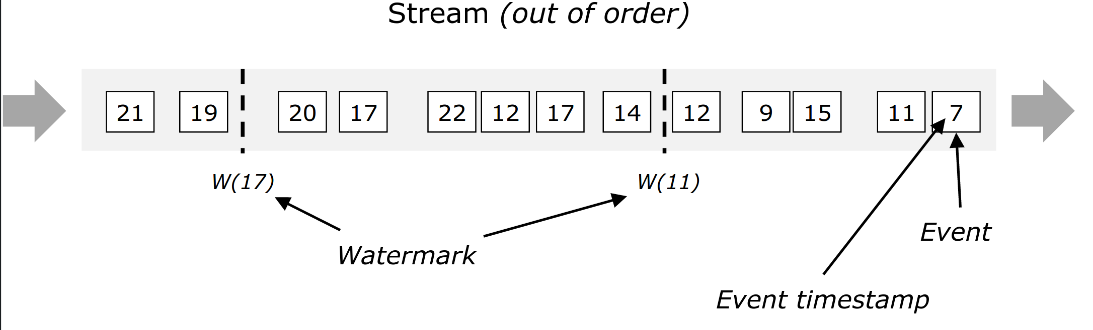
Watermarks
Watermarks flow with the data stream and carry a timestamp; they are crucial for handling out-of-order events
A Watermark(t) is a declaration that all events with a timestamp < t have occurred

Slide 32
Timestamp Assigners / Watermark Generators
DataStream<MyEvent> stream = …
DataStream<MyEvent> withTimestampsAndWatermarks = stream
.assignTimestampsAndWatermarks(new MyTSExtractor());
withTimestampsAndWatermarks
.keyBy(...)
.timeWindow(...)
.addSink(...);

Slide 33
Timestamp Assigners / Watermark Generators
There are different types of timestamp extractors
BoundedOutOfOrdernessTimestampExtractor
Periodically emits watermarks that lag a fixed amount of time behind the max timestamp seen so far
To use, subclass and implement public abstract long extractTimestamp(T element)
Constructor public BoundedOutOfOrdernessTimestampExtractor(
Time maxOutOfOrderness)

Slide 34
References
Documentation
https://ci.apache.org/projects/flink/flink-docs-release-1.1/apis/streaming/event_time.html
https://ci.apache.org/projects/flink/flink-docs-release-1.1/apis/streaming/event_timestamps_watermarks.html
https://ci.apache.org/projects/flink/flink-docs-release-1.1/apis/streaming/windows.html
Blog posts
http://flink.apache.org/news/2015/12/04/Introducing-windows.html
http://data-artisans.com/how-apache-flink-enables-new-streaming-applications-part-1/
https://www.mapr.com/blog/essential-guide-streaming-first-processing-apache-flink
http://data-artisans.com/session-windowing-in-flink/

