Slide 1
Apache Flink® Training
Closing
June 3rd, 2015

Slide 2
How did we do?
Please grab a feedback form
What did you like?
What can be done better?
Thank you!

Slide 3
There is much more!
Flink Streaming
APIs & libraries
Interactive data analysis
Distributed cluster execution

Slide 4
Flink Streaming

Slide 5
DataStream API
Abstraction is called DataStream
Equivalent to DataSet
Many concepts are the same
Many transformations
User function interfaces
Data types
Flexible window operations

Slide 6
Counting Words in Batch and Stream
case class WordCount (word: String, count: Int)
DataSet API (batch):
val lines: DataSet[String] = env.readTextFile(...)
lines.flatMap {line => line.split(" ")
.map(word => WordCount(word,1))}
.groupBy("word").sum("count")
.print()
DataStream API (streaming):
val lines: DataStream[String] = env.fromSocketStream(...)
lines.flatMap {line => line.split(" ")
.map(word => WordCount(word,1))}
.window(Count.of(1000)).every(Count.of(100))
.groupBy("word").sum("count")
.print()

Slide 7
Flink’s APIs & Libraries

Slide 8
APIs & Libraries
Flink offers more APIs than we covered
DataSet API for batch processing
DataStream Iterations
Table API
Gelly
FlinkML
Python API

Slide 9
DataSet Iterations
Two dedicated iteration operators
Bulk iterations are similar to for-loops
Delta iterations are very efficient for certain types of problems (graphs!)
Flink executes iterations natively
Operators are scheduled once and maintain state
Data flows in cycles
Static parts of a loop are optimized

Slide 10
Gelly
API and library for Graph analysis
Offers primitives for graph processing
And graph processing algorithms
Builds on Java DataSet API
Scala DataSet API is WiP
Seamless integration with DataSet API
Preprocess your data with DataSet API
Transform into graph & analyze
Continue processing with DataSet API

Slide 11
FlinkML
API and library for Machine Learning
ML pipelines inspired by SciKitLearn
Comes with
Building blocks for ML algorithms
Implemented algorithms
Seamless integration with DataSet API
Preprocessing, mailing, etc.
Rapidly evolving

Slide 12
Python DataSet API
Write DataSet batch programs in Python
Runs on Flink’s robust runtime
Memory-safe execution
Out-of-core algorithms
Data is handed to Python functions
Similar to Hadoop Streaming
Latest added API

Slide 13
Interactive Data Analysis

Slide 14
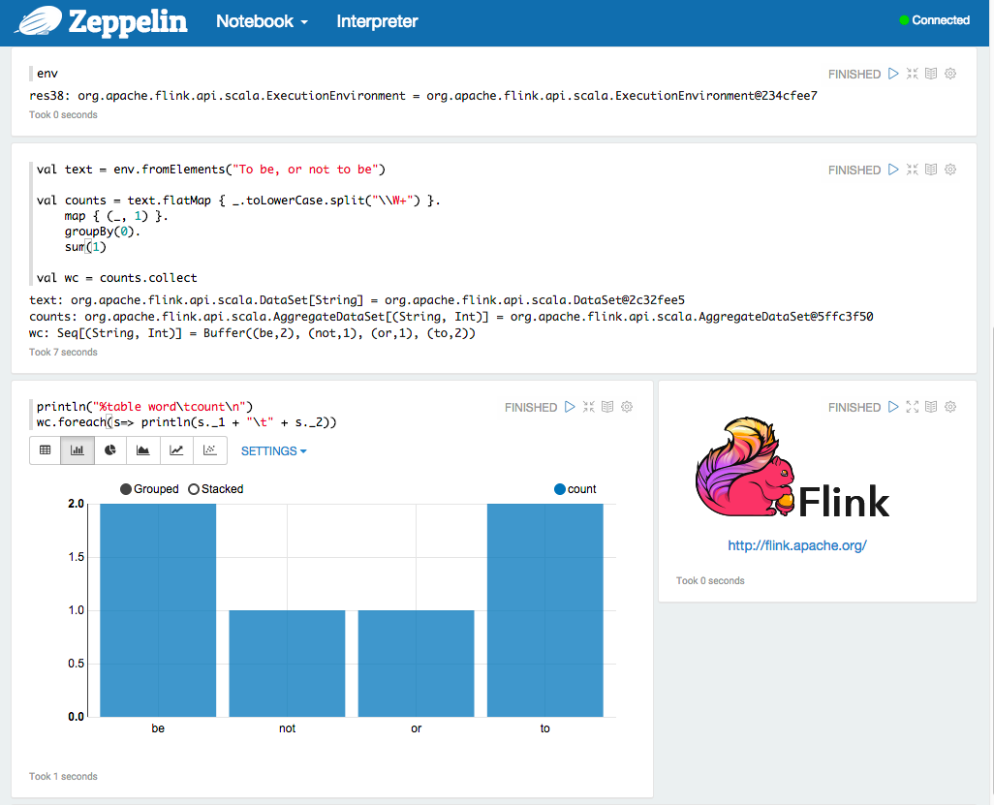
Apache Zeppelin

Slide 15
Scala Repl
./bin/start-scala-shell.sh
Complete Scala API available
Syntax completion
Build your jobs incrementally
Upcoming: Caching of intermediate results (WIP)

Slide 16
Some final words…

Slide 17
Who & how to ask?
Subscribe & write to the user mailing list
user@flink.apache.org
Post a question on stackoverflow
Tag with “flink”
File bugs and issues in JIRA
https://issues.apache.org/jira/browse/FLINK

Slide 18
Stay in touch & join the community
Subscribe to Flink a mailing list
Announcements: news@flink.apache.org
User questions: users@flink.apache.org
Development: dev@flink.apache.org
Follow @ApacheFlink on Twitter
Get involved and improve Flink!

Slide 19
Thank you all for attending!
That’s it.

