Slide 1
Apache Flink® Training
Closing
September 2nd, 2015

Slide 2
How did we do?
Please grab a feedback form
What did you like?
What can be done better?
Thank you!

Slide 3
There is much more!
APIs & libraries
Interactive data analysis
Distributed cluster execution

Slide 4
Flink’s APIs & Libraries

Slide 5
APIs & Libraries
Flink offers more APIs than we covered
DataSet API for batch processing
DataSet & DataStream Iterations
Table API
Gelly
FlinkML
Python API

Slide 6
DataSet API
For scalable batch processing (finite input)
DataSet and DataStream API are very similar
Same data types
Function interfaces
Robust processing backend
In-memory performance
On-disk robustness

Slide 7
Counting Words in Batch and Stream
case class WordCount (word: String, count: Int)
DataSet API (batch):
val lines: DataSet[String] = env.readTextFile(...)
lines.flatMap {line => line.split(" ")
.map(word => WordCount(word,1))}
.groupBy("word").sum("count")
.print()
DataStream API (streaming):
val lines: DataStream[String] = env.fromSocketStream(...)
lines.flatMap {line => line.split(" ")
.map(word => WordCount(word,1))}
.window(Count.of(1000)).every(Count.of(100))
.groupBy("word").sum("count")
.print()

Slide 8
DataSet Iterations
Two dedicated iteration operators
Bulk iterations are similar to for-loops
Delta iterations are very efficient for certain types of problems (graphs!)
Flink executes iterations natively
Operators are scheduled once and maintain state
Data flows in cycles
Static parts of a loop are optimized

Slide 9
Gelly
API and library for Graph analysis
Offers primitives for graph processing
And graph processing algorithms
Builds on Java DataSet API
Scala DataSet API is WiP
Seamless integration with DataSet API
Preprocess your data with DataSet API
Transform into graph & analyze
Continue processing with DataSet API

Slide 10
FlinkML
API and library for Machine Learning
ML pipelines inspired by SciKitLearn
Comes with
Building blocks for ML algorithms
Implemented algorithms
Seamless integration with DataSet API
Preprocessing, mailing, etc.

Slide 11
Python DataSet API
Write DataSet batch programs in Python
Runs on Flink’s robust runtime
Memory-safe execution
Out-of-core algorithms
Data is handed to Python functions
Latest added API

Slide 12
Interactive Data Analysis

Slide 13
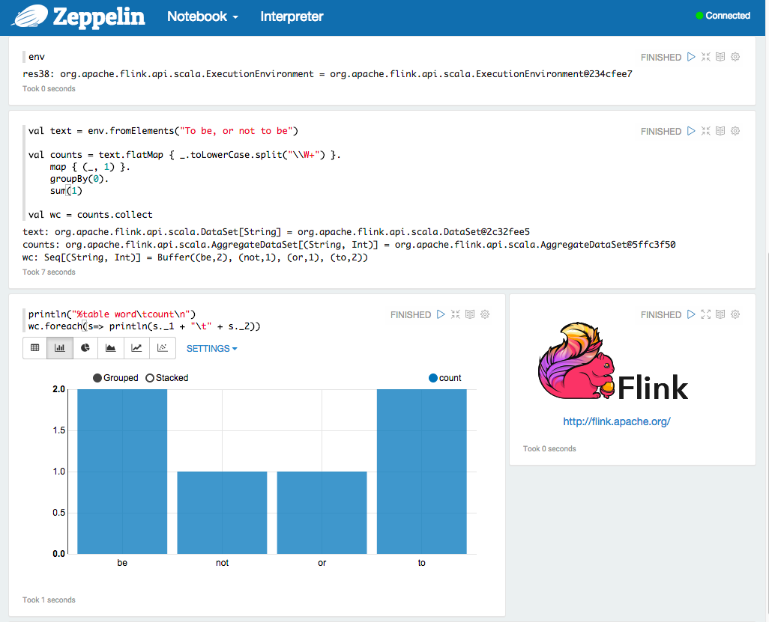
Apache Zeppelin

Slide 14
Scala Repl
./bin/start-scala-shell.sh
Complete Scala API available
Syntax completion
Build your jobs incrementally
Upcoming: Caching of intermediate results (WIP)

Slide 15
Some final words…

Slide 16
Who & how to ask?
Subscribe & write to the user mailing list
user@flink.apache.org
Post a question on stackoverflow
Tag with “flink”
File bugs and issues in JIRA
https://issues.apache.org/jira/browse/FLINK

Slide 17
Stay in touch & join the community
Subscribe to Flink a mailing list
Announcements: news@flink.apache.org
User questions: users@flink.apache.org
Development: dev@flink.apache.org
Follow @ApacheFlink on Twitter
Get involved and improve Flink!

Slide 18
Thank you all for attending!
That’s it.

