Slide 1


DataStream API
Windows & Time
Apache Flink® Training
Flink v1.3 – 19.06.2017

Slide 2
Windows and Aggregates

Slide 3
Windows
Aggregations on streams are different from aggregations on batched data
You cannot count all records of an unbounded stream
Aggregations do make sense on windowed streams, e.g.,
Number of transactions per minute

Slide 4
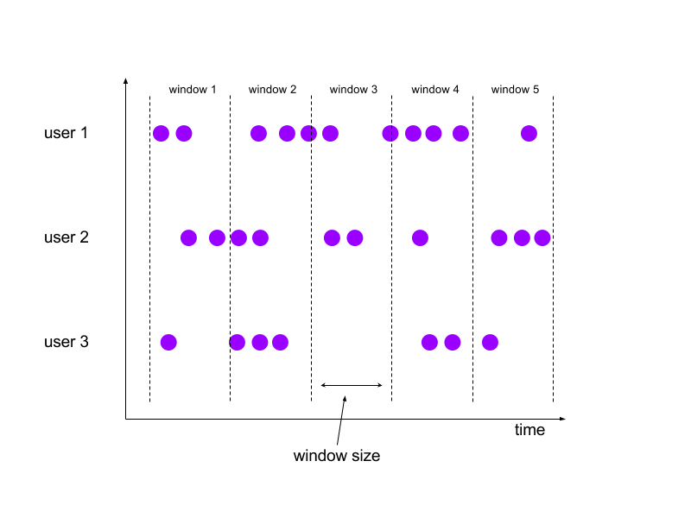
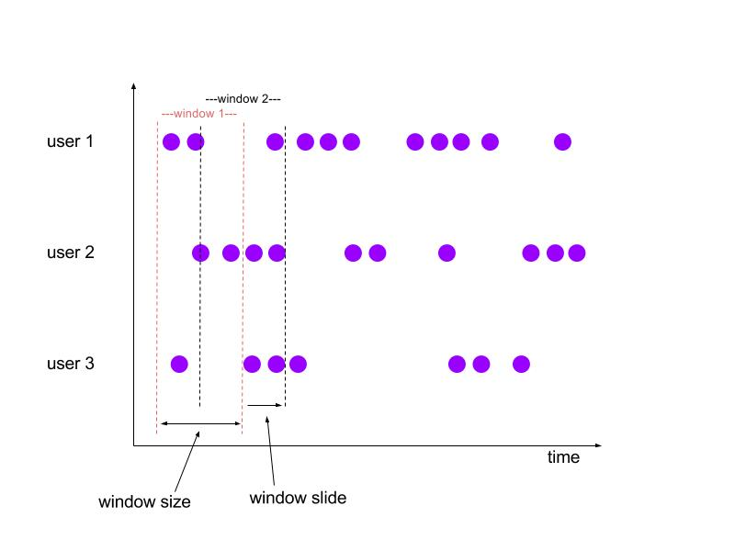
Tumbling and Sliding Windows
Tumbling:
aligned, fixed length,
non-overlapping windows
Sliding:
aligned, fixed length,
overlapping windows

Slide 5
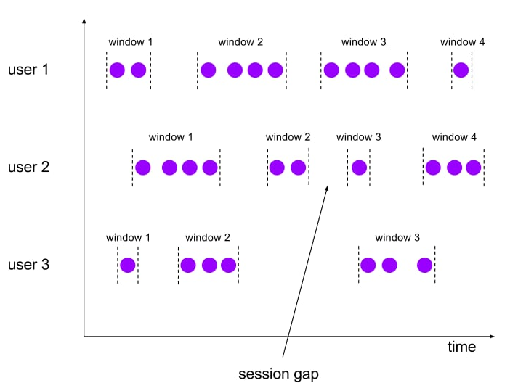
Session Windows
Non-aligned, variable length windows.

Slide 6
Specifying Windowing
stream
.keyBy(…) / keyed vs non-keyed windows
.window(…) / “Assigner”
.trigger(…) / each Assigner has a default Trigger
.evictor(…) / default: no Evictor
.allowedLateness() / default: zero
.process|apply|reduce() / window function

Slide 7
Predefined Keyed Windows
Tumbling time window
.timeWindow(Time.minutes(1))
Sliding time window
.timeWindow(Time.minutes(1), Time.seconds(10))
Tumbling count window
.countWindow(100)
Sliding count window
.countWindow(100, 10)
Session window
.window(SessionWindows.withGap(Time.minutes(30)))

Slide 8
Non-keyed Windows
Windows on non-keyed streams are not processed in parallel!
stream.windowAll(…)…
stream.timeWindowAll(Time.seconds(10))…
stream.countWindowAll(20, 10)…

Slide 9
Aggregations on Windowed Streams
DataStream<SensorReading> input = …
input
.keyBy(“key”)
.timeWindow(Time.minutes(1))
.apply(new MyWastefulMax());
public static class MyWastefulMax implements WindowFunction<
SensorReading, // input type
Tuple3<String, Long, Integer>, // output type
Tuple, // key type
TimeWindow> { // window type @Override public void apply( Tuple key, TimeWindow window, Iterable<SensorReading> events, Collector<Tuple3<String, Long, Integer>> out) {
int max = 0;
for (SensorReading e : events) { if (e.f1 > max) max = e.f1; } out.collect(new Tuple3<>((Tuple1<String>)key).f0, window.getEnd(), max)); } }

Slide 10
Window State during Aggregation
state
7

Slide 11
Window State during Aggregation
state
9
7

Slide 12
Window State during Aggregation
state
3
9
7

Slide 13
Window State during Aggregation
state
8
3
9
7

Slide 14
Window State during Aggregation
state
8
3
9
7
9
window trigger

Slide 15
Incremental Window Aggregation
DataStream<SensorReading> input = …
input
.keyBy(“key”)
.timeWindow(Time.minutes(1))
.reduce(new MyReducingMax(), new MyWindowFunction());
private static class MyReducingMax implements ReduceFunction<SensorReading> {
public SensorReading reduce(SensorReading r1, SensorReading r2) {
return r1.value() > r2.value() ? r1 : r2;
}
}
private static class MyWindowFunction implements WindowFunction<
SensorReading, Tuple2<Long, SensorReading>, String, TimeWindow> {
public void apply(String key,
TimeWindow window,
Iterable<SensorReading> maxReadings,
Collector<Tuple2<Long, SensorReading>> out) {
SensorReading max= maxReadings.iterator().next();
out.collect(new Tuple2<Long, SensorReading>(window.getStart(), max));
}
}

Slide 16
Incremental Aggregation
state
8, 3, 9, 7
7

Slide 17
Incremental Aggregation
state
8, 3, 9
7
9
8, 3, 9

Slide 18
Incremental Aggregation
state
8, 3
9
9
3

Slide 19
Incremental Aggregation
state
8
9
9
3

Slide 20
Incremental Aggregation
9
9
window trigger

Slide 21
Window Operations
Passed an Iterable containing all elements of a Window:
apply(windowFunction)
process(processWindowFunction)
new in 1.3
Notes:
Folding has been deprecated, and will eventually be removed.

Slide 22
ProcessWindowFunction()
public abstract class ProcessWindowFunction<IN, OUT, KEY, W extends Window> extends AbstractRichFunction { /** * Evaluates the window and outputs none or several elements. * * @param key The key for which this window is evaluated. * @param context The context in which the window is being evaluated. * @param elements The elements in the window being evaluated. * @param out A collector for emitting elements. * */ public abstract void process(
KEY key,
Context context,
Iterable<IN> elements,
Collector<OUT> out) throws Exception; // The context holding window metadata. public abstract class Context implements java.io.Serializable { public abstract W window(); public abstract long currentProcessingTime(); public abstract long currentWatermark(); public abstract KeyedStateStore windowState(); // per-key per-window state public abstract KeyedStateStore globalState(); // per-key global state } }

Slide 23
Incremental Window Operations
Passed each element of a window, which is aggregated into a single result:
reduce(reduceFunction)
fold(initialVal, foldFunction)
aggregate(aggregateFunction)
Notes:
Folding has been deprecated, and will eventually be removed.

Slide 24
Other Aggregations
sum(key), min(key), max(key)
return the value
sumBy(key), minBy(key), maxBy(key)
return an element with the value
These are available on KeyedStreams as well as WindowedStreams
Notes:
Folding has been deprecated, and will eventually be removed.

Slide 25
Custom window logic
The DataStream API allows you to define very custom window logic
GlobalWindows
a flexible, low-level window assignment scheme that can be used to implement custom windowing behaviors
only useful if you explicitly specify triggering, otherwise nothing will happen
Trigger
defines when to evaluate a window
whether to purge the window or not
Careful! This part of the API requires a good understanding of the windowing mechanism!

Slide 26
Handling Time Explicitly

Slide 27
The biggest change in moving from batch to streaming is handling time explicitly

Slide 28
Different Notions of Time
Event Producer
Message Queue
Flink Data Source
Flink Window Operator
partition 1
partition 2
Event Time
Ingestion Time
Window Processing Time
Notes:
There’s also Kafka ingestion time (or stream storage time), which has the advantage (compared to Flink injestion time) of being consistent when replayed.

Slide 29

Event Time vs Processing Time
This is called event time
Episode V:
The Empire
Strikes Back
Episode VI:
Return of
the Jedi
Episode I:
The Phantom
Menace
Episode II:
Attach of
the Clones
Episode III:
Revenge of
the Sith
Episode VII:
The Force
Awakens
Episode IV:
A New Hope
1977
1980
1983
1999
2002
2005
2015
This is called processing time

Slide 30
Setting the StreamTimeCharacteristic
final StreamExecutionEnvironment env =
StreamExecutionEnvironment.getExecutionEnvironment(); env.setStreamTimeCharacteristic(TimeCharacteristic.EventTime); // alternatively: // env.setStreamTimeCharacteristic(TimeCharacteristic.IngestionTime); // env.setStreamTimeCharacteristic(TimeCharacteristic.ProcessingTime);

Slide 31
Choosing Event Time has Consequences
With event time, Flink needs to know
how to extract timestamps from stream elements
when enough event time has elapsed that a time window should be triggered

Slide 32
Watermarks
Watermarks mark the progress of event time
They flow with the data stream and carry a timestamp
Watermarks assert that all earlier events have (probably) arrived
Stream (in order)
25
23
22
20
19
17
15
13
12
10
9
6
5
W(20)
W(10)
Watermark
Event
Event timestamp
32

Slide 33
Perfect Watermarks
When stream elements are in order (or in order by key), we can achieve perfect watermarking
Stream (in order)
25
23
22
20
19
17
15
13
12
10
9
6
5
W(20)
W(10)
Watermark
Event
Event timestamp
33

Slide 34
Bounded out-of-orderness
When events are out-of-order, we often assume there is some bound to how out-of-order they can be
Stream (out of order)
23
19
22
24
21
14
17
13
12
15
9
11
7
W(3)
maxOutOfOrderness = 4
34

Slide 35
Bounded out-of-orderness
Each time a new maximum timestamp arrives, we have enough info to emit a new Watermark
Stream (out of order)
23
19
22
24
21
14
17
13
12
15
9
11
7
W(7)
W(3)
maxOutOfOrderness = 4
35

Slide 36
Bounded out-of-orderness
Each time a new maximum timestamp arrives, we have enough info to emit a new Watermark
Stream (out of order)
23
19
22
24
21
14
17
13
12
15
9
11
7
W(11)
W(7)
W(3)
maxOutOfOrderness = 4
36

Slide 37
Bounded out-of-orderness
Each time a new maximum timestamp arrives, we have enough info to emit a new Watermark
Stream (out of order)
23
19
22
24
21
14
17
13
12
15
9
11
7
W(20)
W(17)
W(13)
W(11)
W(7)
W(3)
37

Slide 38
How often to emit Watermarks?
Here we are emitting an new Watermark as often as possible
However, it is best to avoid generating too many Watermarks
Stream (out of order)
23
19
22
24
21
14
17
13
12
15
9
11
7
W(20)
W(17)
W(13)
W(11)
W(7)
W(3)
38

Slide 39
Watermarks define Lateness
Elements where timestamp < currentWatermark are late
Late Event
Stream (out of order)
23
19
22
24
21
14
17
13
12
15
9
11
7
W(20)
W(17)
W(13)
W(11)
W(7)
W(3)
39

Slide 40
Two Styles of Watermark Generation
Periodic Watermarks
Based on a timer
BoundedOutOfOrdernessGenerator is an example
ExecutionConfig.setAutoWatermarkInterval(msec) controls the interval at which your periodic watermark generator is called
Punctuated Watermarks
Based on something in the event stream
40

Slide 41
Pre-defined timestamp extractors / watermark emitters
AscendingTimestampExtractor
For special case when timestamps are in ascending order
BoundedOutOfOrdernessTimestampExtractor
Periodically emits watermarks that lag a fixed amount of time behind the max timestamp seen so far

Slide 42
Example
stream
.assignTimestampsAndWatermarks(new MyTSExtractor())
.keyBy(...)
.timeWindow(...)
.addSink(...);
public static class MyTSExtractor extends
BoundedOutOfOrdernessTimestampExtractor<TaxiRide> {
public TaxiRideTSExtractor() {
super(Time.seconds(MAX_EVENT_DELAY));
}
@Override
public long extractTimestamp(TaxiRide ride) {
return ride.startTime.getMillis();
}
}

Slide 43
public class BoundedOutOfOrdernessGenerator extends
AssignerWithPeriodicWatermarks<MyEvent> {
private final long maxOutOfOrderness = 3500; // 3.5 seconds
private long currentMaxTimestamp;
@Override
public long extractTimestamp(MyEvent element, long previousElementTimestamp) {
long timestamp = element.getCreationTime();
currentMaxTimestamp = Math.max(timestamp, currentMaxTimestamp);
return timestamp;
}
@Override
public Watermark getCurrentWatermark() {
// watermark is current highest timestamp minus the out-of-orderness bound
return new Watermark(currentMaxTimestamp - maxOutOfOrderness);
}
}

Slide 44
public class PunctuatedAssigner extends AssignerWithPunctuatedWatermarks<MyEvent> {
@Override
public long extractTimestamp(MyEvent element, long previousElementTimestamp) {
return element.getCreationTime();
}
@Override
public Watermark checkAndGetNextWatermark(MyEvent lastElement,
long extractedTimestamp) {
return lastElement.hasWatermarkMarker() ?
new Watermark(extractedTimestamp) : null;
}
}

Slide 45

Watermarks in Parallel
Event
[id|timestamp]
Watermark
Source (1)
29
14
map (1)
29
window (1)
Q|44
N|39
M|39
K|35
B|31
A|30
W(33)
14
C|30
Watermark Generation
D|15
Event Time
at input streams
W(17)
E|30
29
Source (2)
17
14
map (2)
window (2)
H|20
G|18
F|15
R|37
O|23
L|22
W(17)
14
Event Time
at the operator

Slide 46
Per-Kafka-Partition Watermarks
N|39
L|35
33
29
14
Source (1)
map (1)
29
window (1)
K|77
B|73
A|30
O|97
M|89
W(33)
C|33
14
Watermark Generation
D|18
W(17)
E|31
29
17
17
14
Q|23
I|21
Source (2)
map (2)
window (2)
H|94
G|91
F|15
T|99
S|97
W(17)
14

Slide 47
Watermarking
Perfect
(Un)comfortably bounded by fixed delay
too slow: results are delayed
too fast: some data is late
Heuristic
allow windows to produce results as soon as meaningfully possible, and then continue with updates during the allowed lateness interval

