Slide 1
Apache Flink® Training
System Overview

Slide 2
What is Flink?
Unified framework for scalable Stream & Batch data processing
Use cases
High-level APIs + Libraries
Scalable, efficient & robust execution engine
Integration with Hadoop ecosystem
HDFS
Yarn
Hadoop IF/OF, functions
Stack figure

Slide 3
What is Apache Flink?
Large-scale data processing engine
Easy and powerful APIs for batch and real-time streaming analysis (Java / Scala / Python)
Backed by a robust execution backend
with true streaming capabilities,
sophisticated windowing mechanisms,
custom memory manager,
native iteration execution,
and a cost-based optimizer.

Slide 4
What is Apache Flink?
A "use-case complete" framework to unify batch & stream processing
Stream
Event logs
ETL
Relational
Graph analysis
ML
Streaming aggregations
Flink
Batch
Historic data

Slide 5



What is Apache Flink?
An engine that puts equal emphasis to streaming and batch processing
Real-time data
streams
Flink
(master)
ETL, Graphs, Machine Learning Relational, …
Low latency windowing, aggregations, ...
Event logs
Kafka, RabbitMQ, ...
Historic data
HDFS, JDBC, ...

Slide 6
Cornerpoints of Flink Design
Flexible Data Streaming Engine
Robust Algorithms on Managed Memory
→ No OutOfMemory Errors
Scales to very large JVMs
Efficient an robust processing
Low Latency Steam Proc.
Highly flexible windows
High-level APIs, beyond key/value pairs
Pipelined Execution of Batch Programs
Java/Scala/Python (upcoming)
Relational-style optimizer
Better shuffle performance
Scales to very large groups
Active Library Development
Native Iterations
Graphs / Machine Learning
Streaming ML (coming)
Very fast Graph Processing
Stateful Iterations for ML

Slide 7
The case for Apache Flink
Performance and ease of use
Exploits in-memory and pipelining, language-embedded logical APIs
Unified batch and real streaming
Batch and Stream APIs on top of a streaming engine
A runtime that "just works" without tuning
C++ style memory management inside the JVM
Predictable and dependable execution
Bird’s-eye view of what runs and how, and what failed and why

Slide 8





Evolution of Architectures
Operator-centric (MapReduce / DAGs)
Operators & DataSets &
Optimizer
Dataset-centric
(RDDs)
Database-oriented

Slide 9
What is a Flink Program?

Slide 10
What is a Flink Program?
Just the concepts, no code!
Data flows, DAGs
DataSet / DataStream
Transformations
Sources + Sinks
Parallelism

Slide 11
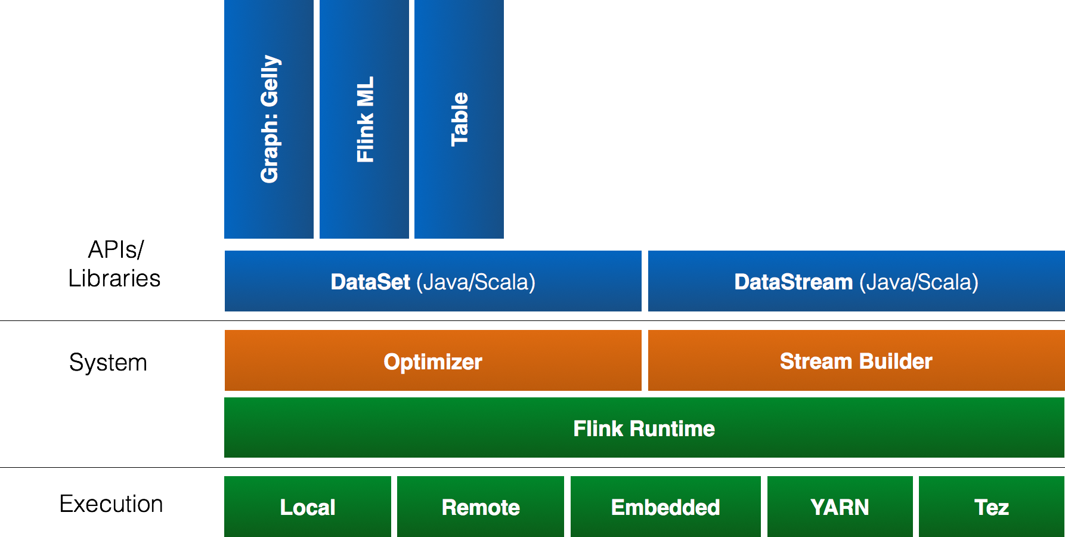
Flink stack

Slide 12
DataSet
Used for Batch Processing
Source
Data Set
Operation
Data Set
Sink
Example: Map and Reduce operation
b | h
2 | 1
3 | 5
7 | 4
… | …
Map
Reduce
a
12
…

Slide 13
Scaling out
Scale out arbitrarily by setting the parallelism
Source
Data Set
Operation
Data Set
Sink
1
Source
Data Set
Operation
Data Set
Sink
Source
Data Set
Operation
Data Set
Sink
2
Source
Data Set
Operation
Data Set
Sink
Source
Data Set
Operation
Data Set
Sink
Source
Data Set
Operation
Data Set
Sink
4
Source
Data Set
Operation
Data Set
Sink
Source
Data Set
Operation
Data Set
Sink
Source
Data Set
Operation
Data Set
Sink
Source
Data Set
Operation
Data Set
Sink
Source
Data Set
Operation
Data Set
Sink
8
Source
Data Set
Operation
Data Set
Sink
Source
Data Set
Operation
Data Set
Sink
Source
Data Set
Operation
Data Set
Sink

Slide 14
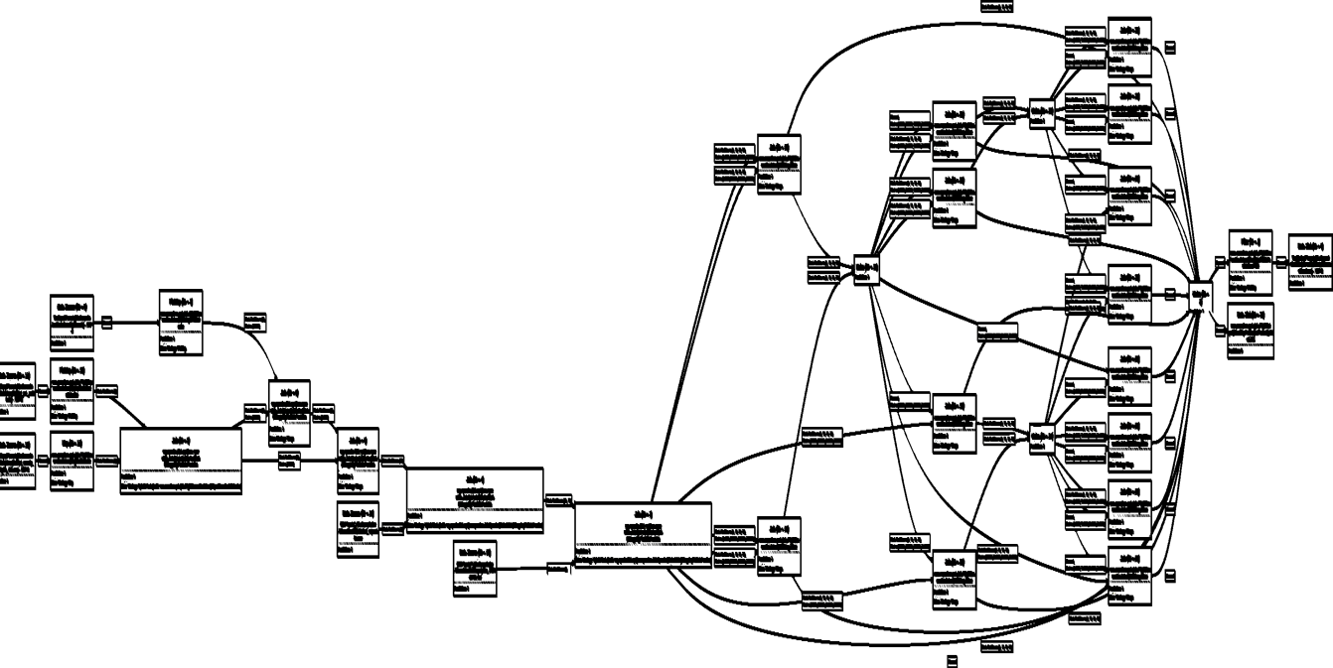
Scaling up

Slide 15
DataStream
Real-time event streams
Source
Data Stream
Operation
Data Stream
Sink
Example: Stream from a live stock feed
Alert if Microsoft > 120
Write event to database
Stock Feed
Name | Price
Microsoft | 124
Google | 516
Apple | 235
… | …
Microsoft | 124
Google | 516
Apple | 235
Sum every 10 seconds
Alert if sum > 10000
Microsoft | 124
Apple | 235
Google | 516

Slide 16
Sources
File-based
TextInputFormat
CsvInputFormat
PrimitiveInputFormat
Collection-based
fromCollection
fromElements

Slide 17
Sinks
File-based
TextOuputFormat
CsvOutputFormat
PrintOutput

Slide 18
Hadoop Integration
Out of the box
Access HDFS
Yarn Execution (covered later)
Reuse data types (Writables)
With a thin wrapper
Reuse Hadoop input and output formats
Reuse functions like Map and Reduce

Slide 19
What’s the Lifecycle of a Program?

Slide 20
Lifecycle of a Program
Overview (client-master-worker)
Client: Data flow instantiation & optimization
Master: Parallelization & scheduling
Worker: Execution
Parallelization Model: Slots, Parallelism, Tasks

Slide 21
From Program to Dataflow
case class Path (from: Long, to: Long)
val tc = edges.iterate(10) {
paths: DataSet[Path] =>
val next = paths
.join(edges)
.where("to")
.equalTo("from") {
(path, edge) =>
Path(path.from, edge.to)
}
.union(paths)
.distinct()
next
}
Type extraction stack
GroupRed
sort
Dataflow Graph
forward
Join
Hybrid Hash
Optimizer
buildHT
probe
hash-part [0]
hash-part [0]
Map
DataSource
lineitem.tbl
Pre-flight (Client)
Filter
Data Source
orders.tbl
Program
deploy operators
Dataflow metadata
Task scheduling
track intermediate results
Master
Workers

Slide 22
Architecture Overview
Client
Master (Job Manager)
Worker (Task Manager)
Client
Job Master
Task Manager
Task Manager
Task Manager

Slide 23
Client
Optimize
Construct Job Graph
Pass JobGraph to Job Master

Slide 24
Job Manager
Parallelization
Generate Execution Graph
Scheduling
Assign tasks to task managers

Slide 25
Task Manager
Operations vs Tasks
Parallelism specifies the number of tasks
Each task of an operation runs in one task slot
Task Manager
Task Manager
Task Manager
Slot
Slot
Slot
Slot
Slot
Slot
Slot
Slot
Slot

Slide 26


Staged (batch) execution
Subseqent stages:
Grep log for matches
Stage 1:
Create/cache Log
Search for str1
Grep 1
Romeo, Romeo, where art thou Romeo?
Load
Log
Search for str2
Grep 2
Search for str3
Grep 3
Caching in-memory and disk if needed

Slide 27
Pipelined execution
Stage 1:
Deploy and start operators
Note: Log DataSet is never “created”!
Search for str1
Grep 1
Romeo, Romeo, where art thou Romeo?
00110011
00110011
00110011
Load
Log
Search for str2
Grep 2
Search for str3
Grep 3
Data transfer in-memory and disk if needed

Slide 28
Pipelining in Flink
Currently the default mode of operation
Much better performance in many cases – no need to materialize large data sets
Supports both batch and real-time streaming
Currently evolving into a hybrid engine
Batch will use combination of blocking and pipelining
Streaming will use pipelining
Interactive will use blocking

Slide 29
Execution Setups

Slide 30
Ways to Run a Flink Program

Slide 31
Local Execution
Starts local Flink cluster
All processes run in the same JVM
Behaves just like a regular Cluster
Very useful for developing and debugging
Job Manager
Task Manager
Task Manager
Task Manager
Task Manager
JVM

Slide 32
Embedded Execution
Runs operators on simple Java collections
Lower overhead
Does not use memory management
Useful for testing and debugging

Slide 33
Remote Execution
Client
Job Manager
Submit job
Submit a Job remotely
Monitors the status of the job
Task Manager
Task Manager
Task Manager
Task Manager
Cluster

Slide 34
YARN Execution
Multi user scenario
Resource sharing
Uses YARN containers to run a Flink cluster
Very easy to setup Flink
Resource Manager
Node Manager
Node Manager
Job Manager
Task Manager
Node Manager
Node Manager
Task Manager
Other Application
Client
YARN Cluster

Slide 35

Execution
Leverages Apache Tez’s runtime
Build on top of YARN
Supports plan changes at runtime
Very robust and scalable
Slower than Flink

Slide 36
Thank you for listening!

