Slide 1


DataStream API:
Stateful Operators
Apache Flink® Training
Flink v1.1.2 – 5.09.2016

Slide 2
Fault Tolerance and Checkpointing

Slide 3
Fault Tolerance
"Exactly once"
Does not mean that each event is processed exactly once
Means that each event affects the state of the system once
"Exactly once" requires
Replayable sources
Checkpointing of Flink's state
Additionally, "exactly once end-to-end" requires
Transactional/idempotent sinks

Slide 4
Guarantees of Data Sources
Source | Guarantee
Apache Kafka | Exactly once
AWS Kinesis Streams | Exactly once
RabbitMQ | At most once (v 0.10) / Exactly once (v 1.0)
Twitter Streaming API | At most once
Collections | Exactly once
Files | Exactly once
Sockets | At most once

Slide 5
Guarantees of Data Sinks
Sink | Guarantee
HDFS rolling sink | Exactly once
Cassandra | Exactly once only for idempotent updates
Kafka | At least once
Elasticsearch | At least once
AWS Kinesis Streams | At least once
File sinks | At least once
Socket sinks | At least once
Standard output | At least once
Redis | At least once

Slide 6
Checkpointing in Flink
Asynchronous Barrier Snapshotting
checkpoint barriers are inserted into the stream and flow through the graph along with the data
this avoids a "global pause" during checkpointing
Checkpoint barriers cause ...
replayable sources to checkpoint their offsets
operators to checkpoint their state
sinks to commit open transactions

Slide 7
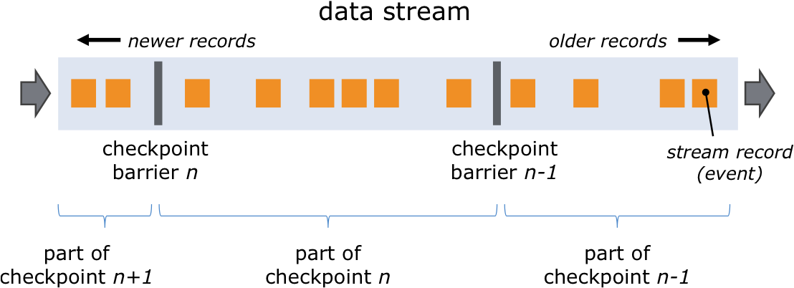
Checkpoint Barriers

Slide 8
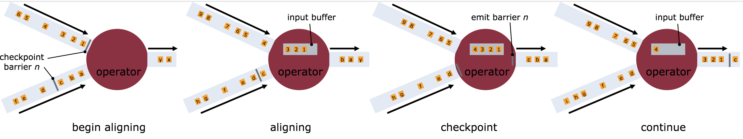
Asynchronous Barrier Snapshotting

Slide 9
Enabling Checkpointing
Checkpointing is disabled by default
To enable checkpointing with exactly-once consistency (checkpoint every 5 seconds):
env.enableCheckpointing(5000)
To configure at-least-once consistency (for lower latency):
env.getCheckpointConfig()
.setCheckpointingMode(CheckpointingMode.AT_LEAST_ONCE);
Setting the interval to a few seconds should be good for most applications
Flink will roll back to the most recently checkpointed state in case of failure

Slide 10
Restart Strategies
Available strategies
Fixed delay
Failure rate
No restart
You can set a default strategy in flink-conf.yaml, otherwise the no-restart strategy is the default
Each job can define a specific restart strategy
See the docs for details
https://ci.apache.org/projects/flink/flink-docs-release-1.1/apis/streaming/fault_tolerance.html#restart-strategies

Slide 11
Fault-Tolerance and Operator State

Slide 12
Stateful Functions
All DataStream functions can be stateful
State is checkpointed and recovered in case of a failure (if checkpointing is enabled).
You can define two types of state
Local State: Functions can arrange for local variables to be checkpointed.
Key-Partitioned State: Functions on a keyed stream can access and update state scoped to the current key. Note: this mechanism scales better.

Slide 13
Using Local State
DataStream<String> aStream;
DataStream<Long> lengths = aStream.map(new MapWithCounter());
public static class MapWithCounter
implements MapFunction<String, Long>, Checkpointed<Long> {
private long totalLength = 0;
@Override public Long map (String value) {
totalLength += value.length();
return totalLength; }
@Override public Long snapshotState(long cpId, long cpTimestamp) throws Exception {
return totalLength; }
@Override public void restoreState(Long state) throws Exception {
totalLength = state; }
}

Slide 14
Using Key-Partitioned State
DataStream<Tuple2<String, String>> aStream;
KeyedStream<Tuple2<String, String>, Tuple> keyedStream = aStream.keyBy(0);
DataStream<Long> lengths = keyedStream.map(new MapWithCounter());
public static class MapWithCounter
extends RichMapFunction<Tuple2<String, String>, Long> {
private ValueState<Long> totalLengthByKey;
@Override public void open (Configuration conf) {
ValueStateDescriptor<Long> descriptor = new ValueStateDescriptor<>(
"totalLengthByKey", Long.class, 0L);
totalLengthByKey = getRuntimeContext().getState(descriptor);
}
@Override public Long map (Tuple2<String, String> value) throws Exception {
long newTotalLength = totalLengthByKey.value() + value.f1.length();
totalLengthByKey.update(newTotalLength);
return totalLengthByKey.value();
}
}

Slide 15
State Backends

Slide 16
State in Flink
Windows gather elements and aggregates until they are triggered
Transformation functions may use the key-partitioned state interface
Transformation functions may implement the Checkpointed interface

Slide 17
State Backends
MemoryStateBackend
checkpoints stored as objects on the Java heap
configurable size limits
the default, suitable for development
FsStateBackend
configured with a filesystem URI (hdfs: or file:)
stores in-flight data in TaskManager's memory
suitable for jobs with large state and/or high-availability requirements
RocksDBStateBackend
configured with a filesystem URI
stores in-flight data in the filesystem
suitable for jobs with very large state and/or high-availability requirements

Slide 18
Configuration
You can configure a default state backend in flink-conf.yaml
You can also set a per-job state backend
env.setStateBackend(
new FsStateBackend("hdfs://namenode:40010/flink/checkpoints"));
See the docs for details
https://ci.apache.org/projects/flink/flink-docs-release-1.1/apis/streaming/state_backends.html

Slide 19
Savepoints

Slide 20
Savepoints
Flink savepoint: a user-triggered, retained checkpoint
Applications can be restarted from a savepoint
Controlled via the command line client
Use cases:
application update
Flink update
maintenance, migration
A/B testing
rescaling

Slide 21
Configuration for Savepoints
By default, savepoints are stored in memory, in the job manager
To store savepoints in file system:
savepoints.state.backend: filesystem
savepoints.state.backend.fs.dir: hdfs:///flink/savepoints

Slide 22
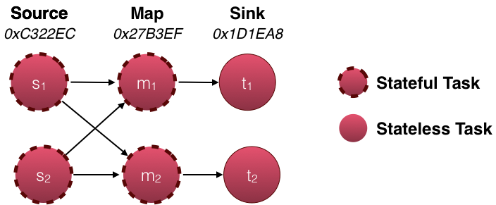
When your Application Changes
The topology of your application is captured as a set of IDs of its stateful tasks
If you want to be able to restore savepoints after changing the topology, you'll need to manually assign fixed IDs to the tasks
DataStream<String> stream = env.
// Stateful source (e.g. Kafka) with ID
.addSource(new StatefulSource())
.uid("source-id")
.shuffle()
// The stateful mapper with ID
.map(new StatefulMapper())
.uid("mapper-id")
// Stateless sink (no specific ID required)
stream.print()

Slide 23
References
Documentation
https://ci.apache.org/projects/flink/flink-docs-release-1.1/internals/stream_checkpointing.html
https://ci.apache.org/projects/flink/flink-docs-release-1.1/apis/streaming/state.html
https://ci.apache.org/projects/flink/flink-docs-release-1.1/apis/streaming/fault_tolerance.html
https://ci.apache.org/projects/flink/flink-docs-release-1.1/apis/streaming/savepoints.html
https://ci.apache.org/projects/flink/flink-docs-release-1.1/apis/cli.html
Blog posts
http://data-artisans.com/how-apache-flink-enables-new-streaming-applications/

