Slide 1
Apache Flink® Training
DataSet API Advanced
June 3rd, 2015

Slide 2
Agenda
Flink’s type system
Define and use keys
More transformations
Further API concepts
Table API

Slide 3
Apache Flink’s Type System
What kind of data can Flink handle?

Slide 4
Apache Flink’s Type System
Flink aims to support all possible data types
Custom type serialization framework
“Serialization is the process of turning a Java object into a binary representation”
Many existing serialization frameworks:
Kryo, Google Protocol Buffers, Apache Thrift
Flink’s serialization framework
Extracts schema information from programs
Generates efficient serializers for data types
Enables operations & comparisons on binary data

Slide 5
Extracting Types from Programs
Programs are analyzed in “Preflight Phase”
Scala API
Flink Java Program
Type Extraction
Plan Translation
Optimizer
Plan Post-pass
Cluster
Python API
Type Extraction
Java Reflection
Scala Compiler
Validation
Are the keys sortable?
Are join keys compatible?
Generation
Serializers
Comparators

Slide 6
Type Extraction Example
DataSet<Tuple3<Integer, Long, String>> countries; DataSet<Tuple2<Person, Integer>> users;
Extracted types:
countries:
TupleType<Tuple3>
BasicType<Integer>
BasicType<Long>
BasicType<String>
users:
TupleType<Tuple2>
PojoType<Person>
BasicType<Integer>
BasicType<String>
BasicType<Integer>

Slide 7
Supported Data Types
Atomic Types:
BasicType
Integer, String, Long, …
ArrayType
Primitives + Objects
WritableType
Hadoop Interface
GenericType
Everything else
Composite Types:
Are composed of other types
TupleType
Tuple1…Tuple25
PojoType
“Bean-style” Java objects
CaseClassType
Scala CaseClasses incl. Tuples

Slide 8
Atomic Types
 | Basic Type | Array Type | Writable Type | GenericType
Supported as Key | Yes | No | If type implements (Writable) Comparable | If type implements Comparable
Serializer | Flink native | Flink native | Writable’s write() readFields() | Kryo or Avro
Support for Binary Operations | Yes | No | No | No

Slide 9
Plain Old Java Objects (POJO)
Default constructor (no arguments)
All fields must be
either public
or accessible through getters & setters
Turn on logging to get messages why the system (TypeExtractor) is not accepting classes.

Slide 10
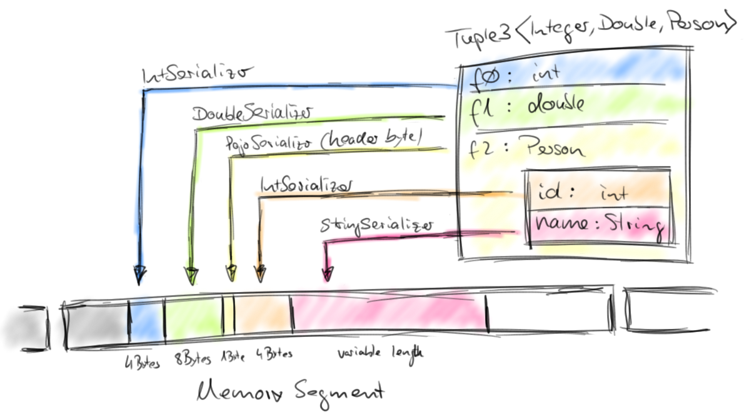
Composite Types
Serializers & comparators delegate to member types

Slide 11
Why should I care about that?
Understand the error messages
Programs efficiency & performance
Flink native types vs. Generic types
Ease-of-use & developer efficiency
Tuples, Pojos, CaseClasses vs. Generic types
Extensible by custom data types
Custom serializers & comparators

Slide 12
Defining Keys
Grouping, Sorting, Joining

Slide 13
Keyed Operations
Flink groups, sorts & joins data for you
Requires definition of a key
Key can be partial or full type of DataSet type
Composite keys also supported
Key must be comparable data type
Key types for binary operations (join, coGroup) must match

Slide 14
Key Definition Examples
DataSet<Tuple3<Integer, Long, String>> countries; DataSet<Tuple2<Person, Integer>> users;
countries.join(users).where(key1).equalTo(key2);
Possible join keys
countries:
TupleType<Tuple3>
BasicType<Integer>
BasicType<Long>
BasicType<String>
users:
TupleType<Tuple2>
PojoType<Person>
BasicType<Integer>
BasicType<String>
BasicType<Integer>

Slide 15
Key Definition Examples
Using Position Key
Only supported for TupleTypes
No support for nesting
DataSet<Tuple3<Integer, Long, String>> countries; DataSet<Tuple2<Person, Integer>> users;
countries.join(users).where(0).equalTo(1);
countries:
TupleType<Tuple3>
BasicType<Integer>
BasicType<Long>
BasicType<String>
users:
TupleType<Tuple2>
PojoType<Person>
BasicType<Integer>
BasicType<String>
BasicType<Integer>

Slide 16
Key Definition Examples
Using Expression Keys
All composite types: Tuple fields: “f0”, “f1”, ..
Support for nesting
DataSet<Tuple3<Integer, Long, String>> countries; DataSet<Tuple2<Person, Integer>> users;
countries.join(users).where(“f0”).equalTo(“f1”);
countries:
TupleType<Tuple3>
BasicType<Integer>
BasicType<Long>
BasicType<String>
users:
TupleType<Tuple2>
PojoType<Person>
BasicType<Integer>
BasicType<String>
BasicType<Integer>

Slide 17
Key Definition Examples
Using Expression Keys
All composite types: Pojo fields by name
Support for nesting
DataSet<Tuple3<Integer, Long, String>> countries; DataSet<Tuple2<Person, Integer>> users;
countries.join(users).where(2).equalTo(“f0.name”);
countries:
TupleType<Tuple3>
BasicType<Integer>
BasicType<Long>
BasicType<String>
users:
TupleType<Tuple2>
PojoType<Person>
BasicType<Integer>
BasicType<String>
BasicType<Integer>

Slide 18
Key Definition Examples
Composite keys
DataSet<Tuple3<Integer, Long, String>> countries; DataSet<Tuple2<Person, Integer>> users;
countries.join(users).where(0,2) .equalTo(“f1”,“f0.name”);
countries:
TupleType<Tuple3>
BasicType<Integer>
BasicType<Long>
BasicType<String>
users:
TupleType<Tuple2>
PojoType<Person>
BasicType<Integer>
BasicType<String>
BasicType<Integer>

Slide 19
Key Definition Examples
Key selector function
DataSet<Tuple3<Integer, Long, String>> countries; DataSet<Tuple2<Person, Integer>> users;
countries.join(users).where(0).equalTo(
new KeySelector<Tuple2<Person, Integer>, Integer>() {
public Integer getKey(Tuple2<Person, Integer> v) {
return v.f1;
} });
countries:
TupleType<Tuple3>
BasicType<Integer>
BasicType<Long>
BasicType<String>
users:
TupleType<Tuple2>
PojoType<Person>
BasicType<Integer>
BasicType<String>
BasicType<Integer>

Slide 20
Key Definition Examples
Incompatible key types
Exception!
DataSet<Tuple3<Integer, Long, String>> countries; DataSet<Tuple2<Person, Integer>> users;
countries.join(users).where(2).equalTo(1);
countries:
TupleType<Tuple3>
BasicType<Integer>
BasicType<Long>
BasicType<String>
users:
TupleType<Tuple2>
PojoType<Person>
BasicType<Integer>
BasicType<String>
BasicType<Integer>

Slide 21
Advanced Sources and Sinks
Getting data in and out

Slide 22
Supported File Systems
Flink build-in File Systems:
LocalFileSystem (file://)
Hadoop Distributed File System (hdfs://)
Amazon S3 (s3://)
MapR FS (maprfs://)
Support for all Hadoop File Systems
NFS, Tachyon, FTP, har (Hadoop Archive), …

Slide 23
Input/Output Formats
FileInputFormat (recursive directory scans supported)
DelimitedInputFormat
TextInputFormat (Reads text files linewise)
CsvInputFormat (Reads field delimited files)
BinaryInputFormat
AvroInputFormat (Reads Avro POJOs)
JDBCInputFormat (Reads result of SQL query)
HadoopInputFormat (Wraps any Hadoop InputFormat)

Slide 24
Hadoop Input/OutputFormats
Support for all Hadoop I/OFormats
Read from and write to
MongoDB
Apache Parquet
Apache ORC
Apache Kafka (for batch)
Compressed file formats (.gz, .zip, ...)
and more…

Slide 25
Using InputFormats
ExecutionEnvironment env = …
// read text file linewise
env.readTextFile(…);
// read CSV file
env.readCsvFile(…);
// read file with Hadoop FileInputFormat
env.readHadoopFile(…);
// use regular Hadoop InputFormat
env.createHadoopInput(…);
// use regular Flink InputFormat
env.createInput(…);

Slide 26
Transformations & Functions

Slide 27
Transformations
DataSet Basics presented:
Map, FlatMap, GroupBy, GroupReduce, Join
Reduce
CoGroup
Combine
GroupSort
AllReduce & AllGroupReduce
Union
see documentation for more transformations

Slide 28
GroupReduce (Hadoop-style)
GroupReduceFunction gives iterator over elements of group
Elements are streamed (possibly from disk), not materialized in memory
Group size can exceed available JVM heap
Input type and output type may be different

Slide 29
Reduce (FP-style)
Reduce like in functional programming
Less generic compared to GroupReduce
Function must be commutative and associative
Input type == Output type
System can apply more optimizations
Always combinable
May use a hash strategy for execution (future)

Slide 30
Reduce (FP-style)
DataSet<Tuple2<Long,Long>> sum = data .groupBy(0)
.reduce(new SumReducer());
public static class SumReducer implements ReduceFunction<Tuple2<Long,Long>> { @Override public Tuple2<Long,Long> reduce(
Tuple2<Long,Long> v1, Tuple2<Long,Long> v2) {
v1.f1 += v2.f1;
return v1; }
}

Slide 31
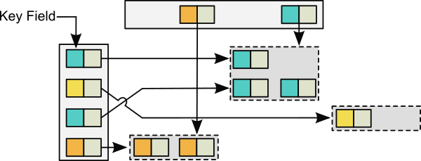
CoGroup
Binary operation (two inputs)
Groups both inputs on a key
Processes groups with matching keys of both inputs
Similar to GroupReduce on two inputs

Slide 32
CoGroup
DataSet<Tuple2<Long,String>> d1 = …;
DataSet<Long> d2 = …;
DataSet<String> d3 = d1.coGroup(d2).where(0).equalTo(1).with(new CoGrouper());
public static class CoGrouper implements CoGroupFunction<Tuple2<Long,String>,Long,String>{
@Override public void coGroup(Iterable<Tuple2<Long,String> vs1,
Iterable<Long> vs2, Collector<String> out) {
if(!vs2.iterator.hasNext()) {
for(Tuple2<Long,String> v1 : vs1) {
out.collect(v1.f1);
}
}
} }

Slide 33
Combiner
Local pre-aggregation of data
Before data is sent to GroupReduce or CoGroup
(functional) Reduce injects combiner automatically
Similar to Hadoop Combiner
Optional for semantics, crucial for performance!
Reduces data before it is sent over the network

Slide 34
Combiner WordCount Example
(A, 1)
(B, 1)
(B, 1)
(A, 1)
(C, 1)
(A, 1)
A B B A C A
(A, 3)
(C, 1)
Map
Combine
(B, 2)
Reduce
(A, 8)
(C, 4)
(C, 1)
(A, 1)
(C, 1)
(B, 1)
(A, 1)
(B, 1)
(A, 2)
(C, 2)
C A C
B A B
Map
Combine
(B, 2)
Reduce
(B, 5)
(D, 1)
(D, 1)
(A, 1)
(A, 1)
(A, 1)
(B, 1)
(C, 1)
(A, 3)
(C, 1)
D A A
A B C
Map
Combine
(B, 1)
(D, 1)

Slide 35
Use a combiner
Implement RichGroupReduceFunction<I,O>
Override combine(Iterable<I> in, Collector<O>);
Same interface as reduce() method
Annotate your GroupReduceFunction with @Combinable
Combiner will be automatically injected into Flink program
Implement a GroupCombineFunction
Same interface as GroupReduceFunction
DataSet.combineGroup()

Slide 36
GroupSort
Sort groups before they are handed to GroupReduce or CoGroup functions
More (resource-)efficient user code
Easier user code implementation
Comes (almost) for free
Aka secondary sort (Hadoop)
DataSet<Tuple3<Long,Long,Long> data = …;
data.groupBy(0)
.sortGroup(1, Order.ASCENDING)
.groupReduce(new MyReducer());

Slide 37
AllReduce / AllGroupReduce
Reduce / GroupReduce without GroupBy
Operates on a single group -> Full DataSet
Full DataSet is sent to one machine
Will automatically run with parallelism of 1
Careful with large DataSets!
Make sure you have a Combiner

Slide 38
Union
Union two data set
Binary operation, same data type required
No duplicate elimination (SQL UNION ALL)
Very cheap operation
DataSet<Tuple2<String, Long> d1 = …;
DataSet<Tuple2<String, Long> d2 = …;
DataSet<Tuple2<String, Long> d3 =
d1.union(d2);

Slide 39
RichFunctions
Function interfaces have only one method
Single abstract method (SAM)
Support for Java8 Lambda functions
There is a “Rich” variant for each function.
RichFlatMapFunction, …
Additional methods
open(Configuration c)
close()
getRuntimeContext()

Slide 40
RichFunctions & RuntimeContext
RuntimeContext has useful methods:
getIndexOfThisSubtask ()
getNumberOfParallelSubtasks()
getExecutionConfig()
Gives access to:
Accumulators
DistributedCache

Slide 41
Further API Concepts

Slide 42
Broadcast Variables
Example: Tag words with IDs in text corpus
map
map
Text data set
map
broadcast (small) dictionary to all mappers
Dictionary

Slide 43
Broadcast variables
register any DataSet as a broadcast variable
available on all parallel instances
// 1. The DataSet to be broadcasted
DataSet<Integer> toBroadcast = env.fromElements(1, 2, 3);
// 2. Broadcast the DataSet
map().withBroadcastSet(toBroadcast, "broadcastSetName");
// 3. inside user defined function
getRuntimeContext().getBroadcastVariable("broadcastSetName");

Slide 44
Accumulators
Lightweight tool to compute stats on data
Usuful to verify your assumptions about your data
Similar to Counters (Hadoop MapReduce)
Build in accumulators
Int and Long counters
Histogramm
Easily customizable

Slide 45
Accumulators
Example: Count total number of words in text corpus
map
long counter++
JobManager
counter =
4 +
18 +
22 = 44
map
long counter++
Text data set
map
long counter++
Send local counts from parallel instances to JobManager

Slide 46
Using Accumulators
Use accumulators to verify your assumptions about the data
class Tokenizer extends
RichFlatMapFunction<String, String>> {
@Override
public void flatMap(String val,
Collector<String> out) {
getRuntimeContext()
.getLongCounter("elementCount").add(1L);
// do more stuff.
}
}

Slide 47
Get Accumulator Results
Accumulators are available via JobExecutionResult
returned by env.execute()
Accumulators are displayed
by CLI client
in the JobManager web frontend
JobExecutionResult result = env.execute("WordCount");
long ec = result.getAccumulatorResult("elementCount");

Slide 48
Table API

Slide 49
Table API Overview
Makes analysis of structured data very easy
Evaluates SQL-like expressions
Code generation for execution
Tight integration with DataSet API
Convert DataSet to Table and back

Slide 50
Table API Overview
Basic data structure is a Table
Table is structured data with named fields
Similar to relational table
Expressions evaluated on a Table yield a new Table

Slide 51
Table API Expressions
Table t = orig.as(“author, title, pages“);
// filter table
Table t2 = t.filter(“pages > 100”);
// project table
Table t3 = t.select(“author, title”);
Table t4 = t.select(“pages*2 as dPages”);
// group table and compute aggregations
Table t5 = t.groupBy(“author”) .select(“pages.avg as avgPages”);
// join two table
Table t6 = t.join(t.select(“author2,title2”)) .where(“author = author2”) .select(“title, title2”);

Slide 52
DataSet to Table
Java DataSet API via TableEnvironment:
// data set
DataSet<Table3<String,Long,Double>> ds = …;
// get a TableEnvironment
TableEnvironment tEnv = new TableEnvironment();
// convert data set to Table and give name to fields
Table t = tEnv.toTable(ds).as(“name, count, price”);

Slide 53
Table to DataSet
Java DataSet API via TableEnvironment
Convert to custom POJO data set
Pojo fields must map to Table fields
public static class Stock {
public String name;
public int count;
public double price;
}
Table t = x.as(“name, count, price”);
TableEnvironment tEnv = new TableEnvironment();
DataSet<Stock> ds = tEnv.toSet(t, Stock.class);

Slide 54
Table to DataSet
Java DataSet API via TableEnvironment
Convert to DataSet<Row>
Most valuable for printing
Table t = x.as(“name, count, price”);
TableEnvironment tEnv = new TableEnvironment();
tEnv.toSet(t, Row.class).print();

